Slide 1
Testing the Equipotential Magnetic Field Line Assumption Using SuperDARN Measurements and the Cluster Electron Drift Instrument (EDI)
Joseph B. H. Baker
Bradley Department of Computer and Electrical Engineering
Virginia Tech

Slide 2
Magnetosphere-Ionosphere Coupling
SUN
SUN
DAWN
Dungey, 1961
Plasma convection in the magnetosphere driven by the solar wind and interplanetary magnetic field (IMF) is mirrored in the ionospheric convection at high latitudes.
ASSUMPTION: Magnetic Field lines can be treated as electrostatic equipotentials

Slide 3
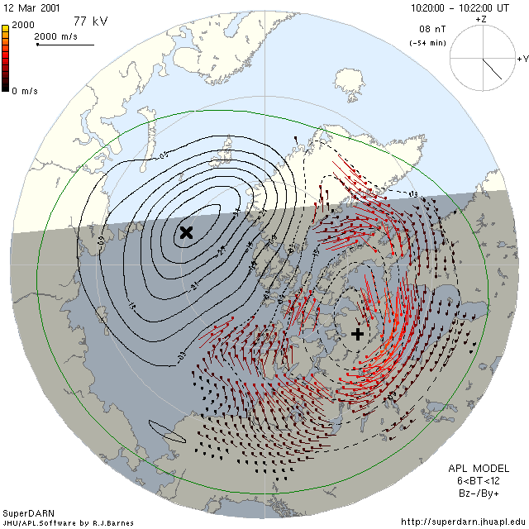
Equipotential Magnetic Field Lines?
Is this a believable representation of magnetospheric convection?
The equipotential field-line assumption can be tested using spacecraft measurements.

Slide 4
Testing the Equipotential Magnetic Field Line Assumption
APPROACH:
Use an empirical magnetic field model (Tsyganenko T01) to identify the magnetic footpoint of the Cluster spacecraft in the ionosphere.
Check to see if there are simultaneous SuperDARN measurements in the close vicinity of the Cluster ionospheric footpoint.
Calculate an EDI estimate for what the ionospheric velocity should be at the footpoint location assuming equipotential magnetic field lines.
Compare the EDI estimate with the SuperDARN measurements.
Any EDI-SuperDARN inconsistencies should be a result of either:
1) Inaccuracies in the T01 magnetic field model.
OR 2) Violation of the equipotential magnetic field line assumption.

Slide 5
EDI-SuperDARN Dataset
448,431 1-minute Cluster-3 EDI values obtained between March 2001 – April 2006.
196,731 “GOOD” Cluster-3 EDI values northward of 55° MLAT.
11,882 “GOOD” EDI values with SuperDARN data within 100km of the T01 footpoint.
8,199 “GOOD” EDI values remain after other selection criteria are satisfied.
e.g. Exclude interplanetary conditions that do not produce nominal T01 performance.
e.g. Exclude periods when the T01 model is inconsistent with Cluster FGM.
15,013 SuperDARN V_{LOS} measurements within 100km of the selected EDI footpoints.
15,072 EDI - SuperDARN data pairs within 100km of each other.
NOTE: Widening the search radius to 250 km and using the same selection criteria yields 97,235 EDI–SuperDARN data pairs.

Slide 6
Conjugate EDI-SuperDARN Locations

Slide 7
EDI Ground-Track Distance
EDI measurements selected for ground distances comparable to a SuperDARN grid-cell

Slide 8
T01 Model Accuracy at Cluster
EDI measurements selected for magnetic field comparable to T01 model estimates

Slide 9
VLOS Comparison

Slide 10
VLOS Distributions
SuperDARN VLOS distribution is truncated because of ground-scatter bias

Slide 11
Magnetosphere-Ionosphere Scaling Factor
On average, 24% of convection measured by EDI is not measured in the ionosphere. However, the peak of the distribution is actually slightly less than unity.

Slide 12
Southward IMF

Slide 13
Northward IMF
Reverse cells??
Reverse cells!!

Slide 14
Summary
SuperDARN measurements have been compared with Cluster EDI measurements to test the assumption of equipotential magnetic field lines.
On average, 24% of the convection measured by Cluster EDI at high altitude is not measured by SuperDARN in the ionosphere.
However, the distribution of the magnetosphere-ionosphere scaling factor is broad and peaks near unity.
The best EDI-SuperDARN consistency occurs during periods of moderate magnetosphere-ionosphere coupling and at high latitudes in the polar cap.
The general consistency between EDI and SuperDARN convection patterns suggests that the majority of inconsistencies operate over small spatial and/or temporal scales.
During northward IMF the multi-cell convection measured by EDI at high altitude is more pronounced than that measured by SuperDARN.

Slide 15
Drift Vector Magnitude Comparison
The EDI drift velocity magnitude distribution has a higher tail than SuperDARN

Slide 16
EDI Drift Velocity Magnitude
There is better EDI-SuperDARN consistency for moderate EDI drift velocities

Slide 17
Kp Magnetic Index
There is better EDI-SuperDARN consistency during moderate magnetic activity

Slide 18
Auroral Hemispheric Power Index
There is better EDI-SuperDARN consistency during moderate auroral activity

Slide 19
IMF Bz Component
There is better EDI-SuperDARN consistency during southward IMF

Slide 20
IMF By Component
There is better EDI-SuperDARN consistency for positive IMF By component

Slide 21
Month of Year
There is better EDI-SuperDARN consistency during Fall-Winter months

Slide 22
Magnetic Local Time
There is better EDI-SuperDARN consistency in the late evening sector

Slide 23
Magnetic Latitude
There is better EDI-SuperDARN consistency at higher latitudes

