Slide 1
Plasma Pressure Constraints on Magnetic Field Structure in the Substorm Growth Phase
Sorin G. Zaharia¹ and Chih-Ping Wang²
¹Los Alamos National Laboratory
²UCLA

Slide 2
Motivation
Substorm growth phase
  Gradual energy loading on time scale >> Alfven time scale
  Configuration (magnetic field, electric current) not well described by existing models
Large plasma beta (ratio of plasma pressure to magnetic pressure; values of 50 and higher [Saito et al., GRL 2008]) plasma has strong influence on the field
Use growth phase observations to construct empirical pressure model
Use pressure model as input to 3D force balanced magnetospheric model

Slide 3
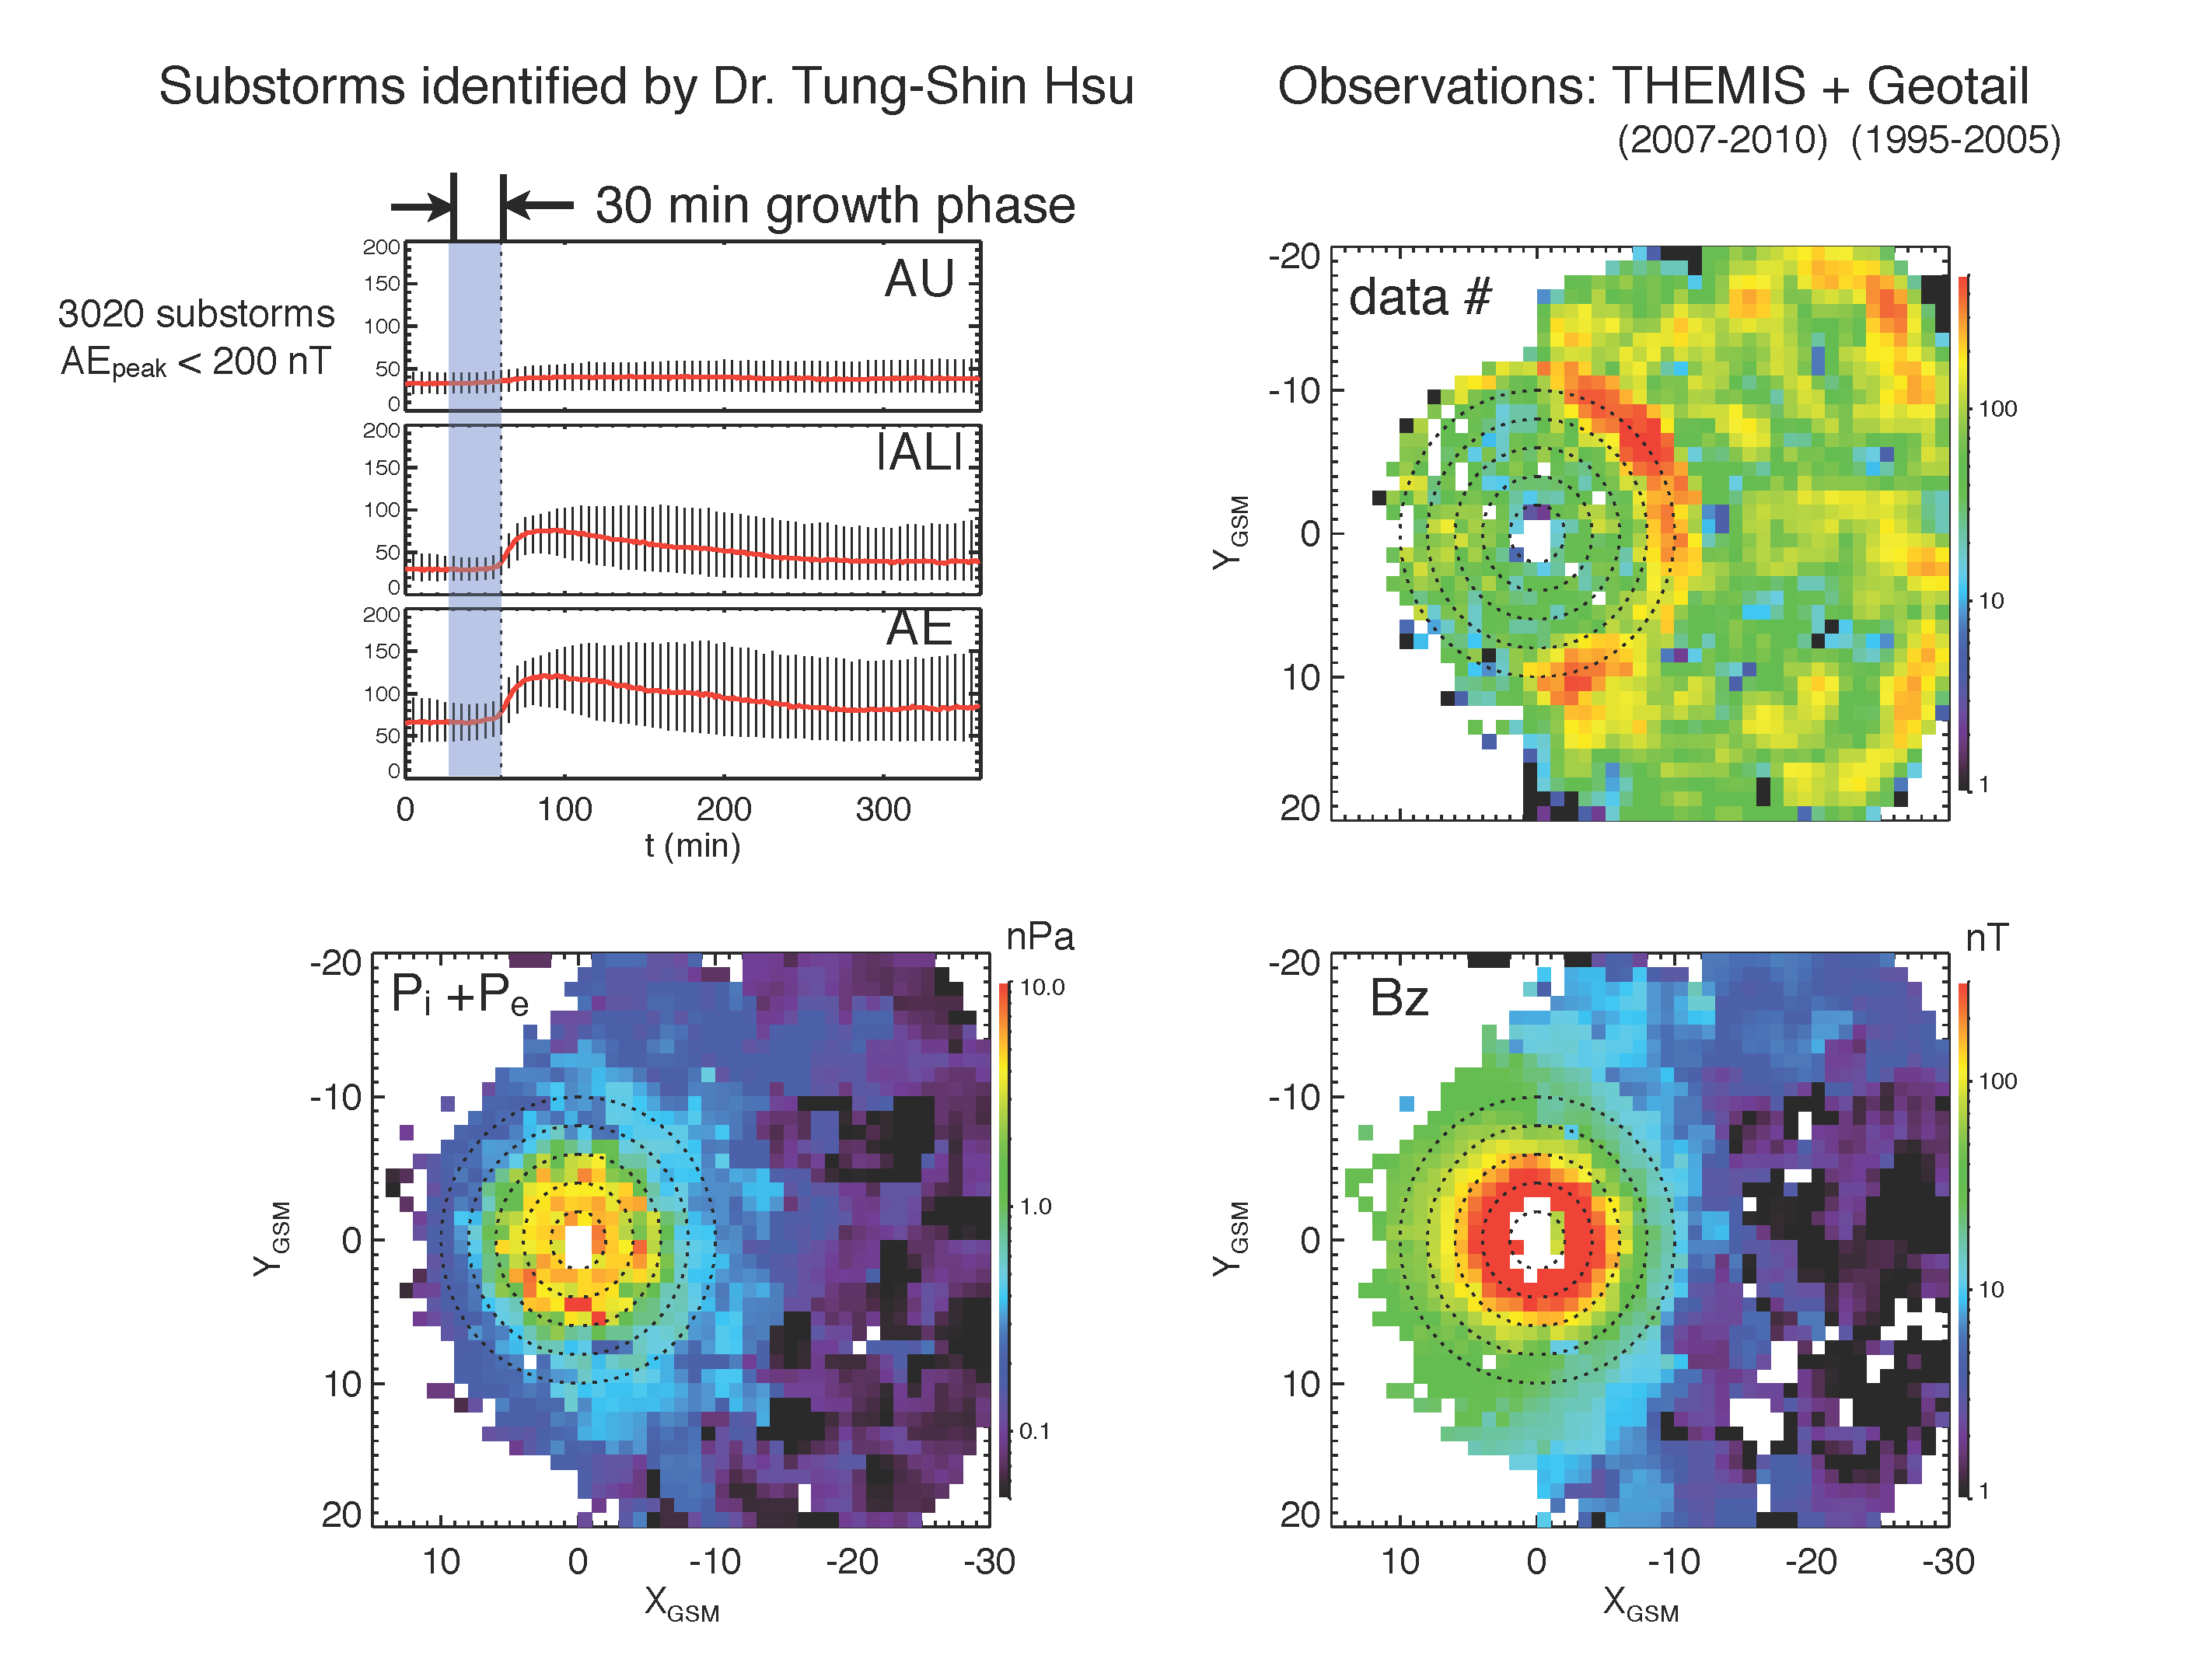
THEMIS/Geotail Plasma Pressure

Slide 4
Preliminary Results: Using THEMIS/Geotail Plasma Pressure
Geotail + THEMIS growth phase data/binned by AE
  Smooth profile while capturing major features
Nonlinear least square fit with constraints
  P > P_{min}
  Bound constraints for coefficients a
Global vs. Local Optimization; solution uniqueness
Cf. Tsyganenko and Mukai, [2003]
(no dawn/dusk asymmetry from Geotail data – LEP)

Slide 5
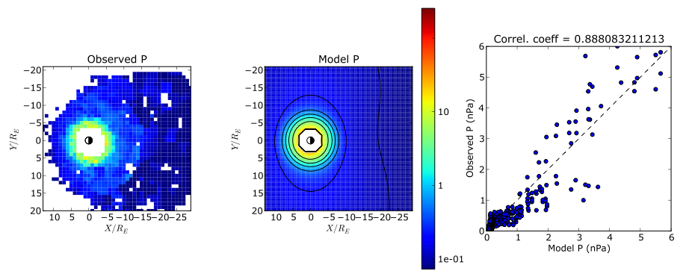
THEMIS/Geotail P Fitting
High correlation coefficient (cf. Tsyganenko and Mukai, [2003])
Dawn-dusk asymmetry in near-Earth region

Slide 6
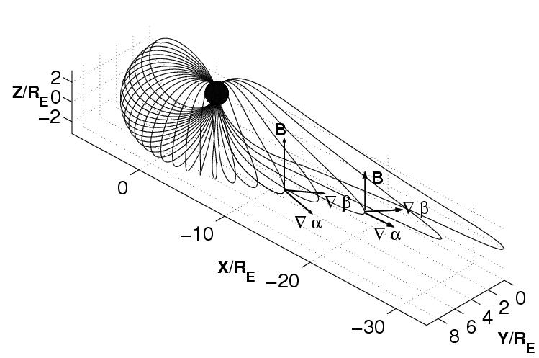
3D Equilibrium - Euler Potential Form
With isotropic pressure:
De-composition along
(1), (2) coupled Grad-Shafranov-like “quasi-2D” equations on const. α and β surfaces; needed: pressure profile + magnetic boundary conditions
Solution - in inverse form; magnetic field lines are explicit output (no need for integration etc.)

Slide 7
Equatorial B-Field
Observed
Calculated

Slide 8
B-Field on Midnight Meridian
Observations not exactly at Z=0; no realistic tilt in model
T89, T96 fields too large at |X| > 15 R_{E} (not enough stretching)

Slide 9
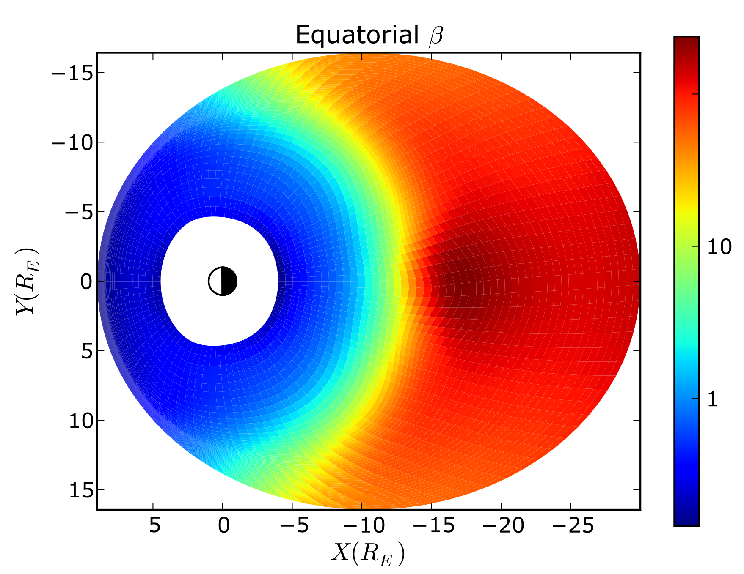
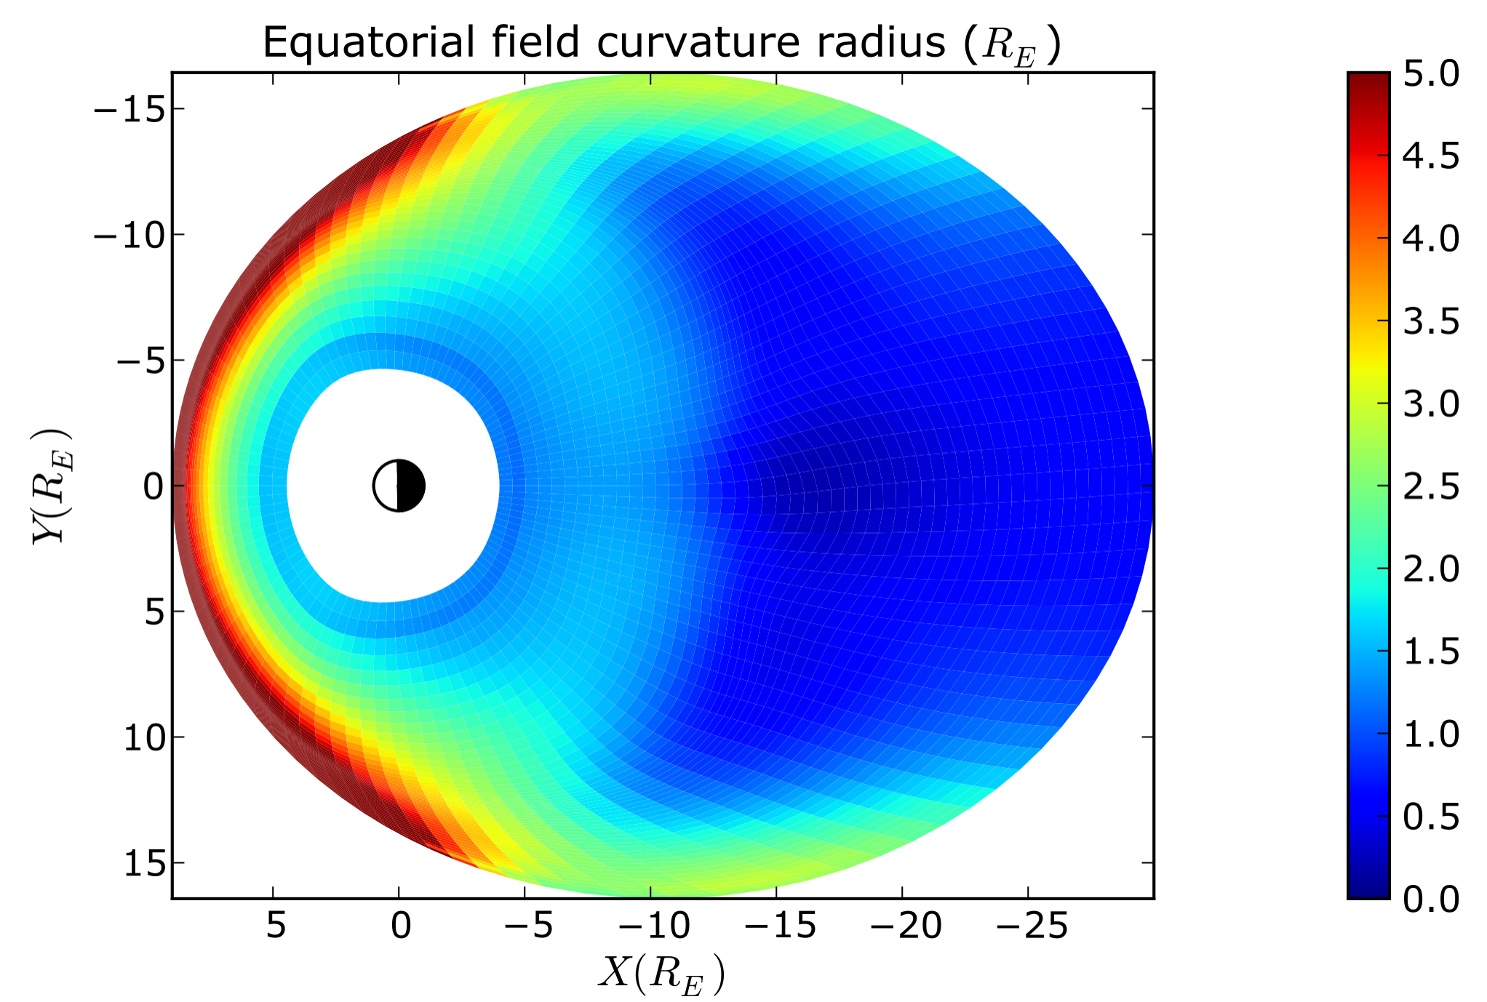
Plasma Beta and Field Curvature

Slide 10
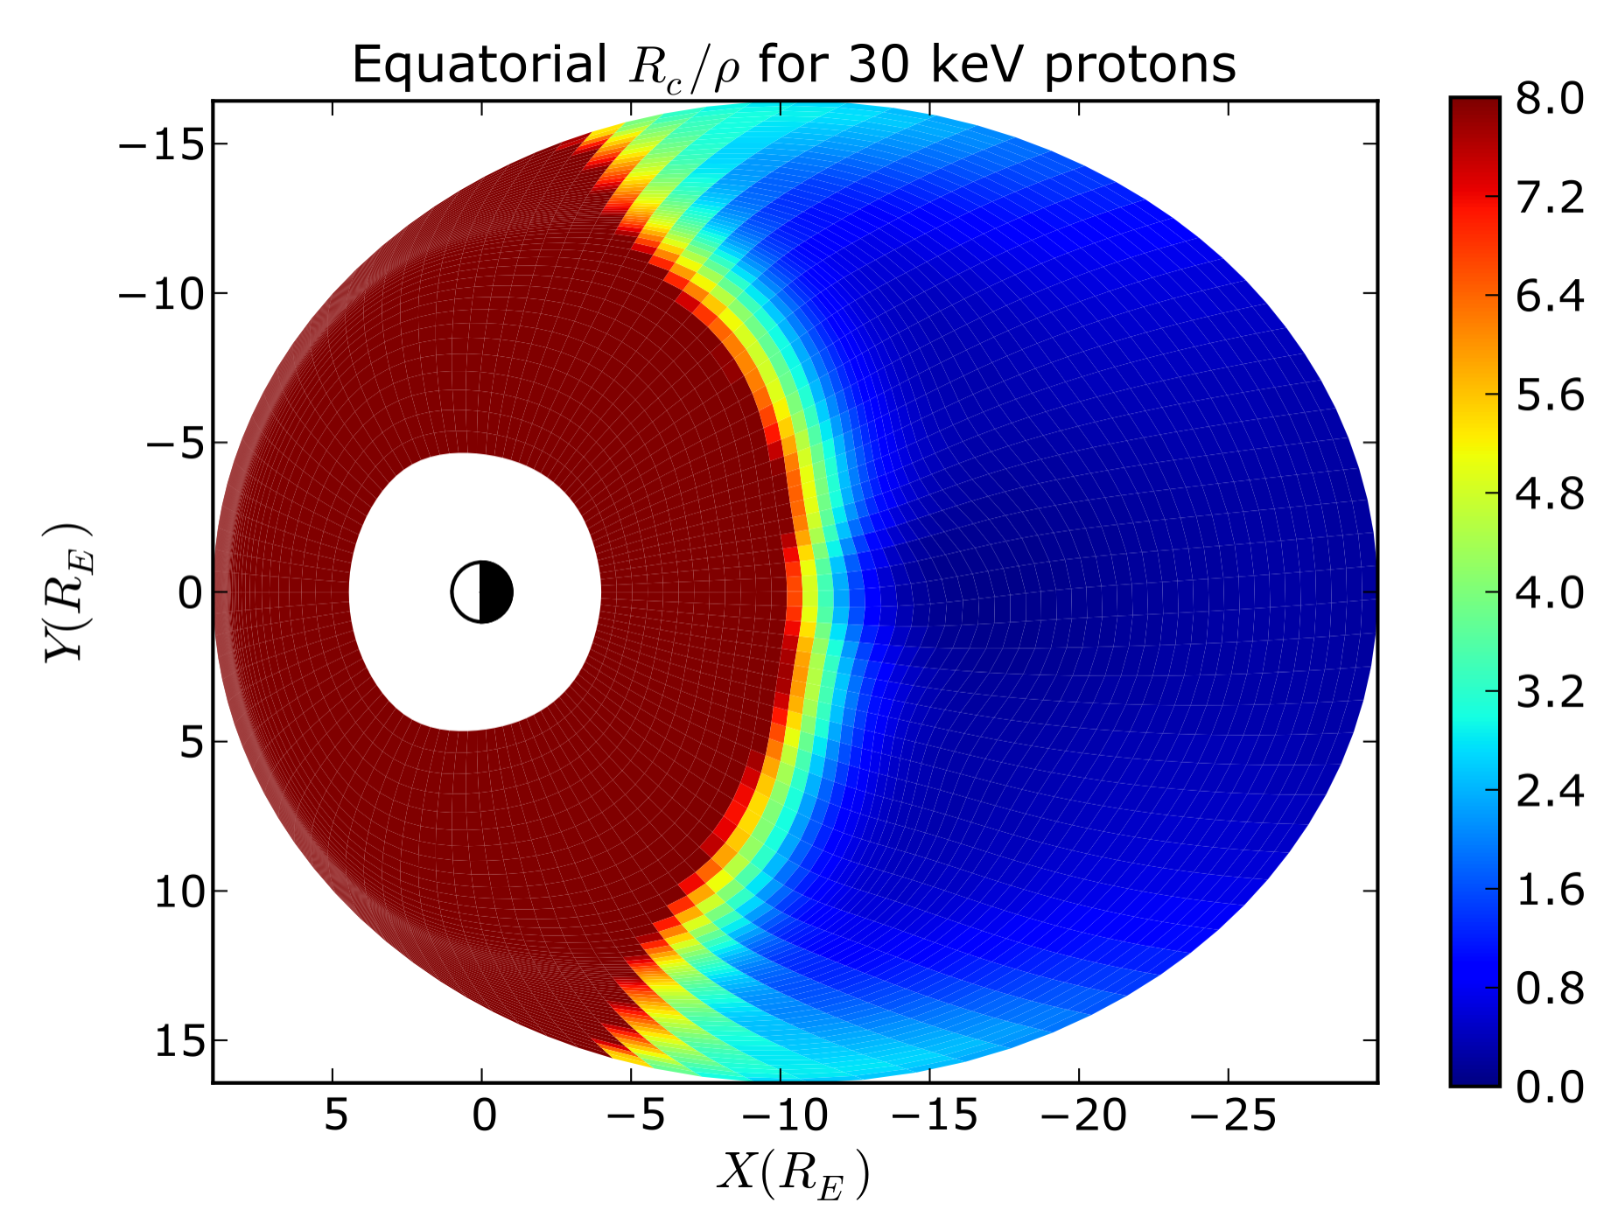
Isotropy Boundary
Isotropy boundary – separating poleward region of energetic (> 30keV) particle isotropic precipitation from equatorward region of weak precipitation/loss-cone filling
Threshold condition
[Sergeev, 1993]
Remote sensing tool – proxy for field curvature
Future work: combine with low-altitude observations (DMSP, FAST)

