Slide 1
Near-term new observational capabilities in magnetosphere-ionosphere coupling science:
AMPERE &
Mid-latitude SuperDARN chain
What are they?
What good are they?
Brian J. Anderson
JHU/APL
2009 GEM Workshop, Friday June 26

Slide 2
M-I Coupling in GEM
The session "AMPERE, Mid-latitude SuperDARN, and other opportunities for new MIC Focus Groups" will be held at 10:30 in the Erickson room.
While you're listening, think of ways these assets used with other excellent tools/data (AMIE, TEC, CCMC) could be used to do MI coupling studies, write them down, and bring those ideas to the session at 10:30. Anyone that shows up with three good ideas wins a lollipop. (Murr, 2009)

Slide 3
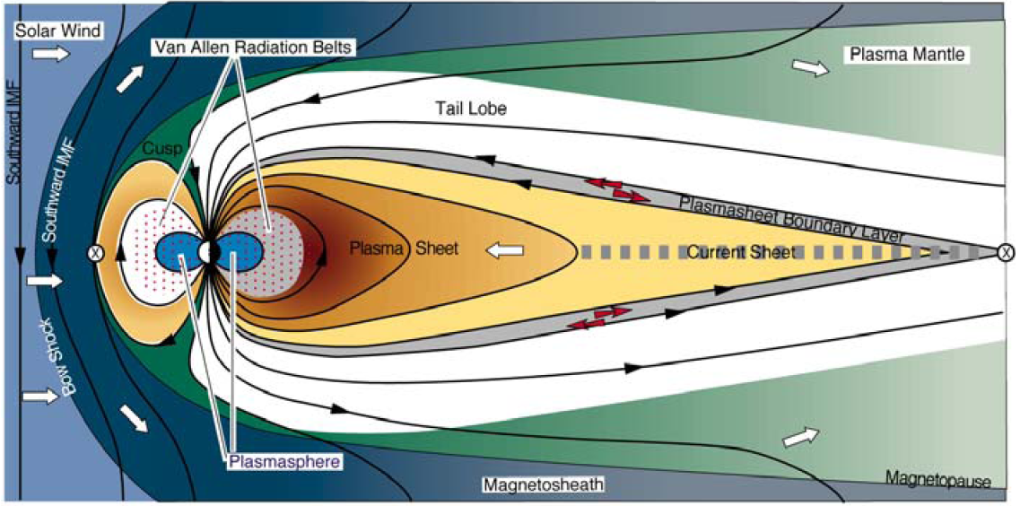
What do we mean by the M-I system?
Is it this cartoon?

Slide 4
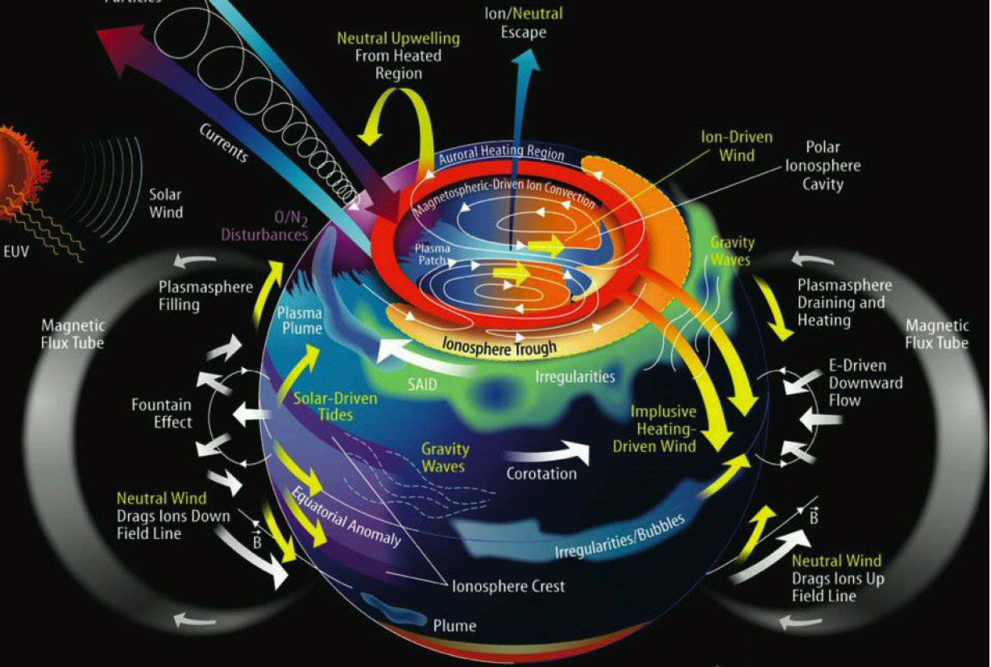
What about this one?

Slide 5
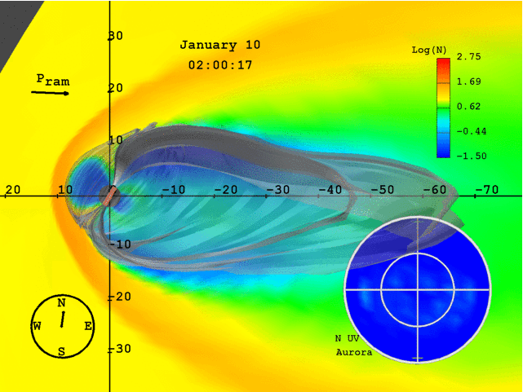
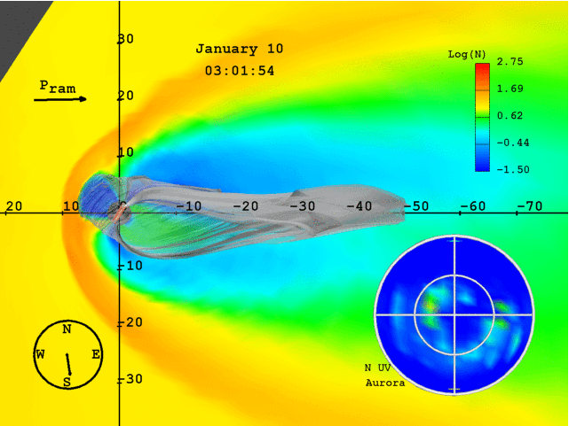
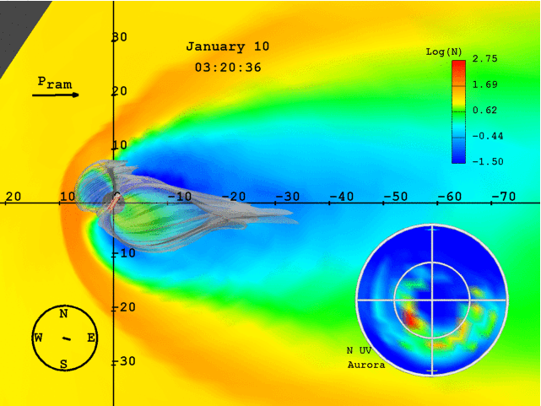
Or this simulation?

Slide 6
Claim: we have largely wrapped up system ‘climatology’
We know the distribution of currents, convection and ionospheric structure for typical ranges of the IMF, solar wind.
We even know a lot about their seasonal and solar cycle variability.
But the system never actually achieves its average state: no family has 2.2 children.

Slide 7
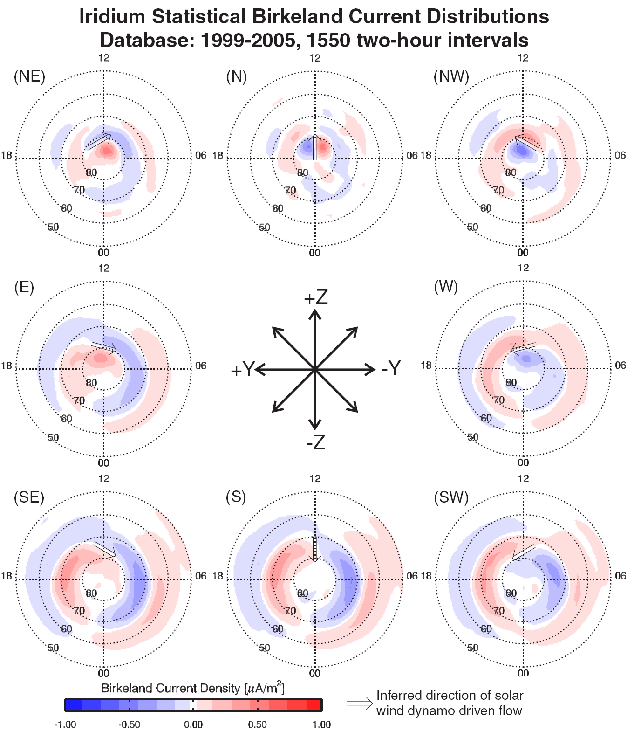
Anderson et al., 2006

Slide 8
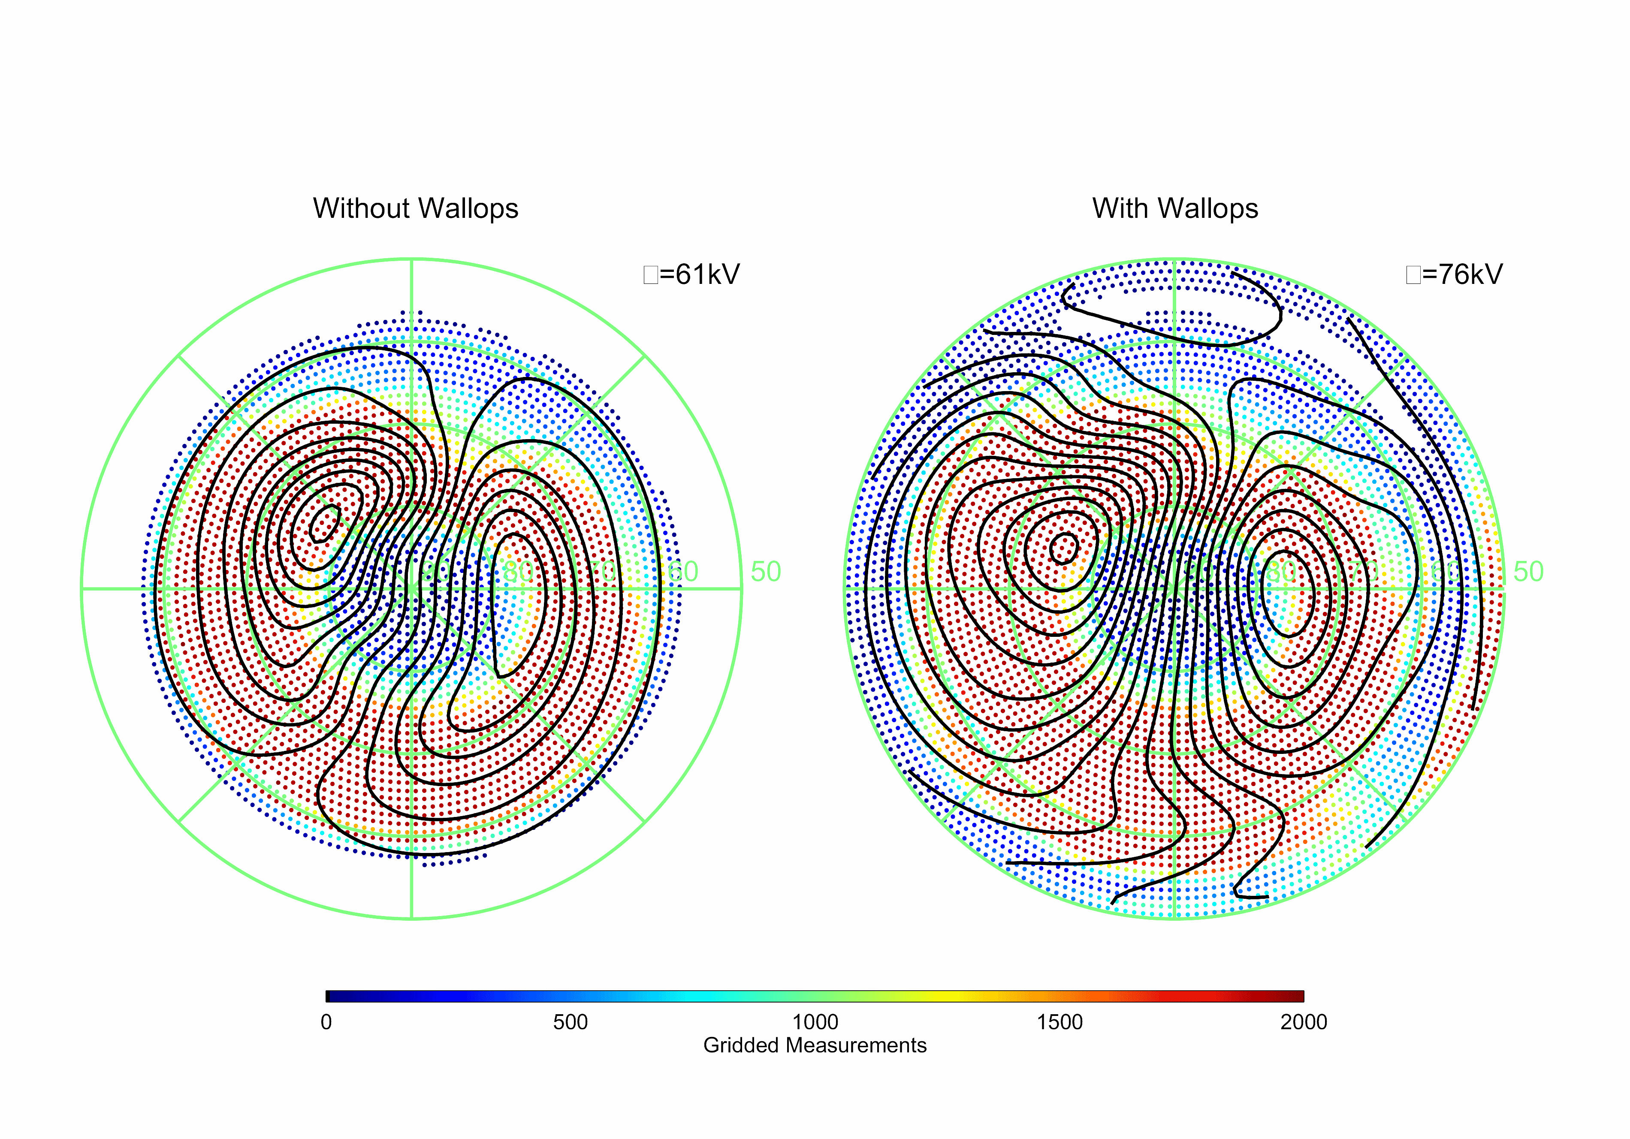
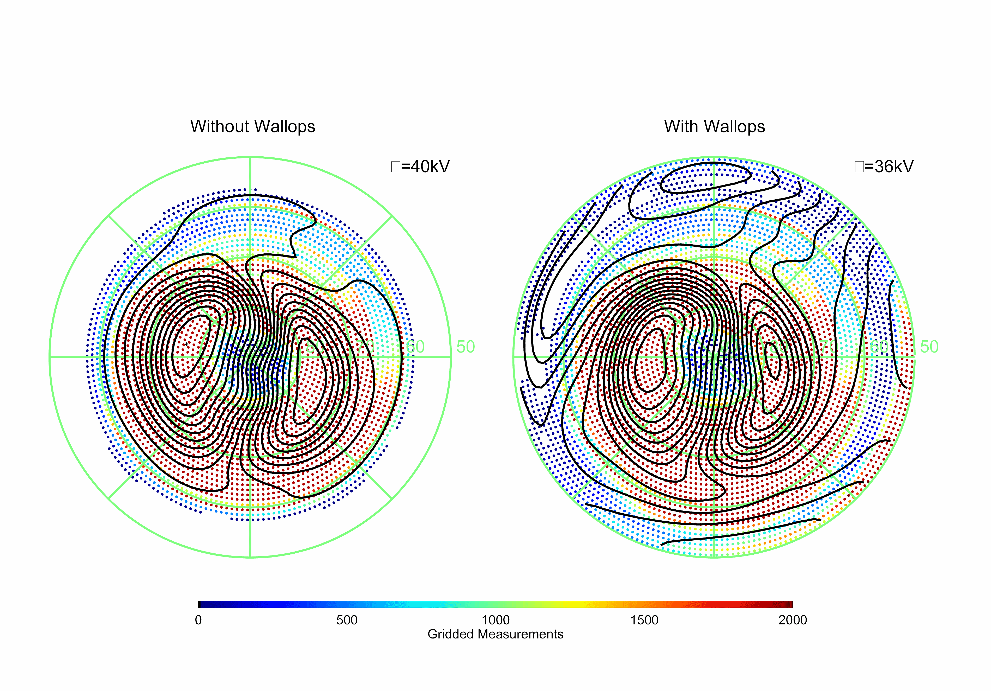
Statistical Convection Patterns
Φ=61kV
Φ=76kV
“Disturbed” Conditions (Kp > 3):
  Average cross polar potential increased by 25%.
“Quiet” Conditions (Kp < 3):
  Two-cell convection pattern is fed from lower latitudes on the evening side and drained on the morning side.
Φ=40kV
Φ=36kV
Baker et al., [2007]

Slide 9
The system is not the average
Dynamic events display convection in different latitudes and local times
Gradients are far sharper than the smeared averages
Structured flows, precipitation, currents necessarily imply dynamics, mass, momentum and energy transport.
System is as system does.

Slide 10
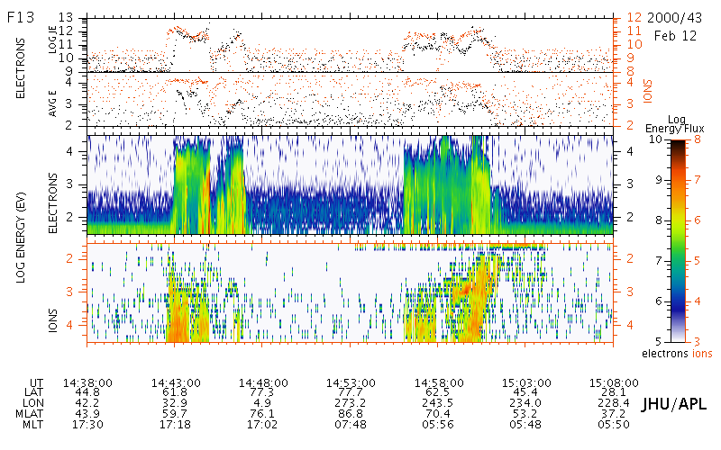
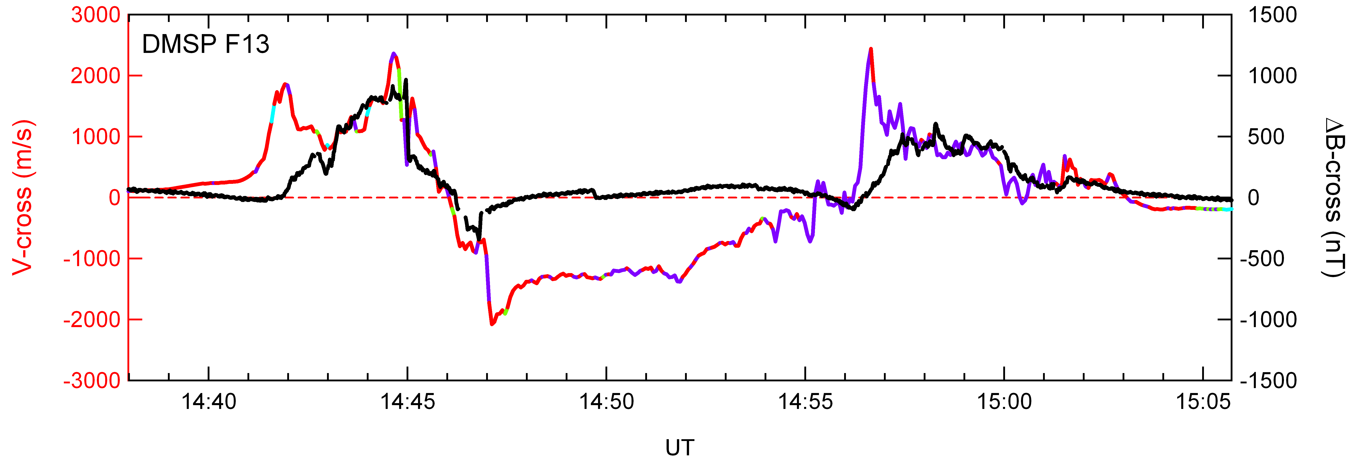

Slide 11
Note that agreement is between an ‘instantaneous’ simulation and a statistical climate average
Strong smearing, ~5x low wrt any real case.

Slide 12
Active-time dynamics
The strongly driven M-I system achieves states that are qualitatively different – with new ‘features’ and phenomena: e.g.
  Saturation (an M-I coupling response)
  Sawtooth events (global substorm events)
  SMC events
  Ionospheric storms, positive and negative
  SAPS/SAID
  Radiation belt re-population or depletion …
These are large, factors of 2 to >10 departures from ‘climate’

Slide 13
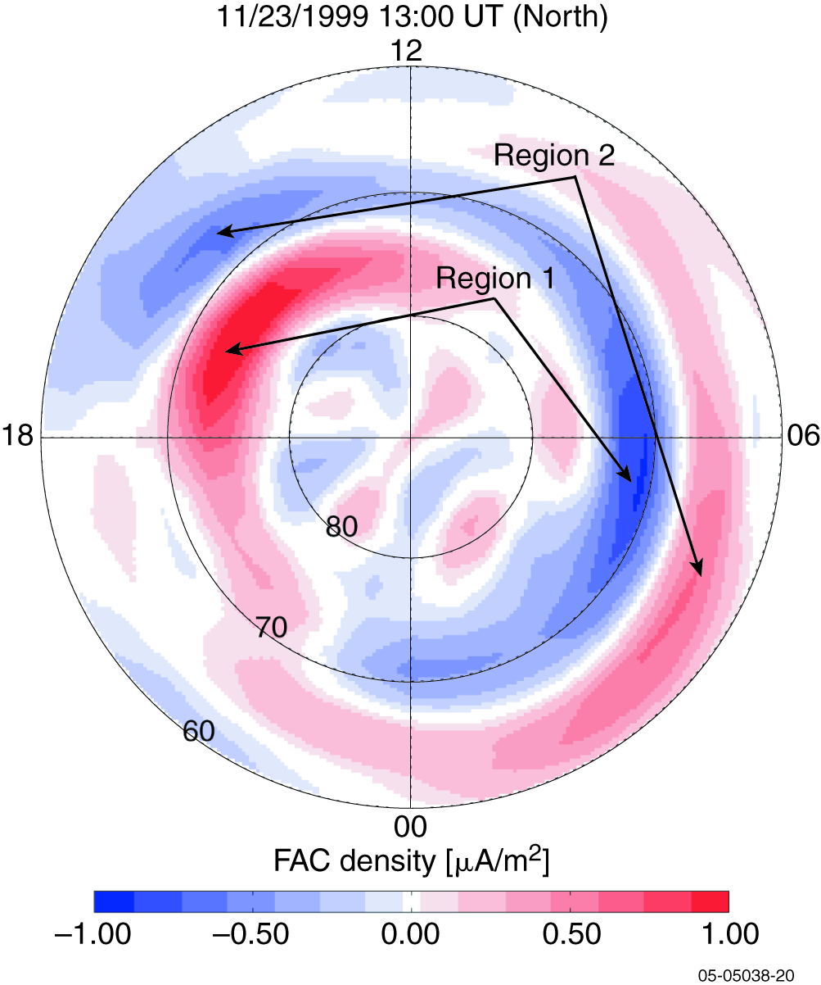
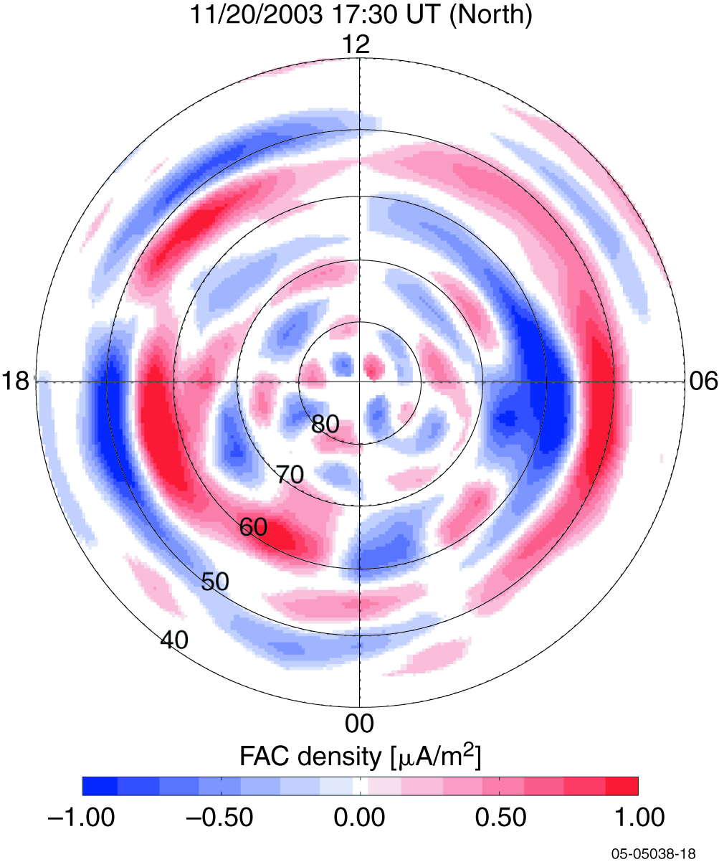
Currents from Iridium*
Non-storm
Severe storm
* 3 hour averages!

Slide 14
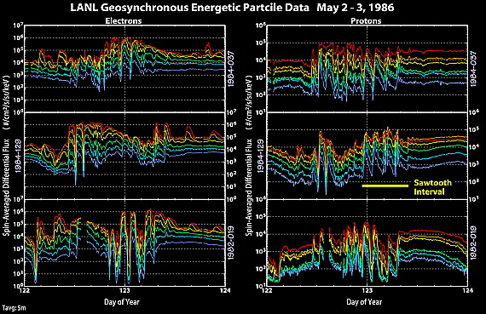
Quasi-periodic instability states
Henderson et al. 2004

Slide 15
Why the climate approach cannot work for storms
Reeves: “If you’ve studied one geomagnetic storm, you’ve studied one geomagnetic storm.”
Even with the assets we have had available to date, we know that every storm is unique.
There are common aspects between them, e.g. main phase, recovery, equatorward expansion, plasmasphere erosion/plumes.
But the end-points that the system achieves (e.g. wrt relativistic electrons) can vary widely – for reasons that we don’t understand.

Slide 16
A few questions we can’t answer (yet?)
What are the different strongly driven convective states? How are they related to nominal activity? How do they arise, evolve and transition? What gives rise to quasi-periodicities?
What is the mechanism for saturation or is there more than one?
Where does the ionospheric energy dissipation occur during active-times? How much of it is Joule/particle heating?
How does evolution and dynamics in the ‘driver’ correspond (lead to?) ionospheric positive and negative storms?
What are the time-lags/delays in the active system? What governs them?

Slide 17
What do we need to measure to make major progress?
Fundamental quantities: minimize uncertainties due to inversions and modeling assumptions.
Globally distributed: ‘all’ local times, ‘all’ latitudes
Short cadence: less than a reconfiguration time-scale (~20 minutes or so).

Slide 18
Magnetosphere
Ionosphere
Flow
Convection
Field lines
convey potential
Momentum
Finite conductance - current
Currents
convey stress
Energy dynamo
Dissipation - drag
EM Energy Flux
Notes:
Where do the field-aligned currents fit into the Magnetosphere-Ionosphere system dynamics?
The FAC convey the stresses between the magnetosphere and ionosphere
FAC are related to the conductance and electric fields, and also the pressure distributions in the magnetosphere
The intensity of the FAC is associated with the energy deposition for a given electric field
If you could only take one ionospheric measurement, the FAC provide more information than any other single observation

Slide 19
The Ionospheric electrodynamics view
Convection
Horizontal currents
= equivalent current potential
Birkeland currents
Electrodynamics equations: 2 eqs, 5 unknowns

Slide 20
Quantity | Technique | Strengths | Operational Considerations
Ψ Equivalent currents | Ground magnetometers | Excellent time resolution; continuous data; coverage improving in latitude, density and southern hemisphere | Non-uniform coverage (oceans, concentration at nominal auroral latitudes, local time gaps)
ϕ Potential convection | SuperDARN: mid-latitudes | Broad field of regard; continuous operation; both hemispheres; 2-min cadence; 10s km resolution | Requires irregularities; D-region absorption (mitigated somewhat by mid-latitude radars)
 | IS radars | Indep. of conditions | Focussed (limited) coverage (few sites)
 | LEO ion drift | Direct ion drift observations | 100 minute revisit time
 |  |  | Restricted local time cuts (4)
Σ_{P}, Σ_{H} | IS radars | Accurate density meas. | Focussed (limited) coverage (few sites)
 | UV imaging | Hemispheric image | Significant uncertainties
 |  |  | Not operational routinely
J|| Birkeland currents | LEO mags | Direct signature of currents | Iridium: long accumulation times (>2 hrs)
 |  |  | Other: ~3 satellites, 100 minute revisit time, Requires geometrical assumptions
 | AMPERE | Direct signature of currents | 30 nT resolution – S:N ~ 10:1
 |  | >70 satellites | Latitude resolution: 1º nominal
 |  | 9 minute revisit time | Event driven sub-degree sampling
 |  | 12 local time cuts

Slide 21
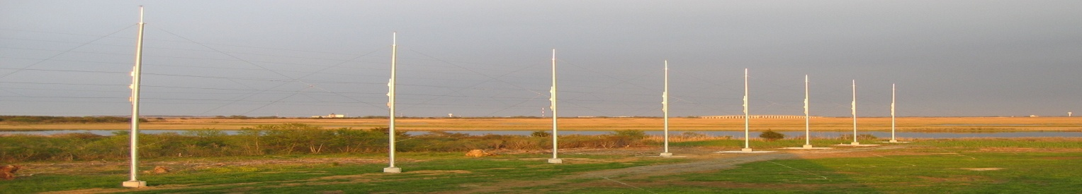
Mid-Latitude SuperDARN
Core Team:
Mike Ruohoniemi, Jo Baker, Ray Greenwald
Virginia Tech
Bill Bristow
University of Alaska
Simon Shepherd
Dartmouth College
Elsayed Talaat
JHU/APL

Slide 22
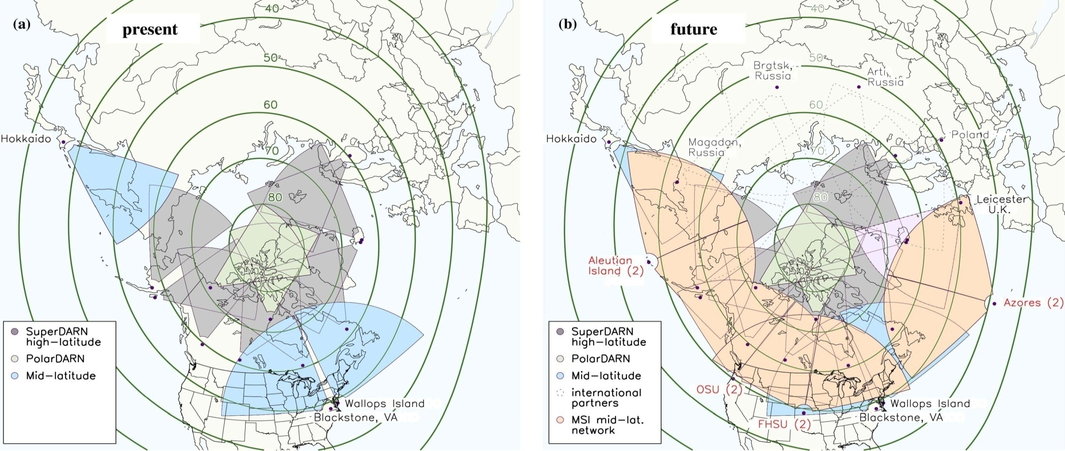
New Mid-Latitude Radars
Funds to build 8 new radars at middle latitudes have been provided through the NSF MSI Program.
Partners: Virginia Tech, University of Alaska, Dartmouth College, JHU/APL.
There are also plans to build mid-latitude radars in Australia, South Africa, and Eastern Europe

Slide 23
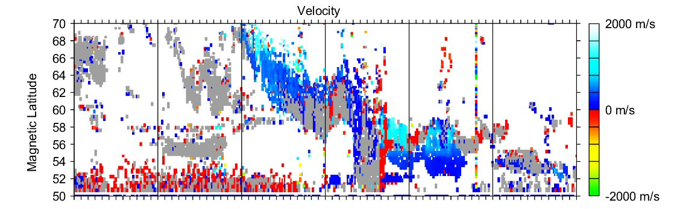
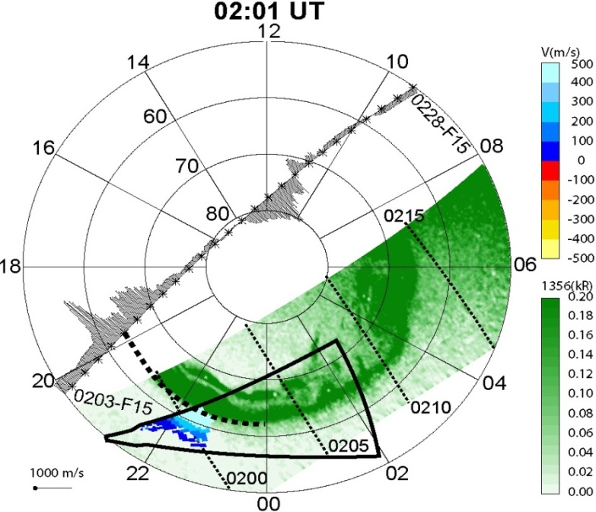
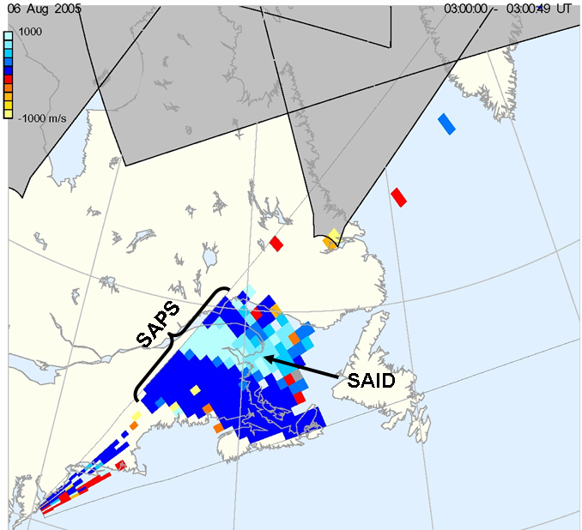
Wallops Measurements: SAPS/SAIDs
Beam 4
12
15
18
21
00
03
06 UT
June 12,2005
June 13, 2005
Two-Dimensional Image of Sub Auroral Ion Drifts (SAID) within the Sub Auroral Polarization Stream (SAPS).
Oksavik et al., [2006]

Slide 24
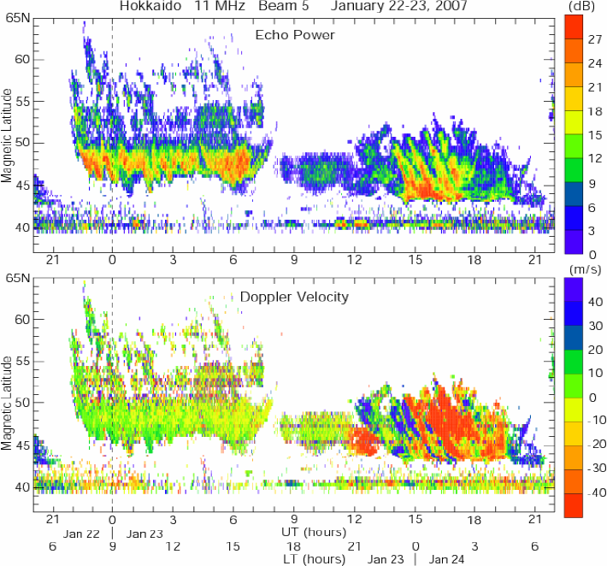
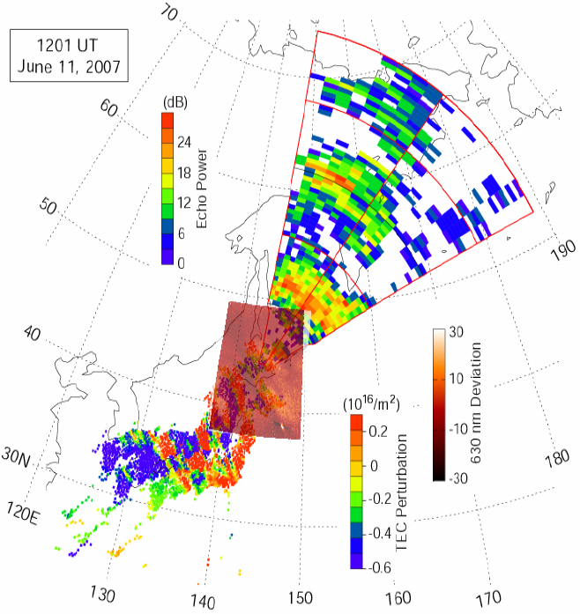
Hokkaido Measurements: TIDs
Daytime TIDs
(Sea Scatter)
Nighttime TIDs
(Ionospheric Scatter)
The second mid-latitude SuperDARN radar became operational at Rikubetsu, Hokkaido, in December, 2006.
PI: N. Nishitani
By combining Hokkaido radar data with ground-based 630nm all-sky imaging and GPS TEC measurements it is possible to continuously monitor the propagation of TID wave fronts over a scale length of 6000km.
Figures courtesy of T. Ogawa, STE Lab, Nagoya University

Slide 25
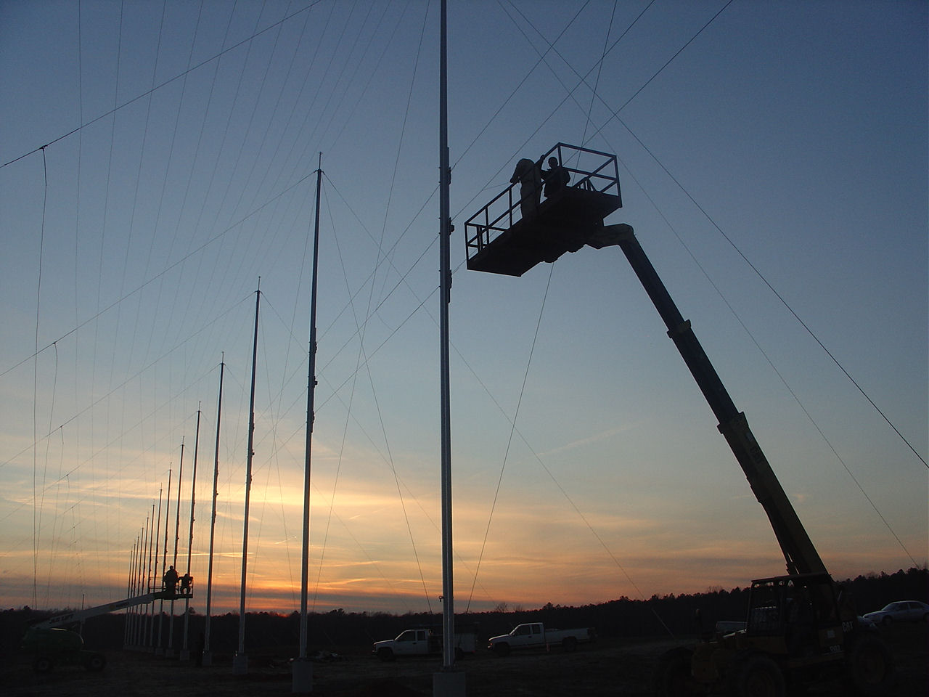
The Blackstone Radar
The third mid-latitude SuperDARN radar became operational at Blackstone, VA, on February 2nd, 2008.
The Blackstone radar is a collaboration between:
    Virginia Tech
    Johns Hopkins University Applied Physics Laboratory
    University of Leicester

Slide 26
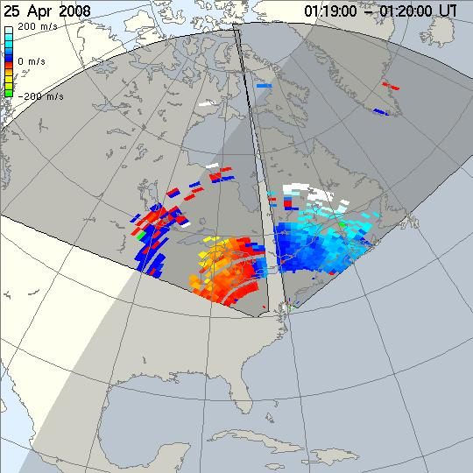
Blackstone/Wallops Field of View

Slide 27
Summary
New SuperDARN radars at middle latitudes are providing:
  Improved Coverage of Ionospheric Convection During Magnetic Storms
  New Details of the Temporal Evolution of SAPS/SAIDs
  Information about Generation Mechanisms for Mid-Latitude Plasma Irregularities
  Information about ULF Electric Field Pulsations at Substorm Onset
  New Capabilities to Investigate Penetration Electric Fields
A 4-year proposal to build 8 additional mid-latitude radars across the North American sector has recently been funded through the NSF MSI Program.

Slide 28
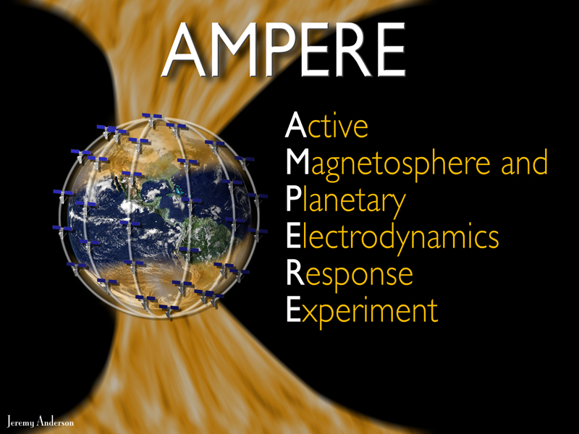
Continuous Global Birkeland Currents from the
Active
Magnetosphere and Planetary Electrodynamics Response
Experiment
Brian J Anderson, The Johns Hopkins University Applied Physics Laboratory

Slide 29
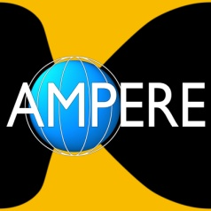


Partners
Sponsor
National Science Foundation
Data provider
Boeing Service Company
Data source
Iridium Satellite LLC
PI Institution, Science Data Center
The Johns Hopkins University Applied Physics Laboratory

Slide 30
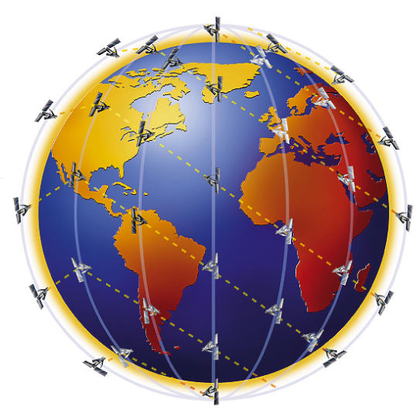
Iridium Constellation for Science
Magnetometer on every satellite
  Part of avionics
  30 nT resolution: S/N ~ 10
>70 satellites, 6 orbit planes, ~11 satellites/plane
Six orbit planes provide 12 cuts in local time
9 minute spacing: re-sampling cadence
780 km altitude, circular, polar orbits
Polar orbits guarantee coverage of auroral zone
Global currents never expand equatorward of system

Slide 31
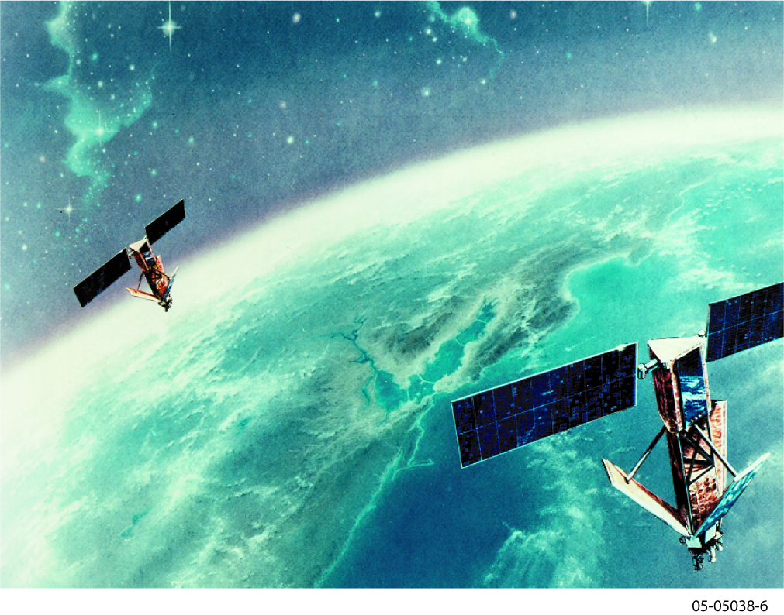
Iridium Satellite LLC
New company founded in 2000
Assumed assets of original Iridium
Profitable since 2001
Majority of revenue non DoD
Estimated satellite constellation life: 2014+

Slide 32
20 min

Slide 33
40 min

Slide 34
60 min

Slide 35
80 min

Slide 36
100 min

Slide 37
120 min

Slide 38
Telemetry Issue & Solution
SC health telemetry packet
MAG samples (0.1% of total)
Existing system:
  Magnetometer data embedded in satellite engineering data packet
  Enormous quantity of engineering data: voltages, currents, temperatures, other attitude sensors, RF system (rec’d intensities), power system (arrays/batteries), computer/memory monitors …
Modification:
  Use alternate path: event message. Designed for satellite to report ‘event’ of interest to operators
  New software to query magnetic field from attitude system processor
  Pack set of magnetic samples (~10 to 100) in an event message.
  Event messages delivered in continuously, sequentially (SV001, 002 …) using satellite network to ground station in true real-time

Slide 39
Existing 200-s sampling often misses signatures
2-s sampling captures small-scale features
20-s sampling captures all large scale currents
30-nT resolution is sufficient

Slide 40
AMPERE Development Effort
Space software upgrade and installation
Ground data system to extract and archive data at Iridium operations center
Data exchange to Science Data Center at JHU/APL
AMPERE Science Data Center: capability to ingest real-time, 24/7 data and process data products
Promotion to highest rate:
  2 s on all satellites (normally ~20 s)
  36-hour promotion span
  16 per year
  Effected in ~1 hour

Slide 41
AMPERE: Boeing/Iridium - Data Provider
Iridium system upgrade: concept in place and ready
  satellite constellation flight software
  ground system development
Real-time data stream
Store & dump data: fill any gaps; definitive orbit/attitude
Flight Software
Ground Architecture
Real-time stream
Supplementary
Product Generation
TLM files
Real-time Extractor
& Processor
Database
Data
Accounting
TLM files
Store-dump Extractor
& Processor
Store & dump
Data Transmission
Constellation
JHU/APL
AMPERE Science
Notes:
This is AMPERE ☺ Basically it just requires upgrades to the current Iridium system – need a flight software and a ground system upgrade
With AMPERE we will get continuous, global observations of large scale FAC system – in real time, with 9 minute cadence
WHY THIS IS NOT DIRT CHEAP: A FLIGHT SOFTWARE UPLOAD TO AN OPERATIONAL, PROFITABLE SATELLITE CONSTELLATION PROVIDING ON-DEMAND SERVICE TO COMMERCIAL AND MILITARY CUSTOMERS WORLD WIDE.

Slide 42
AMPERE: JHUAPL - Science Data Center
Cross track ΔB, vector ΔB map via spherical harmonic fit
j|| from Ampere’s law (arbitrary geometry, no stats or cond.)
Convert all code to common platform: new algorithms for real-time detrending and current inversion
Derived data products
Cross-track ΔB
Spherical harmonic fit: ΔB
j|| = curl ΔB
Upward J||
Downward J||
00
UP
Iridium: 22 Apr 2001 0800-1000 UT

Slide 43
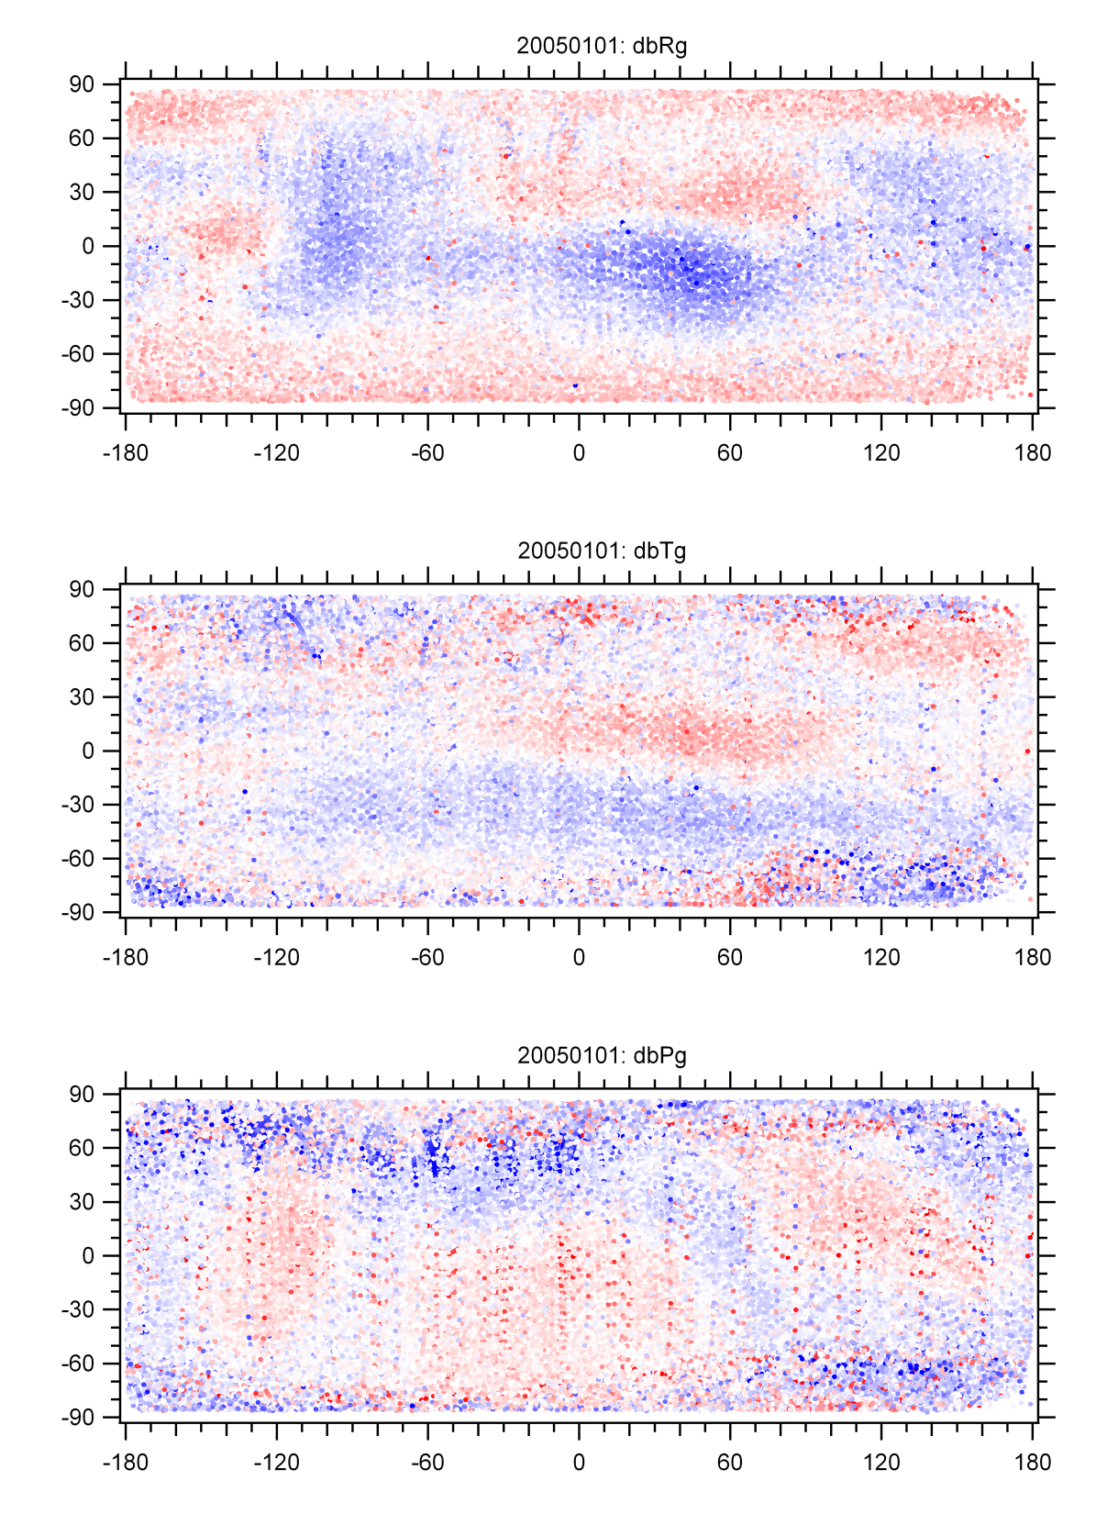
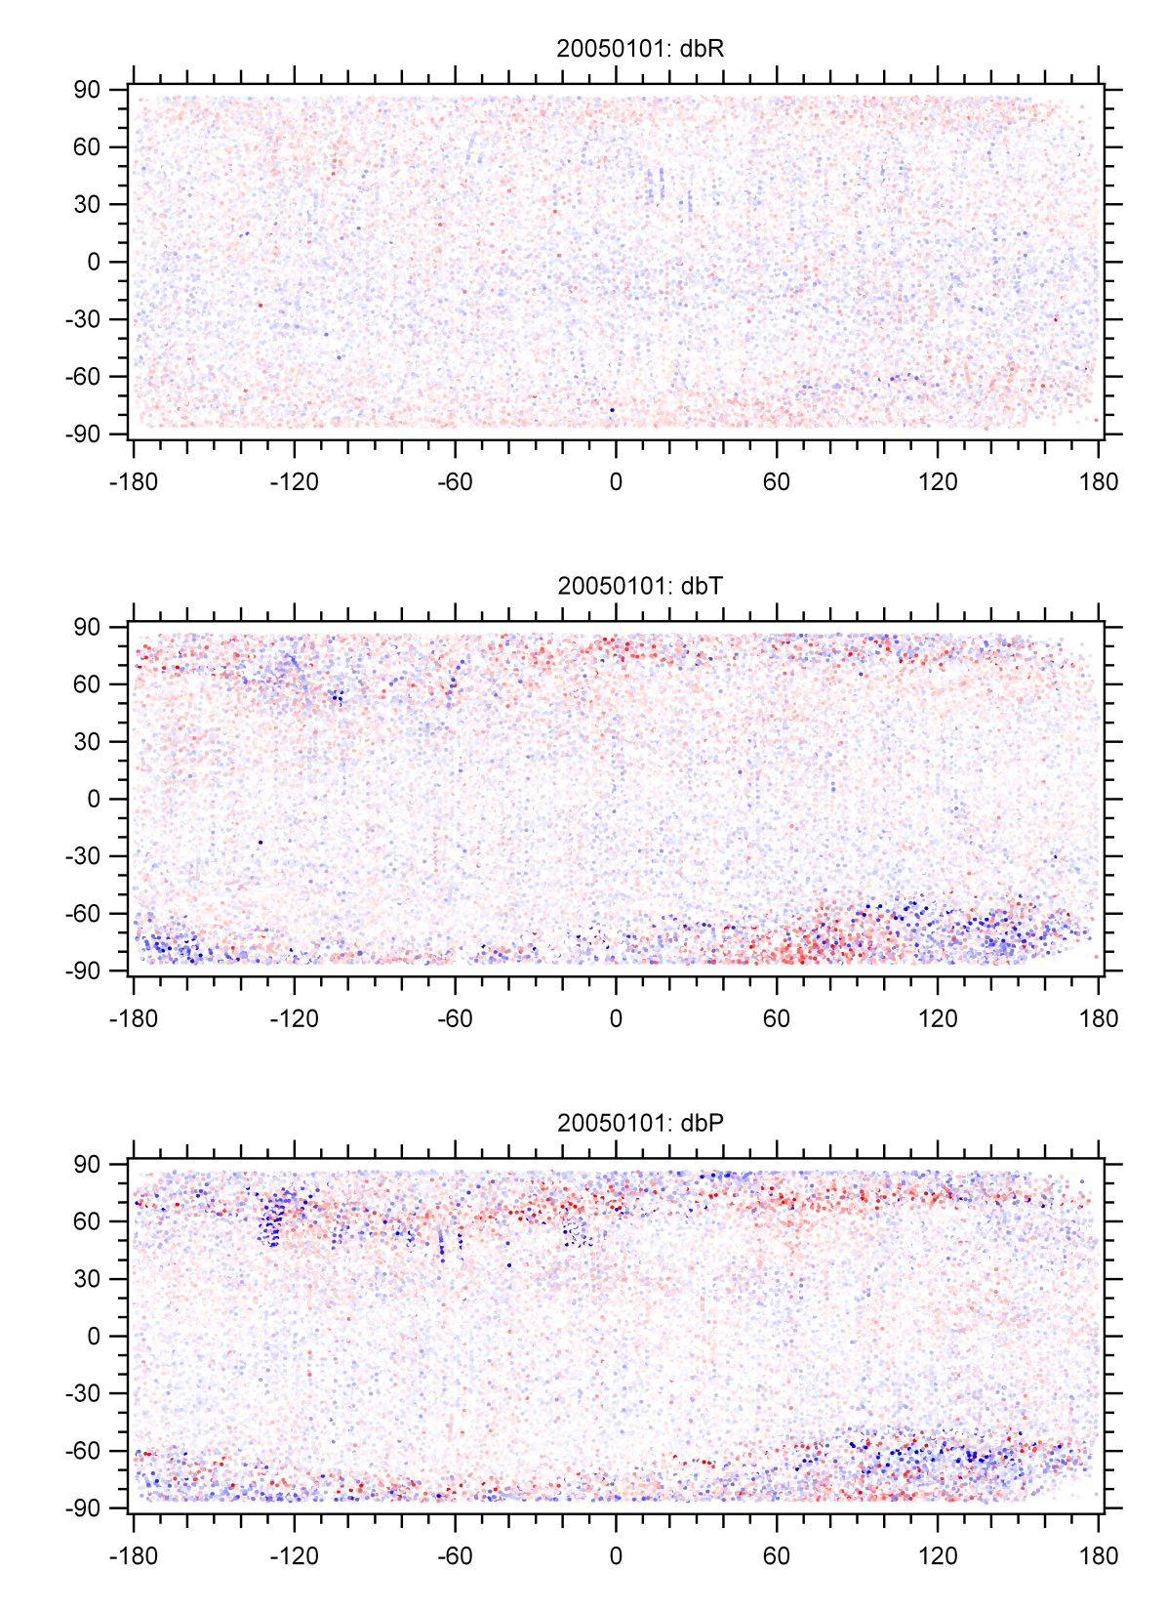
db in Earth fixed r-θ-φ (RTP)
Old
New

Slide 44
Development Timeline
Release of upgraded Fall 2009
‘historical’ data
First ‘light’ Dec 2009
Testing and validation CY 2010
Real-time development CY 2011
‘Burst’ promotion CY 2012
Completion May 2013
Release of products will occur during development as they are ready

