Slide 1
GEM Tutorial: The Magnetosheath
S M Petrinec
Lockheed Martin Advanced Technology Center, Palo Alto, CA

Slide 2
Outline
What is the magnetosheath?
Outer boundary (bow shock)
  Shock jump conditions
  Asymptotic cone angle
  Standoff position (nominal and special cases)
  Bow shock shape
Inner boundary (magnetopause)
  Plasma parameters along inner boundary
  Sources of accelerated flows
Within the magnetosheath
  Historical studies
  Theory and analytic models
  Synoptic maps
Summary

Slide 3
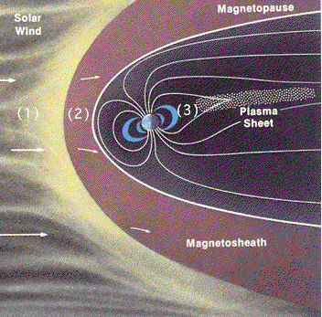
What is the magnetosheath?
The magnetosheath is the region of space between a planetary obstacle (magnetopause or ionopause) and a detached bow shock; which exists to slow and divert the super-magnetosonic solar wind plasma flow around the planetary obstacle.
Figure from Van Allen, J., "Magnetospheres, Cosmic Rays, and the Interplanetary Medium", in The New Solar System, [1991], pg. 29.

Slide 4
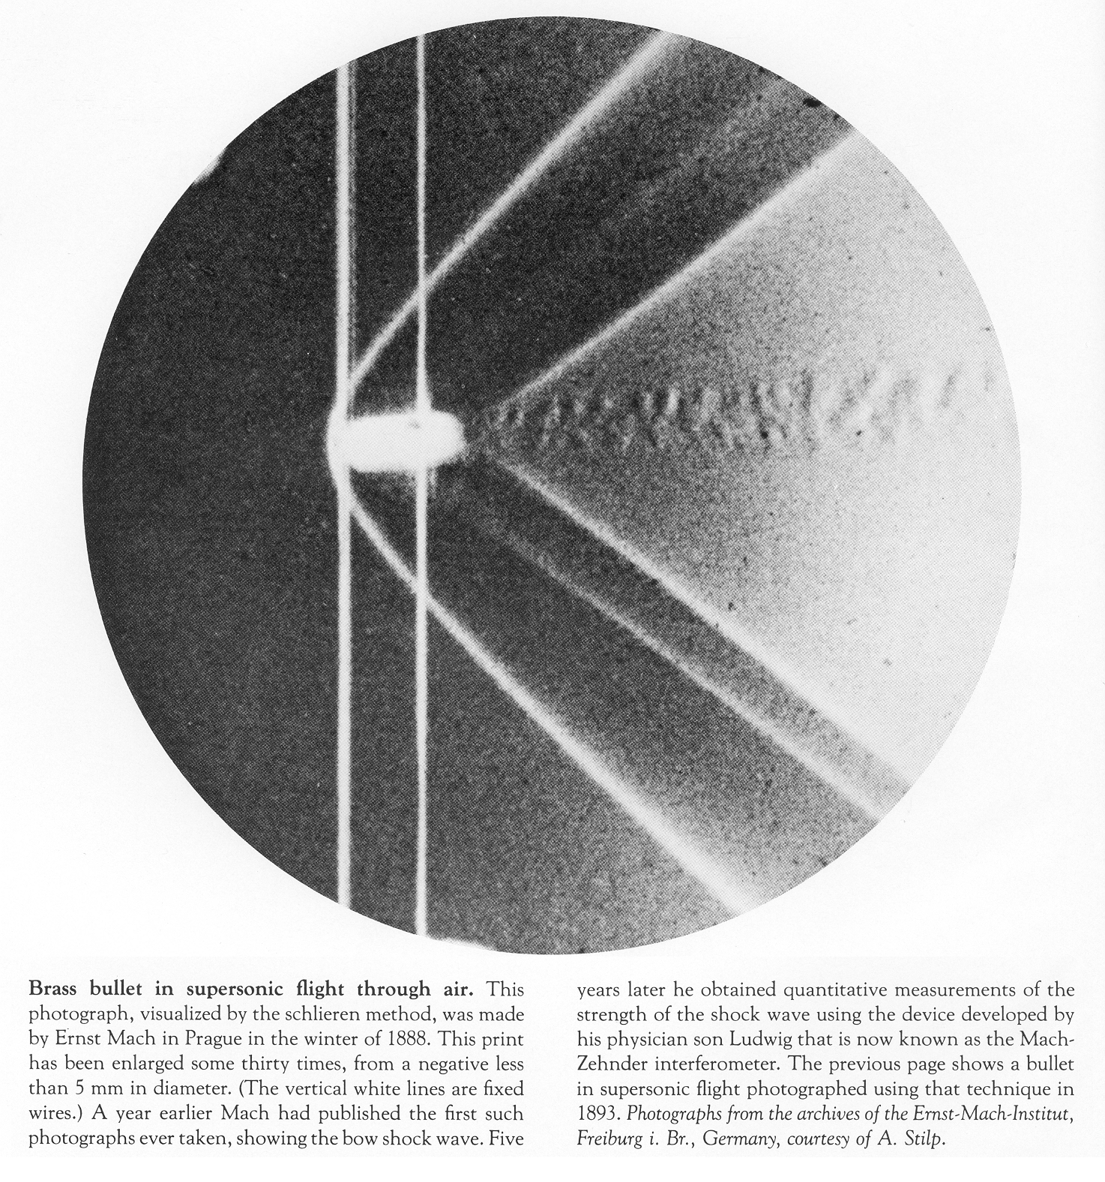
Outer boundary (Bow shock)
From An Album of Fluid Motion by Milton Van Dyke

Slide 5
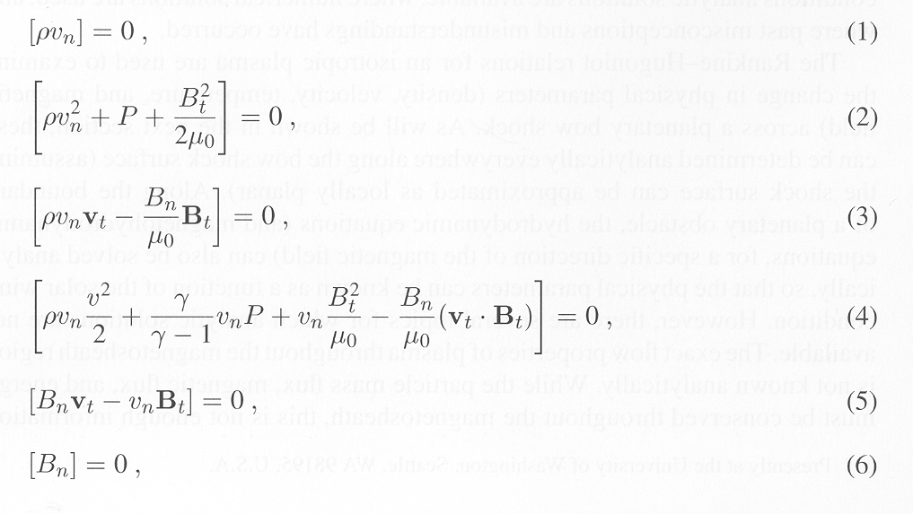
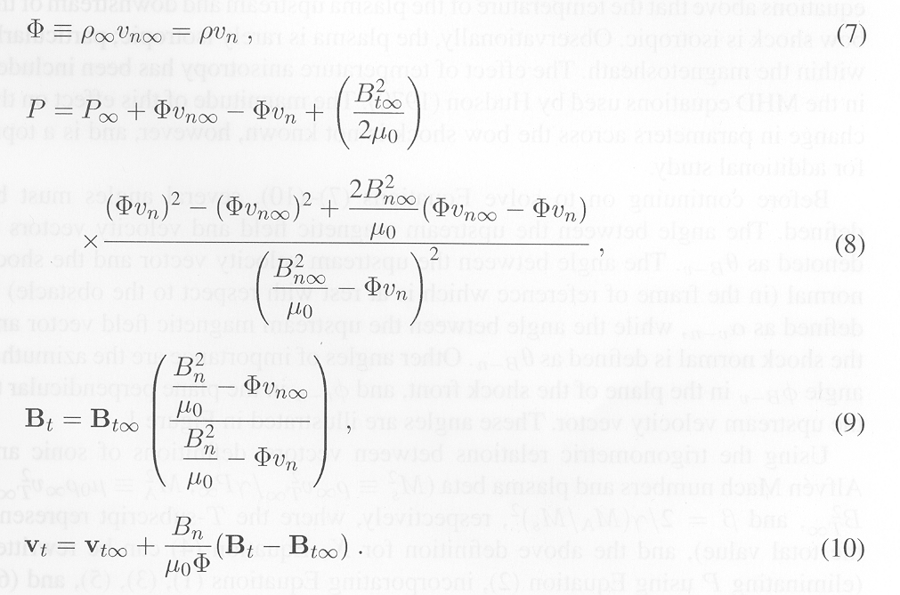
Outer boundary (Bow shock)
Rankine Hugoniot relations:
Zhuang and Russell, JGR, 1981
Petrinec and Russell, Space Sci. Rev., 1997
Define X = ρ∞/ρ

Slide 6
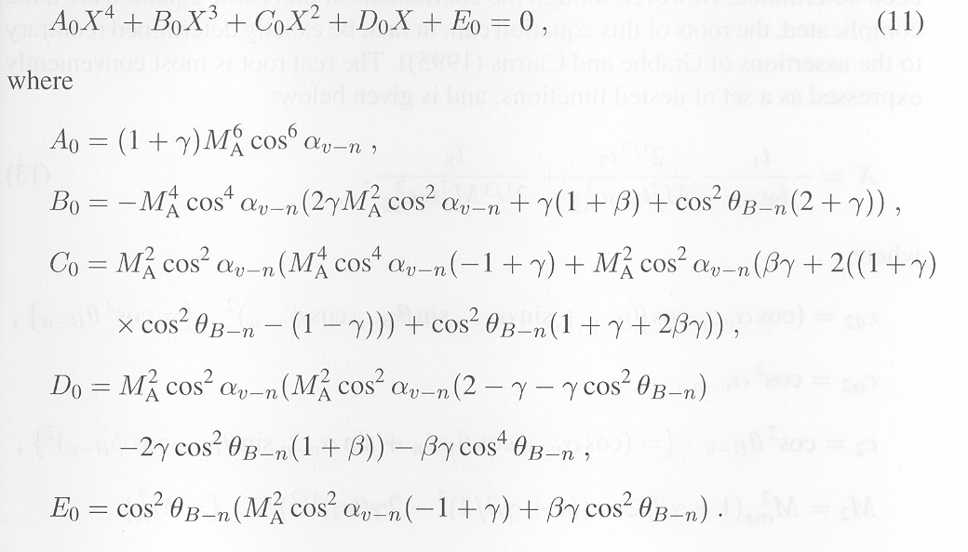
Outer boundary (Bow shock)
Shock jump conditions:
Petrinec and Russell, Space Sci. Rev., 1997

Slide 7
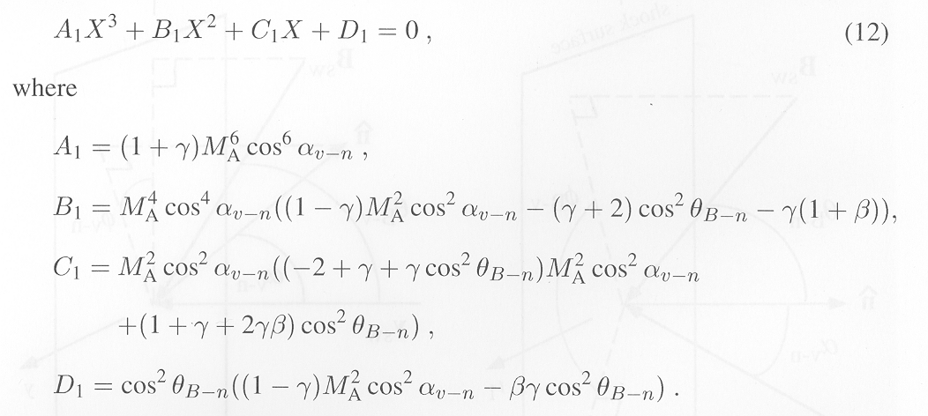
Outer boundary (Bow shock)
Shock jump conditions:
X = 1 (trivial solution)
Analytic solutions exist! (one real root; two complex roots)
Petrinec and Russell, Space Sci. Rev., 1997

Slide 8
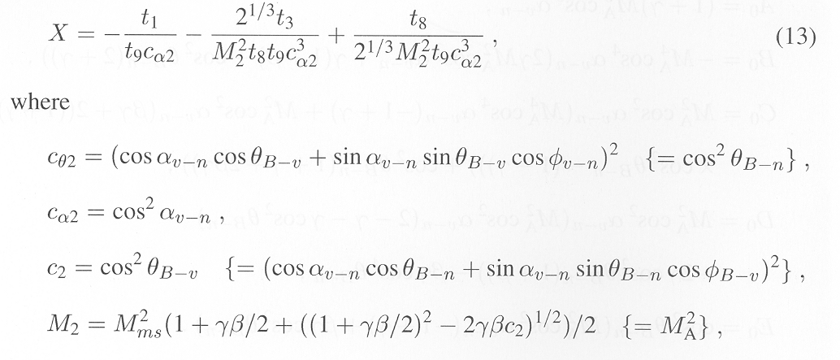
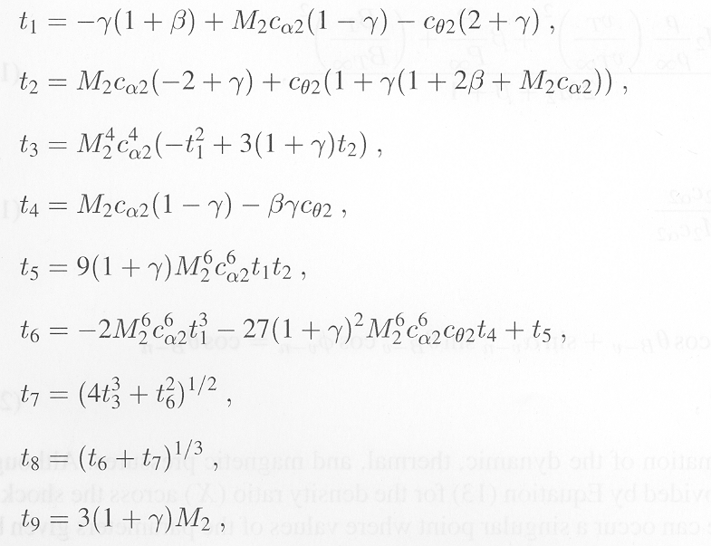
Outer boundary (Bow shock)
Petrinec and Russell,
Space Sci. Rev., 1997

Slide 9
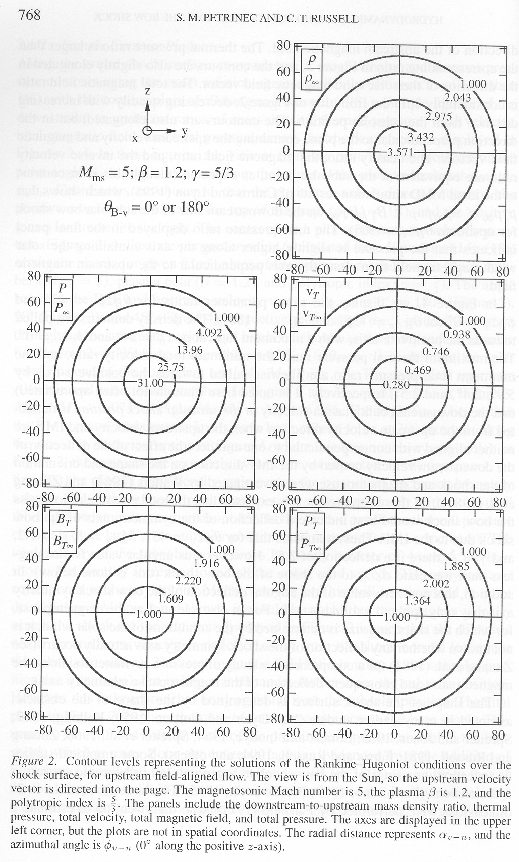
Outer boundary (Bow shock)
Shock jump conditions:
Petrinec and Russell,
Space Sci. Rev., 1997

Slide 10
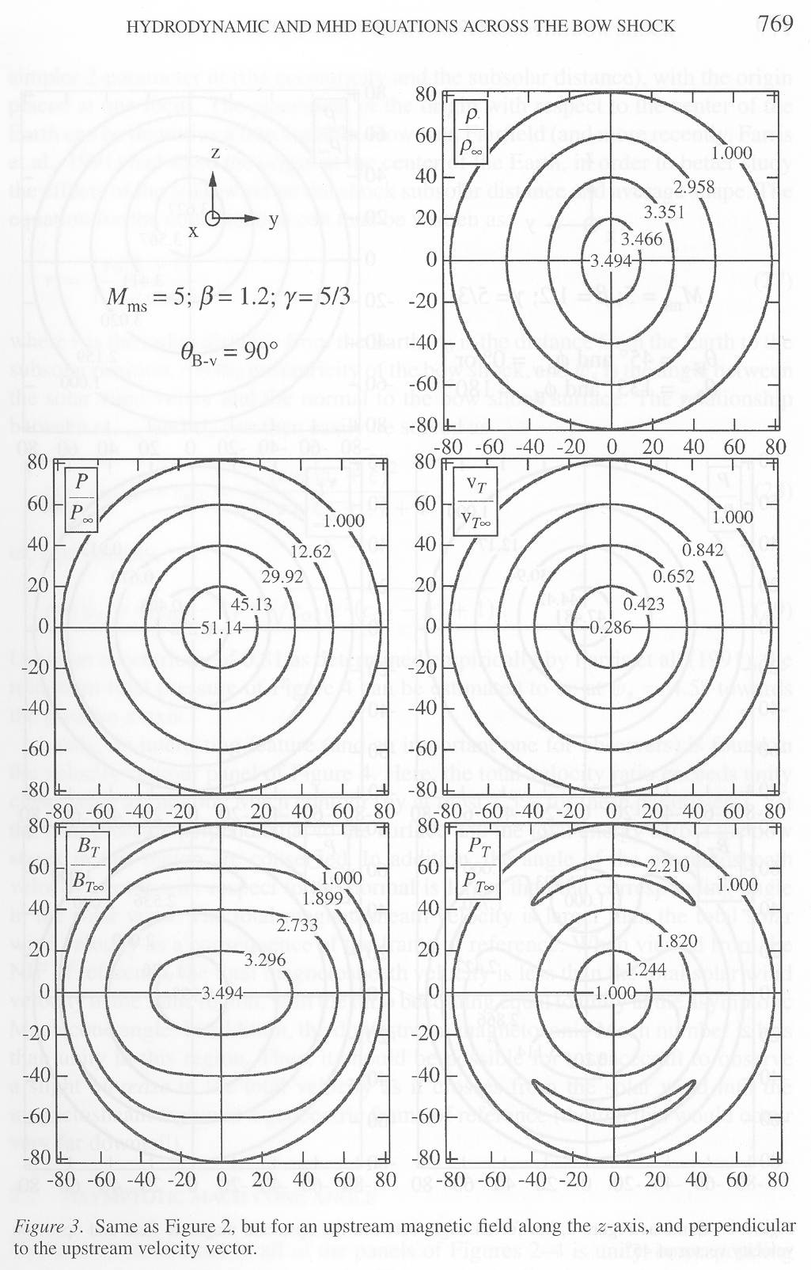
Outer boundary (Bow shock)
Shock jump conditions:
Petrinec and Russell,
Space Sci. Rev., 1997

Slide 11
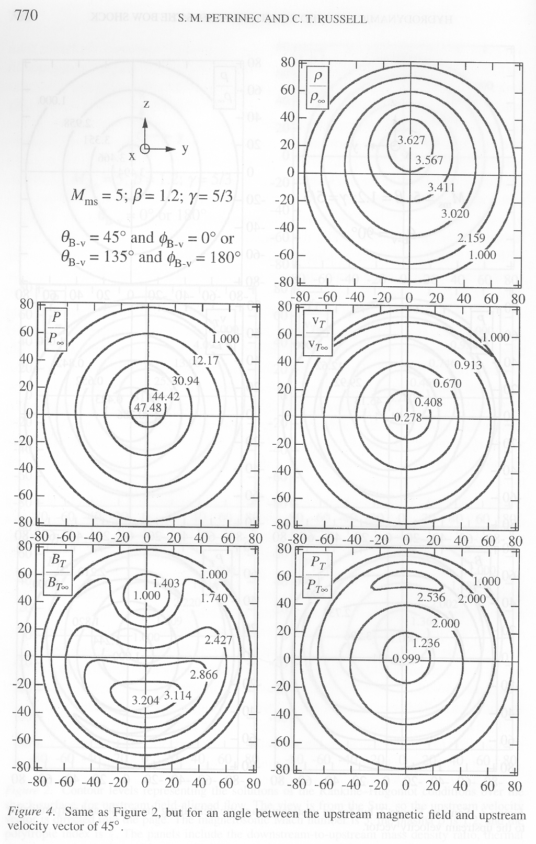
Outer boundary (Bow shock)
Shock jump conditions:
These solutions describe the jump in MHD jump conditions across the shock, but don’t provide any information as to the shape or size of the bow shock
Petrinec and Russell,
Space Sci. Rev., 1997

Slide 12
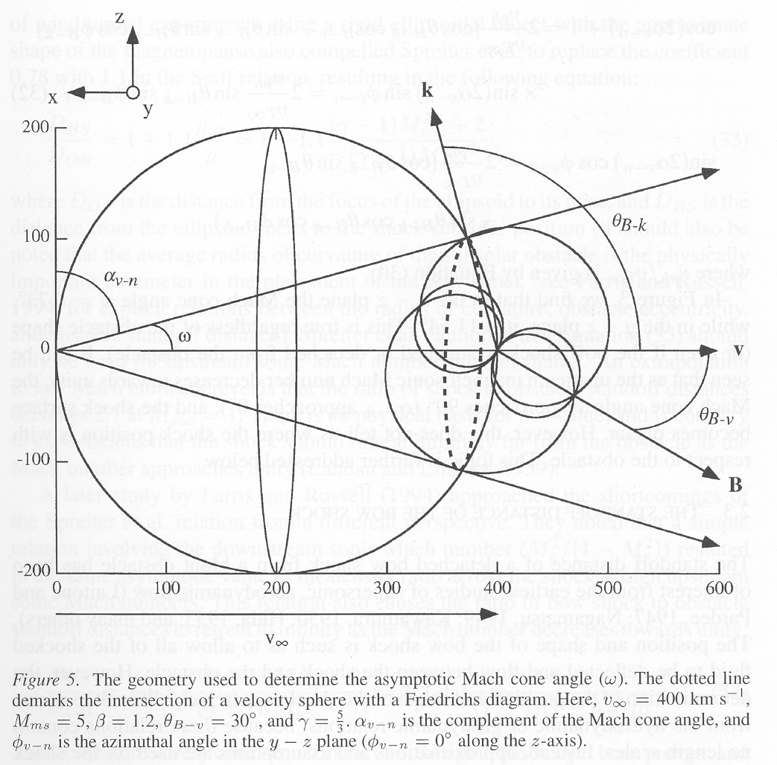
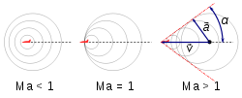
Outer boundary (Bow shock)
Asymptotic angle:
Sonic Mach cone angle (ψ = asin(1/M_{S}))
Petrinec and Russell, Space Sci. Rev., 1997
Good to know, but still doesn’t provide any information as to the shape or size of the bow shock

Slide 13
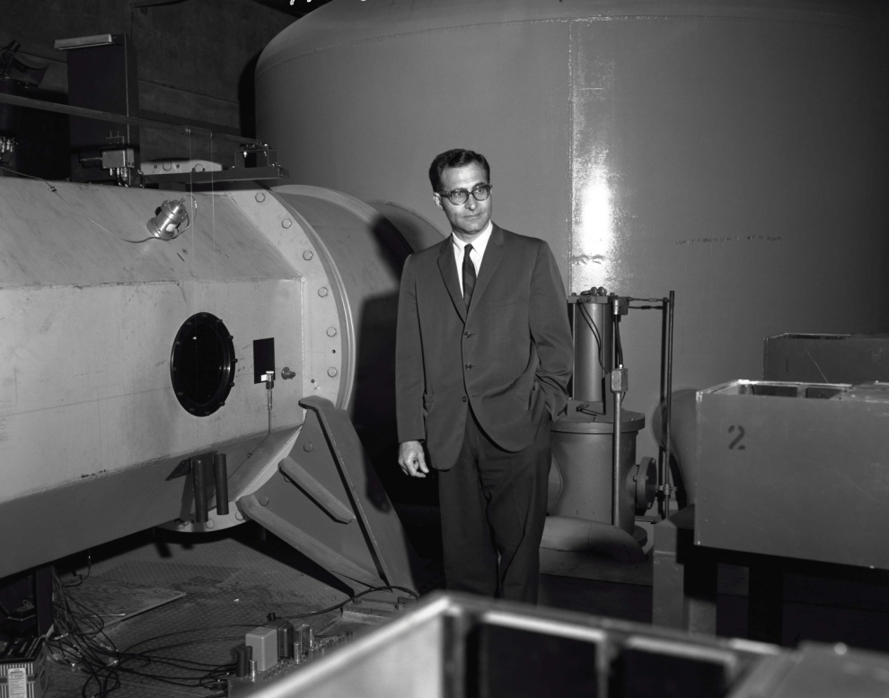
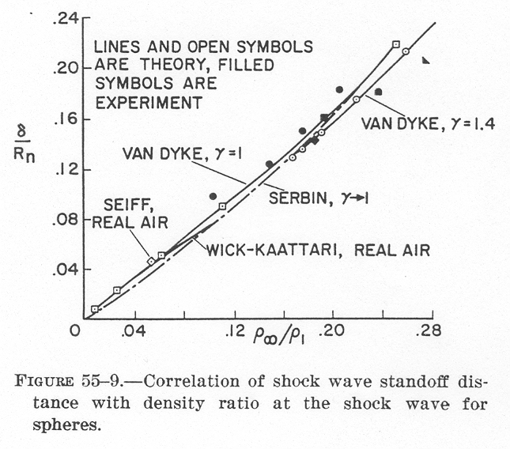
Outer boundary (Bow shock)
Bow shock location: Standoff position
Alvin Seiff at NASA Ames
Hypervelocity Free Flight Facility (1966)
Shock distance in front of a sphere:
δ/R_{n} = 0.78ρ∞/ρ
Seiff, NASA SP-24, 1962

Slide 14
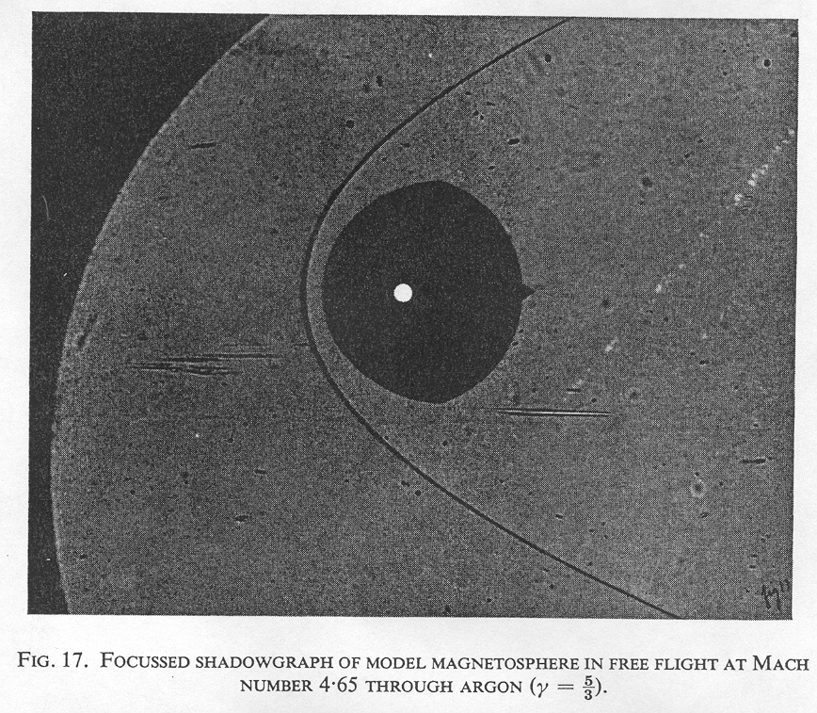
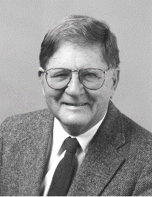
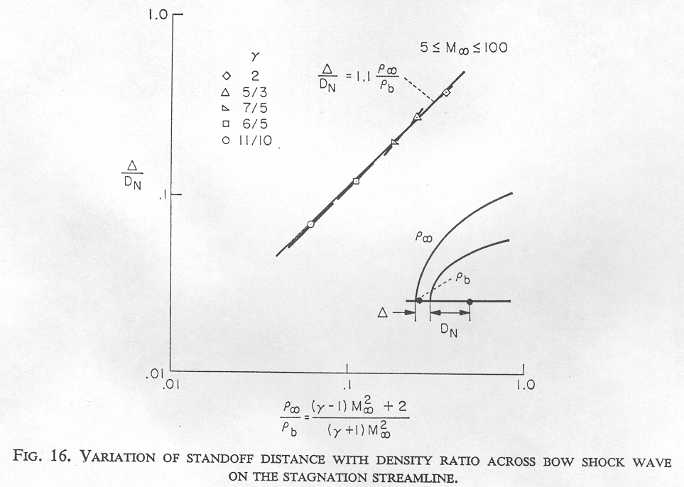
Outer boundary (Bow shock)
Bow shock location: Standoff location
John Spreiter
Bow shock
Spreiter et al., Planet. Space Sci., 1966

Slide 15
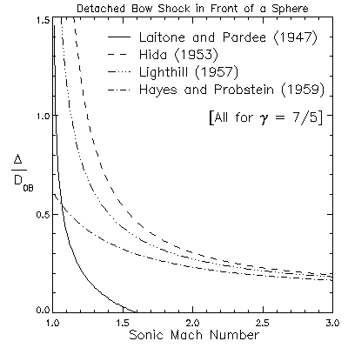
Outer boundary (Bow shock)
Bow shock location: Standoff location
(Low solar wind Mach numbers)
Historical theories of shock wave standoff location in air using hydrodynamics
(Petrinec, Planet. Space Sci., 2002)

Slide 16
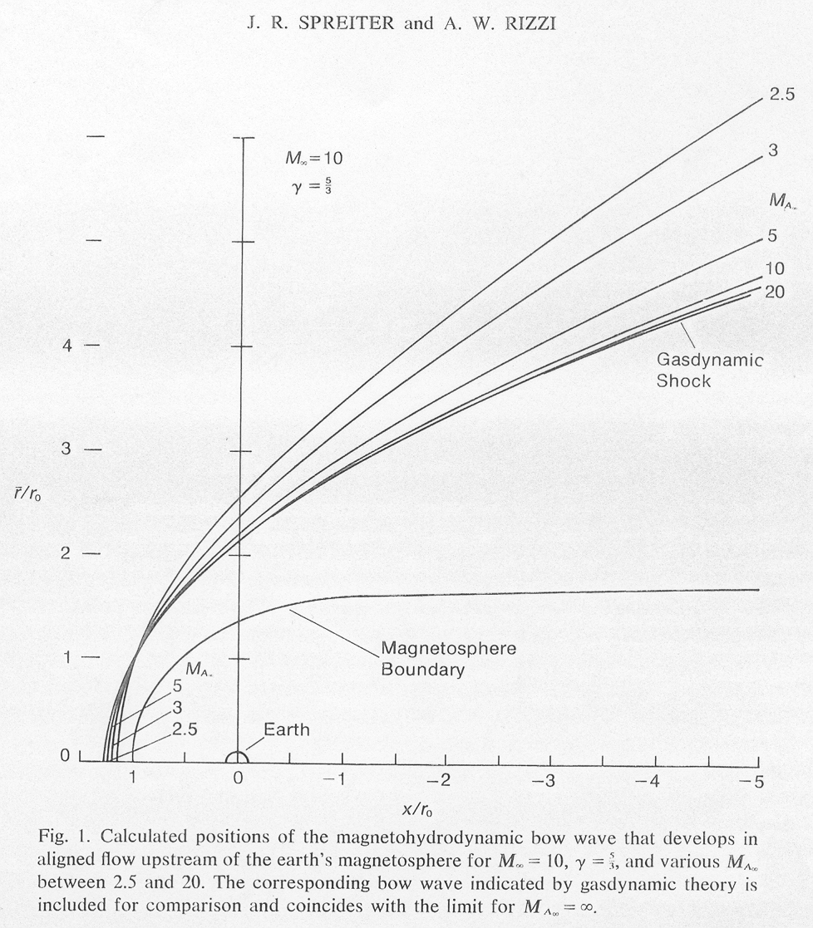
Outer boundary (Bow shock)
Bow shock location: Standoff location
(Low solar wind Mach numbers)
Spreiter and Rizzi, Acta Astron., 1974

Slide 17
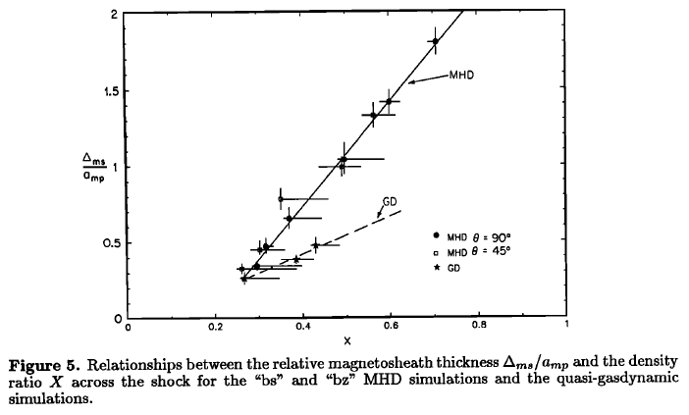
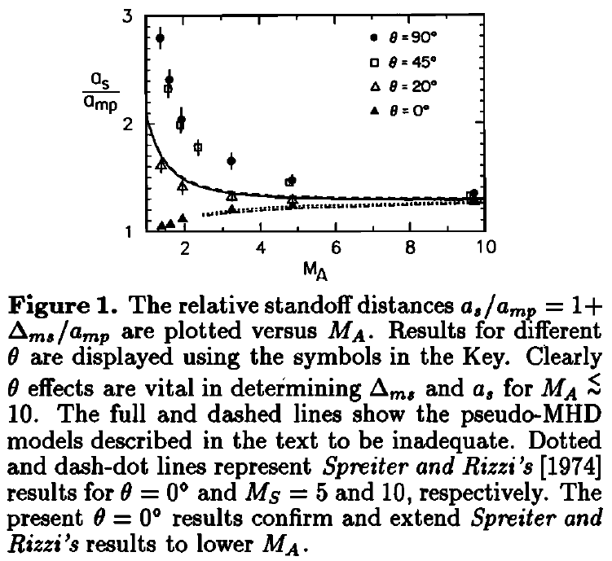
Outer boundary (Bow shock)
Bow shock location: Standoff location
(Low solar wind Mach numbers)
Δ_{ms}/a_{mp} = 3.4X-0.6
Δ_{ms}/a_{mp} = 1.1X
Cairns and Lyon, JGR, 1995
Cairns and Lyon, JGR, 1996

Slide 18
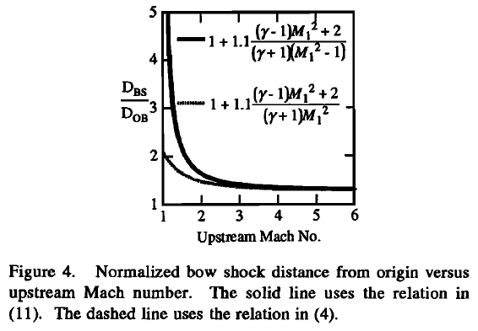
Outer boundary (Bow shock)
Bow shock location: Standoff location
(Low solar wind Mach numbers)
Farris and Russell (1994) conjecture:
For large upstream sonic Mach numbers:
ρ∞/ρ (=X) (γ−1)/(γ+1)
and
M_{s}²/(1-M_{s}²) (γ−1)/(γ+1)
Downstream and upstream sonic Mach numbers are simply related (Landau and Lifshitz, 1959):
M_{s}² = (2+(γ−1)M_{s∞} ²)(2γM_{s∞} ²−(γ−1))
So,
Δ/D_{OB} = 1.1(2X)/((1+γ)(1−X))
= 1.1((γ−1) M_{s∞} ²+2)/(γ+1)(M_{s∞} ²−1))
Farris and Russell, JGR, 1994

Slide 19
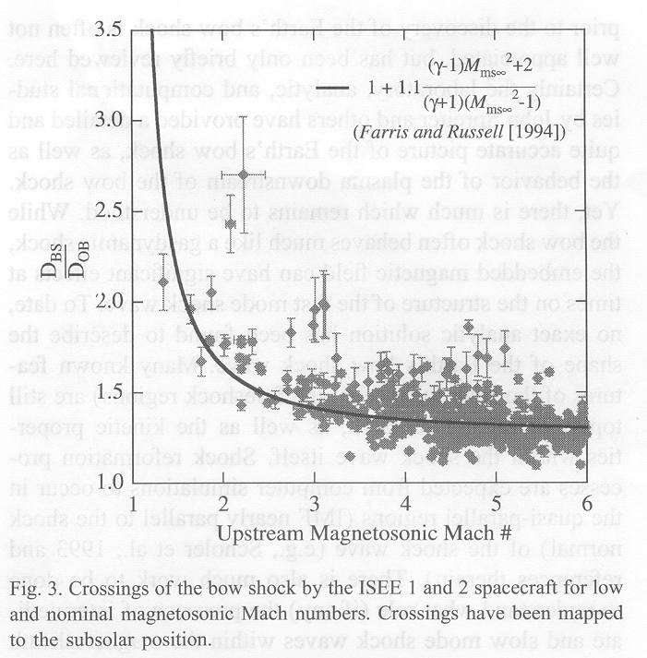
Outer boundary (Bow shock)
Bow shock location: Standoff location
(Low solar wind Mach numbers)
(Petrinec, Planet. Space Sci., 2002)

Slide 20
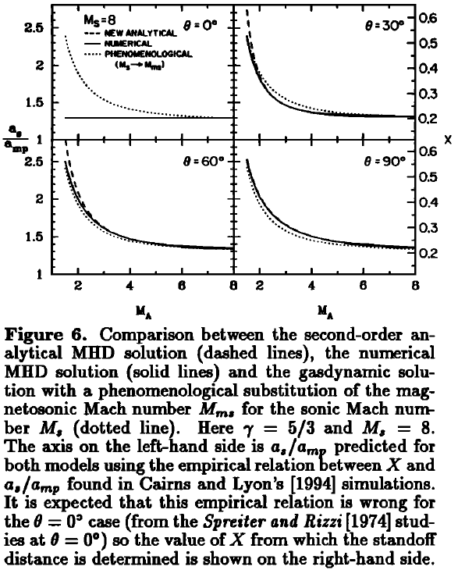
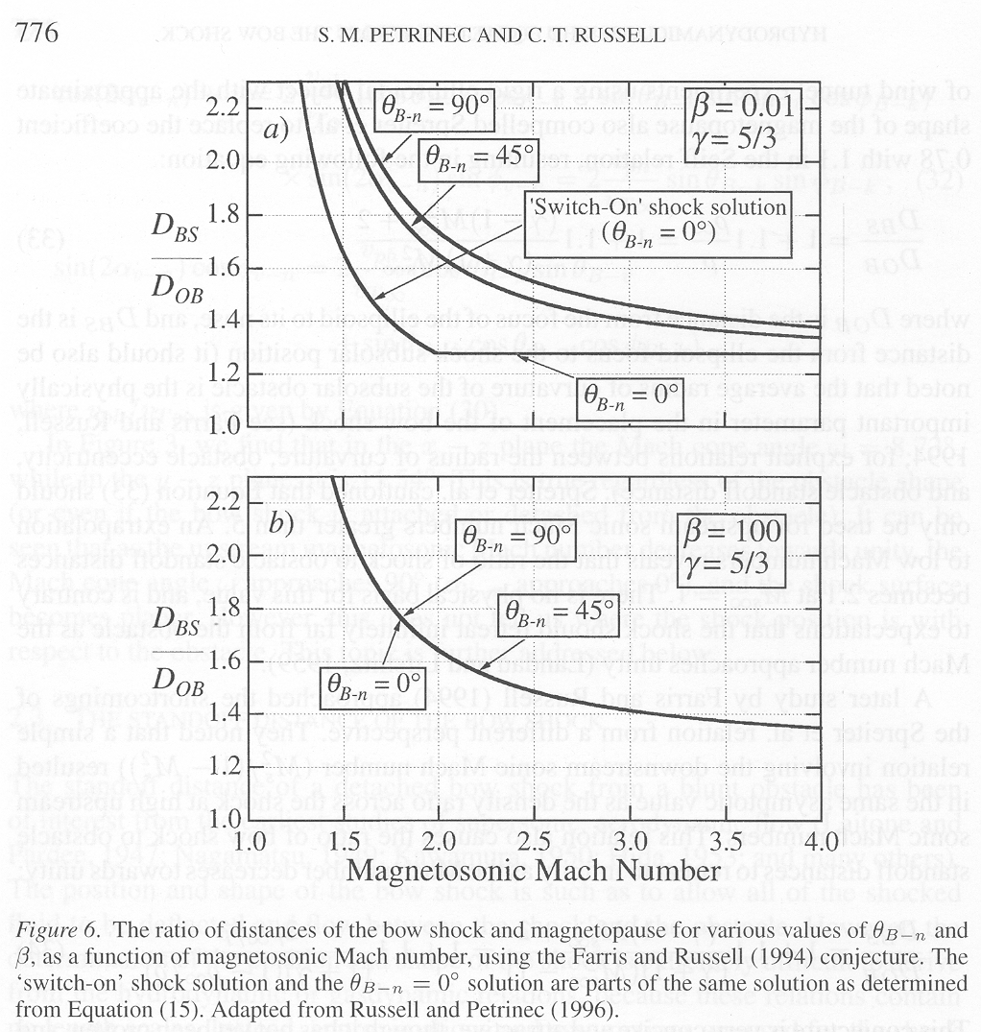
Outer boundary (Bow shock)
Bow shock location: Standoff location
(Low solar wind Mach numbers)

Slide 21
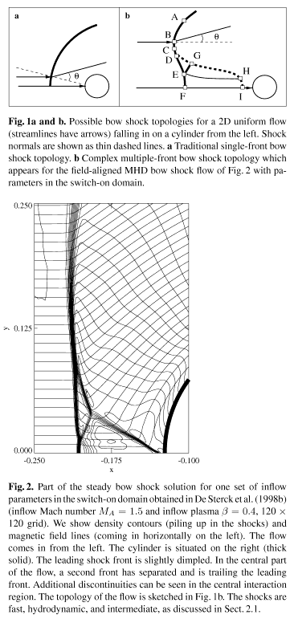
Outer boundary (Bow shock)
Bow shock location: Standoff location
(Low Alfvén Mach number, θ_{Bn} = 0)
De Sterck and Poedts, Astron. Astrophys., 1999

Slide 22
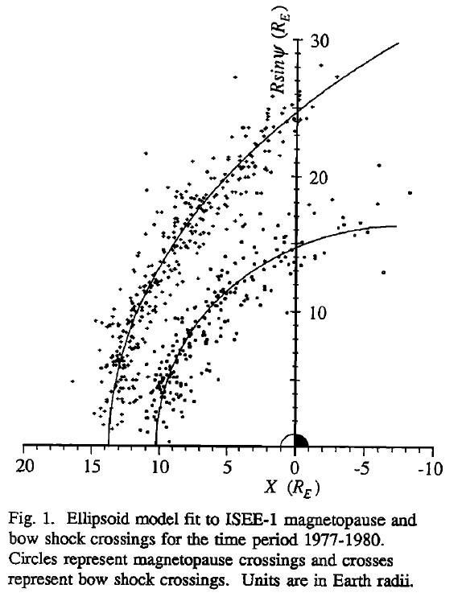
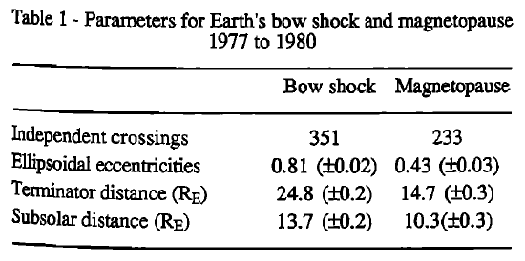
Outer boundary (Bow shock)
Outer boundary (Bow shock)
Bow shock shape
Farris et al., GRL, 1991
Bow shock
Good approximation for the dayside shock, but since it is an ellipsoid and does not asymptote, is not appropriate for the nightside.
Other empirical Earth bow shock models:
Fairfield, JGR, 1971
Formisano, Planet. Space Sci., 1979
Slavin and Holzer, JGR, 1981
Peredo et al., JGR, 1995

Slide 23
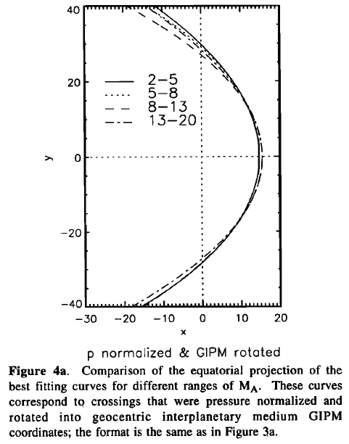
Outer boundary (Bow shock)
Bow shock shape
Peredo et al., JGR, 1995

Slide 24
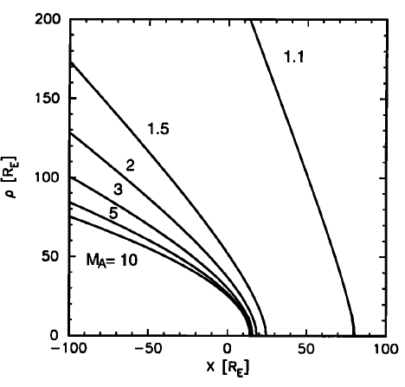
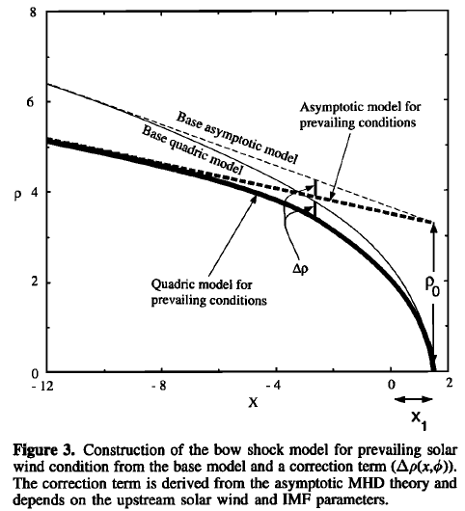
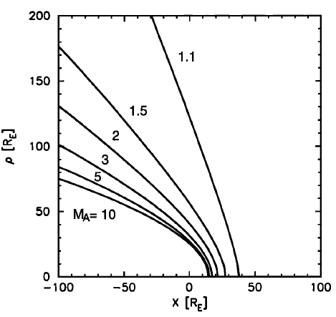
Outer boundary (Bow shock)
Distant bow shock shape
Farris and Russell
model
Khurana and Kivelson, JGR, [1994]
Cairns and Lyons
model
Khuarana and Kivelson model for asymptotic flaring angle correction used to extend various dayside bow shock models (Bennett et al., JGR, 1997)

Slide 25
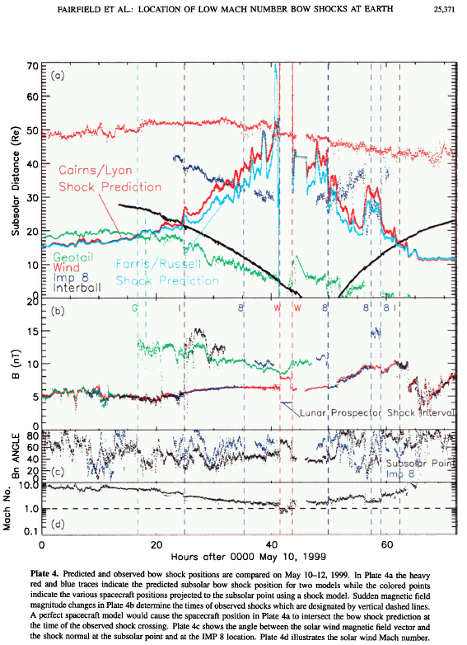
Outer boundary (Bow shock)
Bow shock shape at low Mach number
Fairfield et al., JGR, 2001

Slide 26
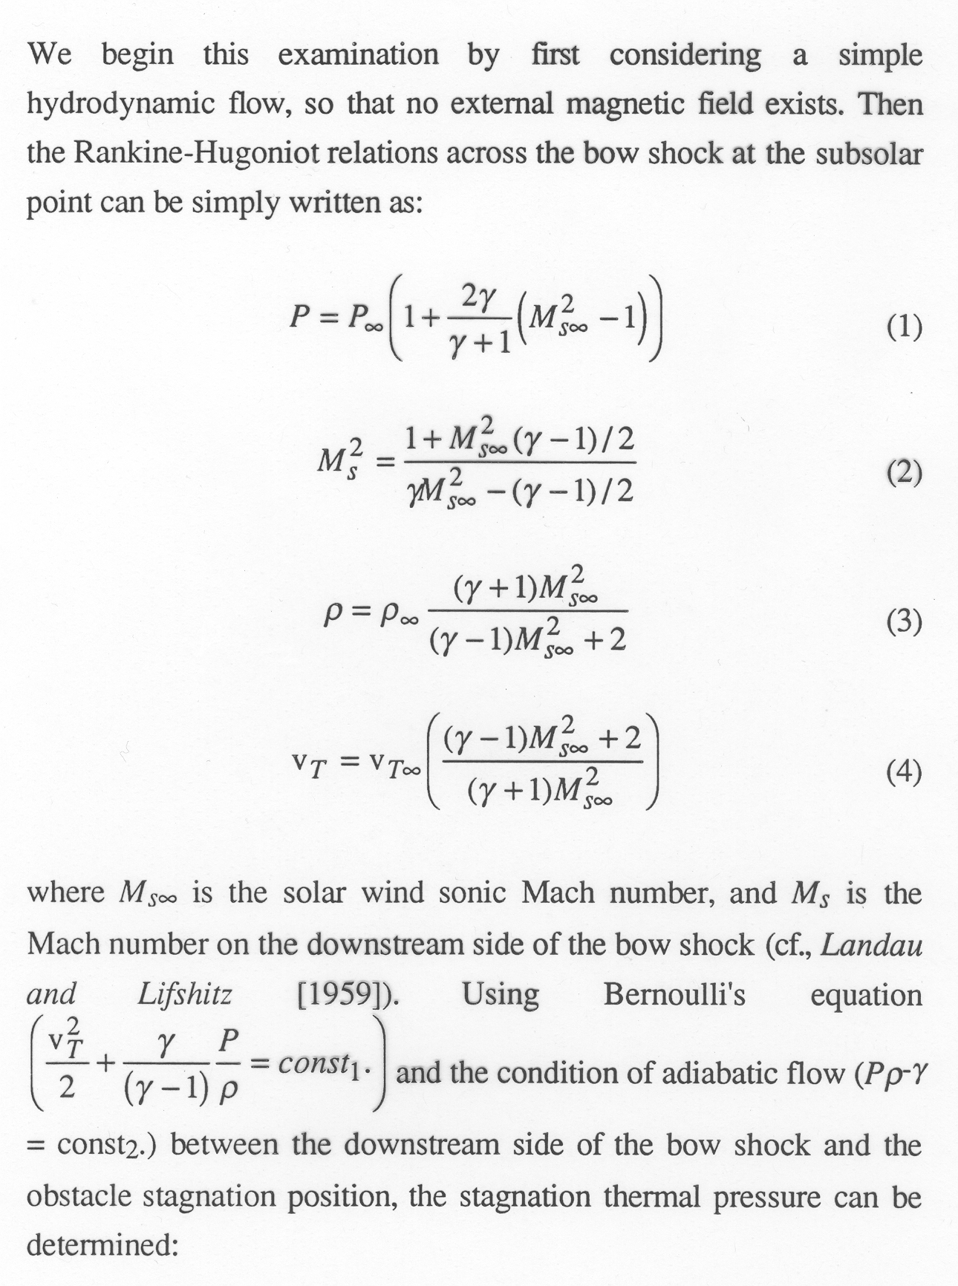
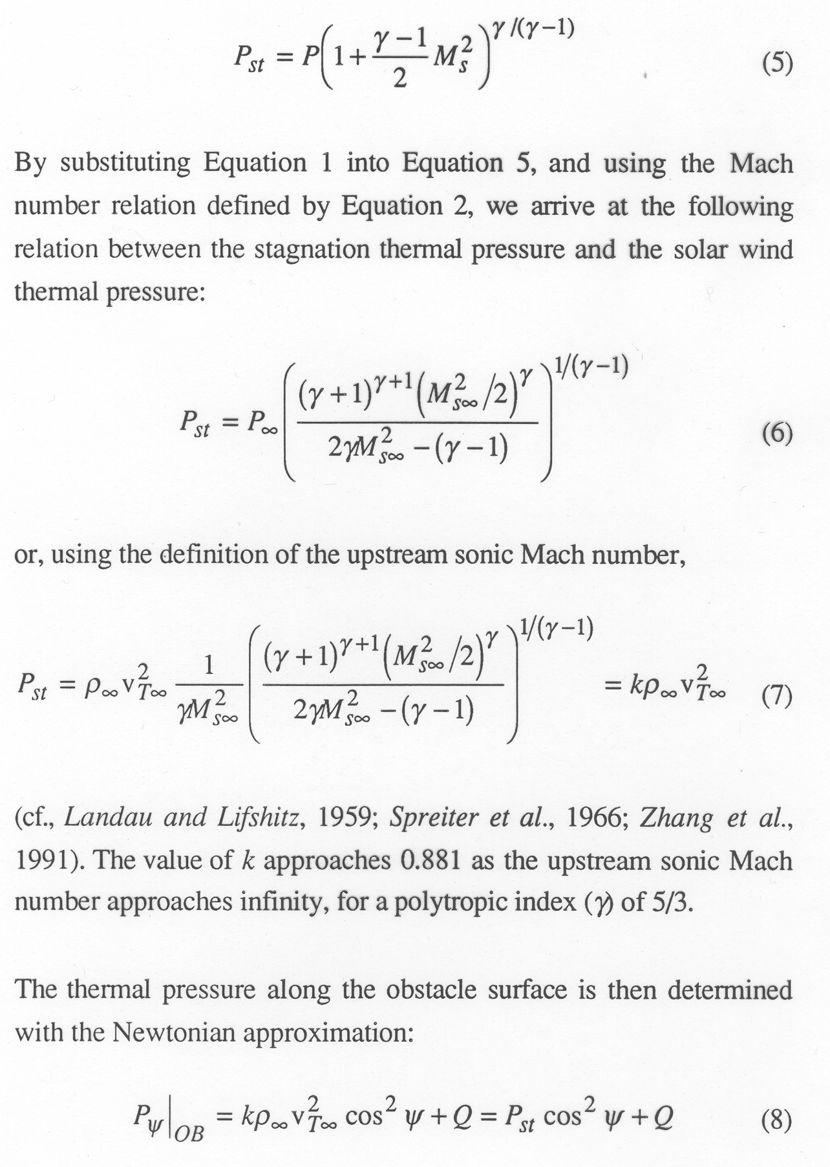
Inner boundary (Along the magnetopause)
Hydrodynamic parameters along inner boundary

Slide 27
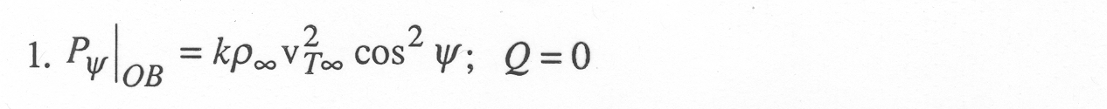
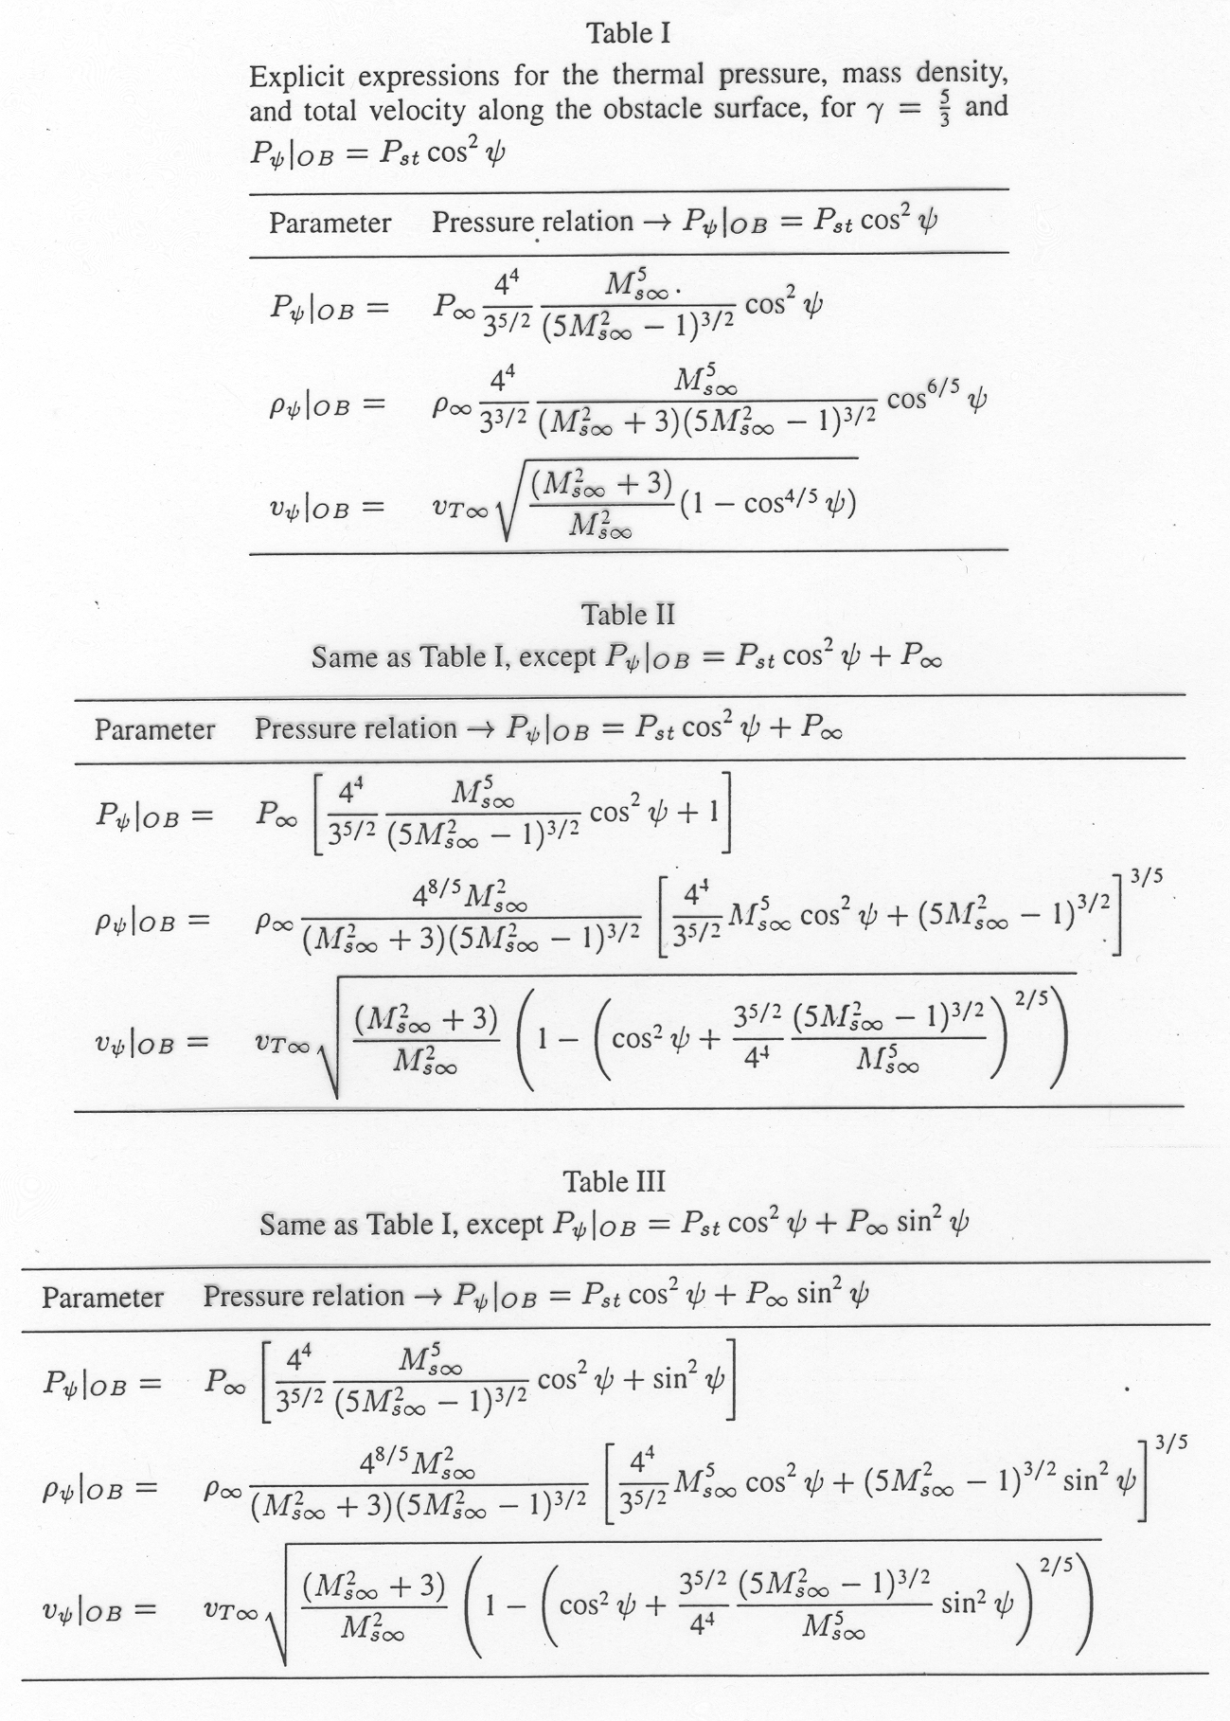
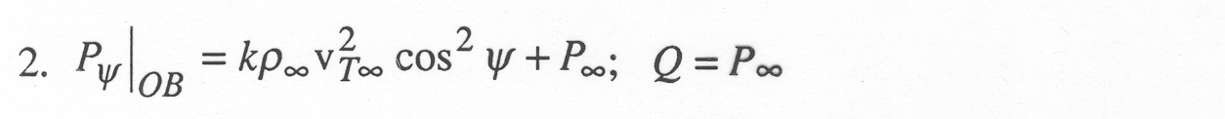
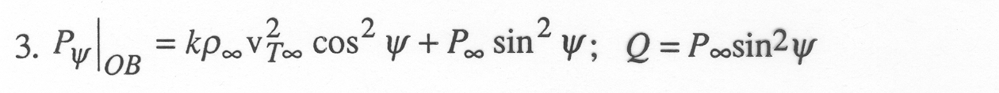
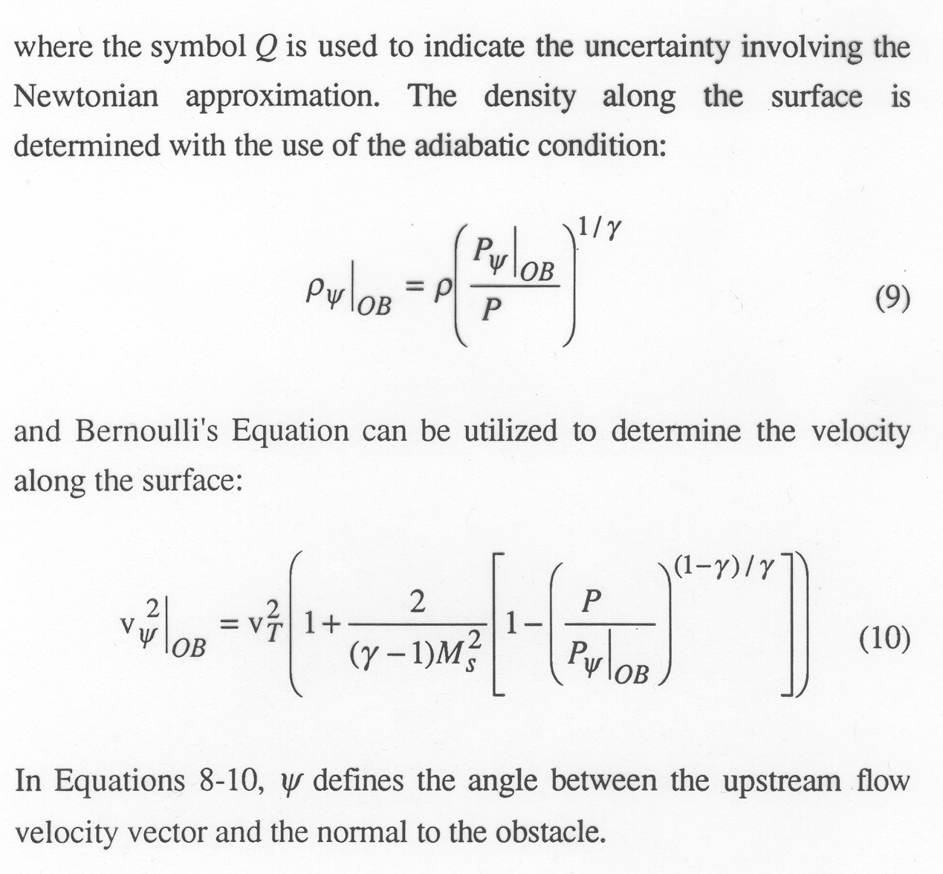
Inner boundary (Along the magnetopause)
Hydrodynamic parameters along inner boundary

Slide 28
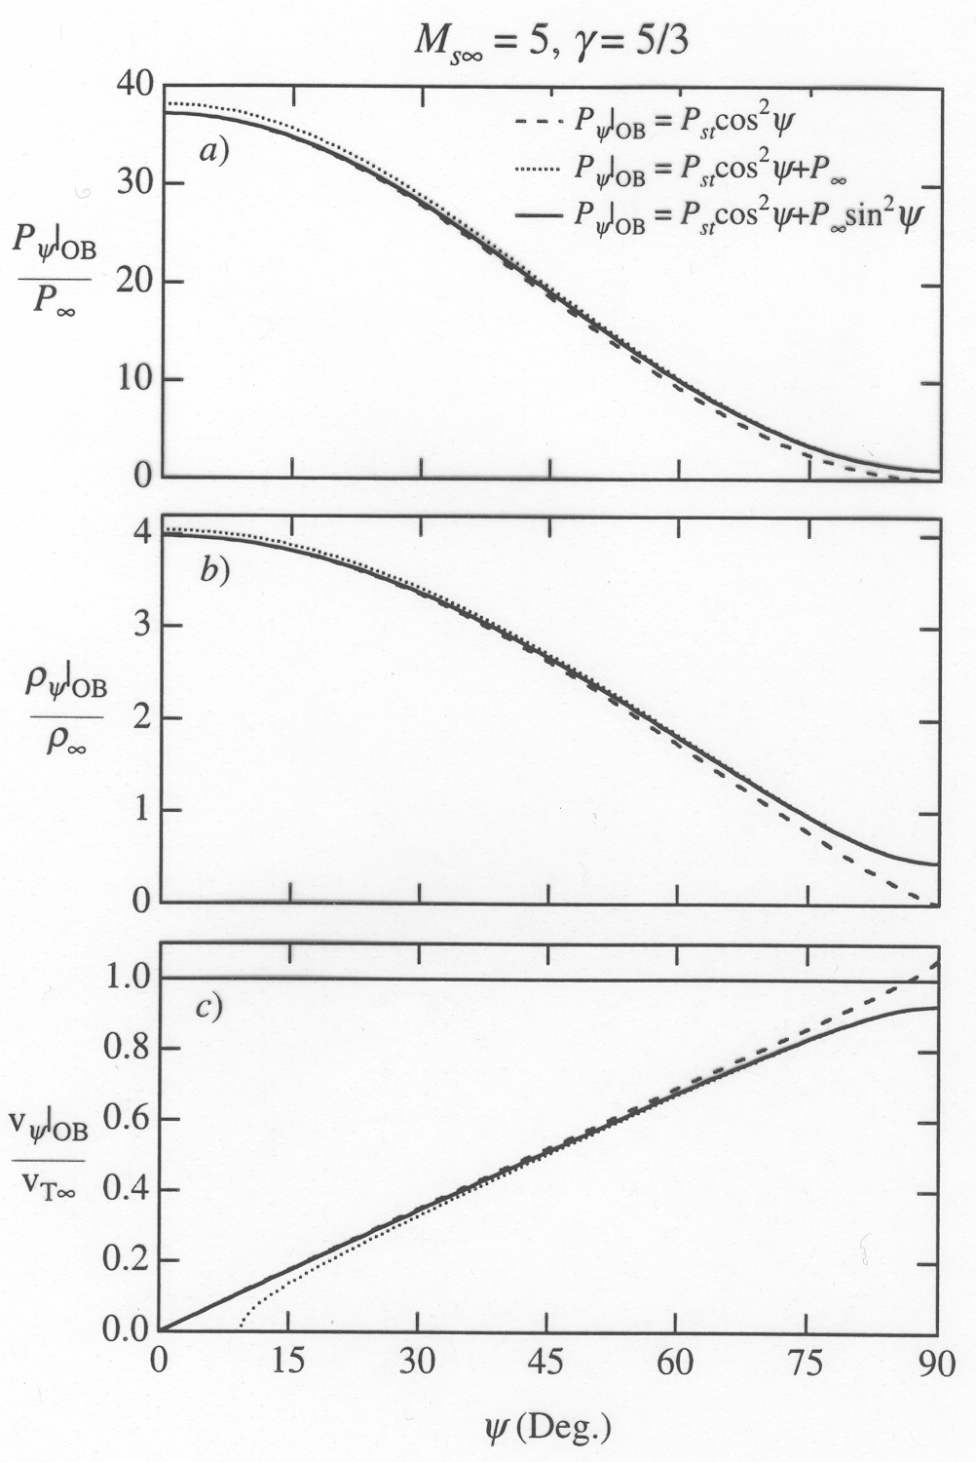
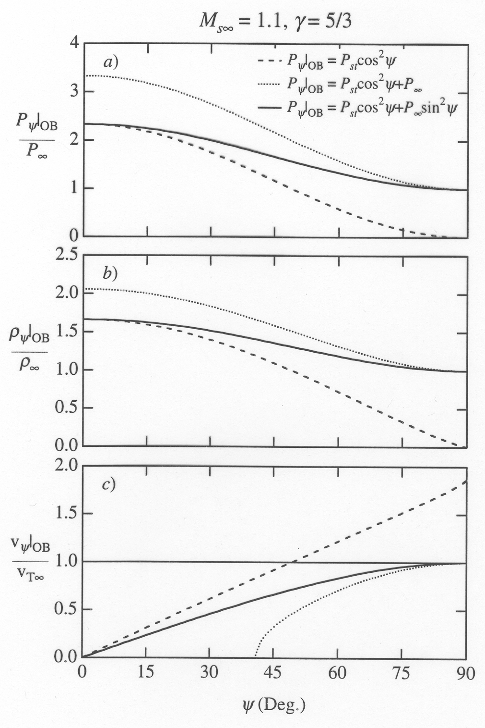
Inner boundary (Along the magnetopause)
Plasma parameters along inner boundary

Slide 29
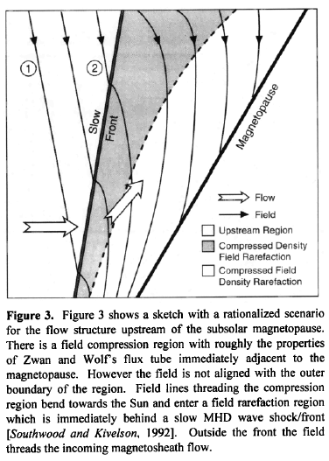
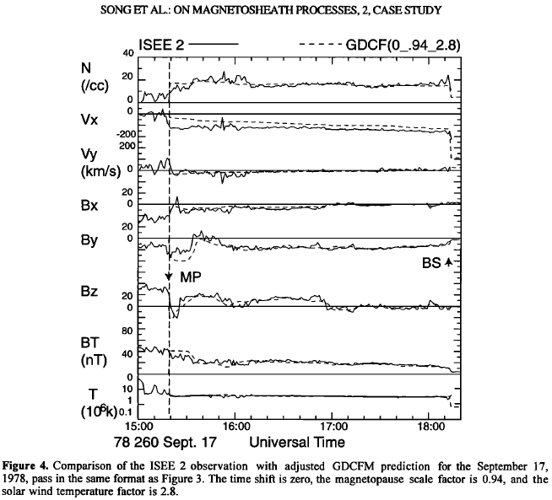
Inner boundary (Along the magnetopause)
MHD features – slow mode shock and plasma depletion layer

Slide 30
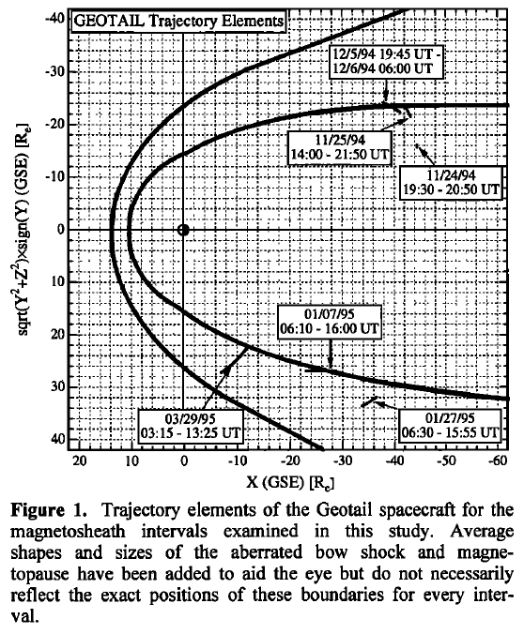
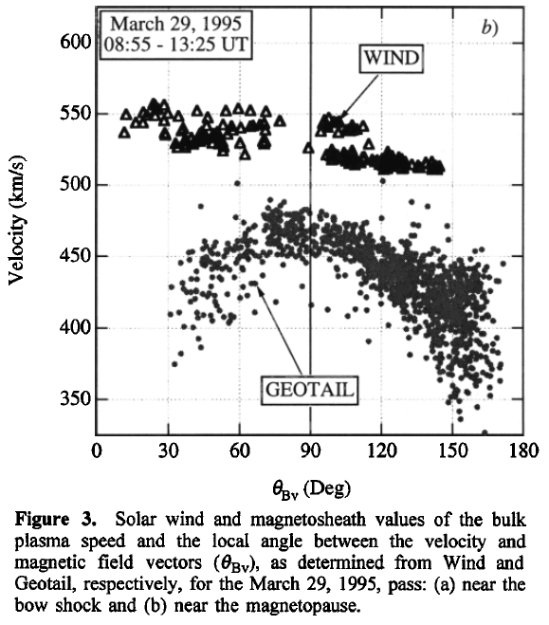
Inner boundary (Along the magnetopause)
Sources of accelerated flows

Slide 31
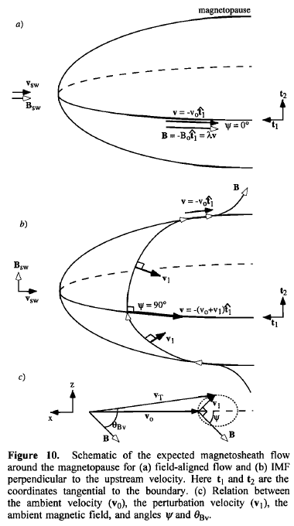
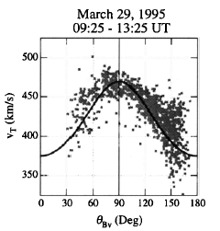
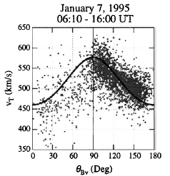

Inner boundary (Along the magnetopause)
Sources of accelerated flows
V_{A}

Slide 32

Inner boundary (Along the magnetopause)
Sources of accelerated flows

Slide 33


Inner boundary (Along the magnetopause)
Sources of accelerated flows
Lavraud et al., GRL, 2007
Accelerations are calculated along the streamlines according to the steady state MHD momentum equation

Slide 34



Within the magnetosheath
Spreiter et al., Planet. Space Sci., 1966

Slide 35

Within the magnetosheath
Spreiter et al., Planet. Space Sci., 1966

Slide 36

Within the magnetosheath
Analytic models of the magnetosheath magnetic field
Kobel and Flückiger, JGR, 1994
Romashets et al., JGR, 2008
Surface shapes:
Bow shock and magnetopause are modeled as paraboloids with a common focus, (halfway between the magnetopause nose and the Earth center)
Procedure:
Procedure:
Determine a magnetosheath scalar magnetic potential for which:
The normal magnetic field component is conserved across the bow shock
The magnetic field is tangential to the magnetopause.
Current-free within the magnetosheath region
Determine a magnetosheath vector magnetic potential for which:
The normal magnetic field component is conserved across the bow shock
Magnetic field is coplanar across the bow shock
The magnetic field change decreases to zero across the distant downstream bow shock
The magnetic field is tangential to the magnetopause
Non-zero currents are allowed within the magnetosheath

Slide 37
Within the magnetosheath
Spacecraft used: Geotail (magnetosheath), Wind (solar wind)
Span of time: 4/1996 – 10/2005
Magnetosheath passes: 2894 (bs-bs, mp-bs, mp-mp)
Caveats:
1. 5-min averages not all statistically independent
2. Orbital bias:
10 R_{E} perigee – subsolar region more often
sampled during low s.w. pressure
30 R_{E} apogee – flanks more often sampled at
high s.w. pressure

Slide 38
Within the magnetosheath
Potential problems (placing boundaries):
Misidentification
Solar wind pressures not accurate (n_{H+}, n_{He++}, etc.)
Wind spacecraft too far off Sun-Earth axis
Estimated solar wind convection time incorrect
Short-term oscillations of the boundaries not accounted for
Discontinuities in the solar wind and traveling through the magnetosheath

Slide 39
Within the magnetosheath
Geotail MGF observations

Slide 40
Within the magnetosheath

Slide 41
Within the magnetosheath
Geotail MGF observations
Petrinec and Russell,
Space Sci. Rev, 1997

Slide 42


Within the magnetosheath
Geotail MGF observations
Petrinec and Russell,
Space Sci. Rev, 1997

Slide 43
Within the magnetosheath
Geotail MGF observations

Slide 44
Within the magnetosheath
Geotail CPI observations
Spreiter et al., PSS 1966

Slide 45

Within the magnetosheath
Geotail CPI observations
Paularena et al., JGR, 2001
GEM Summer Workshop: 20-27 June 2009

Slide 46
Within the magnetosheath
Geotail CPI observations
Spreiter et al., PSS 1966

Slide 47



Within the magnetosheath
Cluster comparison:
Longmore et al., Ann. Geophys. (2005)
Velocity Ratio
Z_{aGSM} < 0
Velocity Ratio
Z_{aGSM} > 0
Authors conclude that higher velocities are seen in the dusk magnetosheath north of the equator; higher in the dawn south of the equator. Not supported by Geotail observations.

Slide 48
Within the magnetosheath
Low solar wind Mach number; IMF along Parker spiral

Slide 49
Within the magnetosheath
High solar wind Mach number; IMF along Parker spiral

Slide 50
Summary
The magnetosheath contains many features. Some are fairly well-understood, while others are not. Observations are very important for determining the weaknesses, and for constraining analytic and MHD models. The difficulty with in situ observations is placing them in spatial context with respect to the boundaries, and accurately matching with the solar wind.
The most prevalent physical phenomena in the outer magnetosheath include plasma compression, diversion, and heating, beams, and plasma instabilities. The inner edge of the magnetosheath is where the slow mode discontinuities and plasma depletion layers occur. The interaction between the solar wind and the magnetosphere (primarily via the reconnection process) also occurs at the inner edge of the magnetosheath.

