Slide 1
GEM Summer Workshop, June 20, 2012
Empirical geomagnetic field modeling
M. Sitnov
(JHU/APL)
In collaboration with G. Stephens, A. Ukhorskiy, P. Brandt, B. Anderson, H. Korth, J. Vandegriff, and N. Tsyganenko

Slide 2
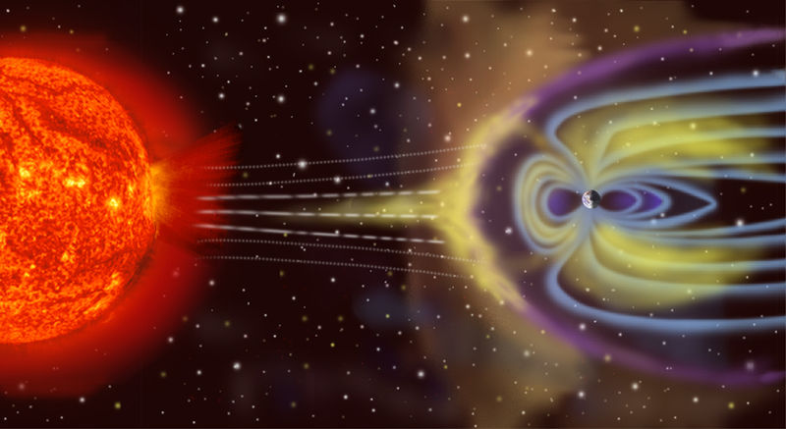
Magnetosphere

Slide 3
Earth’s magnetosphere
- How to get its global picture?
Courtesy David Stern

Slide 4
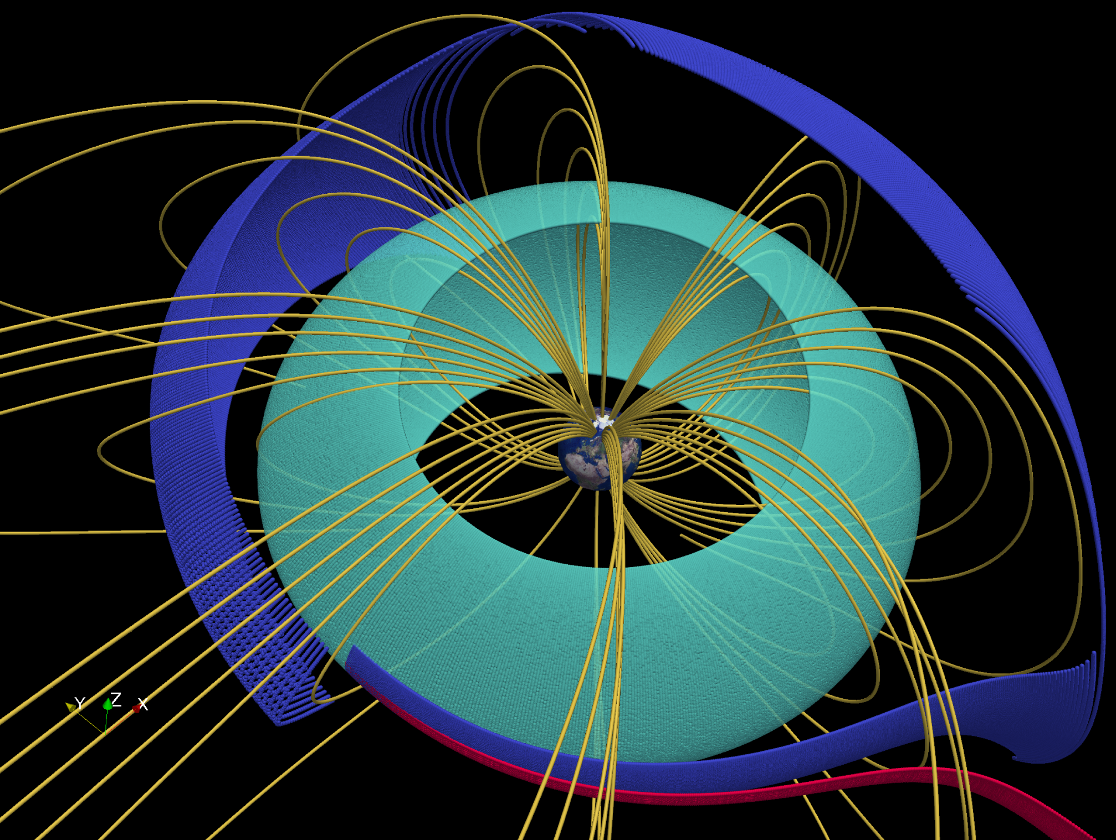
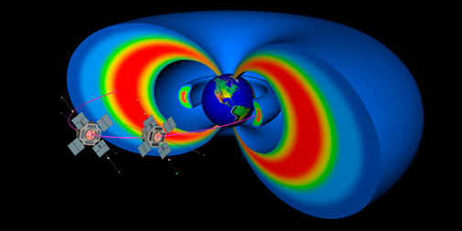
Space Weather/RBSP: Modern challenge for geomagnetic field modeling
Ukhorskiy et al. [2011]

Slide 5
http://www.bu.edu/cism/CISM_Thrusts/modelsandcoupling.html

Slide 6
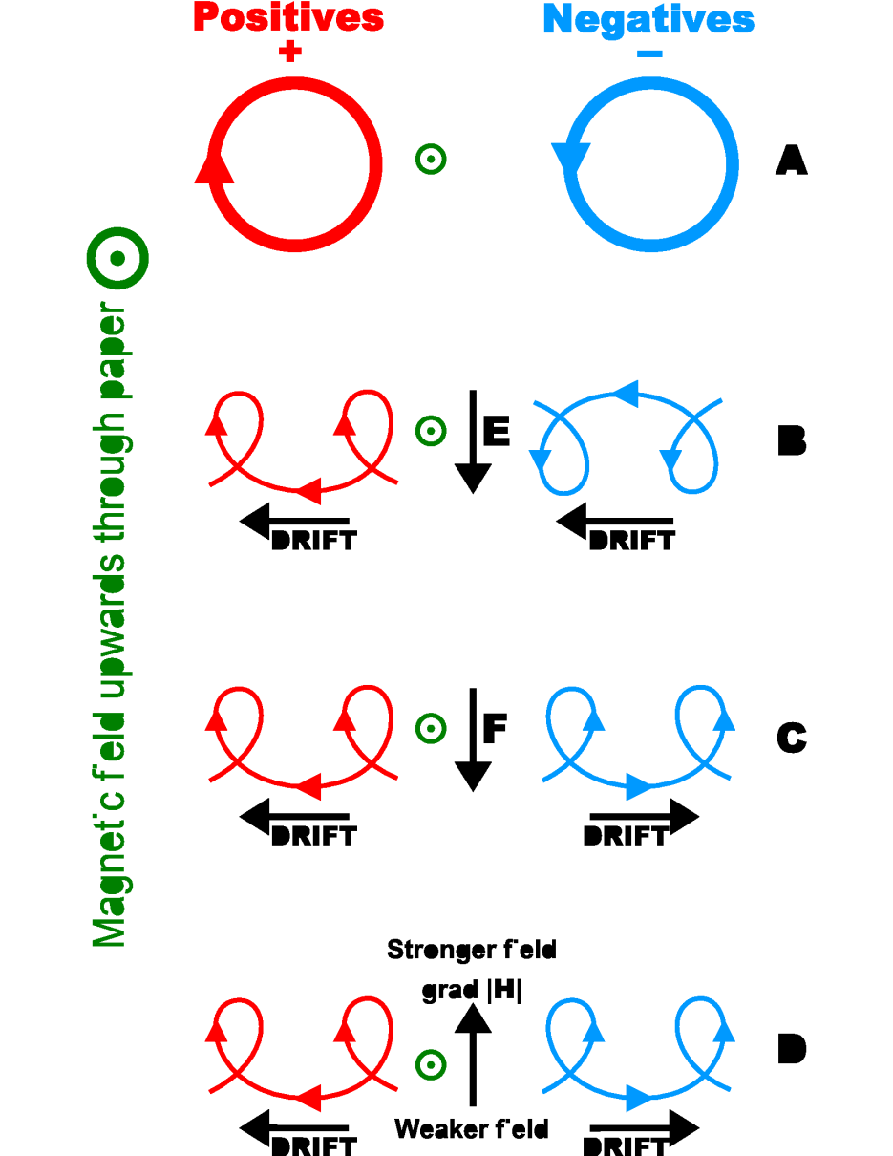
First-principles modeling limitations: MHD
Particle drifts: Curvature and gradient drifts are not described by a single-fluid MHD model
Wave-particle interactions: play very important role as a mechanism of the ring current buildup and decay
MHD equation of state (adiabatic) does not describe plasma kinetics of magnetic storms
MHD models cannot fully describe the storm-time ring current

Slide 7
Kinetic ring current models
Wolf et al. [1983], Chen et al. [1994], Fok et al. [1995; 2001], Jordanova et al. [1996], Ridley and Liemohn [2002]
Zaharia et al. [2006]: April 2001 storm
Slow-flow approximation
Boundary conditions (often geosynchronous)
Limited self-consistency
Coupled MHD-Ring current models: De Zeeuw et al. [2004], Toffoletto et al. [2004], Buzulukova et al. [2010], Hu et al. [2010] Zaharia et al [2010], Pembroke et al. [2012]
Is there at present a global first-principle code capable of describing the evolution of the storm-time magnetosphere?

Slide 8
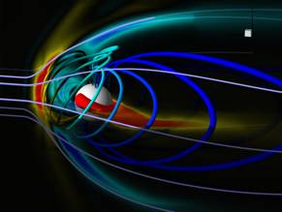
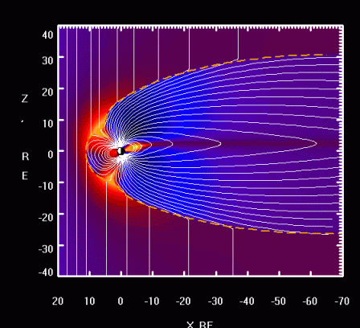
First-principles and empirical approaches
First-principles approach
Inner boundary conditions
(Ionosphere)
Solar wind input
(B, n, v, T)
Output
(B, n, v, T)
Maxwell and Vlasov equations
Plasma model
(MHD, kinetic, hybrid)
Empirical approach
Training output
(B, database)
Predefined modules or
regular expansions
Solar wind input
(B, n, v, P)
Output (B)
Model structure (divB=0, divJ=0)

Slide 9
T≤05 and TS07D …Only Tsyganenko models?
Earlier models: Mead and Fairfield [1975]; Olson and Pfitzer [1977]; Alexeev et al. [1996]
Recent contributions: Le et al. [2004]; Ganushkina et al. [2004]; Zaharia et al. [2005]; Yang et al. [2012]
Equatorial ring current distribution for different activity levels [Le et al., 2004]
Tsyganenko-class models are freely available as open source codes

Slide 10
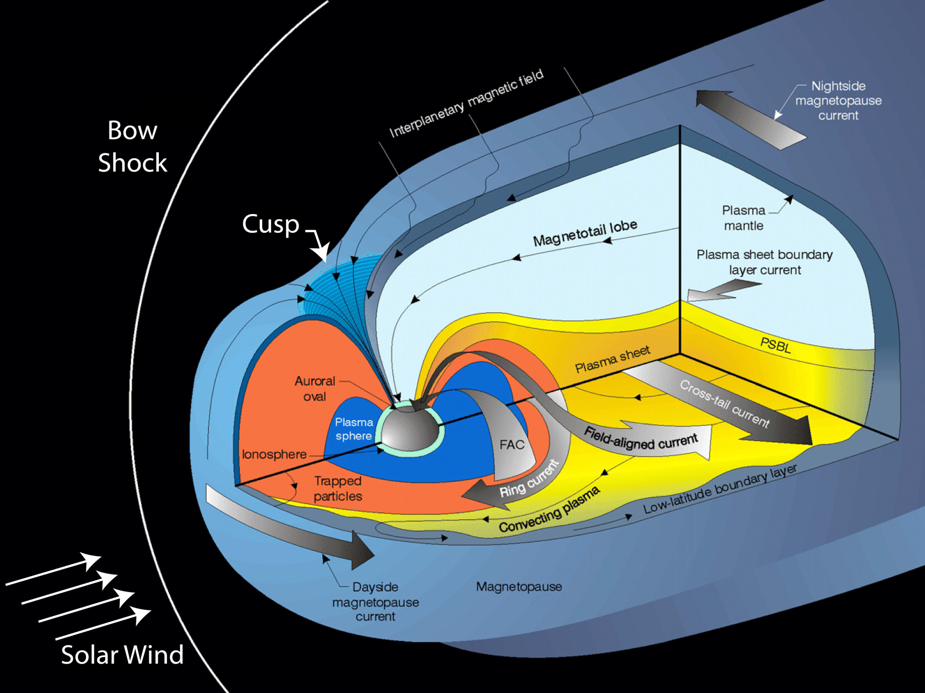
Classical empirical geomagnetic field models
TS05 model:

Slide 11
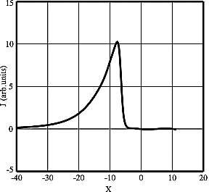
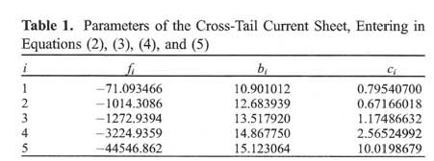
TS05 model: Structure
Tail modules
Modules are custom-made, sophisticated, but hard to interpret and generalize (to further improve spatial resolution)

Slide 12
TS05 model: Input and data binning
Tail modules
TS05 binning is “climatological” (several universal response functions). Yet, it is quite sophisticated and it may take into account important solar wind and IMF features.

Slide 13
TS05 model usage
Model website:
http://geo.phys.spbu.ru/~tsyganenko/modeling.html

Slide 14
Transition to TS07D model: Using huge amount of data to increase resolution and remove model constraints
Data from GOES 12, Imp-8, Polar, Geotail, and Cluster
POLAR (red)
GOES-12 (yellow)
Cluster (magenta)
Geotail (blue)
IMP 8 (black)

Slide 15
TS07 model : Spatial structure
Sample basis function
Basic idea: Magnetic field of an axisymmetric current disc [Tsyganenko, 1989]
Ampere’s equation
z
J_{φ}
Solution
y
x
Finite sum form:

Slide 16
Modeling field-aligned currents
Currents corresponding to
deformed magnetic field
Main module [Tsyganenko, 2002]
Undeformed
conical current
Field-aligned currents
Equatorial currents
“Quadrupole” current
Coupling with equatorial currents
“Quadrupole” current
Axisymmetric current
Partial ring current

Slide 17
It is moving!

Slide 18
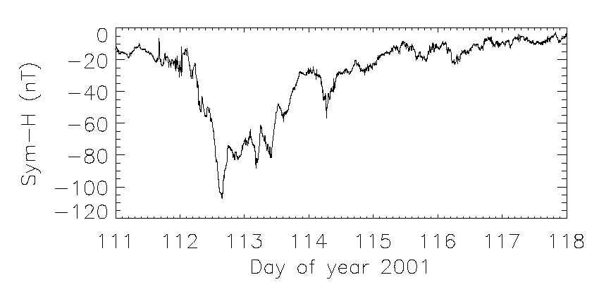
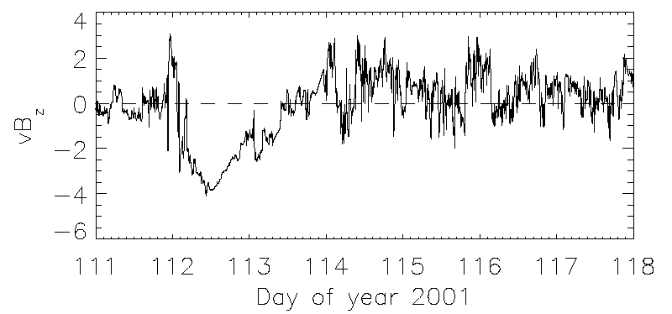
TS07D: Dynamical system approach to data mining
Magnetosphere as a black box:
IMP 8, Wind, ACE
Ground magnetometers
vB_{z}
Magnetosphere
Sym-H
Solar wind electric field
Sym-H index
Main phase
Recovery phase
Burton et al. [1975]:

Slide 19
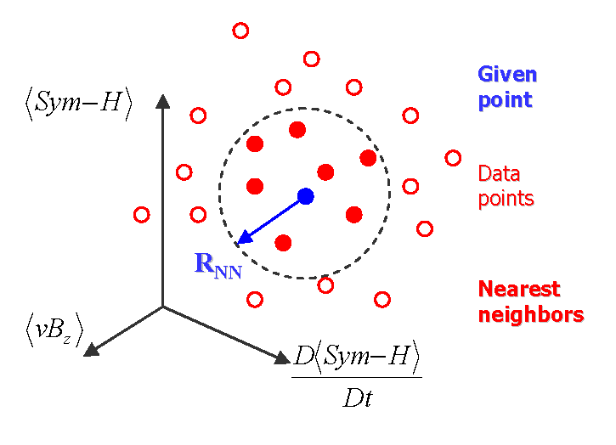
TS07D: Nearest neighbor method
A small subset of the whole database is used to fit the model with data at the time of interest. It consists of points that neighbor the magnetosphere at that time in its state space.
T/4=6 hours – we only consider storm scales
Global parameter state space of the storm-time magnetosphere
G_{NN}^{(i)} – nearest neighbors

Slide 20
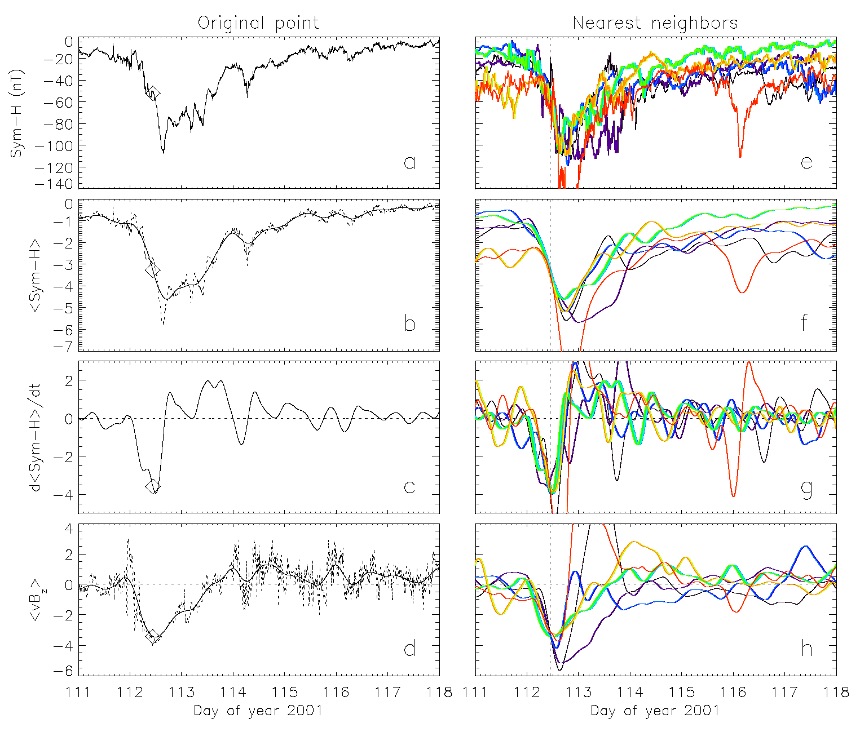
NN technique: April 2001 storm
Sitnov et al. [2008]

Slide 21
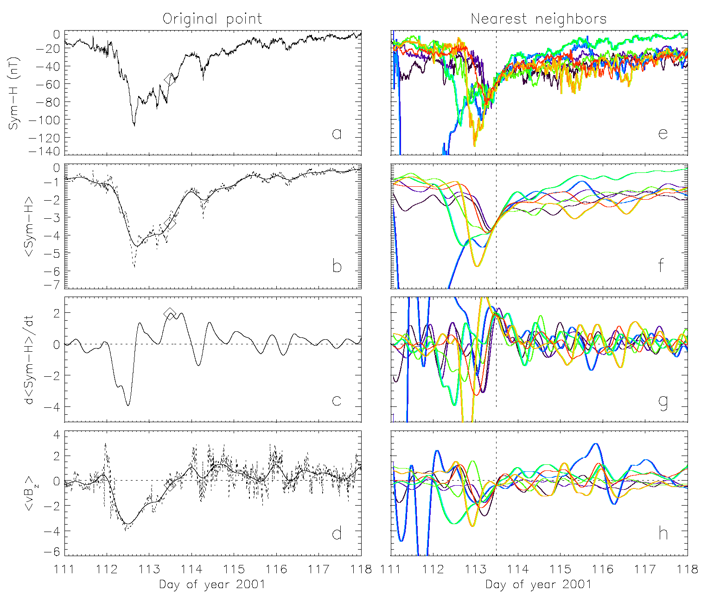
NN technique: April 2001 storm
Sitnov et al. [2008]

Slide 22
Nearest neighbor selectivity
NN=8000
NN algorithm provides a balance between earlier statistical models like T89, 96, 05 (NN=N_{database}~10⁶) and event oriented models (NN<~10).

Slide 23
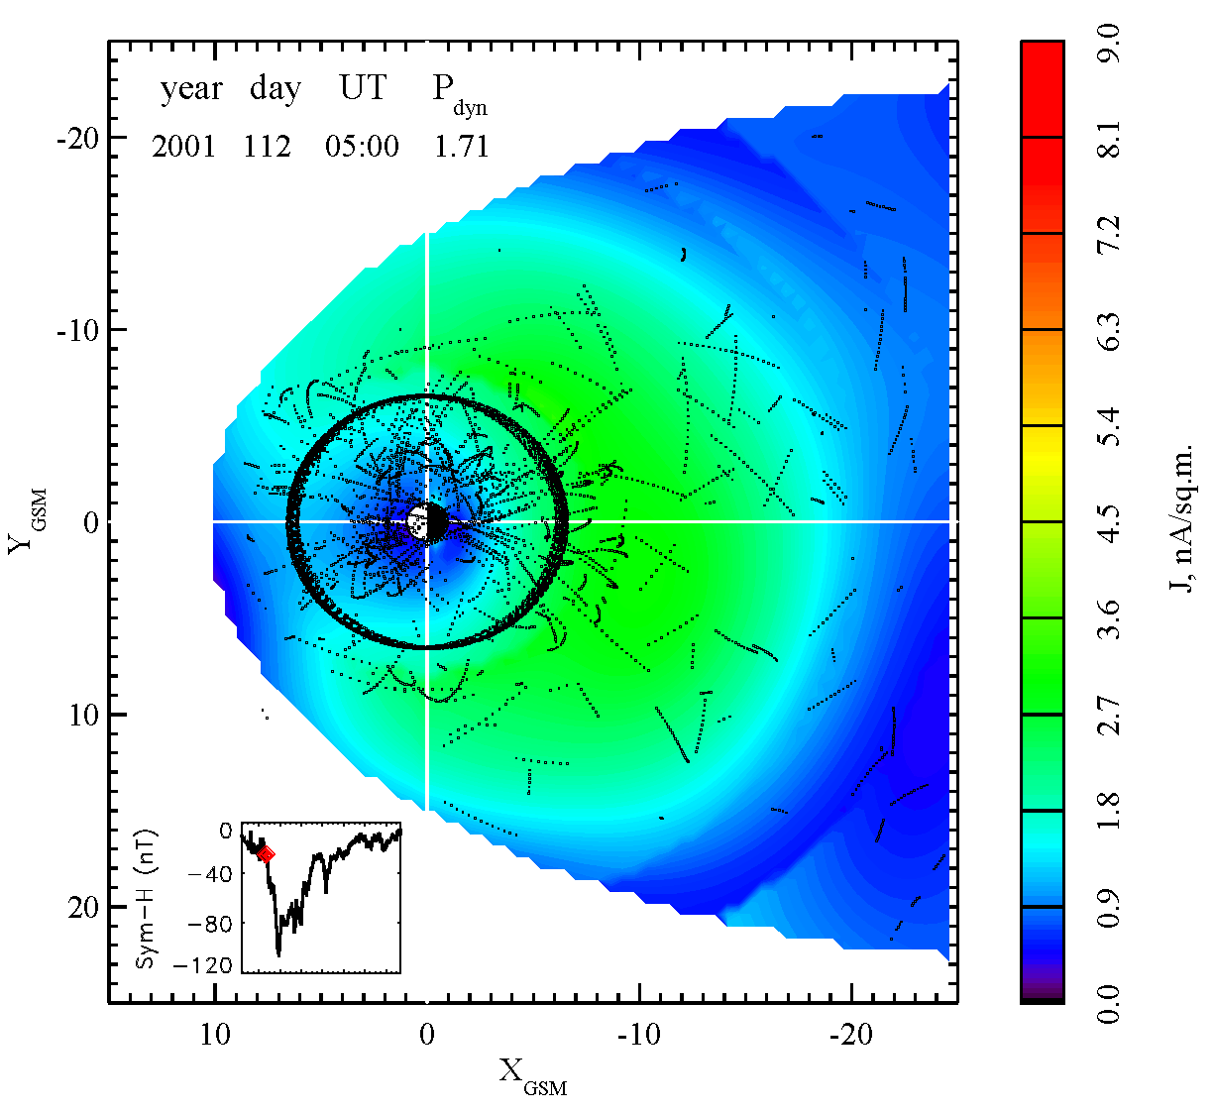
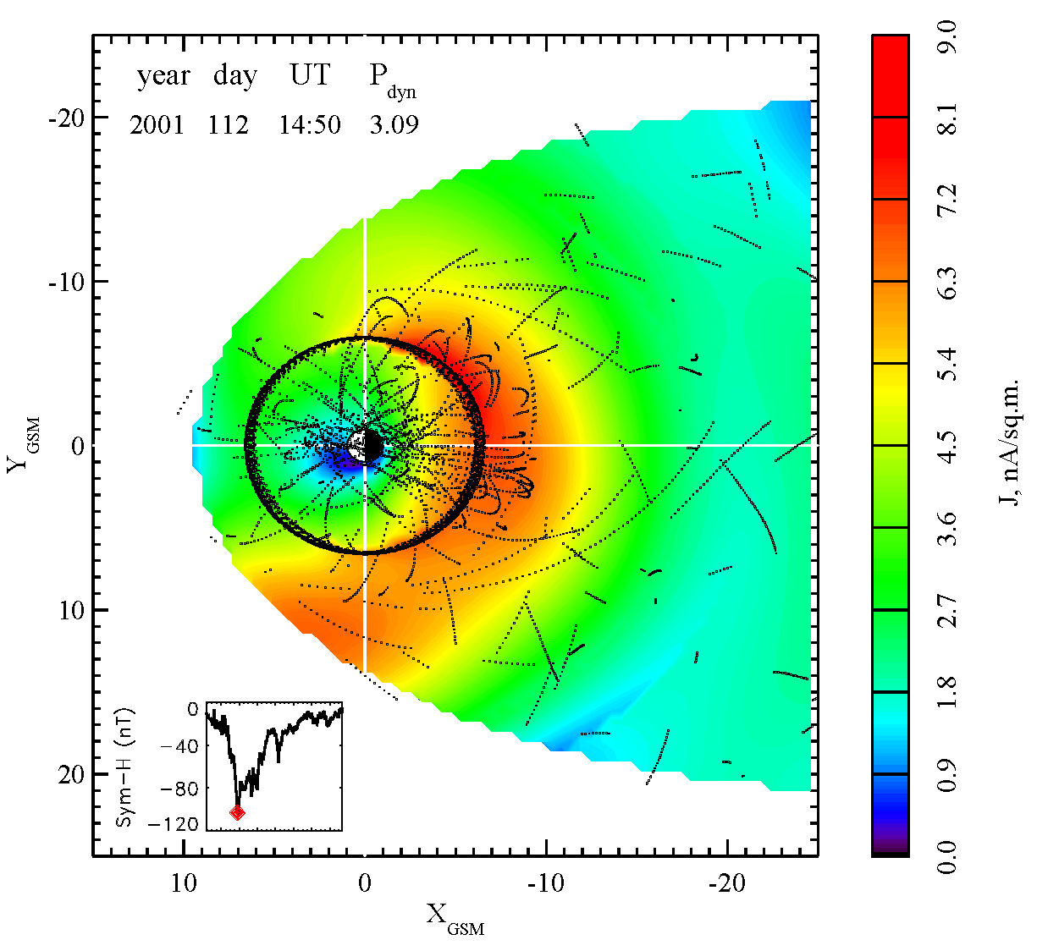
Instantaneous subsets of magnetic field data
TS07D has 5 global parameters in total: <Sym-H>,D<Sym-H>/Dt, <vB_{z}> plus P_{dyn} and tilt angle

Slide 24
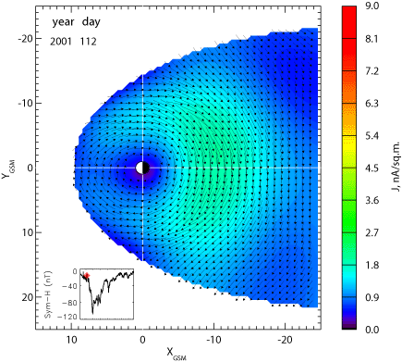
CME-driven storm: April 21-23, 2001
http://geomag_field.jhuapl.edu/model/

Slide 25
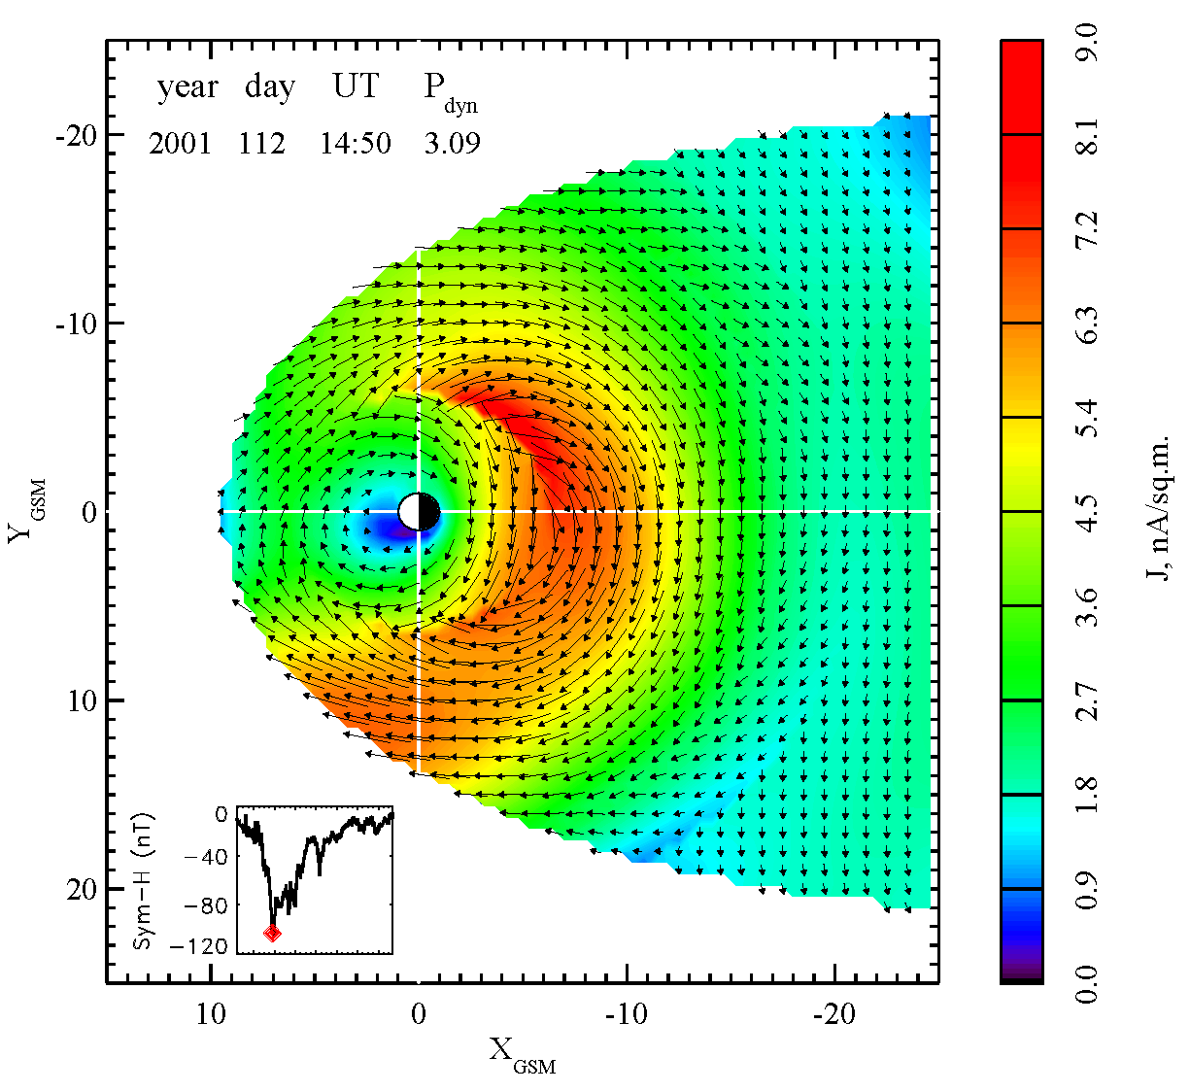
Hook-shaped current
Postmidnight current intensification (Brandt et al., 2002; Ebihara and Fok, 2004)
Dayside flow-out effect (Takahashi et al.,1990; Ebihara and Ejiri, 1998; Liemohn et al.1999; Keika et al., 2004, 2005)
In TS07D tail and ring currents constitute the united current system and they differ only by their closure paths (through the ionosphere or the magnetopause)

Slide 26
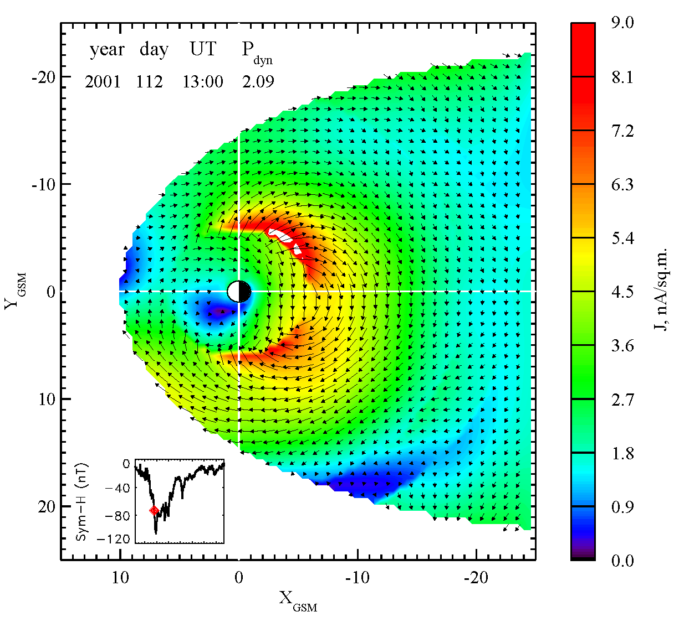
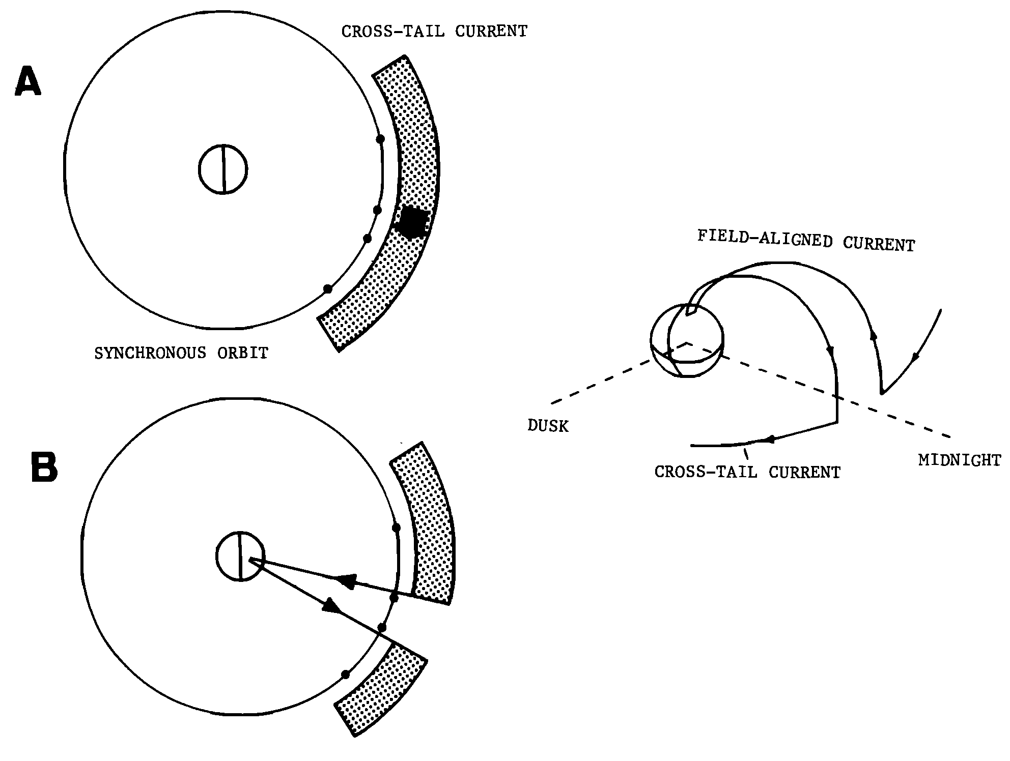
Ring current bifurcation effect
Nagai [1982]
TS07D captures integrated (storm-scale) effects of substorms

Slide 27
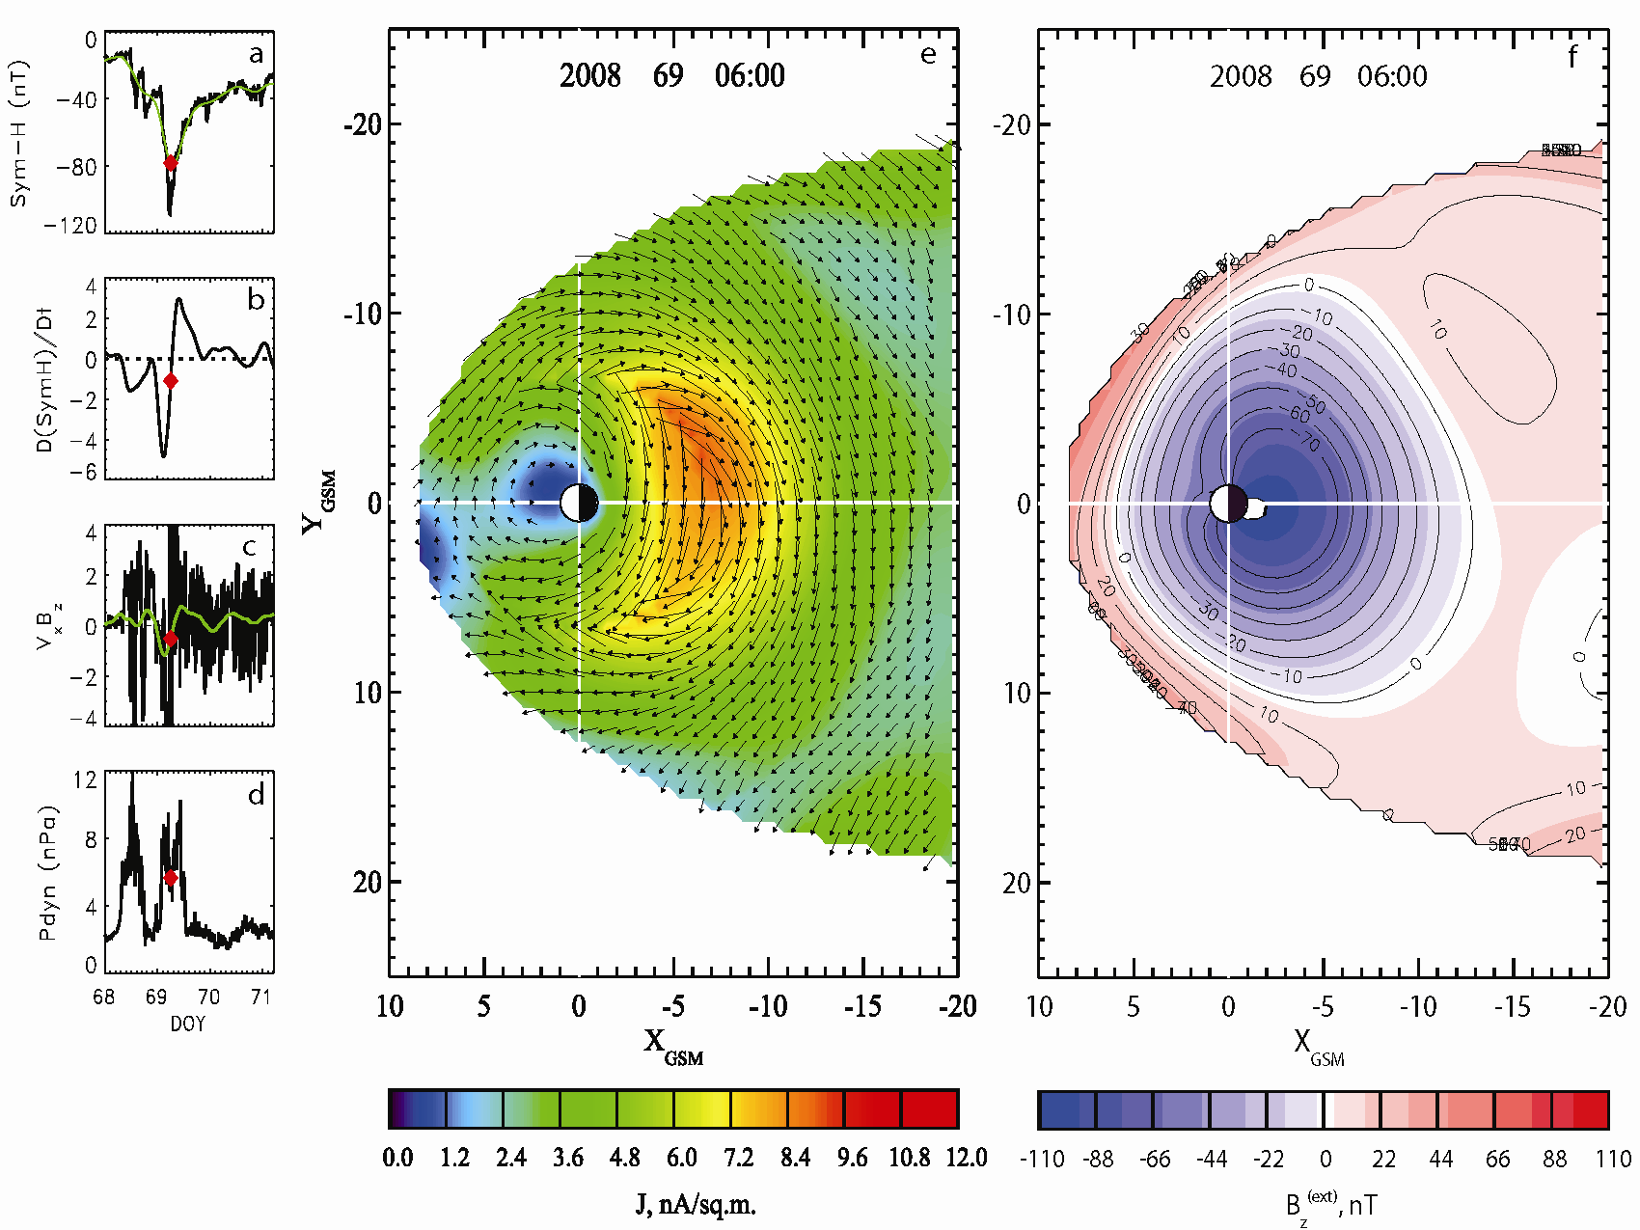
March 8-11, 2008 CIR-driven storm: Main phase

Slide 28
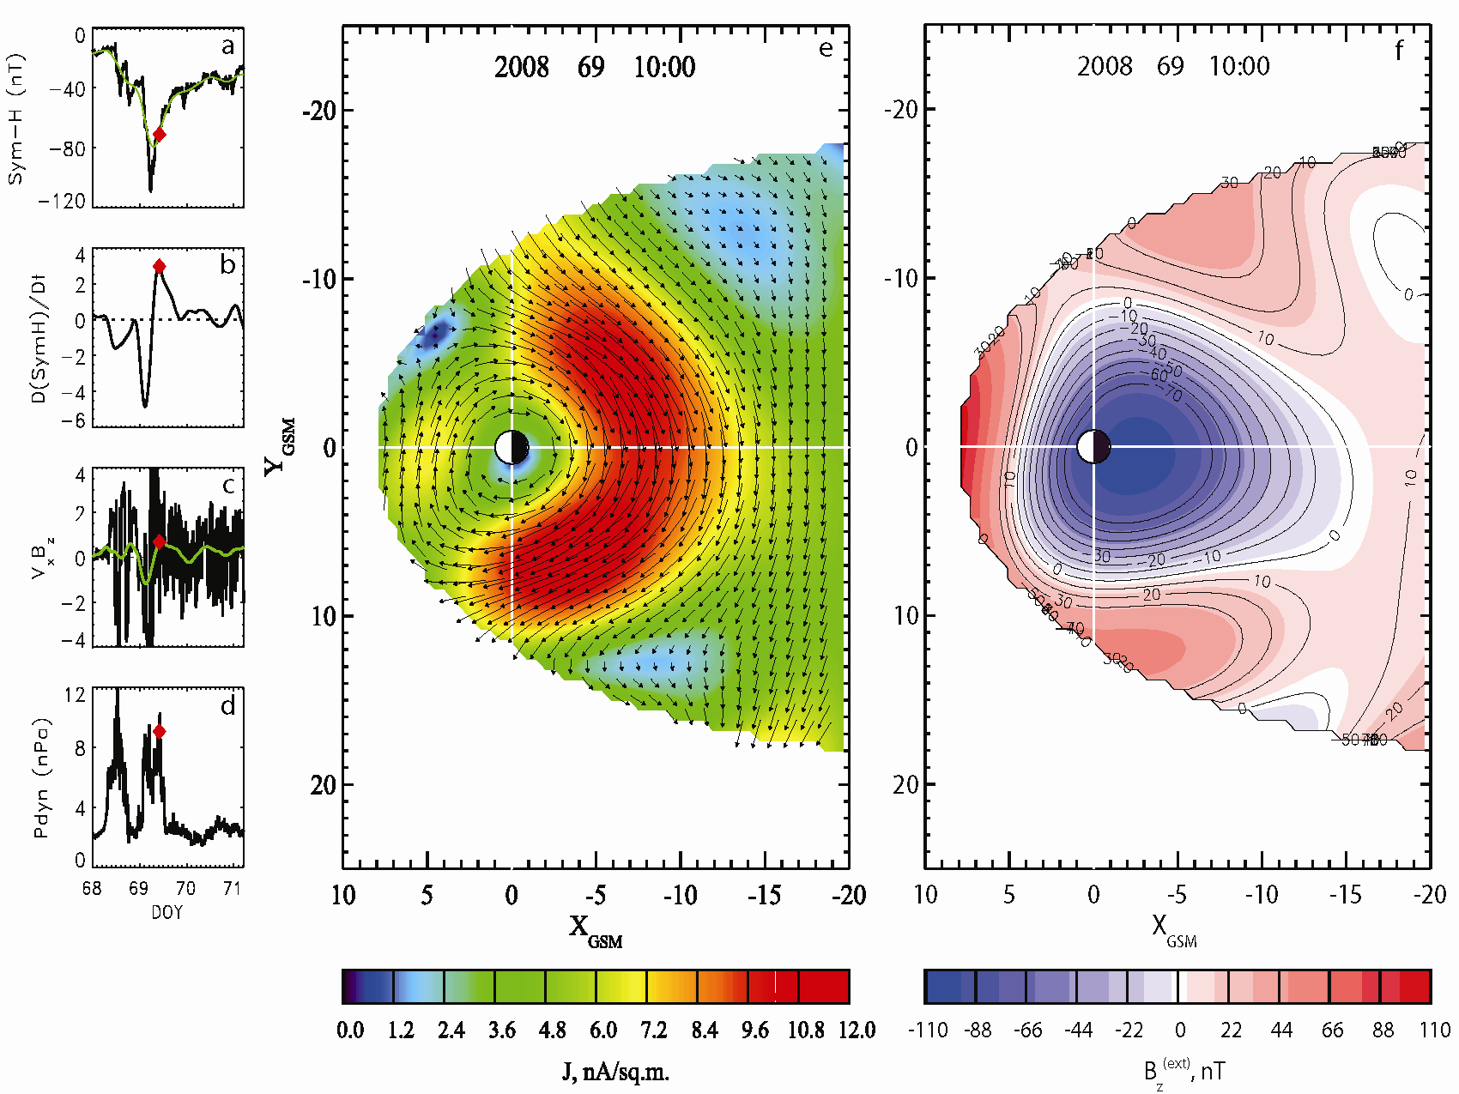
March 8-11, 2008 CIR-driven storm: Recovery phase

Slide 29
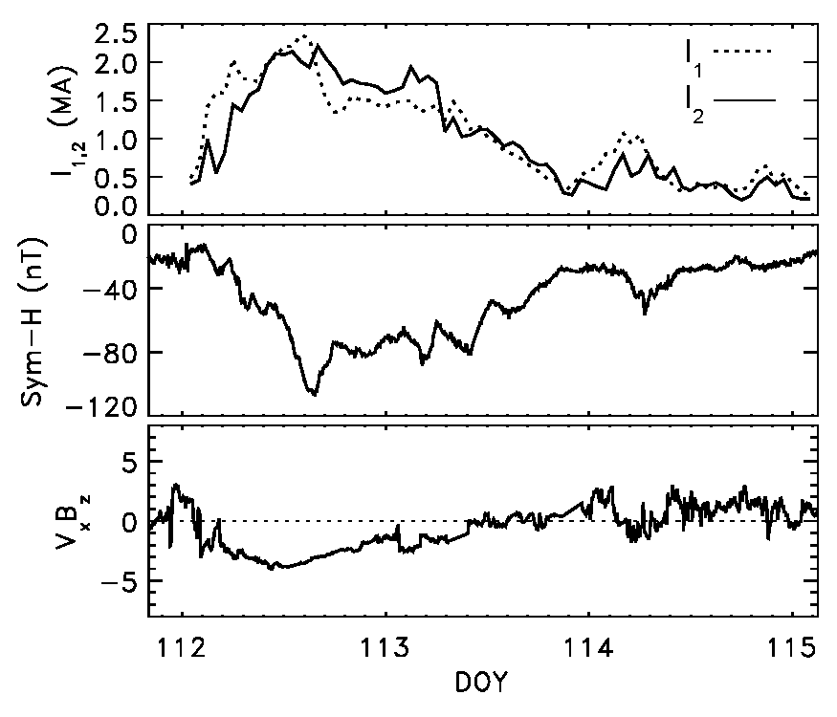
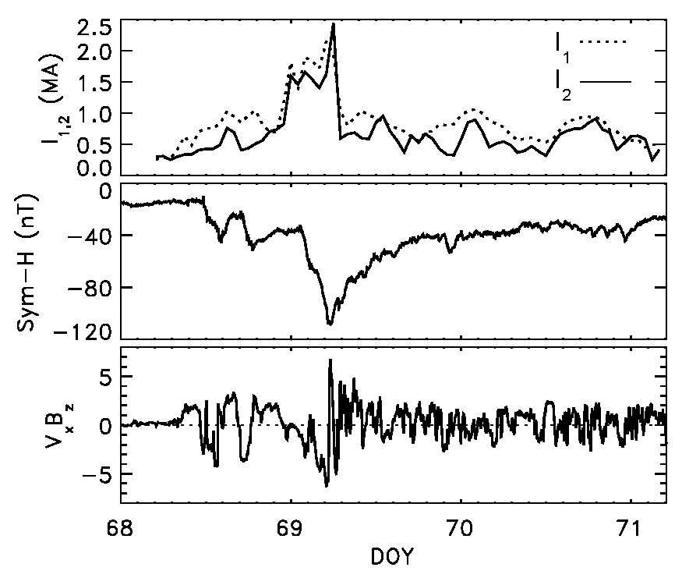
CME- and CIR-driven storms compared
CME-driven April 2001 storm
CIR-driven March 2008 storm
Tail-type storm-time current (instead of PRC) arises when the equatorial current systems are enhanced (by P_{dyn}), while the field-aligned currents are suppressed because of the weak solar wind electric field.

Slide 30
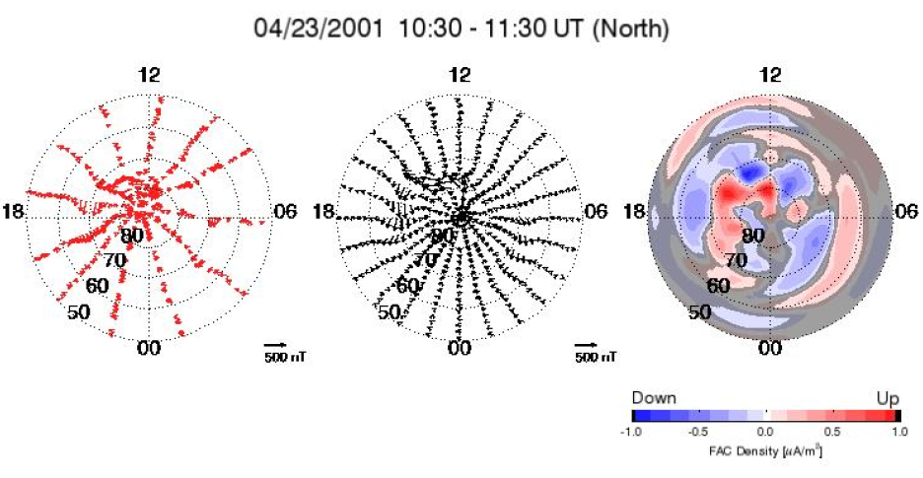
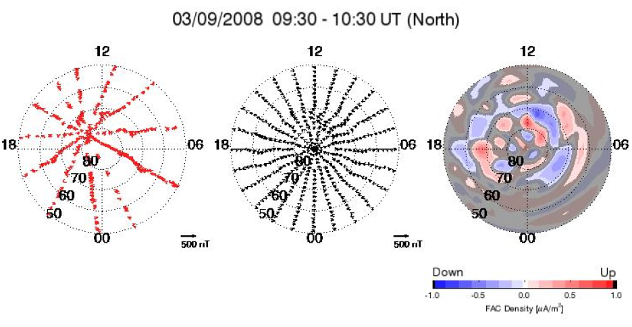
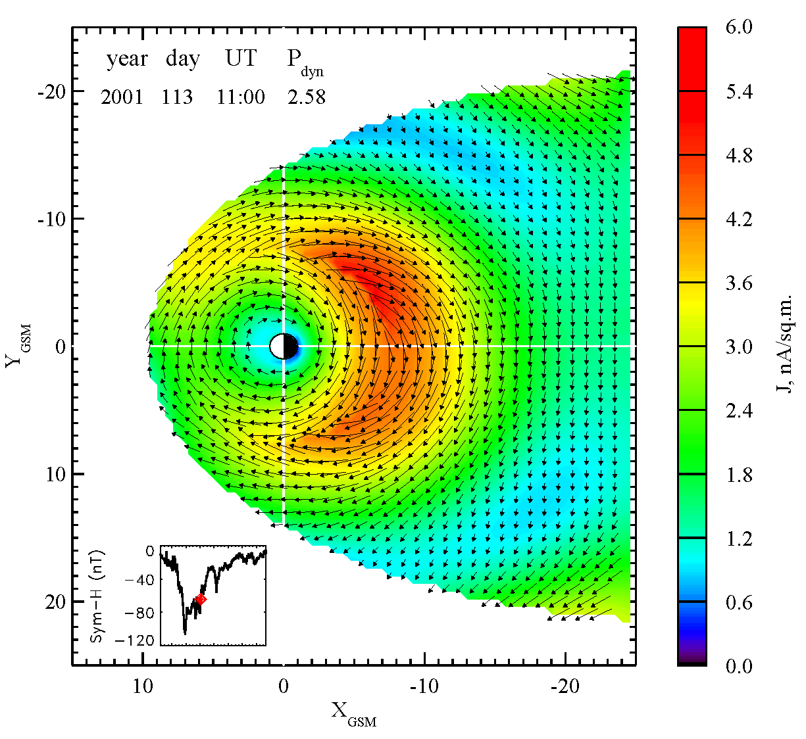
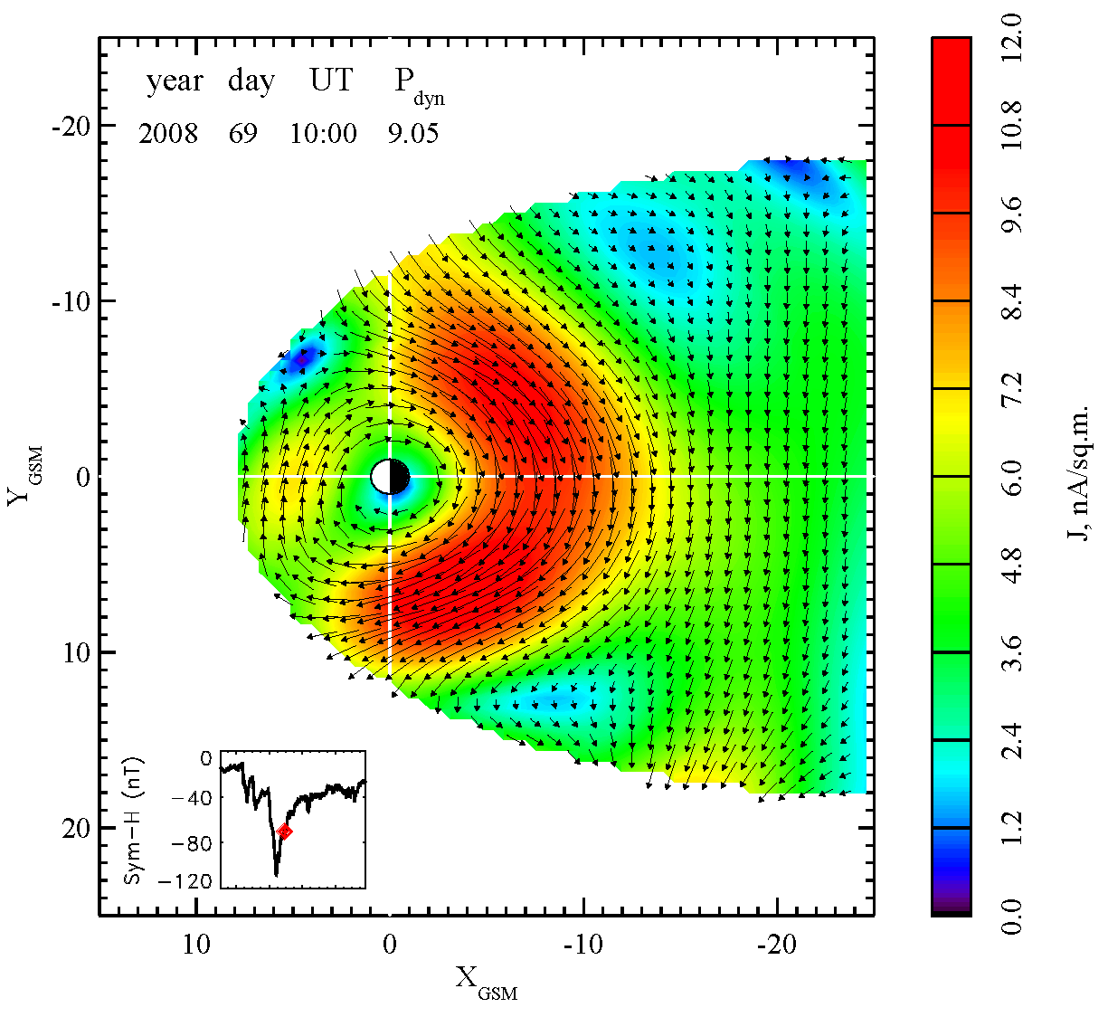
CME- and CIR-driven storms compared

Slide 31
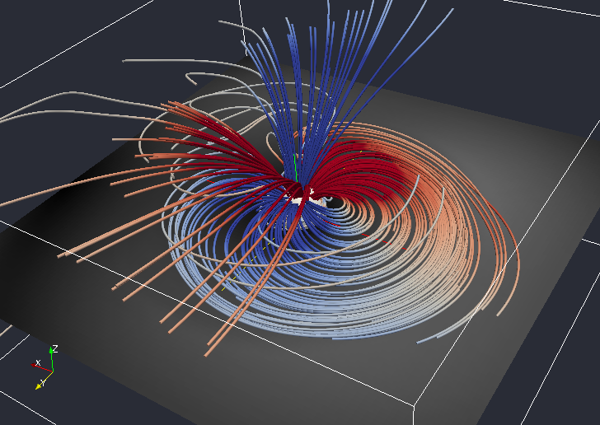
3D current system picture: April 2001 storm (DOY=113; UT=11:00)

Slide 32
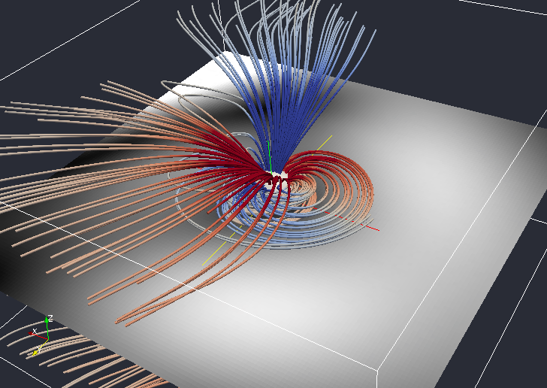
3D current system picture: March 2008 storm (DOY=69; UT=10:00)

Slide 33
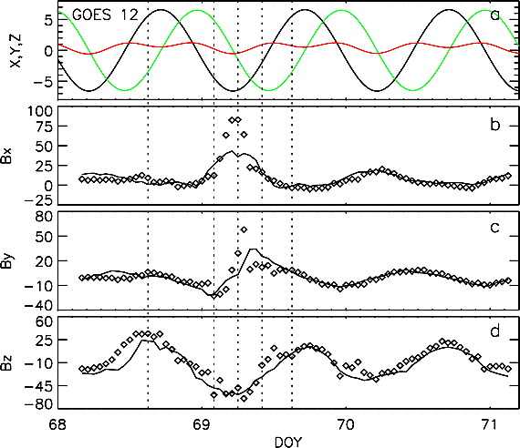
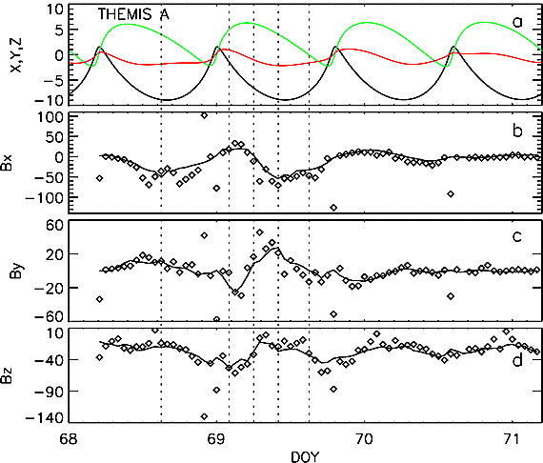
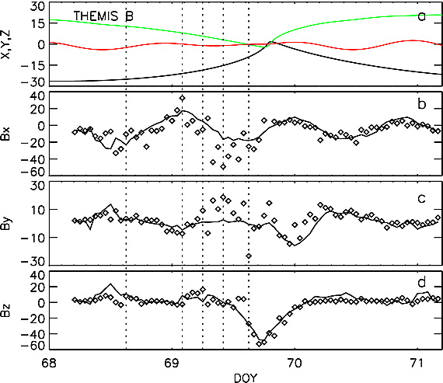
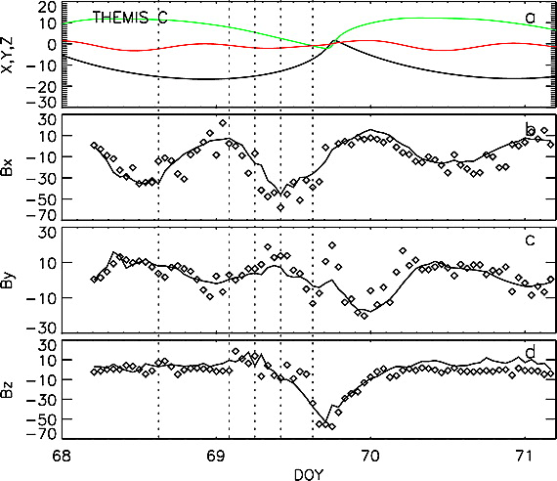
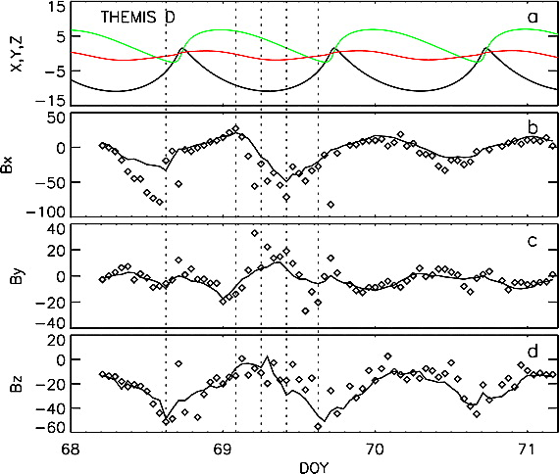
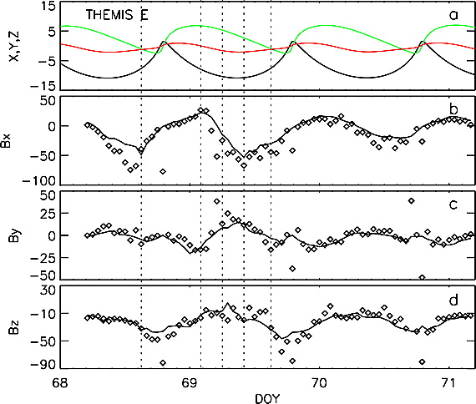
TS07D validation example
March 8-11, 2008 magnetic storm
The model accurately reconstructs the magnetic field on storm scales everywhere in the magnetosphere (note the spatial separation between the spacecraft shown)

Slide 34
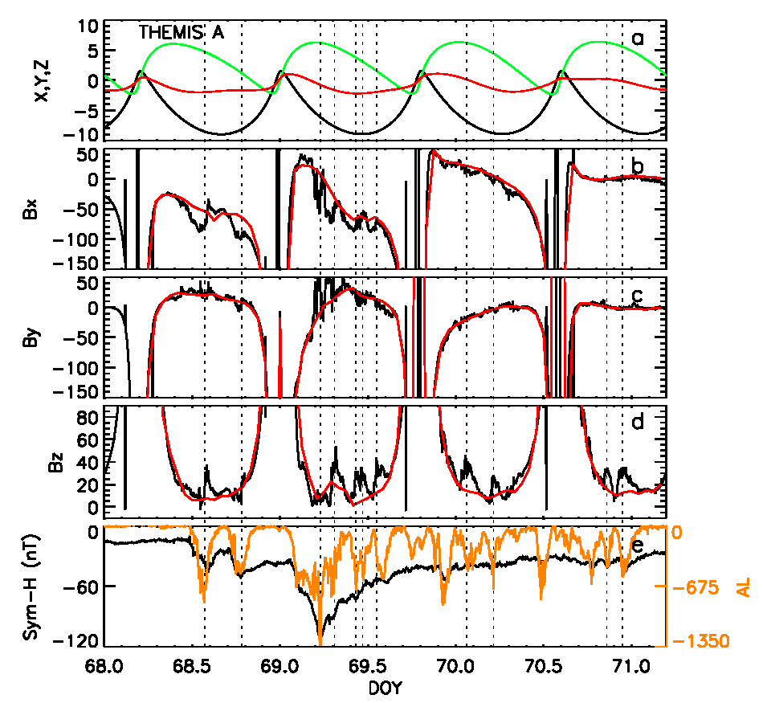
TS07D validation: Substorm effects
March 8-11, 2008 magnetic storm reconstructed using TS07D model
Characteristic deviations of the model from THEMIS data are observed during each substorm
CS thinning
dipolarization

Slide 35
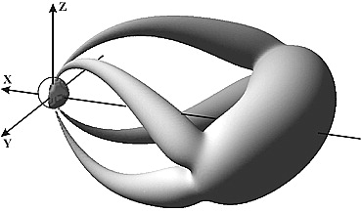
Empirical geomagnetic field modeling: Substorms
Tail current sheet thinning
Kubyshkina et al. [1999, 2002, 2009, 2011] use thin current sheet module
Dipolarization
Sergeev et al., [2011] based on a new SCW module
Both approaches employ classical custom-tailored modules (T≤05 models)
Both are missing their PRC counterparts (with Region 2-sense FACs)
Substorm-time magnetosphere has too many degrees of freedom to match the presently available number of observations

Slide 36
Tsyganenko models compared
Model | TS05 | TS07D
Structure | Rigid modules | Regular expansions
Data binning method | “Climatology”: Model coefficients are universal functions of the solar wind and IMF parameters | Dynamical: Nearest neighbor approach
Database | ~10⁵ points (~68% geosynchronous) | ~10⁶ points (weighted to provide even distribution in the magnetosphere)

Slide 37
TS07D versus TS05
TS07D
TS05
TS07D is less dependent on pre-defined current modules based on a priori assumptions regarding the morphology of magnetospheric current systems

Slide 38
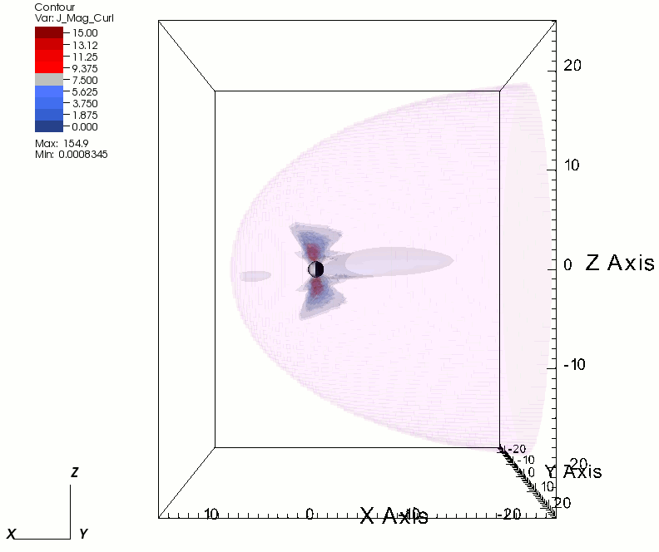
3D dynamical reconstruction of magnetospheric currents
April 17-21, 2002 storm: TS07D 3D visualization
Current density (1 hour cadence)
http://sd-www.jhuapl.edu/geostorm/sidecropped.gif

Slide 39
Combining with first-principles models
MHD equations
Adjusting storm time scale equation of state
RCM equations
Adjusting external boundary conditions

Slide 40
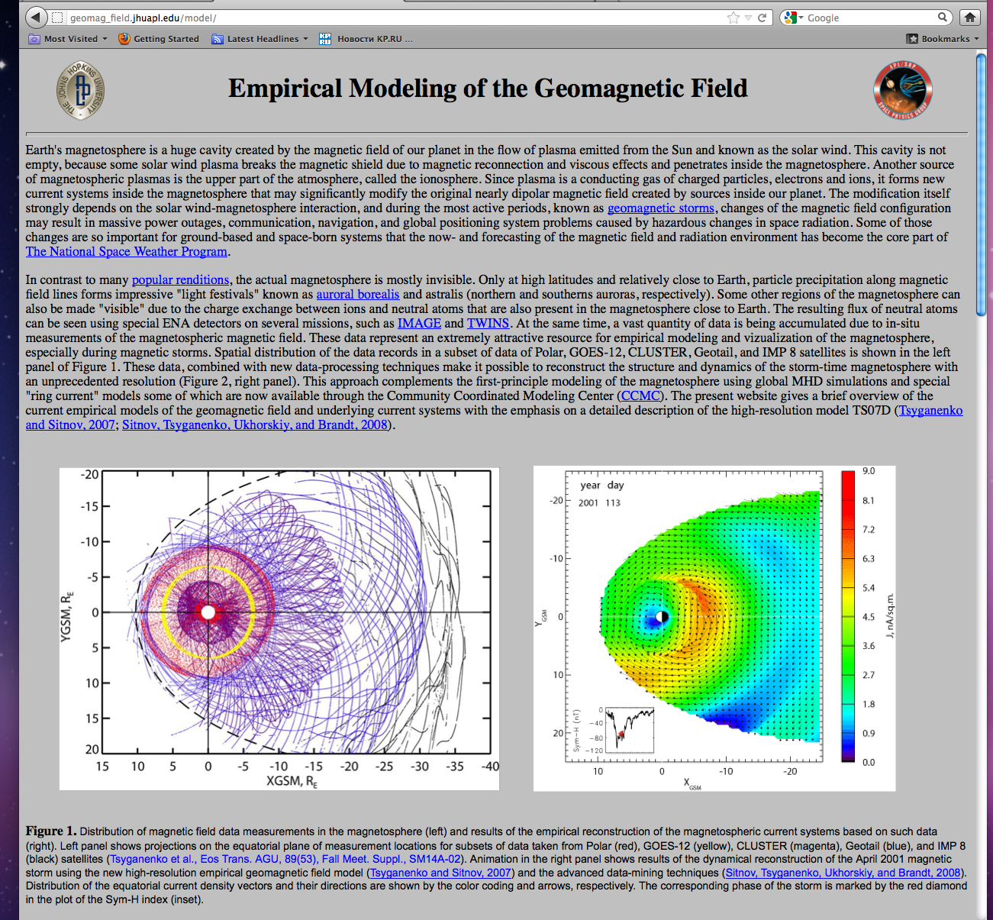
TS07D usage
Model website
http://geomag_field.jhuapl.edu/model/

Slide 41
TS07D usage

Slide 42
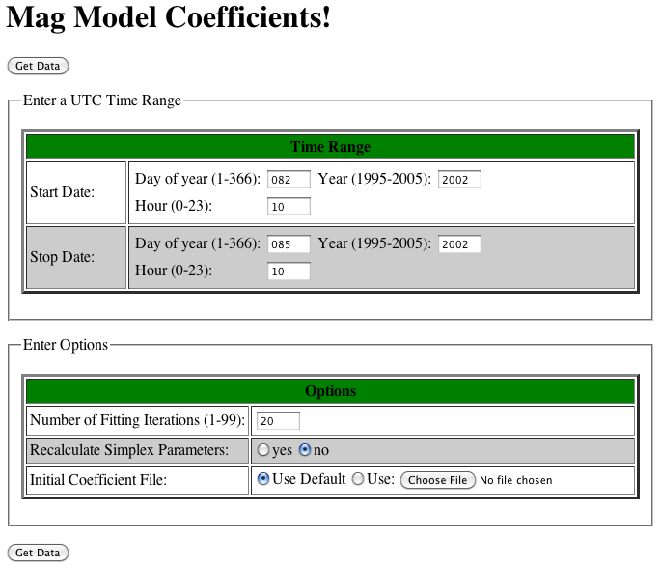
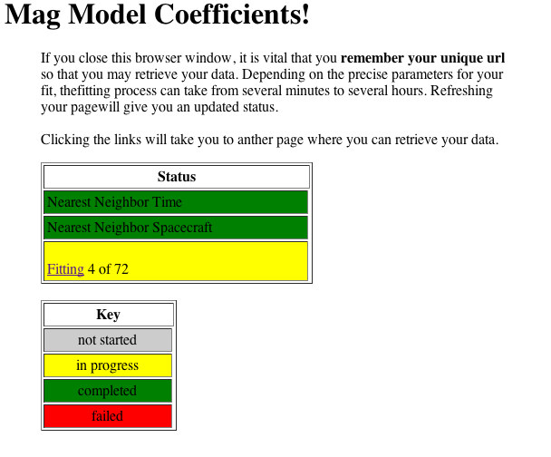
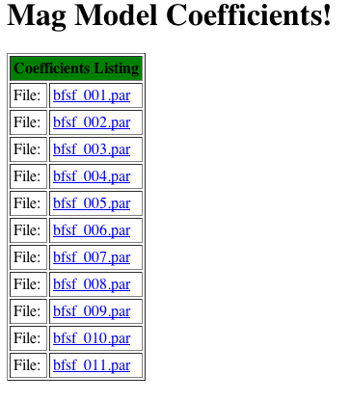
RUN-ON-REQUEST application
Location: http://geomag_field.jhuapl.edu/model/ (go to “RUNS ON REQUEST”)

Slide 43
Conclusion
Modern empirical geomagnetic field modeling opens new opportunities in studies of the magnetosphere.
The new model, TS07D, is less dependent on assumptions regarding the shape of magnetospheric current systems and modes of their response to solar wind driving. Therefore it allows one to infer both the geometry of the currents and their evolution directly from data.
This new empirical picture of the magnetic field and underlying electric currents can be used both for conventional applications, such as particle tracing and mapping, and for investigation of the storm-scale current morphology as well as for ingesting additional empirical information into first-principles models.

Slide 44
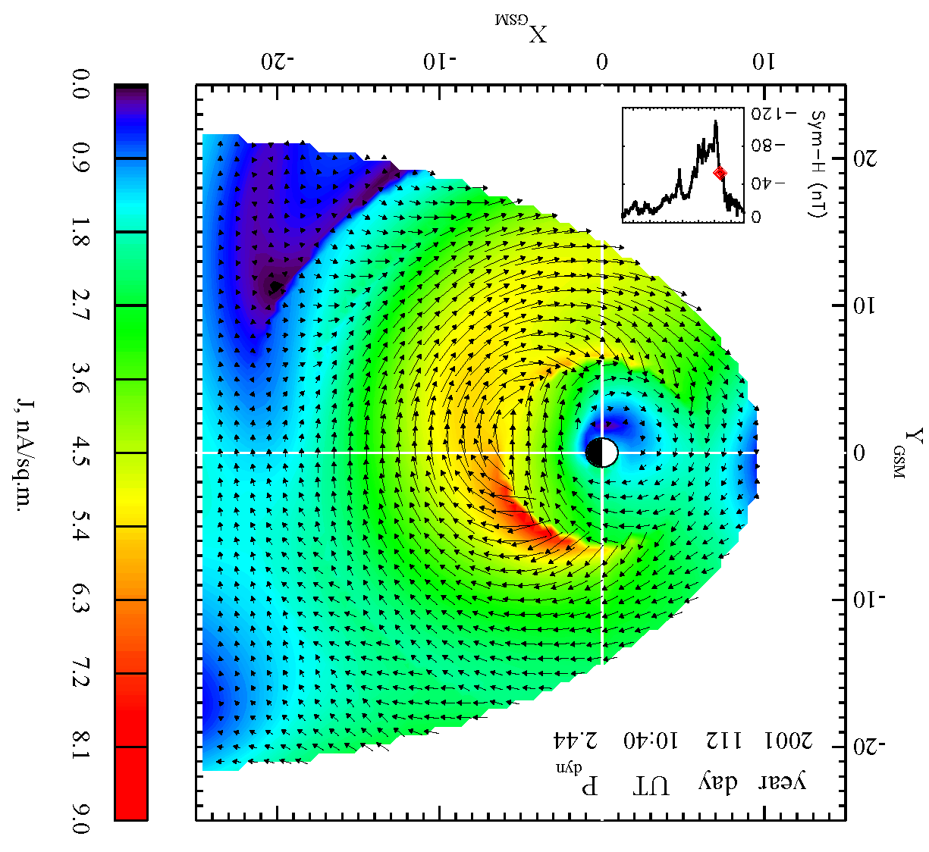
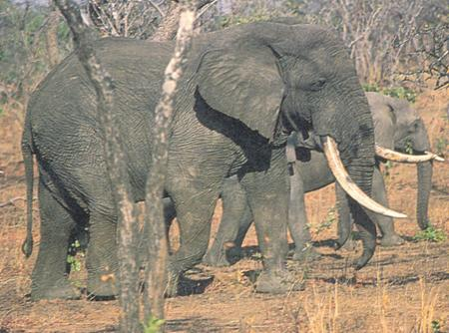
It looks like an elephant!
David Stern was right…

