Slide 1
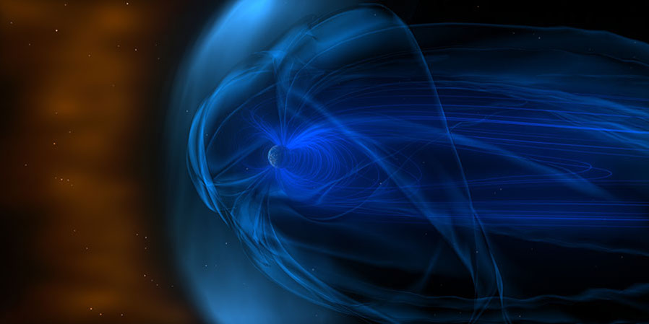
Global Modeling of the Magnetosphere-Ionosphere Electrodynamic Coupling: Overview and Challenges
Yiqun Yu
School of Space and Environment
Beihang University
Beijing, China
June 22, 2017

Slide 2
Outline
Introduction
Recent advances in modeling and understanding the electrodynamics of MI coupling
Dayside magnetosphere –ionosphere
Magnetotail –ionosphere
Inner magnetosphere –ionosphere
Challenges
Conductance – feedback effects
Summary

Slide 3
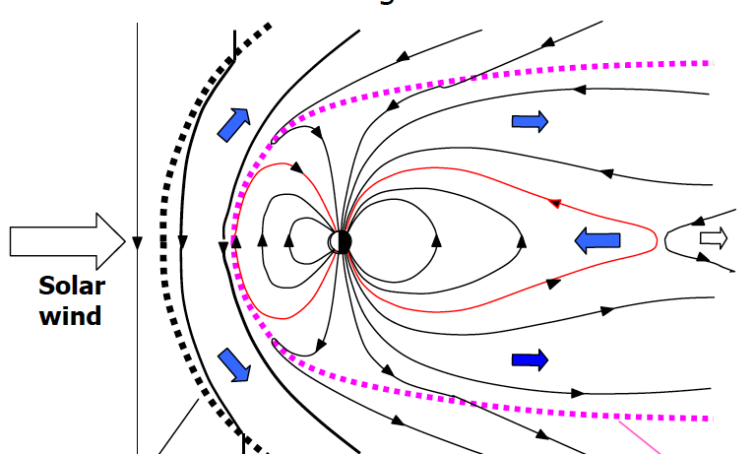
Magnetosphere-ionosphere convection
Noon-Midnight Meridian Plane
Ionospheric altitude
1️⃣
2️⃣
3️⃣
4⃣
9⃣
1️⃣
5️⃣
6⃣
2️⃣
7⃣
3️⃣
9️⃣
8️⃣
8⃣
4⃣
7⃣
6⃣
5⃣
Bow shock
magnetopause

Slide 4
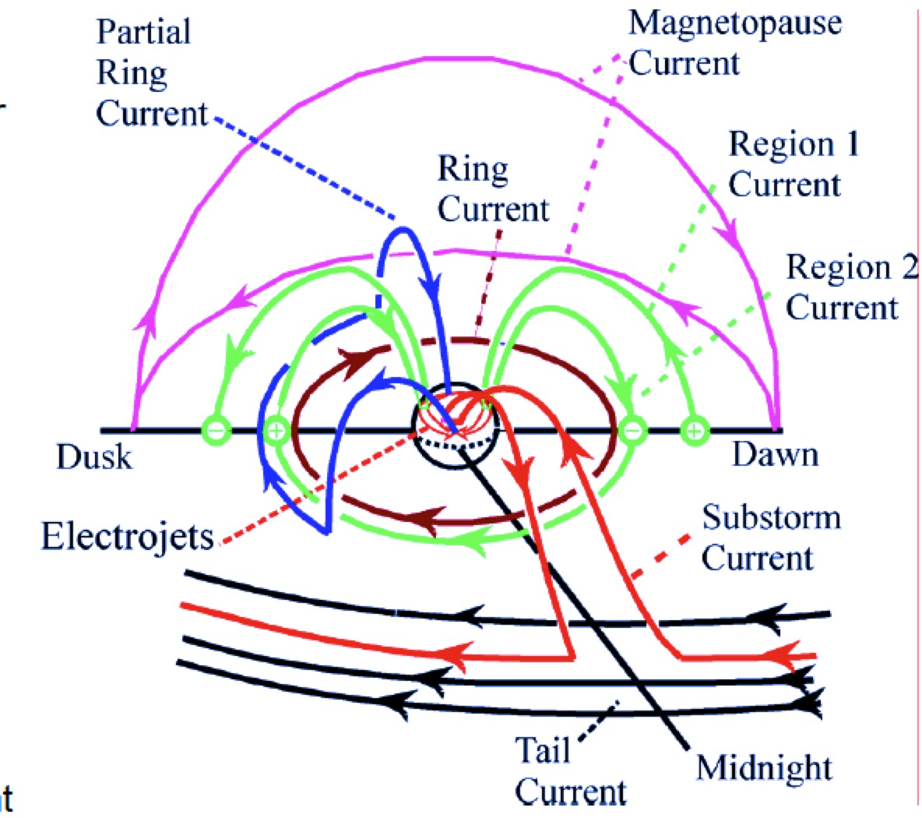
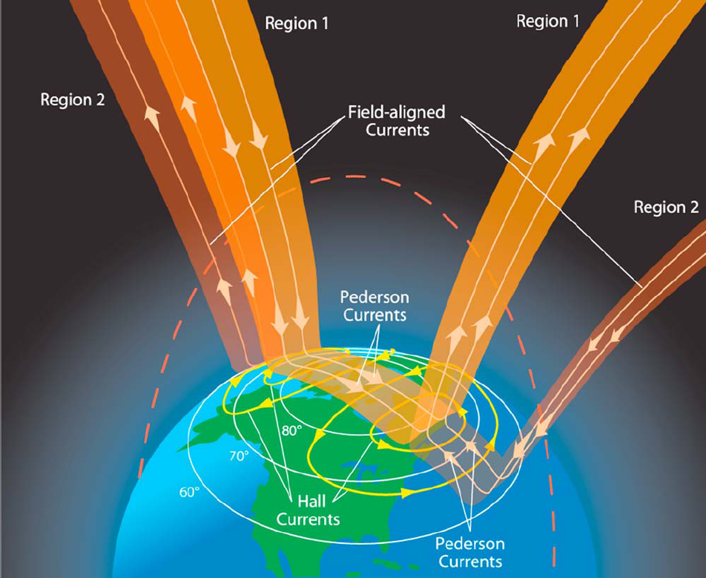
Large-scale currents
McPherron,1991
Magnetopause current
Ring current
Region 1/2 FACs
Substorm current wedge
Region 1 FACs
Region 2 FACs
Connecting with ionospheric currents

Slide 5
Magnetospheric particle precipitation
“The ionosphere and magnetosphere are coupled in so many different ways that nearly every magnetospheric process bears on the ionosphere in some way and every ionospheric process on the magnetosphere!” – R. Wolf
particle
Precipitation
Loss cone particles
Earth
Wave-particle
interactions
Ionosphere
Magnetic field line

Slide 6
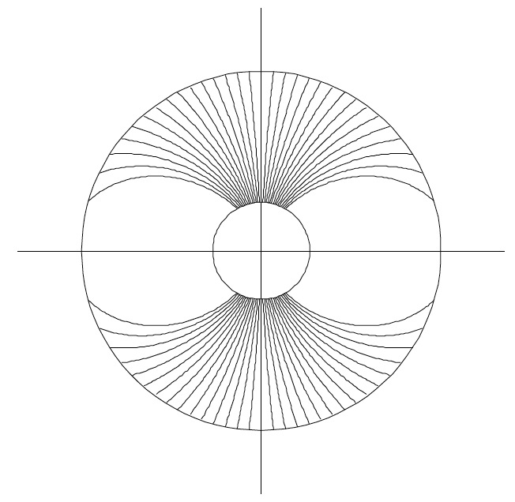
Magnetosphere-ionosphere coupling
Typical modeling of the M-I system includes:
1. Magnetosphere: MHD/kinetic model (inner boundary ~ 2.5 Re)
2. Ionosphere: electrostatic solver
(a 2D spherical thin current sheet layer at ~110 km)
3. “Gap” region: between the two
Perfect mapping along B field lines
Zero potential drop
Magnetosphere Model
Inner boundary at ~2.5 Re
B field lines
Ionosphere (~110km)
“Gap” region
Potential
FACs
Conductance

Slide 7
Outline
Introduction
Recent advances in modeling and understanding the electrodynamics of MI coupling
Dayside magnetosphere–ionosphere
Magnetotail–ionosphere
Inner magnetosphere–ionosphere
Challenges
Conductance – feedback effects
Summary
: PI/MI
: SCW
: SAPS

Slide 8
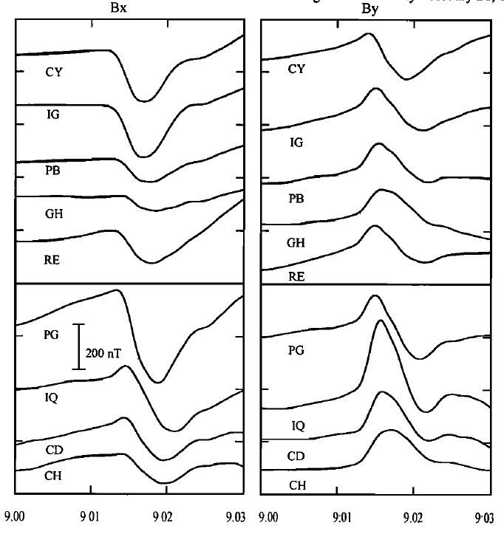
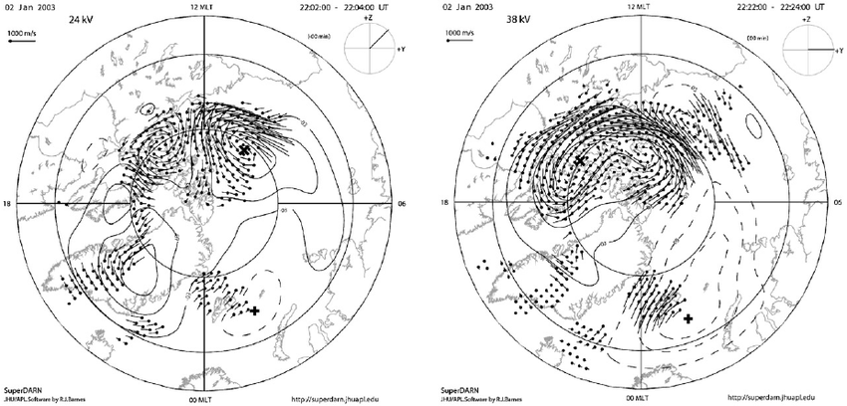
SW-dayside-ionosphere
B_{east}
afternoon
B_{north}
SuperDARN observations
Engebretson et al., 1999
Travelling convection vortices (TCVs)
Preliminary impulse (PI) and Main impulse (MI) [Araki 1994] following storm sudden commencement (SSC)
The ionospheric currents paly a role.

Slide 9
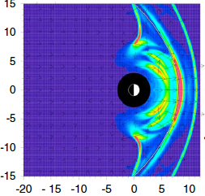
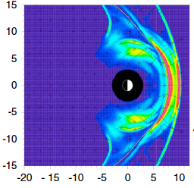
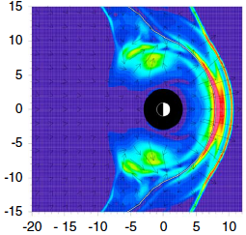
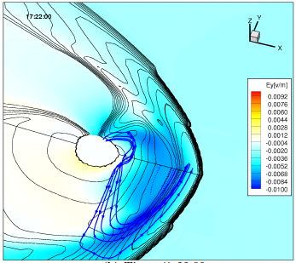
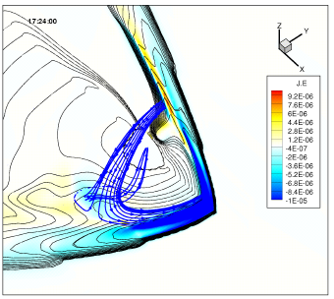
SW-dayside-ionosphere
Cause: transient FACs in the ionosphere
Different types of FACs:
PI: FACs connecting to magnetopause current
MI: FACs emerged from the magnetospheric vorticity
Samsonov et al., 2013
FACs
FACs
Yu et al. 2009

Slide 10
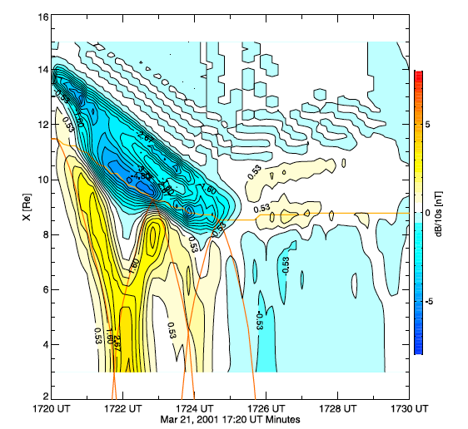
SW-dayside-ionosphere
FACs
Sun
Temporal variation of B
R2
Magnetopause
R1
Plasmapause/ionosphere/inner boundary
Earth
R2
Time
SW driven fast-mode waves (f~10 mHz) are bounced between the magnetopause and plasmasphere
Ionospheric dayside FACs alternatively vary in polarity
Yu et al., 2011

Slide 11
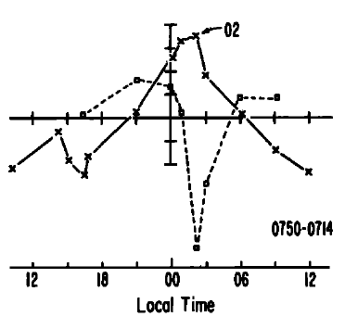
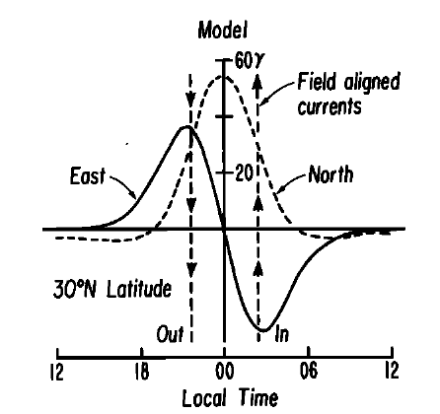
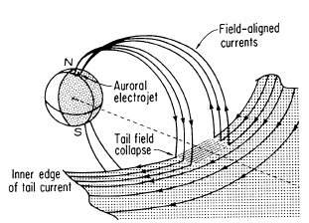
Mid-magnetotail-ionosphere
Eastward dB
Northward dB
McPherron et al., 1973
Nightside mid-latitude magnetic perturbations:
Northward dB component peaks where Eastward dB component is zero.
Concept of substorm current wedge (SCW):
A pair of FACs (region-1 sense), closed by the tail current and by westward electrojet in the ionosphere

Slide 12
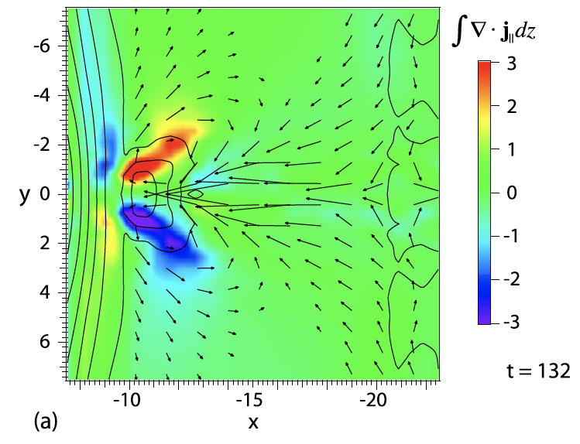
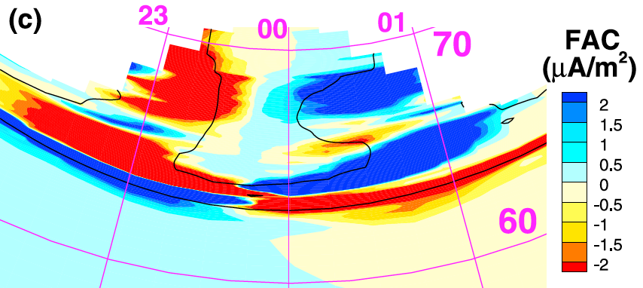
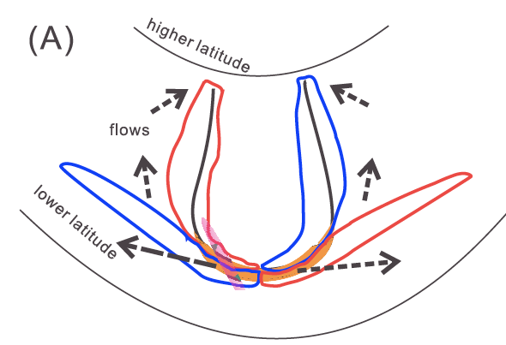
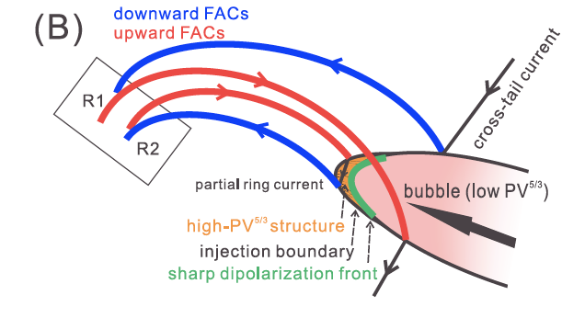
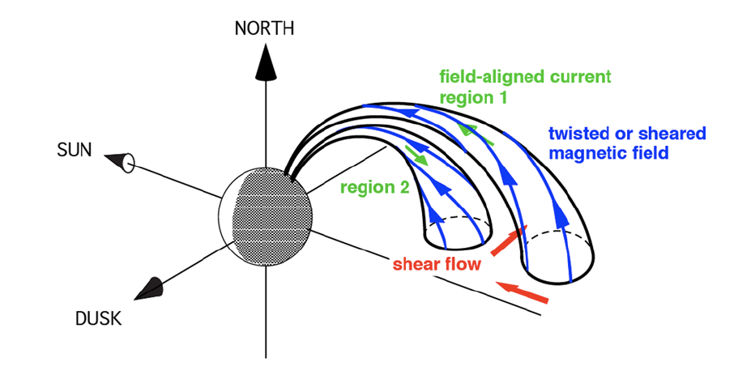
Mid-magnetotail-ionosphere
Equatorial plane
Ionospheric altitude
BBFs
R2
R2
Birn et al., 2011
R1
R2
Yang et al. 2012
Birn et al., 2013
Recent simulations explored new pictures of the SCW loops
Region-2 FACs earthward of Region-1 FACs of SCW

Slide 13
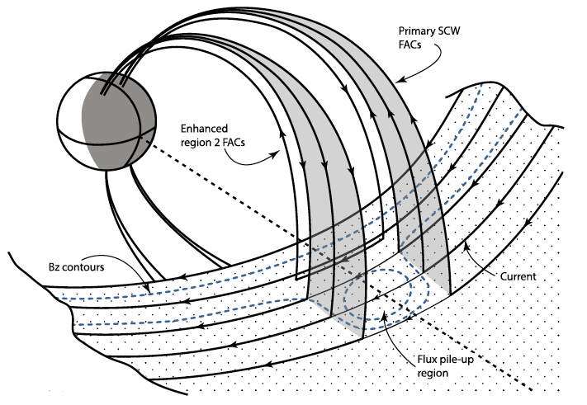
Mid-magnetotail-ionosphere
McPherron et al.,1973
Kepko et al., 2015
Update the SCW picture:
Region-2 FACs earthward of Region-1 FACs of SCW

Slide 14
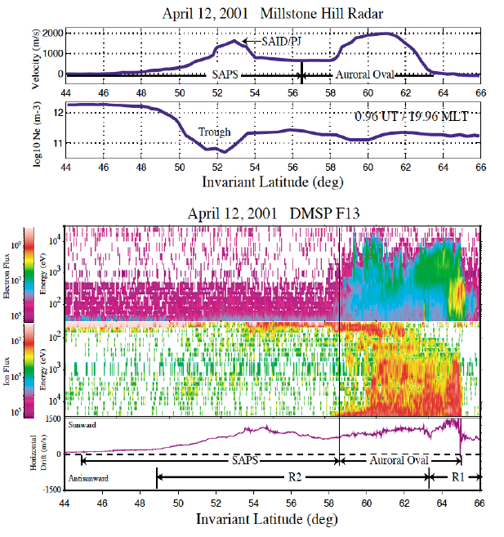
Inner magnetosphere-ionosphere
Subauroral polarization streams (SAPS):
Large westward convection flows equatorward of dusk electron auroral boundary
Large electric field impacts on plasmasphere/ionosphere dynamics
Proposed mechanisms
Large poleward E is required to close the currents following into the low-conductance region［Southwood & Wolf 1987］
Friction, positive feedback
Foster & Burke, 2002
Region 2 current
Electron auroral zone
E
Ion inner edge
After Wolf 2002 GEM tutorial

Slide 15
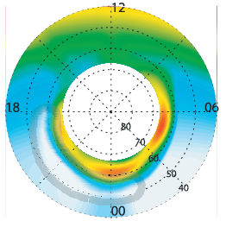
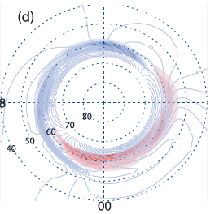
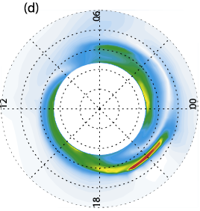
Inner magnetosphere-ionosphere
Idealized simulations:
Test the relationship between Region-2 FACs, low conductance, and SAPS
Conductance
Region-2 FACs
V drift
Zheng et al., 2008

Slide 16
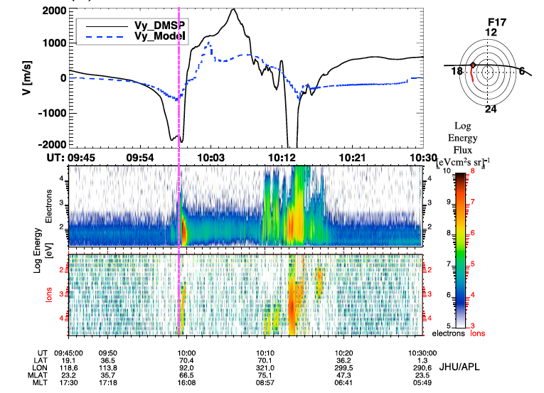
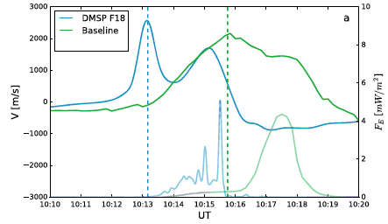
Inner magnetosphere-ionosphere
Idealized simulations:
Test the relationship between Region-2 FACs, low conductance, and SAPS
Real event simulations with state-of-the-art models:
Flow speed weaker than observations
Two-channel flow profile not prominent
Location missed
BATS-R-US + RAMSCB
model
data
LFM+RCM
Yu et al., 2015
After Wiltberger et al. 2017

Slide 17
Summary part 1
Capability:
Capable of modeling many coupling processes in the MI system
Revealing underlying relationships within the coupled system
Issues:
Improvements are still required
What needs improvement?

Slide 18
Outline
Introduction
Recent advances in modeling and understanding the electrodynamics of MI coupling
Dayside magnetosphere –ionosphere
Magnetotail –ionosphere
Inner magnetosphere –ionosphere
Challenges
Conductance – feedback effects
Summary

Slide 19
Challenges
Particle precipitation
Solar radiation
Challenge: Conductance
one critical element that determines and controls the MI interactions
feedback effects
towards self-consistency
Then how?
ionosphere
conductance
FACs
Ionospheric electric field
magnetospheric plasma transport,
wave excitation, particle scattering

Slide 20
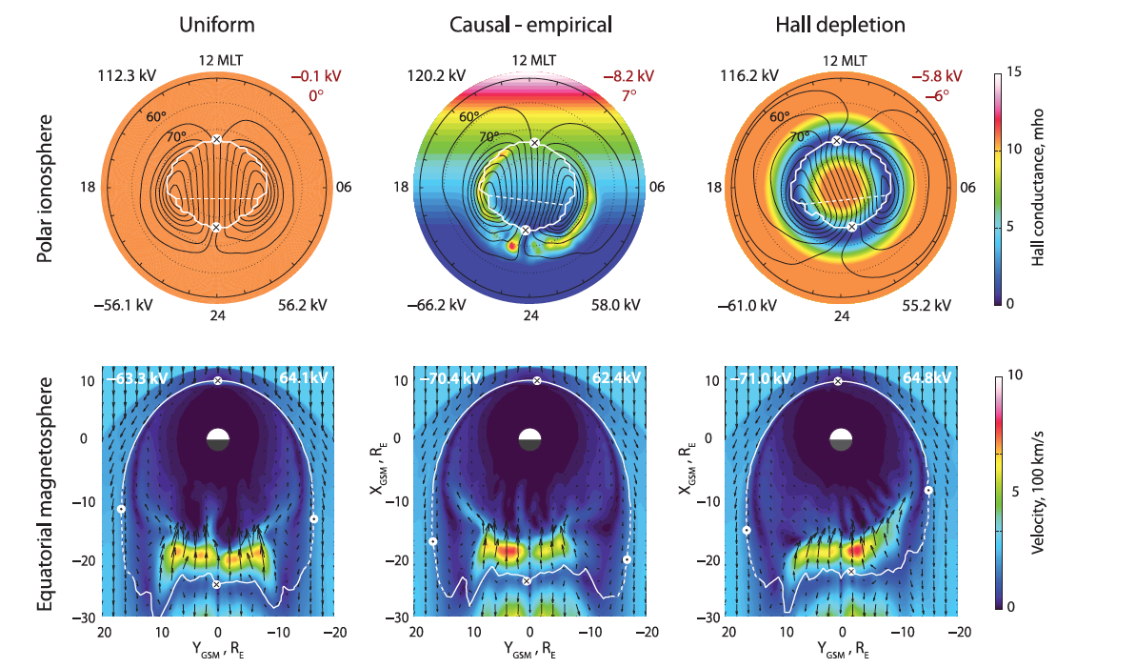
Impact of conductance: convection asymmetry
Lotko et al., 2014
Asymmetric magnetotail convection in response to a more realistic conductance
May impact on the ionospheric footprint of field-aligned currents, and the entire current closure

Slide 21
Impact of conductance: MP/BS location/shape
Smaller Σ
Larger Σ
Merkin et al., 2005
The shape and location of both magnetopause and bow shock depend on the ionospheric conductance
Influence the dayside MI coupling

Slide 22
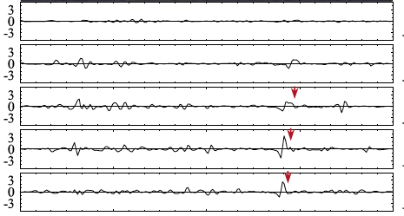
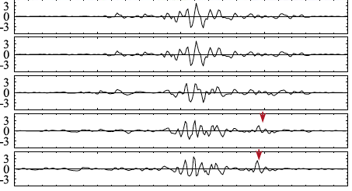
Impact of conductance: flow channels/Pi2
Σ_{p}=6S
UCLA model
Larger Σ
L
0
Σ_{p}=20S
LFM model
Smaller Σ
L
0
Ream et al, 2015
The depth of the earthward-moving fast flows highly depends on the conductance
Smaller conductance results in deeper penetration of flow channels, and more perturbations (such as Pi2 pulsations)

Slide 23
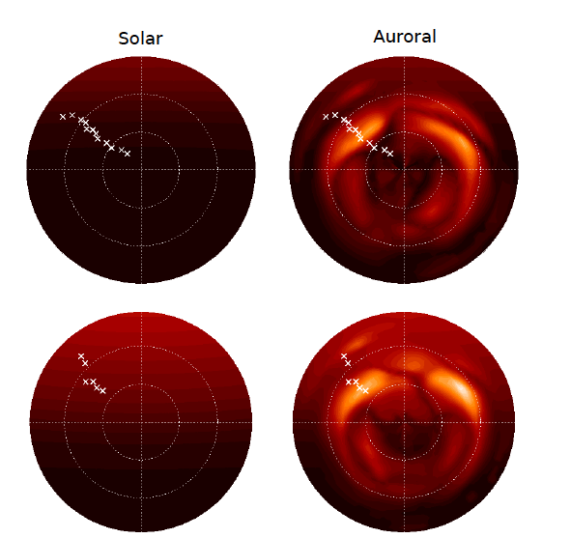
Impact of conductance:magnetic perturbations
North
South
Hartinger et al. 2017
Auroral conductance reduces the effect of the asymmetry between the southern/northern hemispheres during solstice, changing the magnetic perturbations on ground.

Slide 24
Challenges: specification of conductance
These examples demonstrate the dependence of the MI system on the specification of conductance
A reliable conductance is needed in models
Two main sources
Particle precipitation
Solar radiation
To specify the aurora conductance:
Empirical formula: Robinson
Transport code: GLOW, B3c
Global IT model: CTIPe, TIEGCM,GITM
Particle precipitation is the input!
To specify the precipitation:
MHD parameterization
Kinetic calculation
Ionosphere
conductance
FACs
Ionospheric electric field
magnetospheric plasma transport,
wave excitation, particle scattering

Slide 25
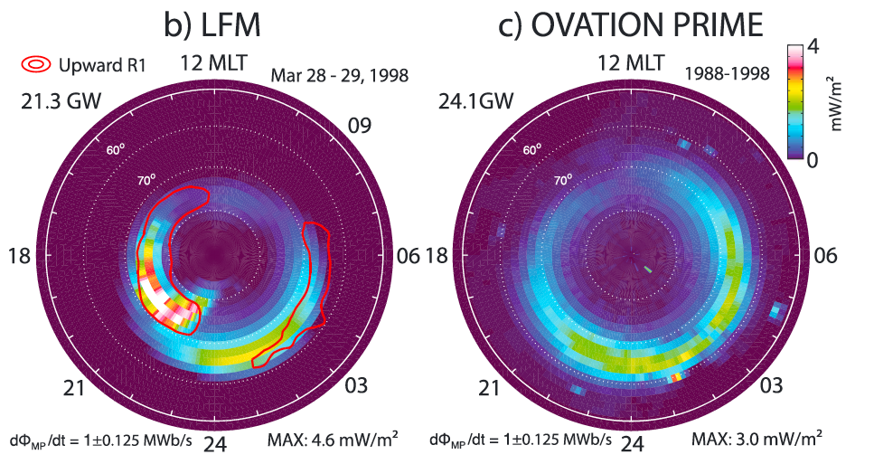
Precipitation for the conductance model
MHD parameterization of precipitation
e.g., LFM electron precipitation model
Based on adiabatic kinetic theory, given the source region electron distribution
Diffuse and discrete precipitation
conductance
MHD parameters (T, Ne)
Empirical Robinson formulism
Precipitation number/energy flux
After Zhang et al., 2015

Slide 26
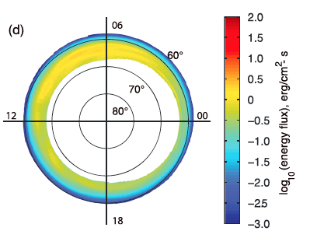
Precipitation for the conductance model
Hall
Kinetic calculation of precipitation
Ring current dynamics
Diffusive precipitation
“lifetime” approach
e.g., RCM-E
Pedersen
Wave-induced precipitation
Chen, et al, 2016
Electron loss due to wave particle interaction
F_{E}
Empirical Robinson formula
Chen, et al., 2015
conductance

Slide 27
Precipitation for the conductance model
Kinetic calculation of precipitation
Ring current dynamics
Diffusive precipitation
“lifetime” approach
e.g., HEIDI
Wave-induced precipitation
Electron loss due to wave particle interaction
F_{E}
Perlongo et al., 2017
Vary maximum electron lifetime
Affect auroral Σ and electric field
Empirical Robinson formula
conductance

Slide 28
Precipitation for the conductance model
POES
Kinetic calculation of precipitation
Ring current dynamics
Diffusive precipitation
“lifetime” approach
vs.
“diffusion coefficient” approach
e.g., RAM-SCB
The latter agrees better with
POES-observed precipitation.
Model:
Lifetime
method
Model:
Diffusion
method
Yu et al., 2016
Electron lifetime τ(E)
Diffusion coefficient D_{αα}(E, α)

Slide 29
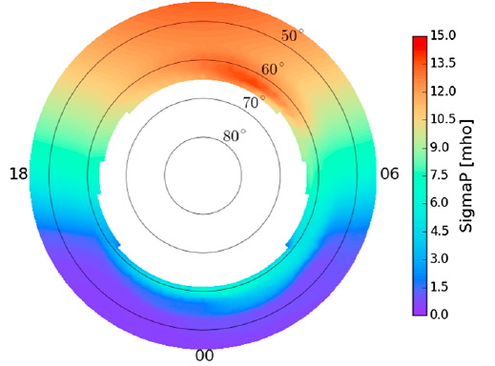
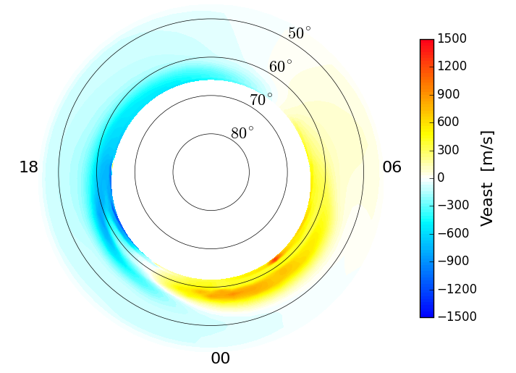
Precipitation for the conductance model
Kinetic calculation of precipitation
“diffusion coefficient” approach
e.g., RAM-SCB
SAPS flow speed close to observations
Double-channel flow profile captured
Σ_{p}
V drift
Drift velocity comparison
Wave-induced precipitation
2-channel
Yu et al, 2017
Empirical Robinson formula
conductance

Slide 30
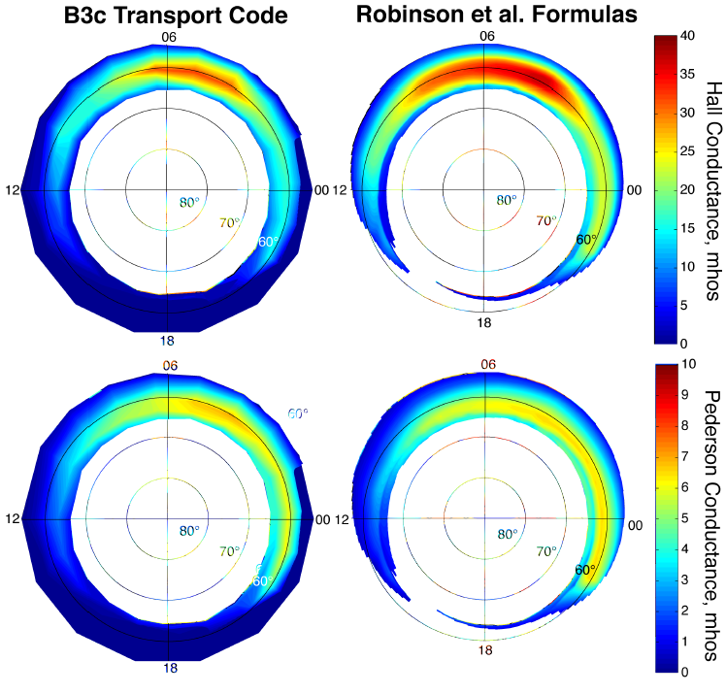
More accurate calcualtion of conductance
Replacing Robinson formula
MHD/Kinetic model + transport code
RCM-E + B3c
Conductance lower than Robinson’s
MHD/kinetic model + global IT model
Chen, et al, 2016

Slide 31
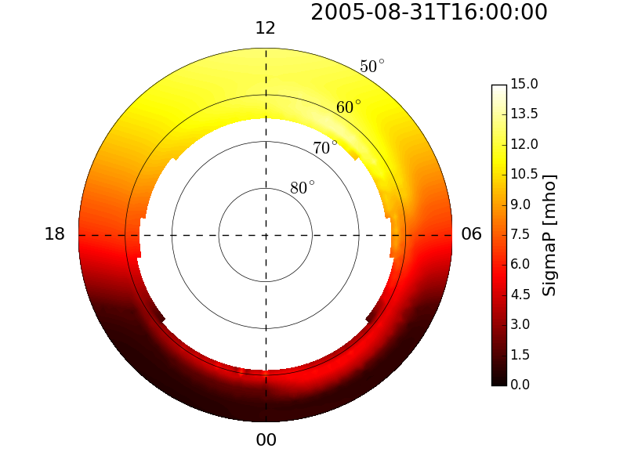
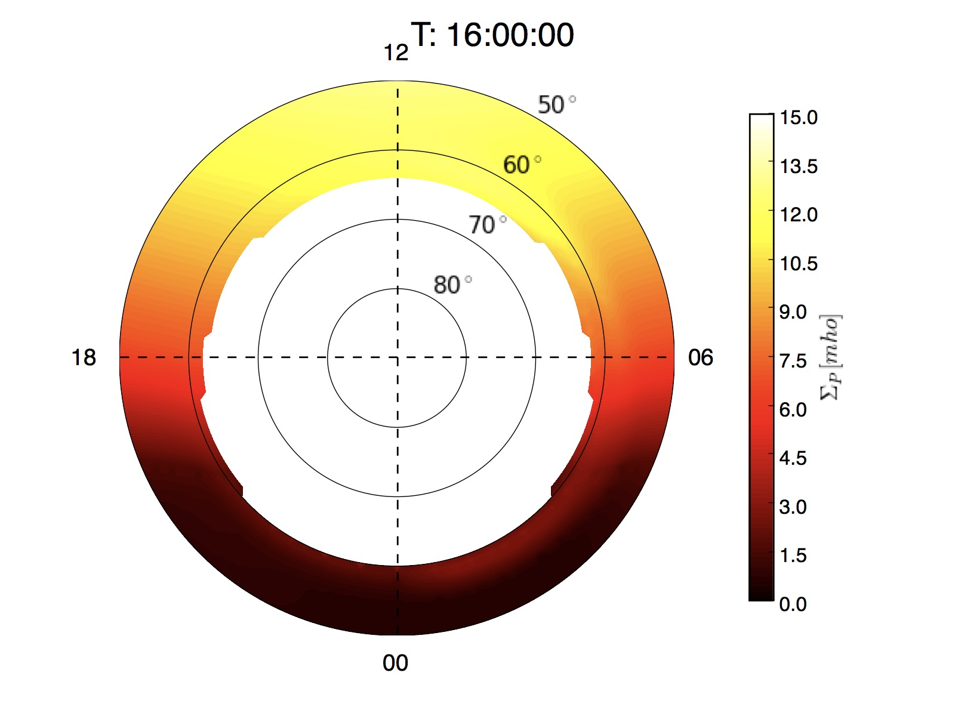
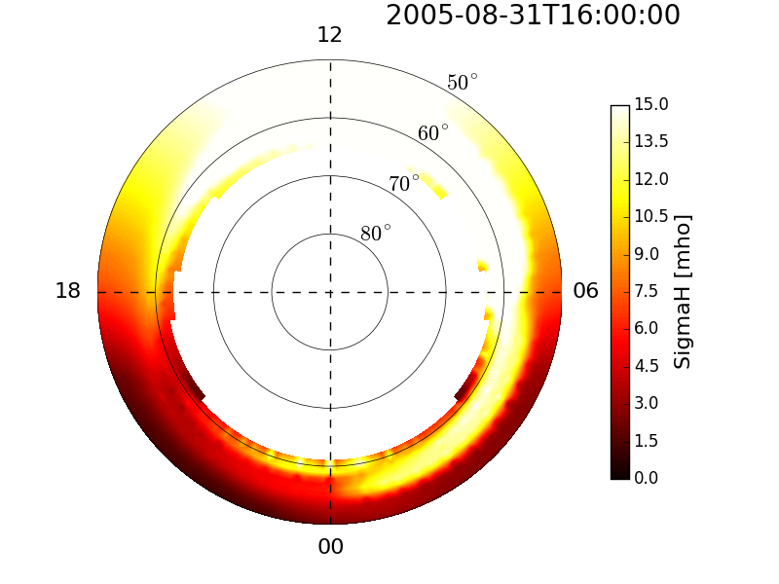
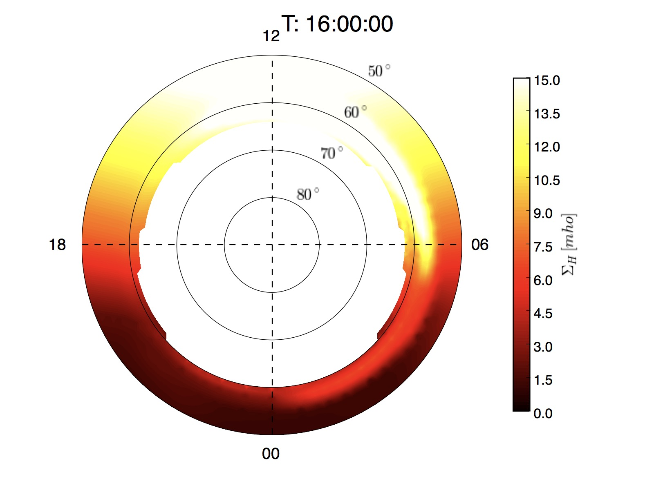
More accurate calcualtion of conductance
Replacing Robinson formula
MHD/Kinetic model + transport code
RCM-E + B3c
Conductance lower than Robinson’s
RAM-SCB + GLOW
Conductance lower than Robinson’s
MHD/kinetic model + global IT model
Robinson formula
GLOW-calculated
Pedersen
Hall

Slide 32
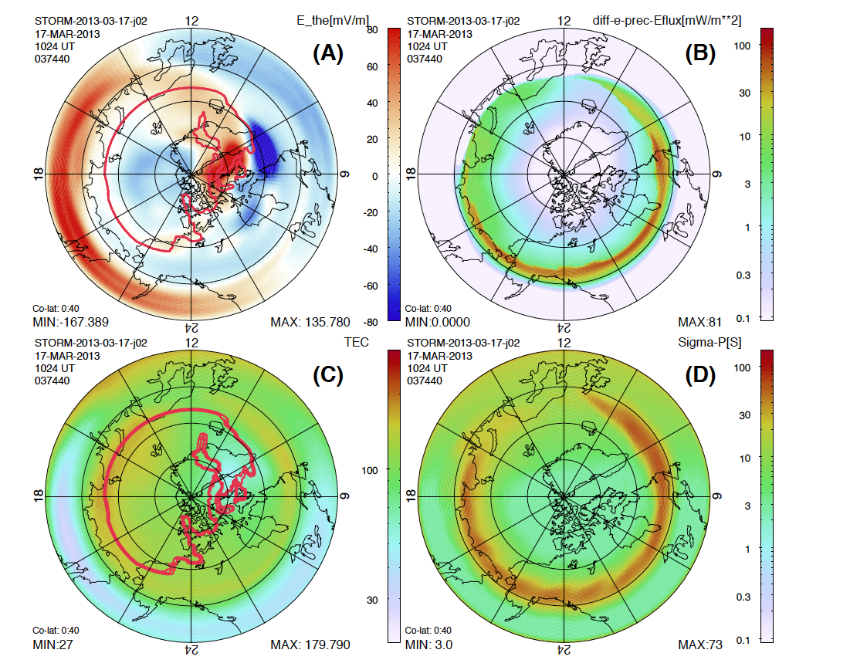
More accurate calcualtion of conductance
Replacing Robinson formula
MHD/Kinetic model + transport code
RCM-E + B3c
Conductance lower than Robinson’s
RAM-SCB + GLOW
Conductance lower than Robinson’s
MHD/kinetic model + global IT model
OpenGGCM + RCM + CTIM
Diffusive F_{E}
Σp
Wave-induced precipitation
Density trough
Low Σ
Raeder et al, 2016
Transport code/IT model
conductance

Slide 33
Challenges: specification of conductance
The goal is to more self-consistently include more physics within the MIT system
To obtain a more accurate conductance
Ionosphere-thermosphere physics
Empirical → transport code → 3D global model
Magnetospheric precipitation
MHD parameterization → physics-based kinetic method (electrons)

Slide 34
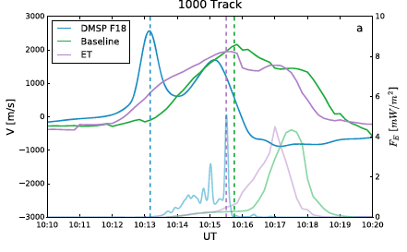
Challenges: specification of conductance
The goal is to more self-consistently include more physics within the MIT system
To obtain a more accurate conductance
Ionosphere-thermosphere physics
New: electrojet turbulence (ET)
Magnetospheric precipitation
density trough
W/O ET
With ET
ET included
data
LFM+RCM
Wiltberger et al., 2017

Slide 35
Challenges: specification of conductance
The goal is to more self-consistently include more physics within the MIT system
To obtain a more accurate conductance
Ionosphere-thermosphere physics
New: electrojet turbulence (ET)
Magnetospheric precipitation
New: ion precipitation
Other related physics too!
Gap region physics
Parallel electric field
…
Ion
Electron
Ion trend
Electron trend
Ion Contribution to
the Pederson Conductance
~ 30%
Yang et al., 2017

Slide 36
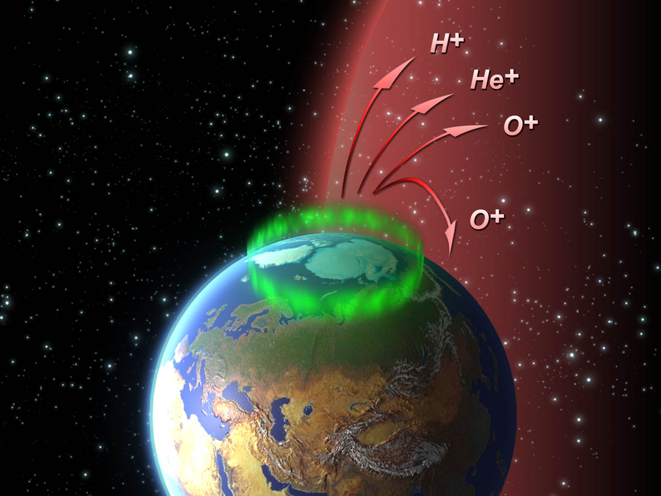
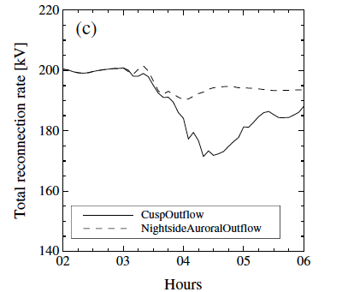
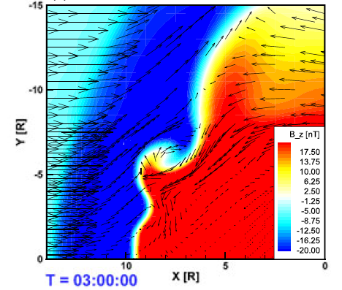
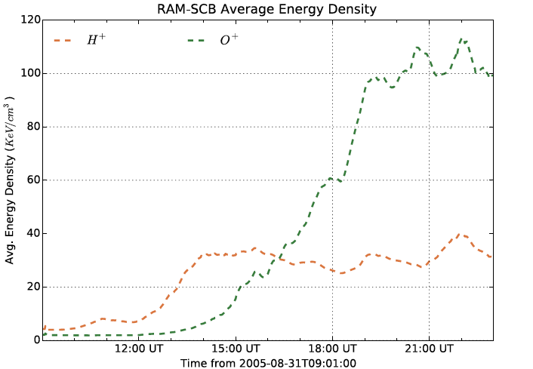
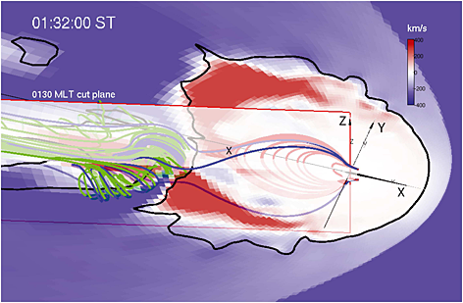
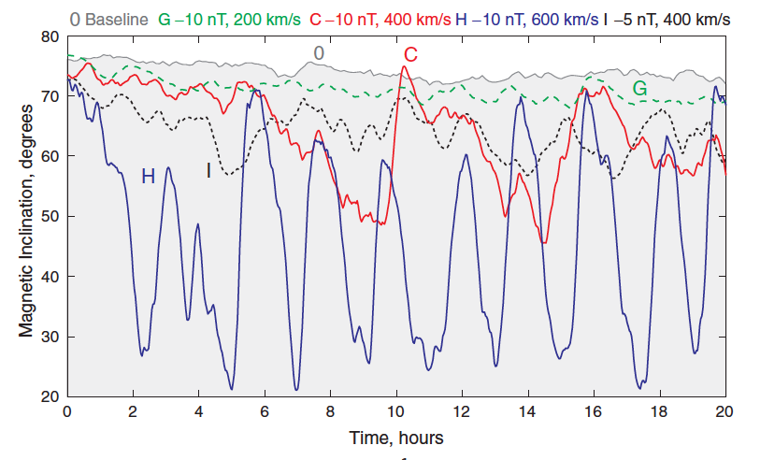
Challenges: Impact of “gap” region physics
Ionoshperic outflow -- bring in more complexity
A rich variety of physics exist in this region: acceleration, dissipation, outflow
With O⁺ outflow, impacts include:
outflow starts
With a large outflow density
Magnetic reconnection rate reduced
Kelvin-Helmholtz instability triggered
Ring current energy density enhanced
Sawteeth oscillation induced
Tail dynamics altered
and many more…
Yu & Ridley, 2013a
Yu & Ridley, 2013b
Ring current energy density
O⁺ included
Welling et al., 2015
Bramble et al., 2011
Zhang et al., 2016

Slide 37
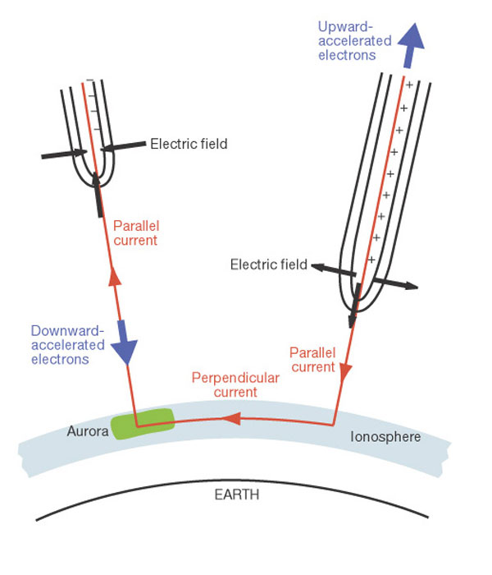
Challenges: Impact of parallel electric field
Parallel electric field -- been ignored in coupled models
Largest in regions with upward FACs; Ambipolar, nonlinear process; Below a few Re; Dissipative collisionless effect
With potential drop included, for the first time, in global LFM simulations
CPCP is lowered
Exhaust velocity is enhanced
Tail X-line closer to Earth
With E||
Xi, Lotko, et al., 2016

Slide 38
Summary part 2
Challenges in improving the conductance and
modeling the MI system:
And many other aspects …
low altitude
A thin current sheet layer
3D ionosphere/thermosphere
Empty “gap” region
A rich variety of physics
Equipotential B field lines
Parallel E field
Inner magnetosphere
Microphysics wave-particle interactions
high altitude

Slide 39
Summary
Magnetosphere-ionosphere system is a fully coupled, complicated,dynamic system, which requires a self-consistent treatment in the models.
Great progresses have been achieved in the modeling and understanding of the MI coupled system in various areas.
Dayside-magnetosphere-ionosphere
Magnetotail-ionosphere
Inner magnetosphere-ionosphere
To fulfill the link of self-consistency within the models is a big challenge. It’s not a small, short-term project, but a community-wide, long-term project!
3D ionosphere-thermosphere model
“Gap” region physics
Magnetospheric physics

Slide 40
Thank you!
Yiqun Yu
yiqunyu17@gmail.com
Beihang University

Slide 41
References
Araki, T.: A Physical Model of the Geomagnetic Sudden Com- mencement, in: Solar Wind Sources of Magnetospheric Ultra- Low-Frequency Waves, edited by: Engebretson, M. J., Takahashi, K., and Scholer, M., p. 183, 1994
Birn, J., R. Nakamura, E. V. Panov, and M. Hesse (2011), Bursty bulk flows and dipolarization in MHD simulations of magnetotail reconnection, J. Geophys. Res., 116, A01210, doi:10.1029/2010JA016083.1.
Birn, J., andM. Hesse (2013), The substorm current wedge in MHD simulations, J. Geophys. Res. Space Physics, 118, 3364–3376, doi:10.1002/jgra.50187.
Brambles, O. J., W. Lotko, B. Zhang, M. Wiltberger, J. Lyon, and R. J. Strangeway (2011), Magnetosphere Sawtooth Oscillations Induced by Ionospheric Outflow, Sci., 332, doi:10.1126/science.1202869.
Engebretson et al. (1999) A multipoint determination of the propagation velocity of a sudden commencement across the polar ionosphere, J. Geophys. Res. Space Physics, 104, 433-451, doi:10.1029/1999JA900237.
Chen, M., (2016) Efforts to improve modeling of ionospheric conductance and inner magnetospheric electric fields in the Rice Convection Model Equilibrium (RCM-E), presentation in the Metrics and Validation FG/Conductance challenge, mini GEM, 2016
Foster, J. C., and W. J. Burke (2002), SAPS: A new categorization for sub-auroral electric fields, Eos Trans. AGU, 83(36), 393–394, doi:10.1029/2002EO000289.
Fujita, S., H. Yamagishi, K. T. Murata, M. Den, and T. Tanaka (2012), A numerical simulation of a negative solar wind impulse: Revisited, J. Geophys. Res., 117, A09219, doi:10.1029/2012JA017526.
Hartinger, M, et al. (2017), Associating ground magnetometer observations with current or voltage generators, J. Geophy. Res. doi:10.1029/2017JA024140.
L. Kepko, R.L. McPherron, O. Amm, S. Apatenkov, W. Baumjohann J. Birn, M. Lester, R. Nakamura , T.I. Pulkkinen, V. Sergeev (2015), Substorm CurrentWedge Revisited, Space Sci Rev (2015) 190:1–46 DOI 10.1007/s11214-014-0124-9.
Lotko, W., R. H. Smith, B. Zhang, J. E. Ouellette, O. J. Brambles, and J. G. Lyon (2014), Ionospheric control of magnetotail reconnection, Science, 345(6193), 184–187, doi:10.1126/science.1252907.
R.L. McPherron, C.T. Russell, M.P. Aubry, Satellite studies of magnetospheric substorms on August 15, 1968. 9. Phenomenological model for substorms. J. Geophys. Res. 78, 3131 (1973a)
Merkin, V. G., G. Milikh, K. Papadopoulos, J. Lyon, Y. S. Dimant,A.S. Sharma, C. Goodrich, and M. Wiltberger (2005), Effect of anomalous electron heating on the transpolar potential in the LFM global MHD model, Geophys. Res. Lett., 32, L22101, doi:10.1029/2005GL023315.
Joachim Raeder, William D. Cramer, Joseph Jensen, Timothy Fuller-Rowell, Naomi Maruyama, Frank Toffoletto and Hien Vo (2016), Sub-Auroral Polarization Streams: A complex interaction between the magnetosphere, ionosphere, and thermosphere, Journal of Physics: Conference Series 767 012021
Ream, J. B., R. J. Walker, M. Ashour-Abdalla, M. El-Alaoui, M. Wiltberger, M. G. Kivelson, and M. L. Goldstein (2015), Propagation of Pi2 pulsations through the braking region in global MHD simulations, J. Geophys. Res. Space Physics, 120, 10,574–10,591, doi:10.1002/2015JA021572.
Samsonov, A. A., and D. G. Sibeck (2013), Large-scale flow vortices following a magnetospheric sudden impulse, J. Geophys. Res. Space Physics, 118, doi:10.1002/jgra.50329.

Slide 42
References
Welling, D. T., V. K. Jordanova, A. Glocer, G. Toth, M. W. Liemohn, and D. R. Weimer (2015), The two-way relationship between ionospheric outflow and the ring current, J. Geophys. Res. Space Physics, 120, 4338–4353, doi:10.1002/2015JA021231
Wiltberger, M., et al. (2017), Effects of electrojet turbulence on a magnetosphere-ionosphere simulation of a geomagnetic storm, J. Geophys. Res. Space Physics, 122, doi:10.1002/2016JA023700.
Rowland, D. E., and J. R. Wygant (1998), Dependence of the large-scale, inner magnetospheric electric field on geomagnetic activity, J. Geophys. Res., 103(A7), 14,959–14,964, doi:10.1029/97JA03524.
Xi, S., W. Lotko, B. Zhang, M. Wiltberger, and J. Lyon (2016), Effects of auroral potential drops on plasma sheet dynamics, J. Geophys. Res. Space Physics, 121, 11,129–11,144, doi:10.1002/ 2016JA022856.
Yang Y., Y. Yu, K. Han (2017), Contribution of ion precipitation to ionospheric conductance, to be submitted.
Yang, J., F. R. Toffoletto, R. A. Wolf, S. Sazykin, P. A. Ontiveros, and J. M. Weygand (2012), Large-scale current systems and ground magnetic disturbance during deep substorm injections, J. Geophys. Res., 117, A04223, doi:10.1029/ 2011JA017415.
Yang, J., F. R. Toffoletto, and R. A. Wolf (2014), RCM-E simulation of a thin arc preceded by a north-south-aligned auroral streamer, Geophys. Res. Lett., 41, 2695–2701, doi:10.1002/2014GL059840
Yu, Yiqun, and A. J. Ridley (2009), The response of the magnetosphere-ionosphere system to a sudden dynamic pressure enhancement under southward imf conditions, Annales Geophysicae, 27 (12), 4391-4407.
Yu, Yiqun, and A. Ridley (2011), Understanding the response of the ionosphere-magnetosphere system to sudden solar wind density increases, J. Geophy. Res., 116, A04210, doi:10.1029/2010JA015871.
Yu, Yiqun, and A. Ridley (2013a), Exploring the effect of ionospheric heavy ion outflow on magnetospheric dynamics: dependence of source location, J. Geophy. Res., 118, doi:10.1029/2012JA018411.
Yu, Yiqun, and A. Ridley (2013b), Exploring the effect of ionospheric heavy ion outflow on magnetospheric dynamics: effect of intensity, J. Geophy. Res., 118, doi:10.1029/jgra.50528.
Yu, Yiqun, V. Jordanova, S. Zou, R. Heelis, M. Ruohoniemi, and J. Wygant (2015), Modeling Sub-Auroral Polarization Streams during the March 17, 2013 storm, J. Geophy. Res., 120, 1738-1750, doi:10.1002/2014JA020371.
Yu, Yiqun, V. Jordanova, A. Ridley, J. Albert, R. Horne, C. Jeffery (2016), A new ionosphereic electron precipitation module coupled with RAM-SCB within geospace general circulation model, J. Geophy. Res.,doi:10.1002/2016JA 2016JA022585.
Yu, Y., V. K. Jordanova, A. J. Ridley, G. Toth, and R. Heelis (2017), Effects of electric field methods on modeling the midlatitude ionospheric electrodynamics and inner magnetosphere dynamics, J. Geophys. Res. Space Physics, 122, doi:10.1002/2016JA023850.
Zheng, Y., P. C. Brandt, A. T. Y. Lui, and M.-C. Fok (2008), On ionospheric trough conductance and subauroral polarization streams: Simulation results, J. Geophys. Res., 113, A04209, doi:10.1029/2007JA012532.
Zhang, B.,W.Lotko,O.Brambles, M.Wiltberger, and J. Lyon (2015), Electron precipitation models in global magnetosphere simulations, J. Geophys. Res. Space Physics, 120, doi:10.1002/2014JA020615
Zhang, B., O. J. Brambles,W. Lotko, J. E. Ouellette, and J. G. Lyon (2016), The role of ionospheric O+ outflow in the generation of earthward propagating plasmoids, J. Geophys. Res. Space Physics, 121, 1425–1435, doi:10.1002/2015JA021667.

