Slide 1

METplus - A Unified Verification and Validation Tool for a Coupled Modeling System
Tara Jensen¹, J. Vigh¹, N. Maruyama², D. Fuller-Rowell², T. Onsager², T. Fuller-Rowell², J. Halley Gotway¹, L. Mays³, L. Raestaetter³
¹NCAR/RAL and DTC, ²CU –CIRES and NOAA SWPC, ³NASA CCMC
2020 Virtual GEM Summer Workshop
July 20-23, 2020

Slide 2
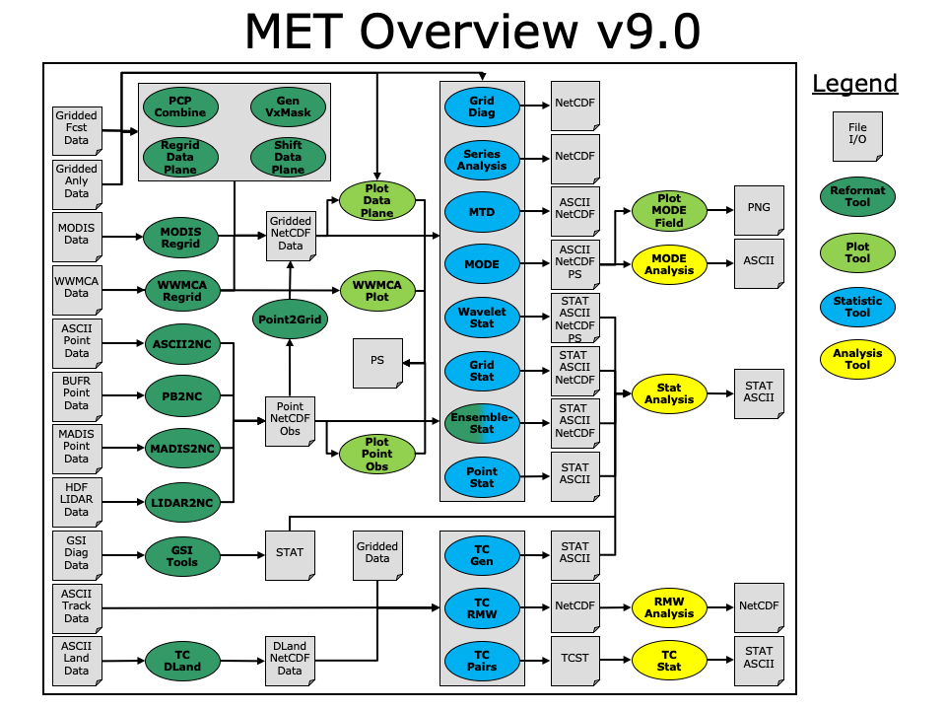
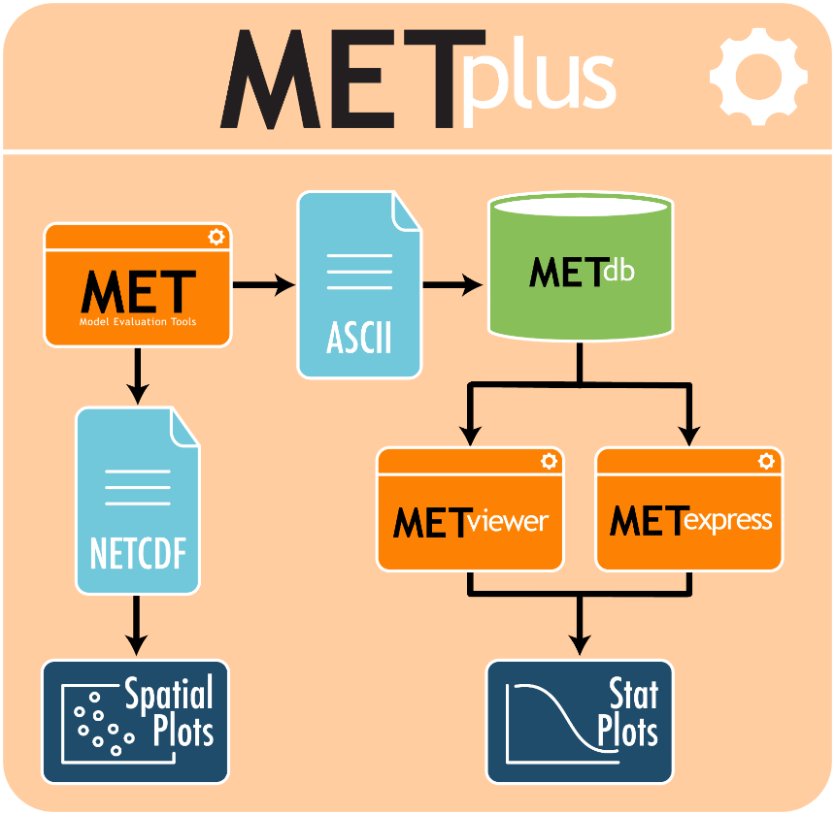
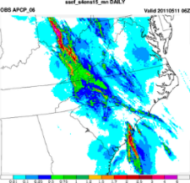
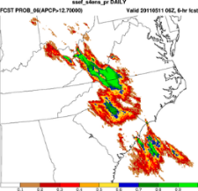
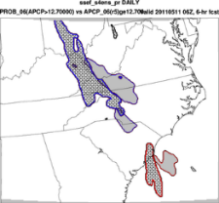
METplus
Selected to be the NOAA Unified Forecast System (UFS) verification capability
Will be used part of NCAR’s System for Integrated Modeling of the Atmosphere (SIMA)
Over 100 traditional statistics using both point and gridded datasets
8 Spatial and Diagnostic methods
Applied to many spatial and temporal scales
Applied to many applications
Object Based and Spatial Methods
Originally developed to replicate and extend the EMC mesoscale and NHC tropospheric verification systems
Platform independent and extensible
Outstanding helpdesk support
Online and in-person tutorial
Container Support
3500+ users; Int’l and US
Python wrappers around:
MET (core)
MET database and display systems (core)
Plotting
  METviewer User Interface
  METviewer Batch Engine
  Python plotting scripts
Communication between MET & Python algorithms
Extensions to other verification packages
Bad forecast or
Good forecast
with displacement
error?

Slide 3
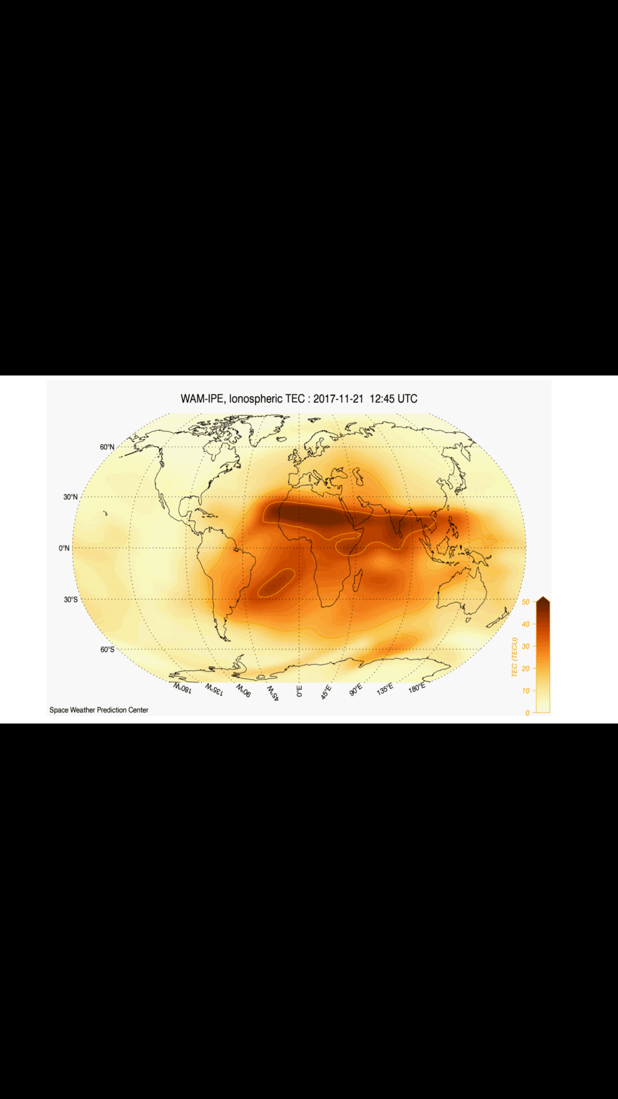
WAM-IPE Model Development
Whole Atmosphere Model (WAM) coupled with the Ionosphere Plasmasphere Electrodynamics (IPE) model with WAM Data Assimilation System (WDAS) running on WCOSS-Dev
Whole Atmosphere Model:
Extended GFS (up to 600 km)
Drives ionosphere model (one way coupling)
Imparts terrestrial weather structures onto the ionosphere.
      planetary, tidal, gravity waves
Forecasts of Ionospheric/Thermosphere conditions support users of GPS/GNSS, HF Radio, Satellite Com. Satellite Drag,…
Courtesy of Rodney Viereck, NOAA SWPC

Slide 4
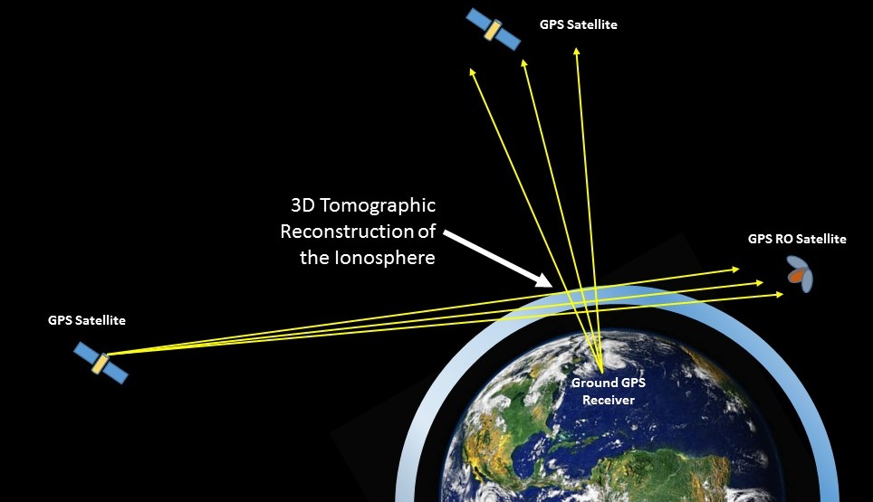
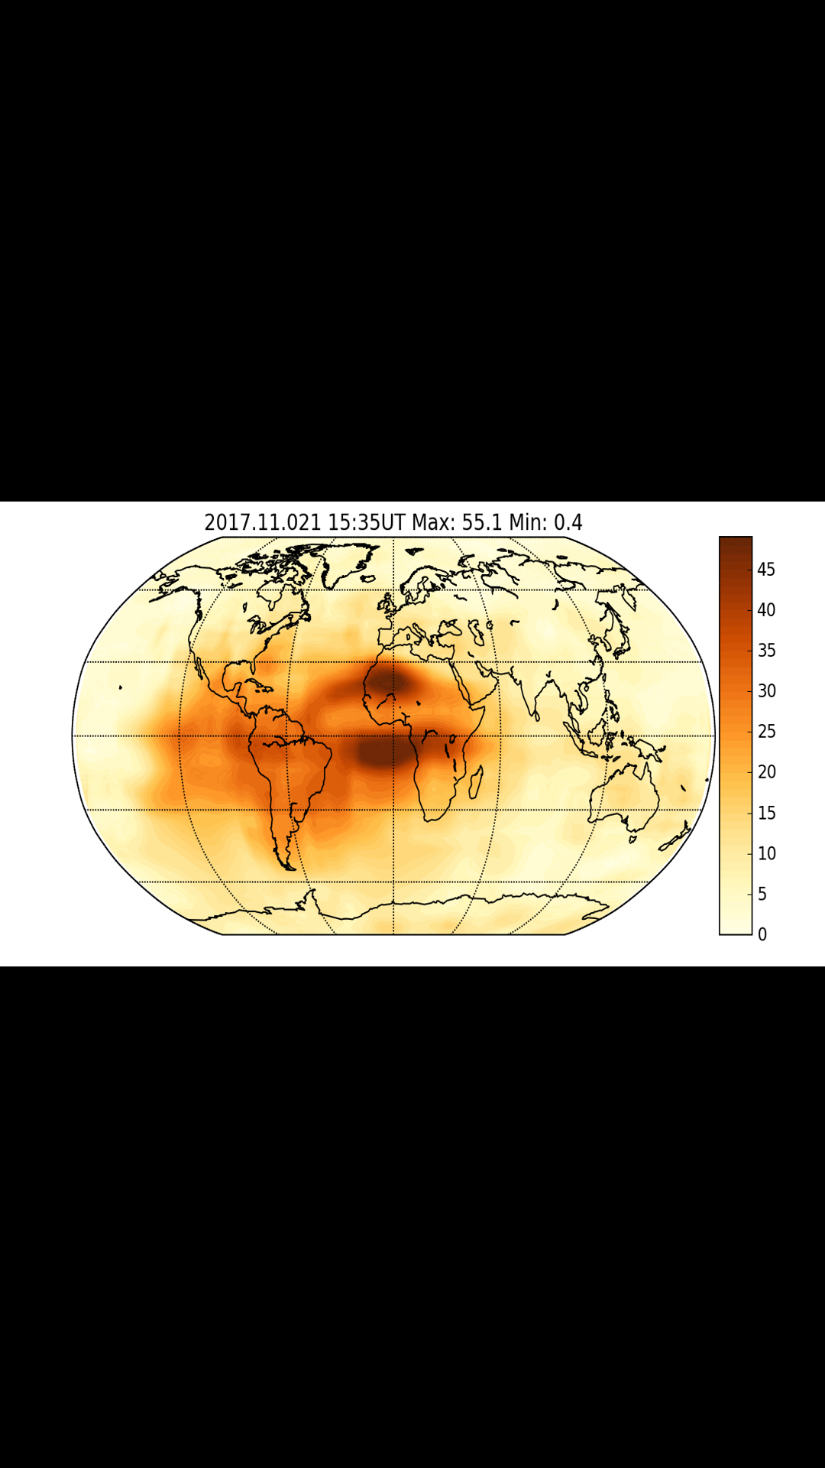
GloTEC Model and COSMIC 2 Data
Assimilative model of the ionosphere
Global Total Electron Content (GloTEC):
  Combines ground-based and space-base (COSMIC) GPS/GNSS observations to create a 3D assimilative map of the ionosphere
  Proves specification of parameters relevant to a number of users
    GPS/GNSS, HF Communication, Satellite Communication
Courtesy of Rodney Viereck, NOAA SWPC
TEC Units
GloTEC Total Electron Content

Slide 5
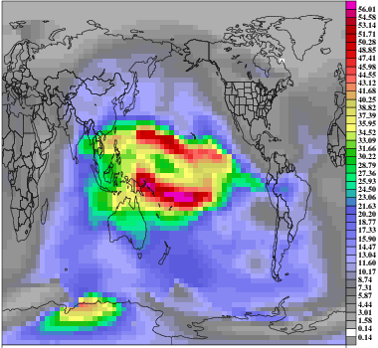
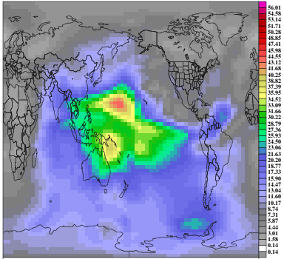
MET Example: WAM-IPE vs GloTEC
Provided by NOAA Space Weather Prediction Center
6 days of data – 21-26 November 2017
Forecasts every 15 minutes
Observations every 10 minutes
Evaluation performed on the intersection of
the datasets (aka every 30 minutes)
MET Tools
MODE
MODE-TD
Wavelet
Stat
Grid
Stat
Series
Analysis
Ensemble
Stat
Point
Stat
WAM-IPE
GloTEC

Slide 6
Grid-Stat Tool in MET
Computes
Traditional Continuous Statistics such as Error (also Mean Error, Bias), RMSE, MAE
Traditional Categorical Statistics such as Probability of Detection and False Alarm Ratio
Neighborhood Statistics such as Fractional Skill Score and Distance Map Metrics

Slide 7
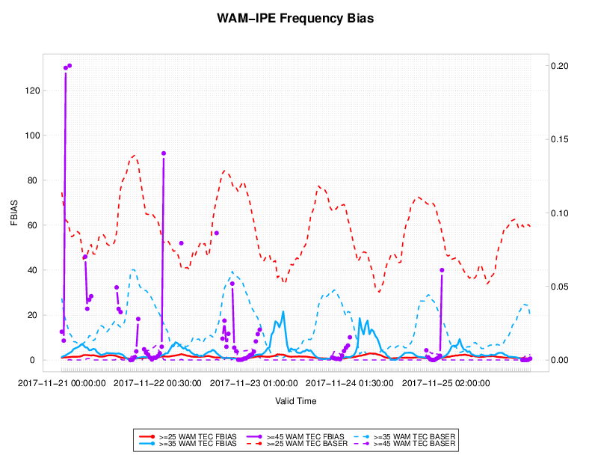
MET Tool: Grid Stat
# Forecasted Events
# Observed Events
Optimal = 1
# Observed Events
Sample Size
Optimal = 1
Legend: >25
>35
>45
Frequency Bias
Base Rate

Slide 8
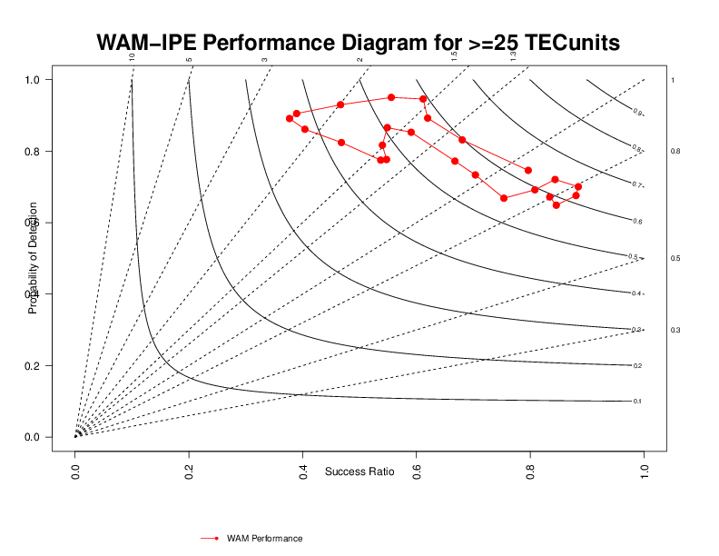
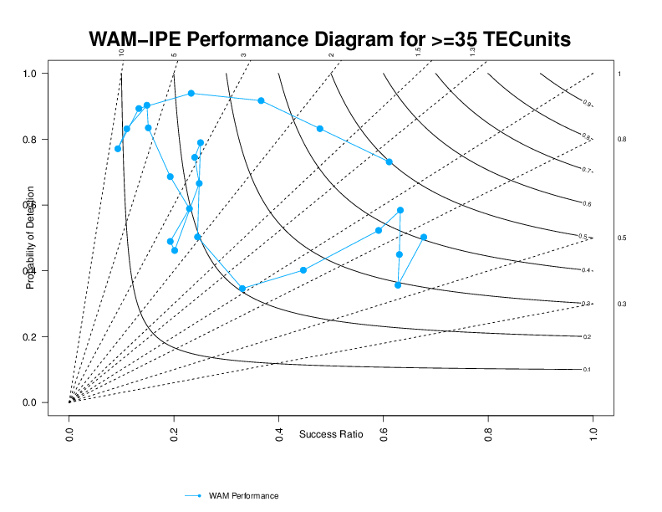
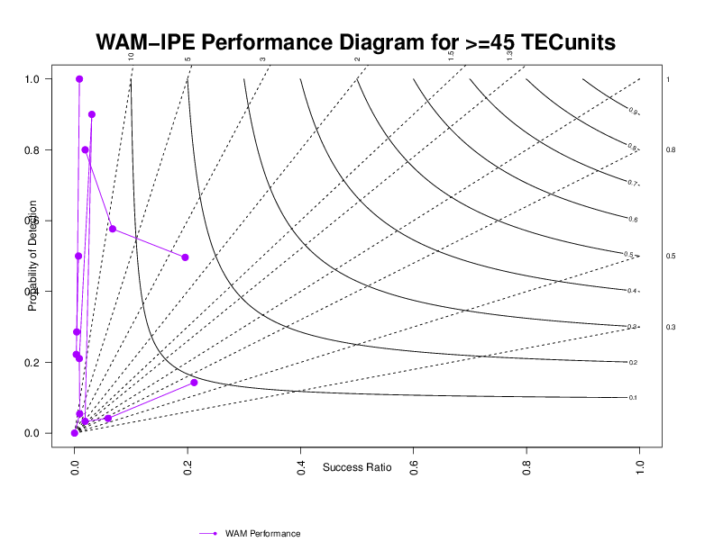
MET Tool: Grid Stat
Optimal
00 UTC
23 UTC
Optimal
00 UTC
Optimal
23 UTC
00 UTC
Performance Diagram:
Synthesis tool that plots 4 categorical scores on 1 diagram. Above blue line: over-forecast; Below blue line: under-forecast; Upper right is optimal
23 UTC

Slide 9
MODE Tool in MET
Identifies objects in the 2 gridded fields based on user settings. Matches the objects across fields. Computes object attributes.

Slide 10
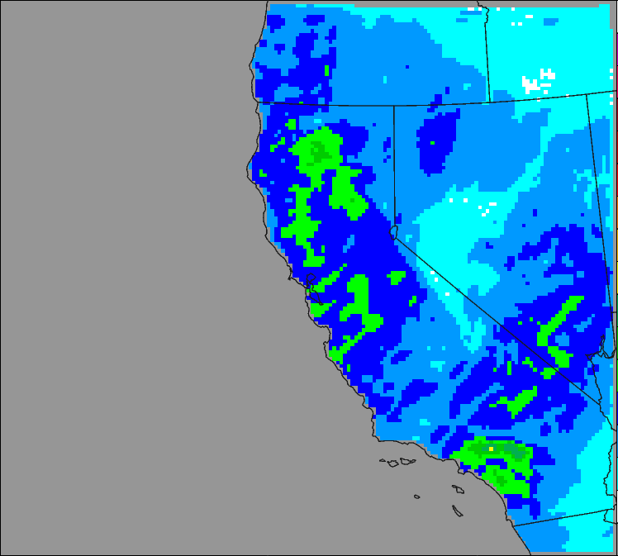
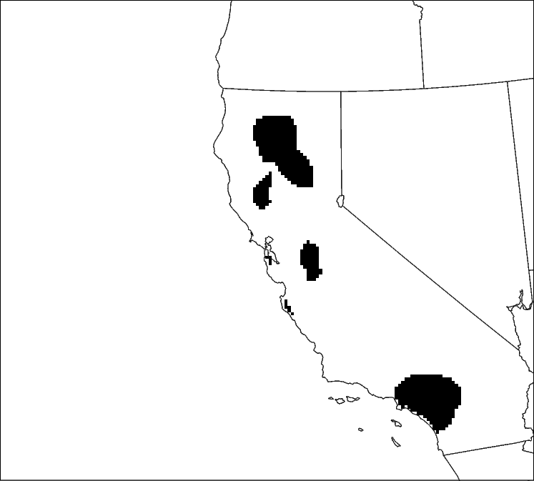
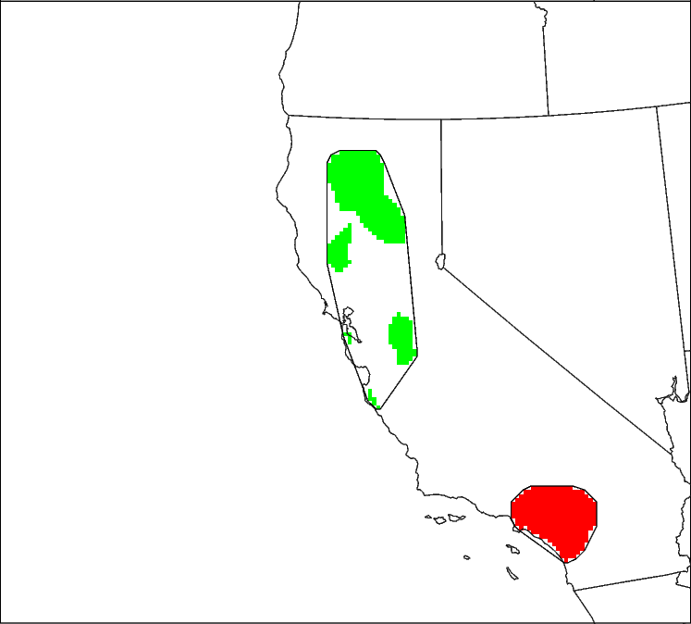
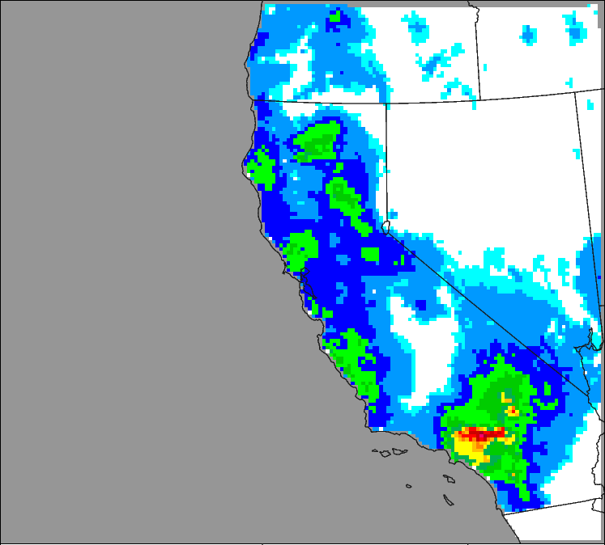
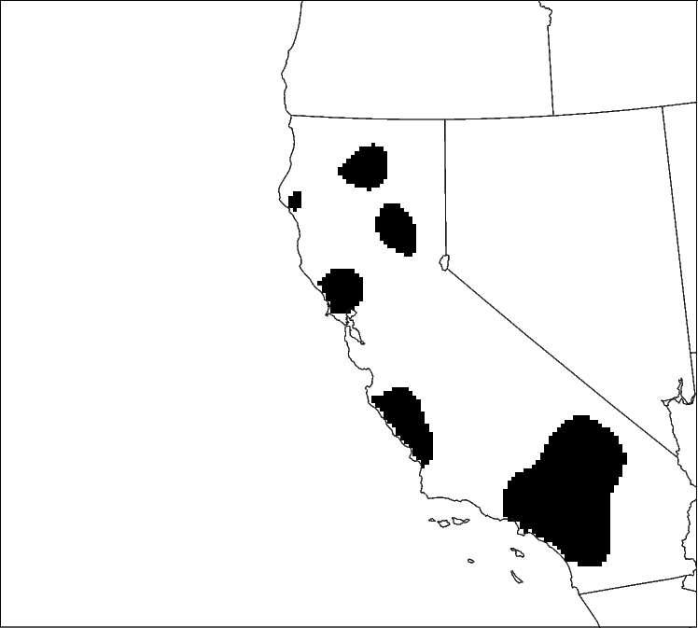
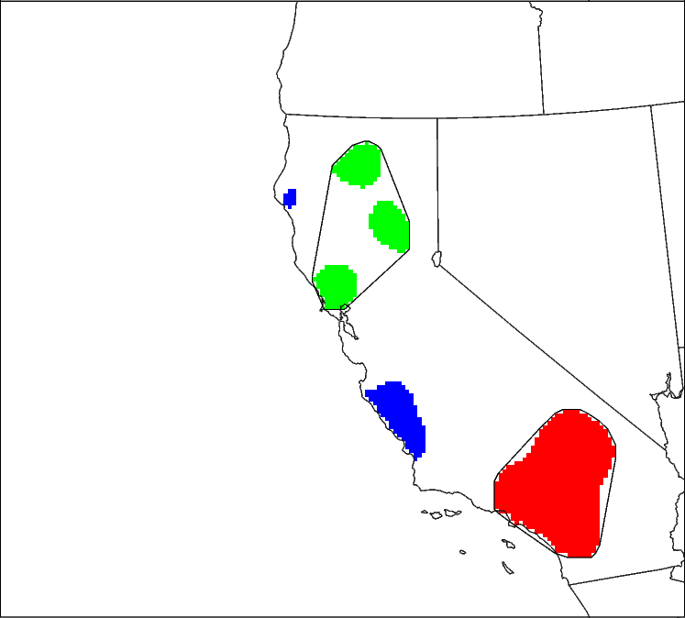
MET Object Oriented Method: MODE
Precipitation Forecast versus Analysis Field
ENS FCST
OBS
Radius=5
Thresh>0.25”
Radius=5
Thresh>0.25”
Merging
Merging
No false alarms
Misses
Matching

Slide 11
Use of Pair Attributes defined by MODE
Forecast
Field
Analysis
Field
Centroid Distance: Provides
a quantitative sense of spatial
displacement of forecast.
0 is optimal
Axis Angle: For non-circular
objects – gives measure of
orientation errors.
0 is optimal
Area Ratio: Provides an
objective measure of whether
there is an over- or under-
prediction of areal extent of forecast.
1 is optimal
Area Ratio =
F Area
A Area

Slide 12
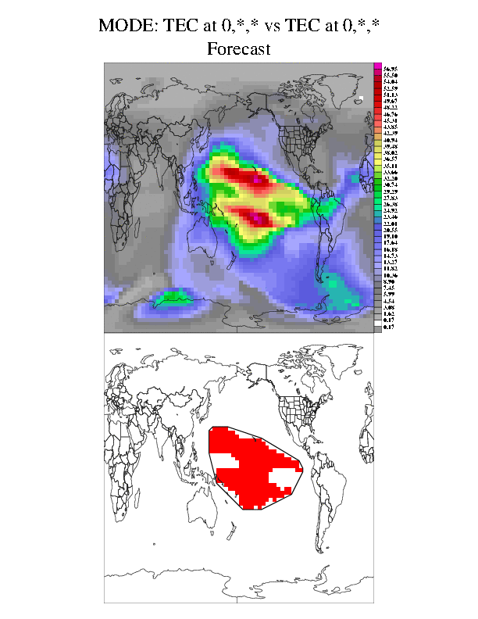
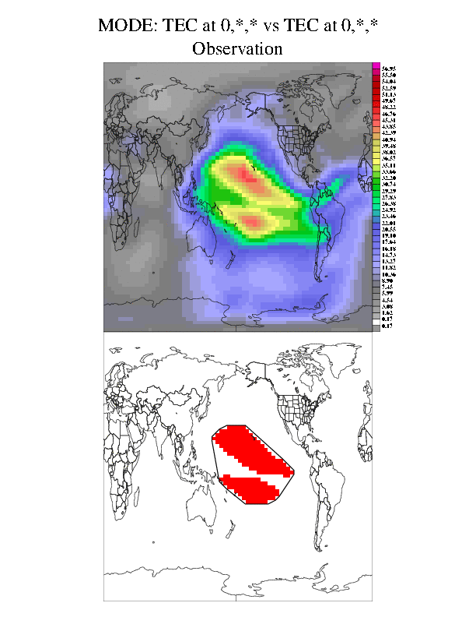
MET Tool: MODE
WAM-IPE >45 TECunits
GloTEC >45 TECunits

Slide 13
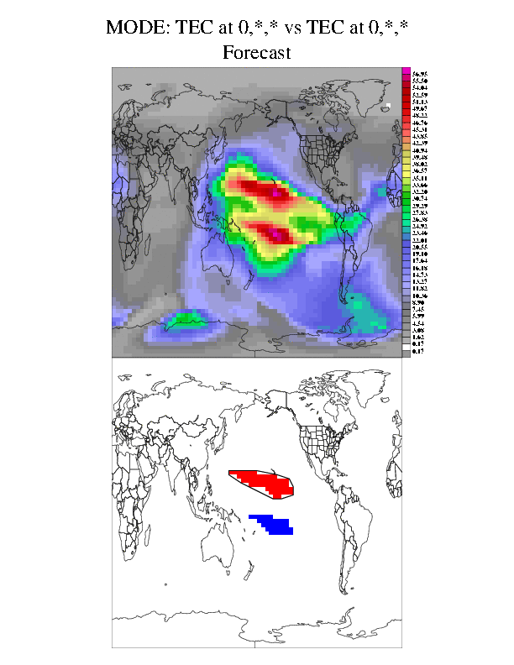
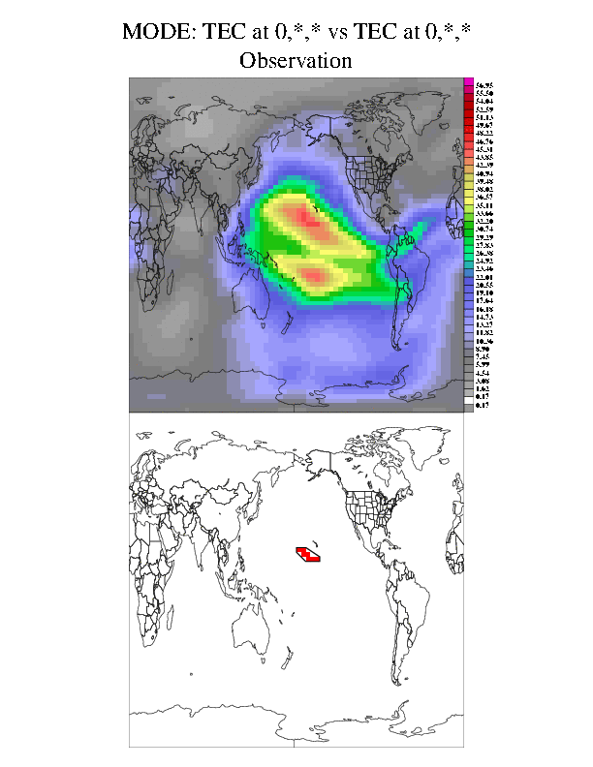
MET Tool: MODE
WAM-IPE >45 TECunits
GloTEC >45 TECunits

Slide 14


MET Tool: MODE
WAM-IPE >45 TECunits
GloTEC >35 TECunits
WAM-IPE bias confirmed by other more traditional statistics over several cases
This information was fed back to SWPC developers who were able to made adjustments

Slide 15
Series Analysis Tool in MET
Computes statistics at each grid-point across a series of time or height or whatever series makes sense

Slide 16
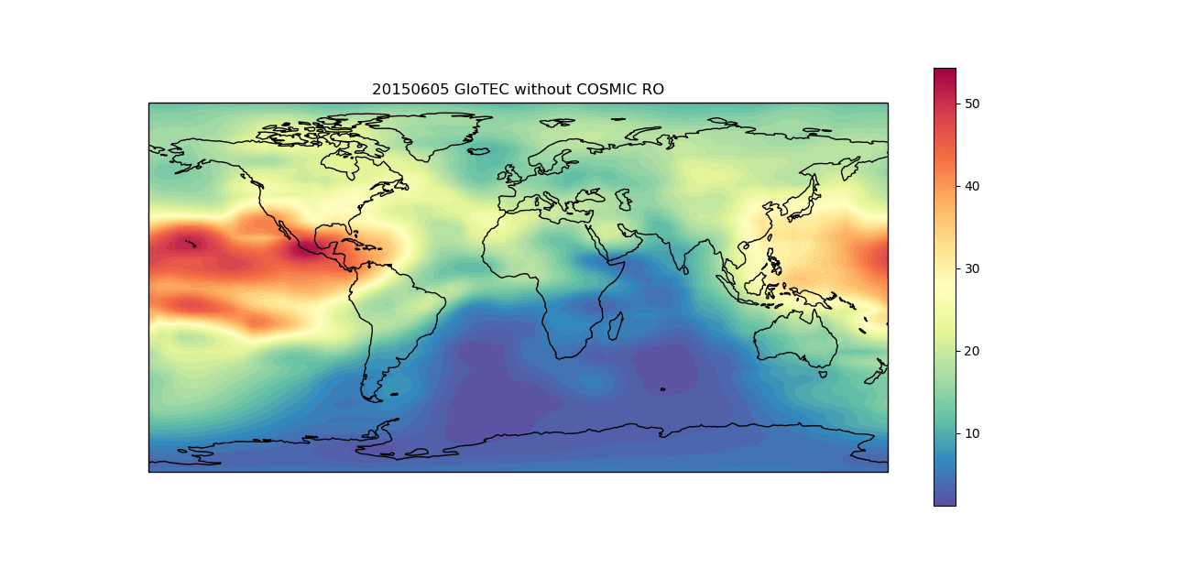
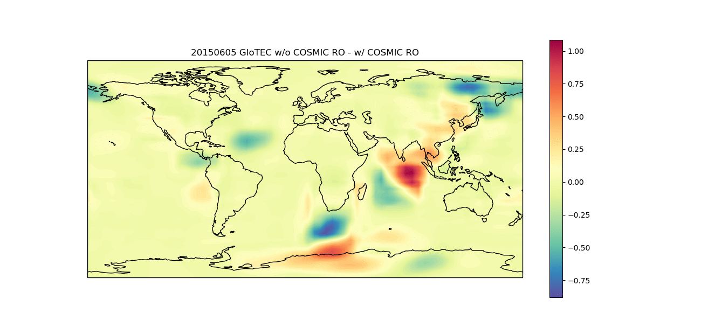

GloTEC With and Without COSMIC RO

Slide 17
Other Tools and Future Work
Masking to evaluate over Regions of Interest
Evaluations of Ensembles
Computing Climatology Based Percentile Thresholds
Neighborhood Methods for Point Data
Computation of Statistics from Time Series Data

Slide 18
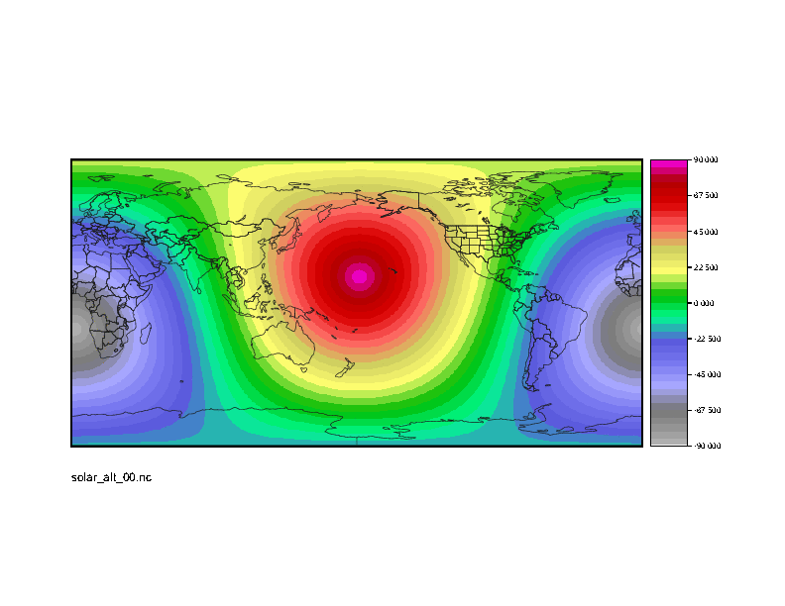
Gen-Vx-Mask: types
Lat/Lon File
  Polyline (poly)
  Box
  Circle
  Track
Gridded data file
  Grid
  Data (e.g. qc flag, terrain, etc…)
  Lat or Lon bands
Gridded data file or timestamp
  Solar Altitude (solar_alt)
  Solar Azimuth (solar_azi)

Slide 19
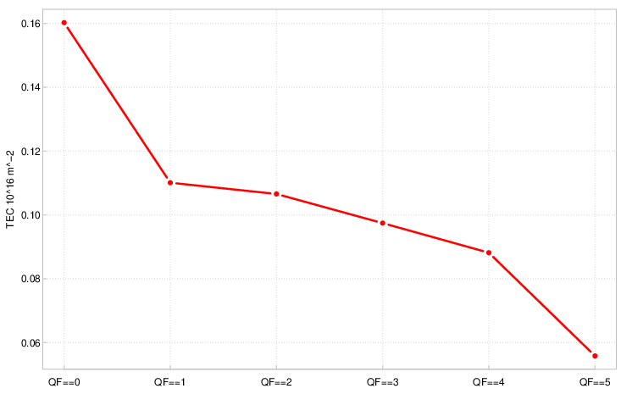
Example: Data Density Flag Masking
Difference in TEC without and with RO
More difference
in data sparse
regions
Less difference
when ground-based observations
available
QF = number
of voxel’s passing through a grid point

Slide 20
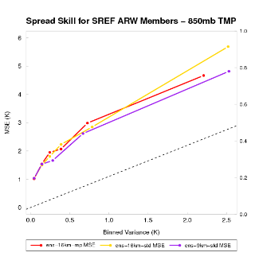
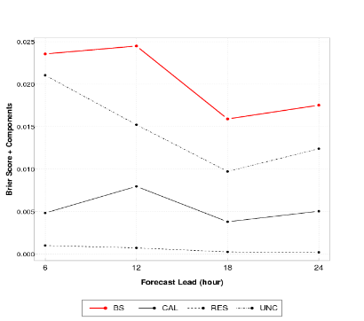
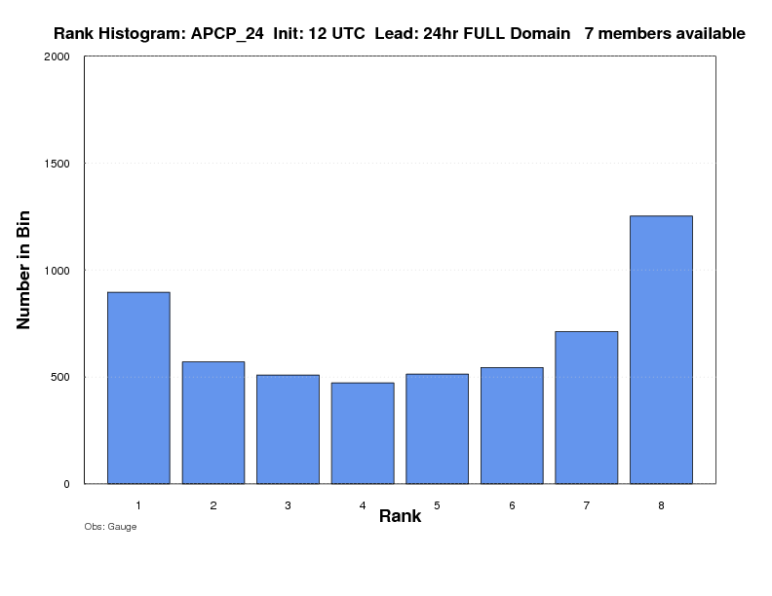
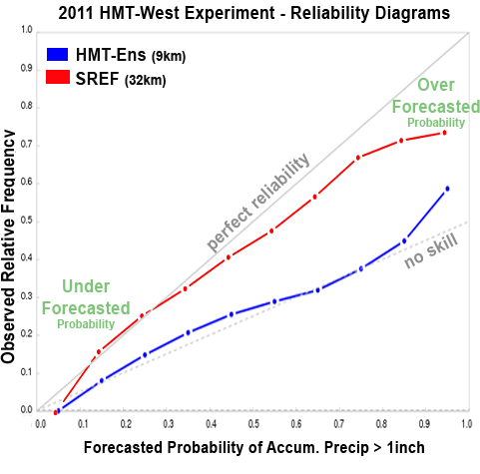
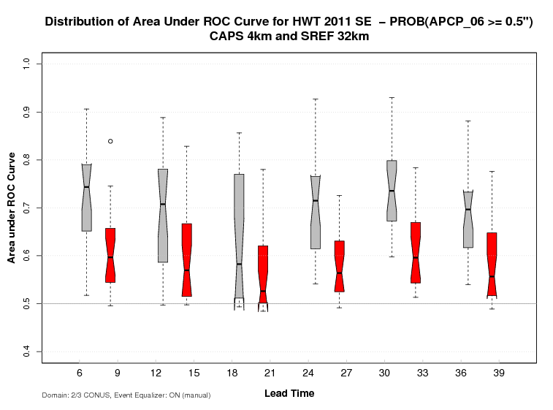
MET Ensemble and Probability Evaluation
Ensemble Characteristics (Ensemble Stat)
Probability Measures
(Grid and Point stat)
CRPS, CRPSS
Ignorance Score
Spread-Skill
Rank Histogram
PIT, RELP
Brier Score + Decomposition
Brier Skill Score
ROC and Area Under ROC
Reliability

Slide 21
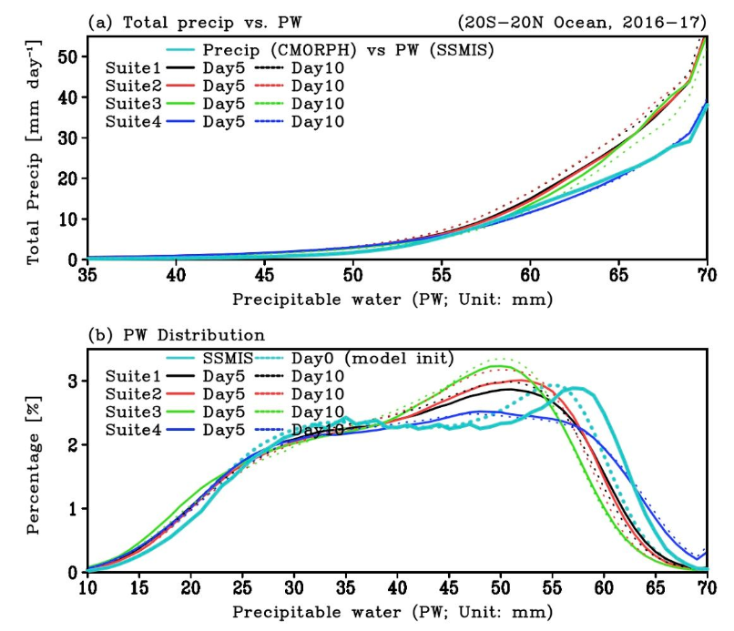
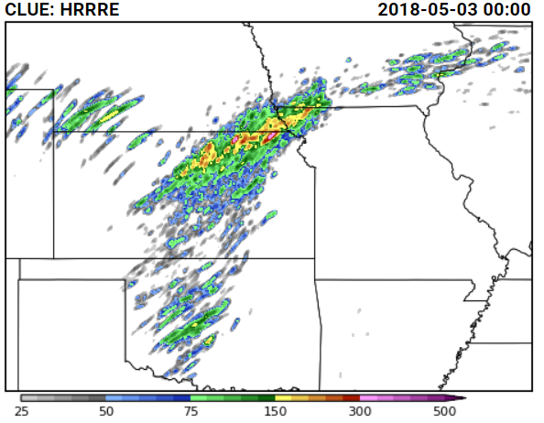
Philosophy: One Tool - Many Applications – GridDiag Tool
S2S
Inventories the data
Develops the PDF (one or two-dimensional)
User configurable bins for PDF and percentiles
Writes out – or holds in memory – bins or percentiles for use by other tools ( Grid-Stat, Point-Stat, MODE, MTD)
Correlate
distributions
of two fields
Space
Weather
CAM
Normalize
fields based
on their
sample
climatology
Adapt
measures
to regional
max values
Updraft Helicity

Slide 22
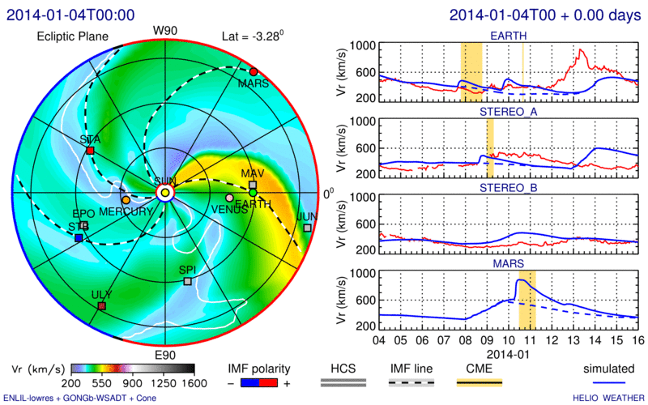
From CCMC:
Coronal Mass Ejections (CMEs).
Validating the arrival time and Peak observed CME speed (or density, or magnetic field) compared to the predicted speed as it passes over the spacecraft.
Interesting Features in Time Series

Slide 23
HiRA Framework
STB .
Example Original Model Forecast
White boxes <= value
Colored boxes > value
. Earth
Deterministic forecasts matched to point observations.
Neighborhood fraction of events in place of probability forecast.
Allows for some spatial / temporal uncertainty in either model or observation by giving credit for being ‘close’.
Allows for comparison of deterministic and ensemble forecasts via the same set of probabilistic statistics.
Also allows for comparison of models with different grid resolutions via adjustment of neighborhood size.
Example HiRA applied to model
Blue boxes = events
HiRA proportion
Neighborhood size 1: 1/1
Neighborhood size 9: 1/9
Neighborhood size 25: 4/25
Mittermaier, 2014

Slide 24
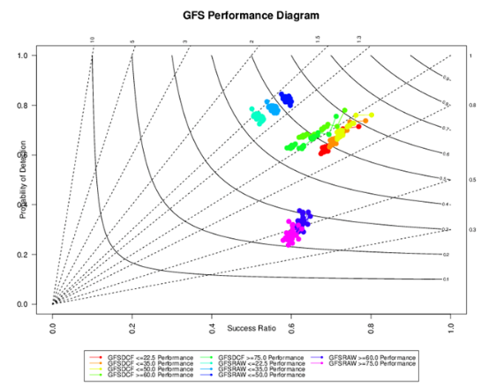
Future Work
Peaks in Solar Wind
Python – Read Time Series and format to pass to MET Tool
MET:
Stat-Analysis
Statistics

Slide 25
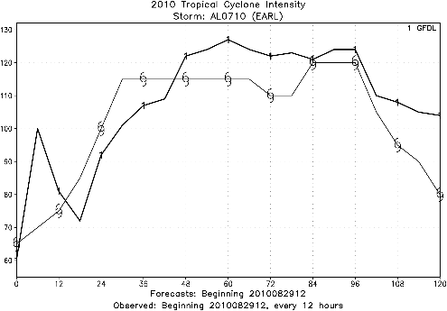
Rapid Intensification (RI) Events
Original support for tropical cyclone verification then expanded for other applications
Events identified by automated algorithm or user defined criteria of
DI / DT
OBS
Speed (m/s)
FCST
Also applicable to any intensity change event
Renewable Energy Ramps
Solar Wind during CMEs
Magenetic Field
Temperature
Miss
Hit: Flexible Event Definition (i.e., Fcst and Observed Track both fall into an 18 hour window)
Categorical statistics for RI or Rapid Weakening events (RW) can be computed

Slide 26
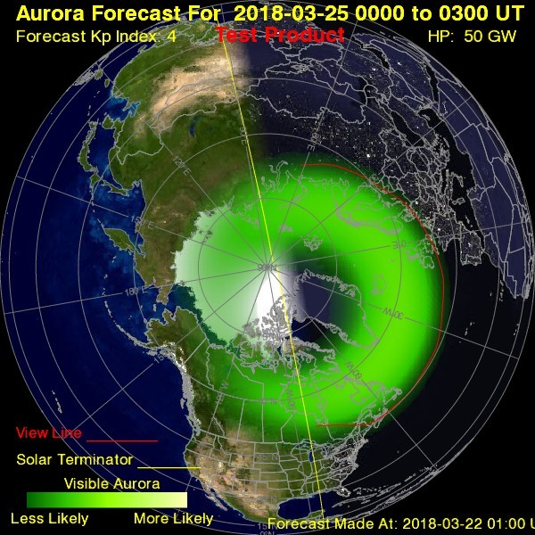
MODE for Aurora Forecasts
Outer Ring
Edge
Inner
Ring Edge
Working with SWPC and CCMC on Aurora
Forecast Evaluation
Using MODE to characterize the Inner and Outer Ring Edge

Slide 27





Thanks
All help requests go through MET Helpdesk: met_help@ucar.edu
Contacts: Tara Jensen – jensen@ucar.edu and John Halley Gotway – johnhg@ucar.edu
Users Page: https://dtcenter.org/community-code/metplus
METplus GitHub: github.com/NCAR/METplus
MET GitHub: github.com/NCAR/MET
US Pre-compiled installations available on: Cheyenne, Casper, Stampede2, Hera, Jet, Gaea, WCOSS (all 6 platforms) – see https://dtcenter.org/community-code/model-evaluation-tools-met/download and follow the link to Existing Builds for more details
Where to get coordinated release and documentation
METplus work is funded by the DTC partners (NOAA, Air Force, NCAR and NSF), NOAA WPO, OSTI, and NESDIS, NASA, US Naval Research Lab, and Met Office (coming soon)

