Slide 1
The Impact of Ionospheric Plasma on the Magnetosphere
A Long History and a Changing Perspective
Rick Chappell—Vanderbilt University July 21, 2020

Slide 2
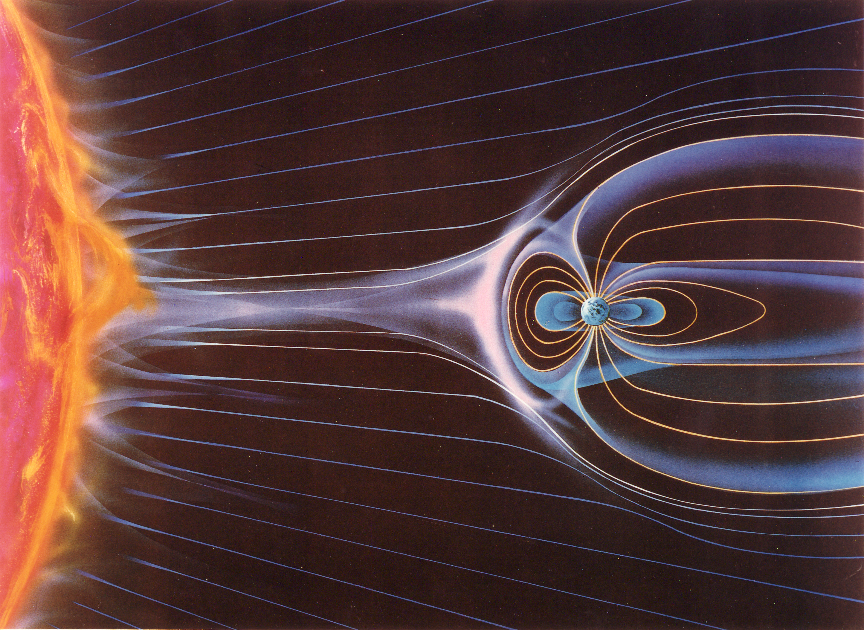

Slide 5
The Big Event!!
“Satellite Observations of Energetic Heavy Ions During a Geomagnetic Storm”
Ed Shelley, Dick Johnson, Dick Sharp— Lockheed Palo Alto Research Laboratory
The O+ ions had to come from the ionosphere and they were energized to magnetospheric energies! (What about the H+?? All solar wind?)

Slide 7
Polar Wind Theory-Banks and Holzer 1969 1970 Measurement-Hoffman 1980’s Polar Wind, Polar Cusp and Auroral Outflow—Dynamics Explorer, Akebono, Polar

Slide 8
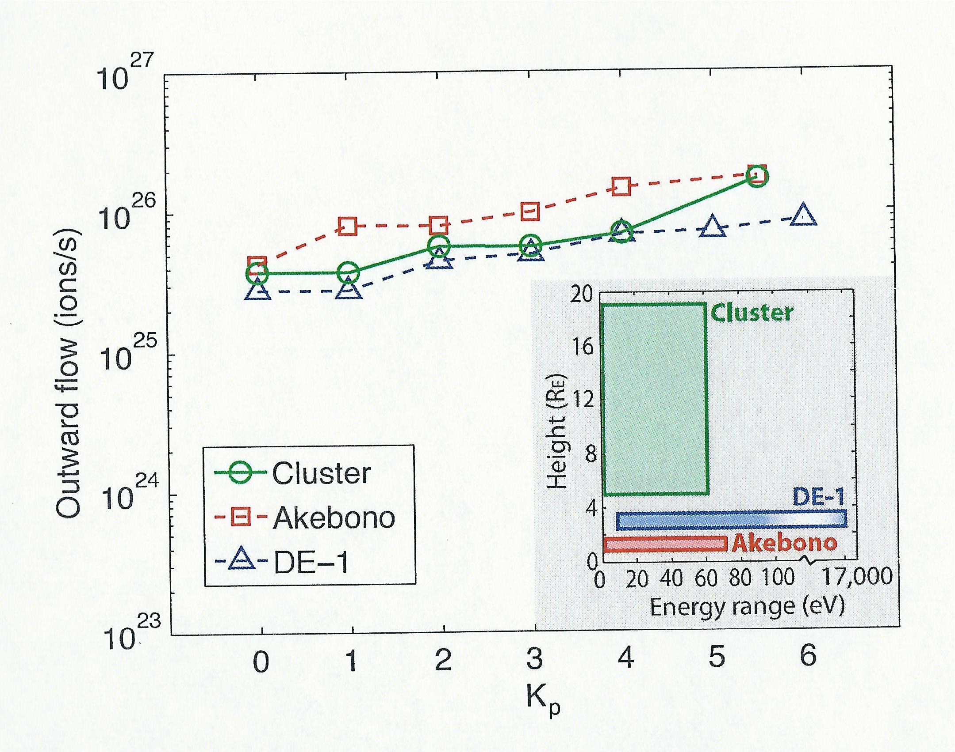

Slide 9
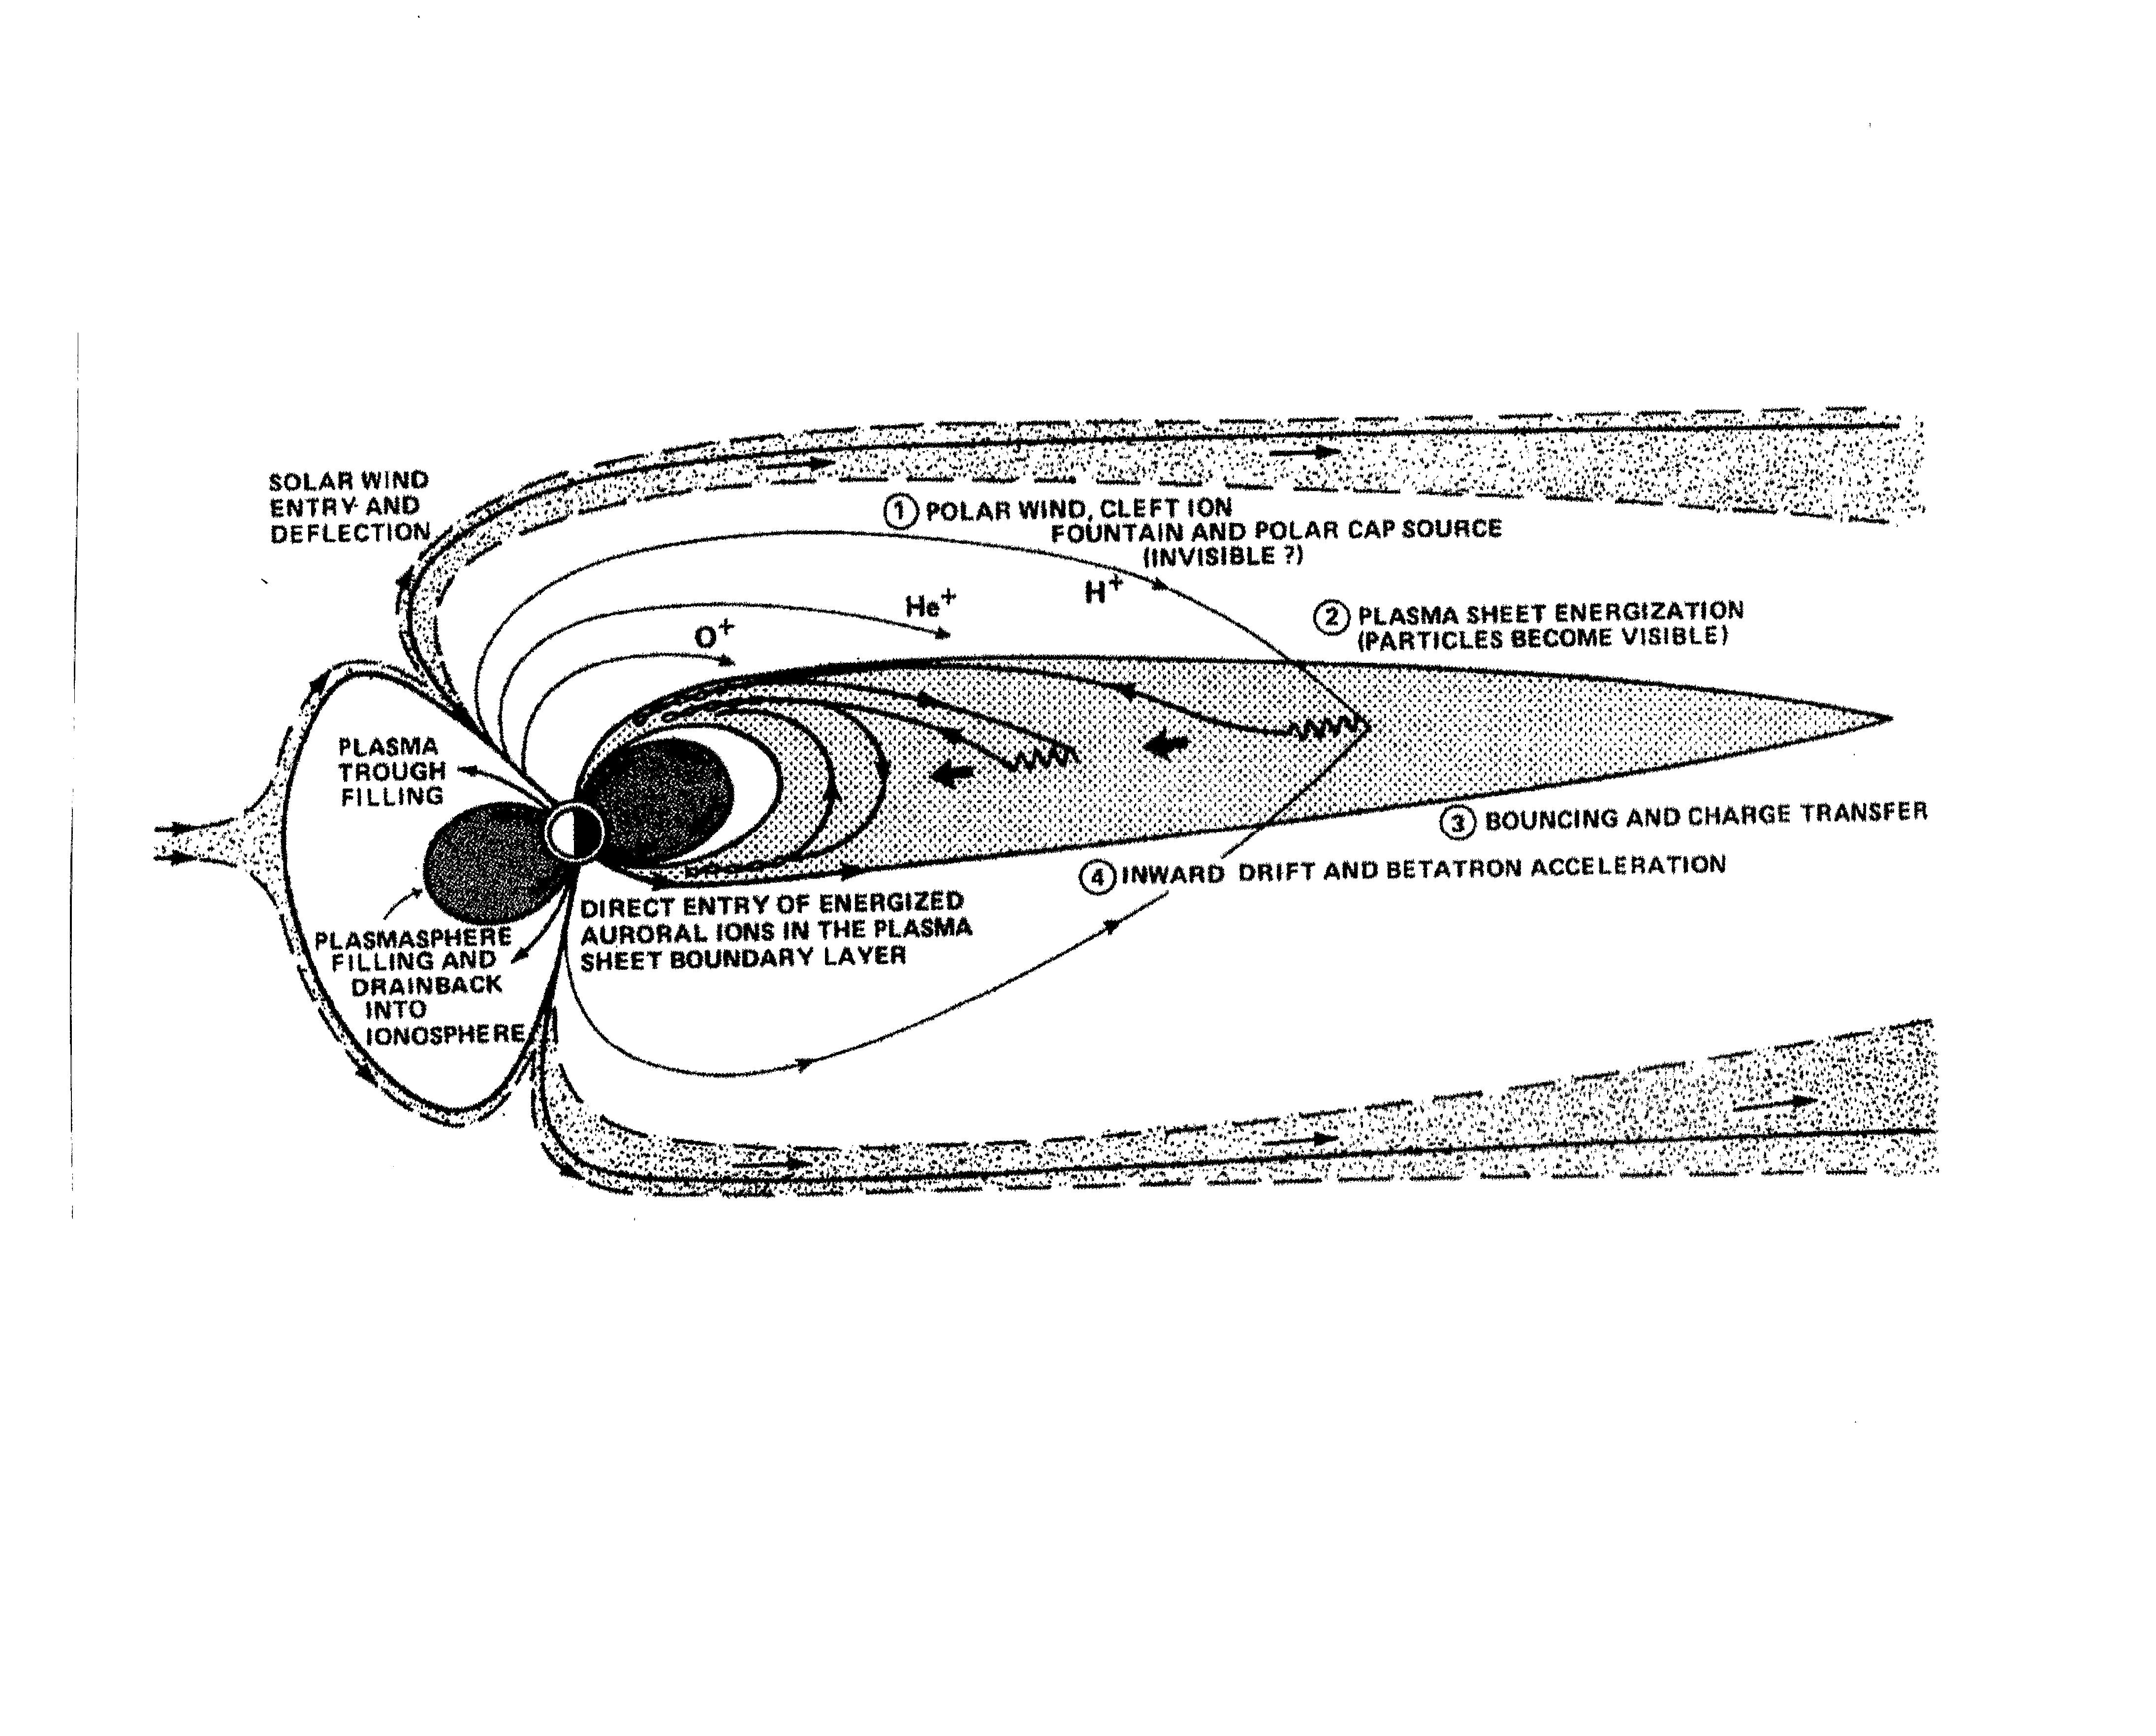

Slide 10
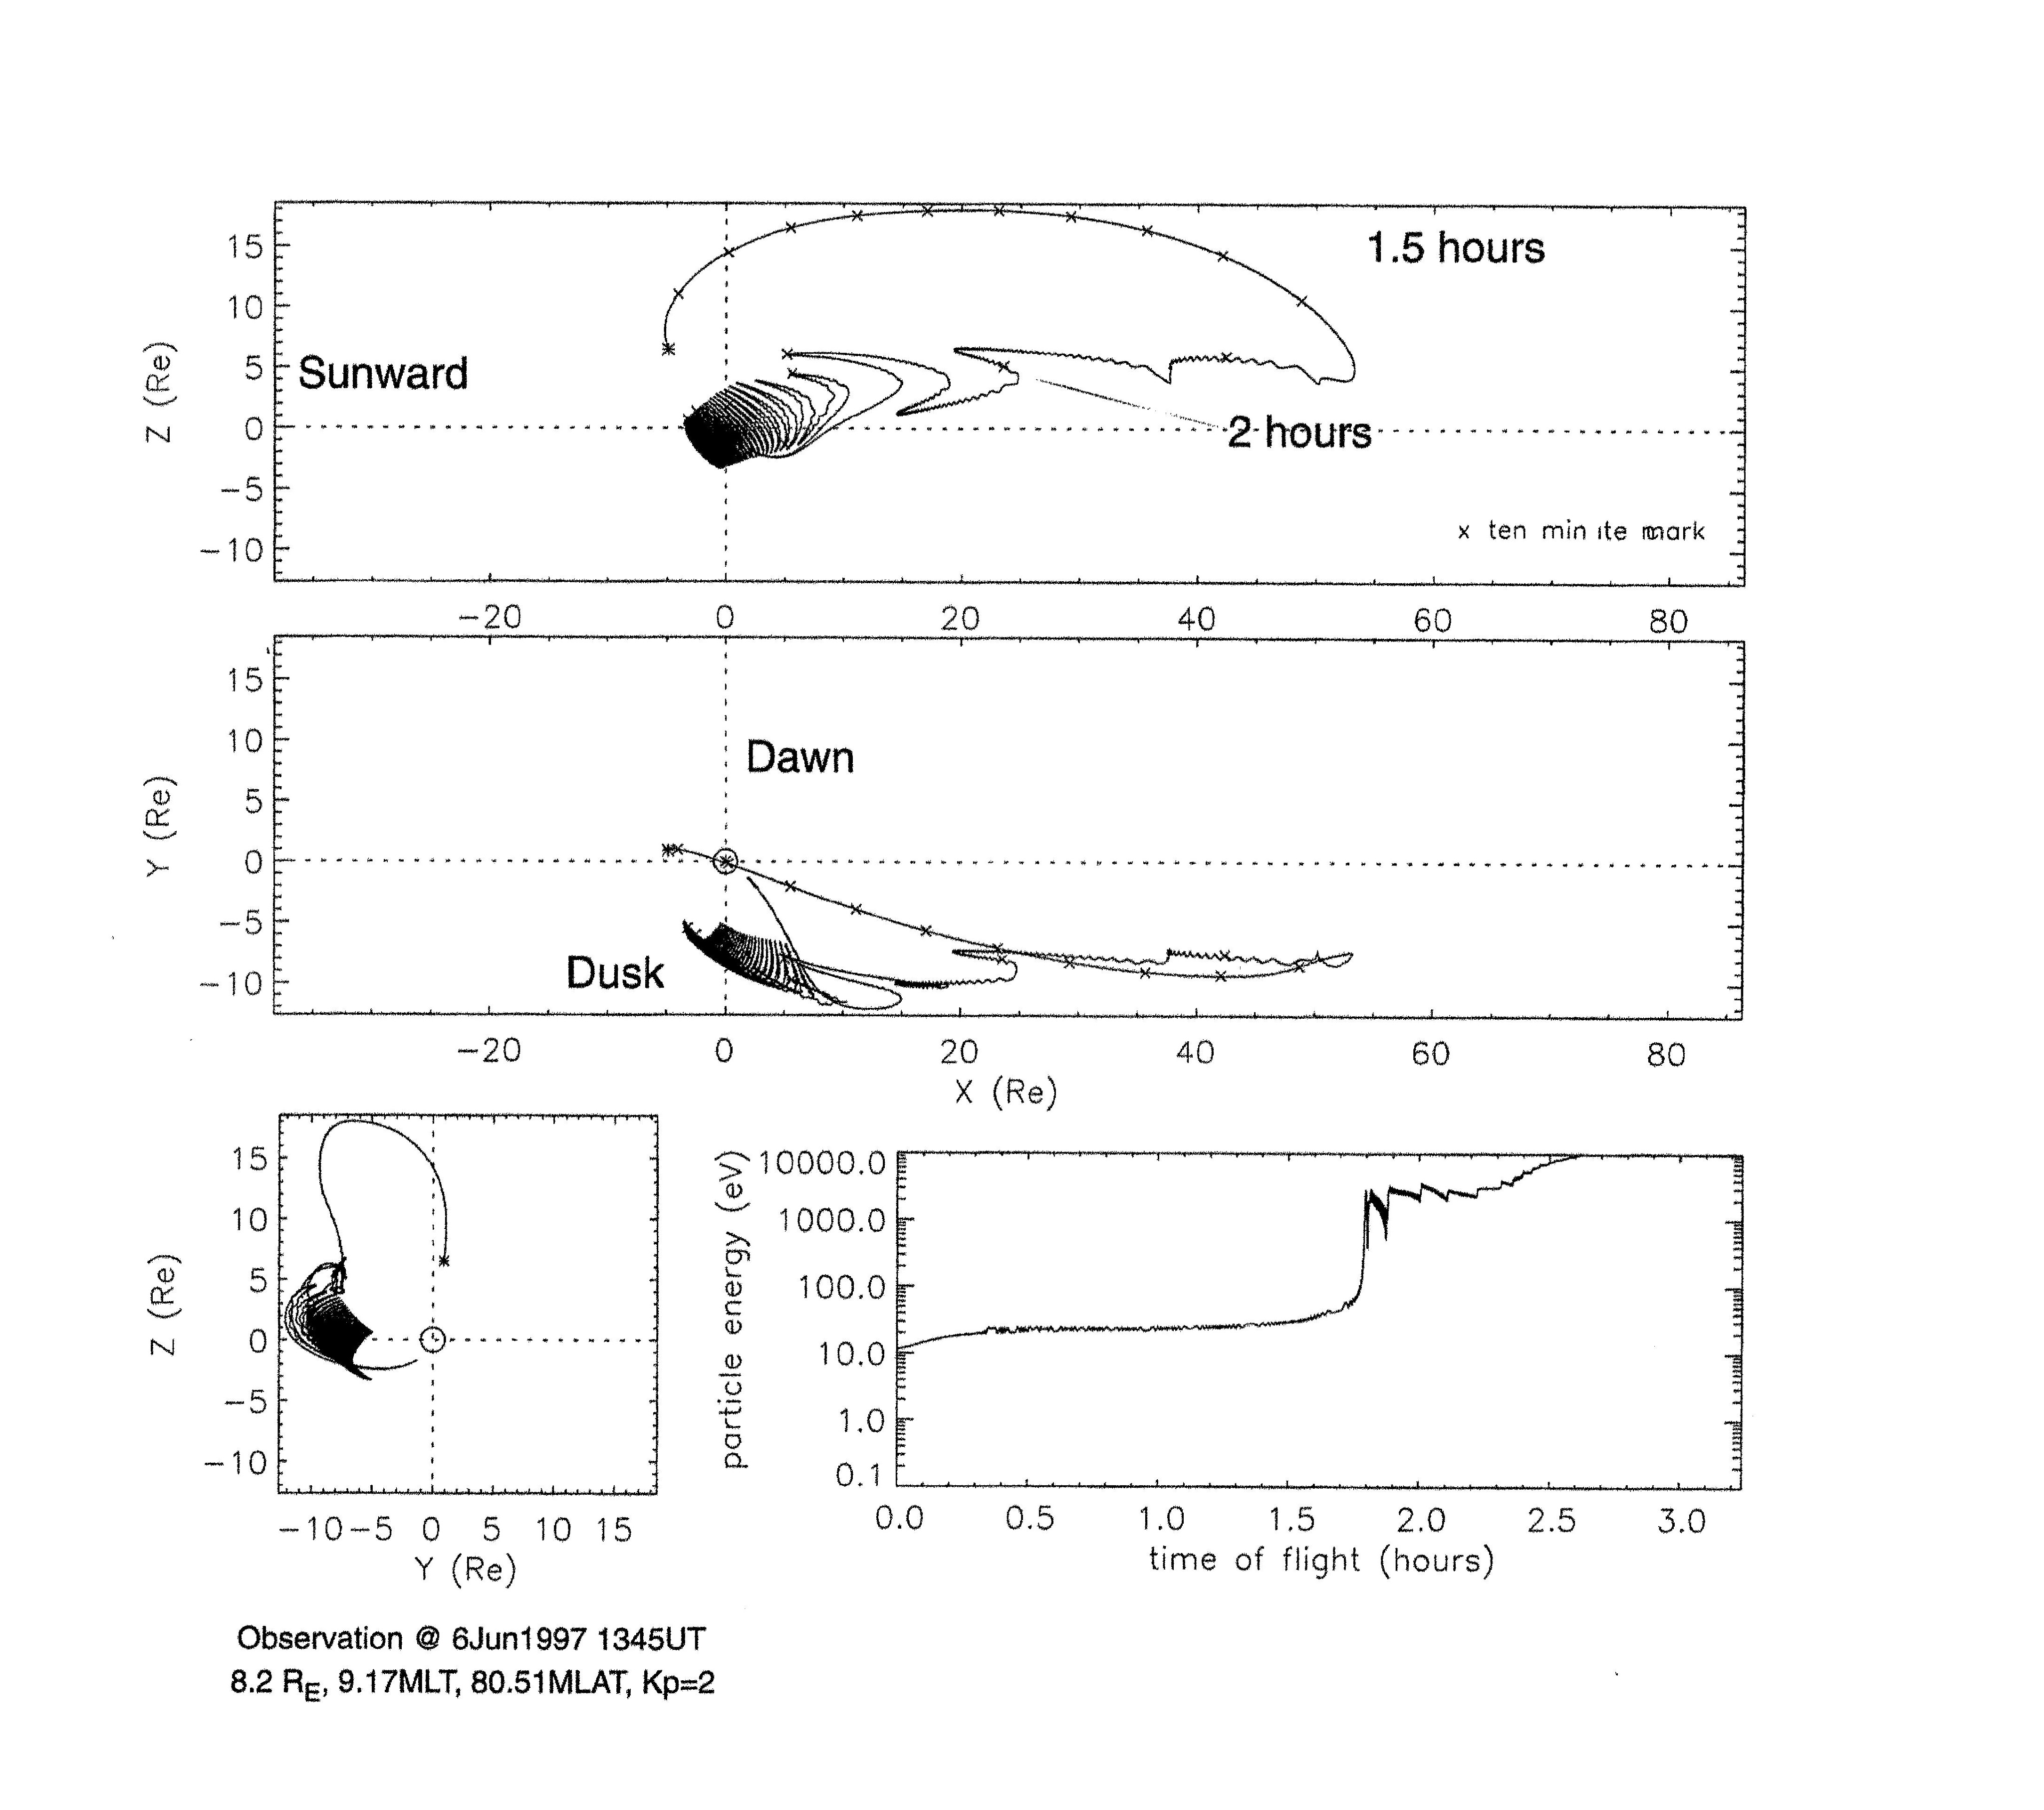

Slide 11
Ionosphere Making the Plasma Sheet

Slide 12
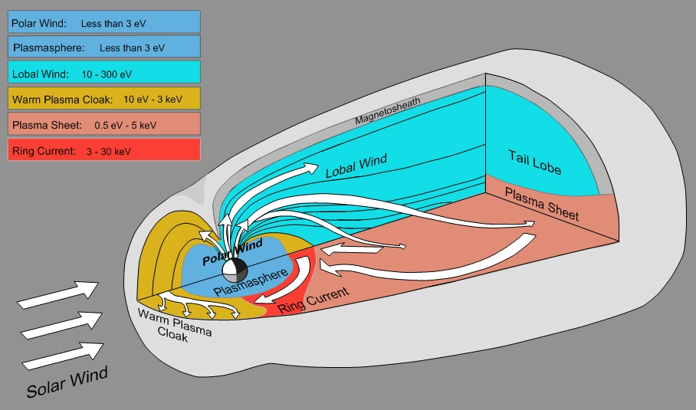

Slide 13
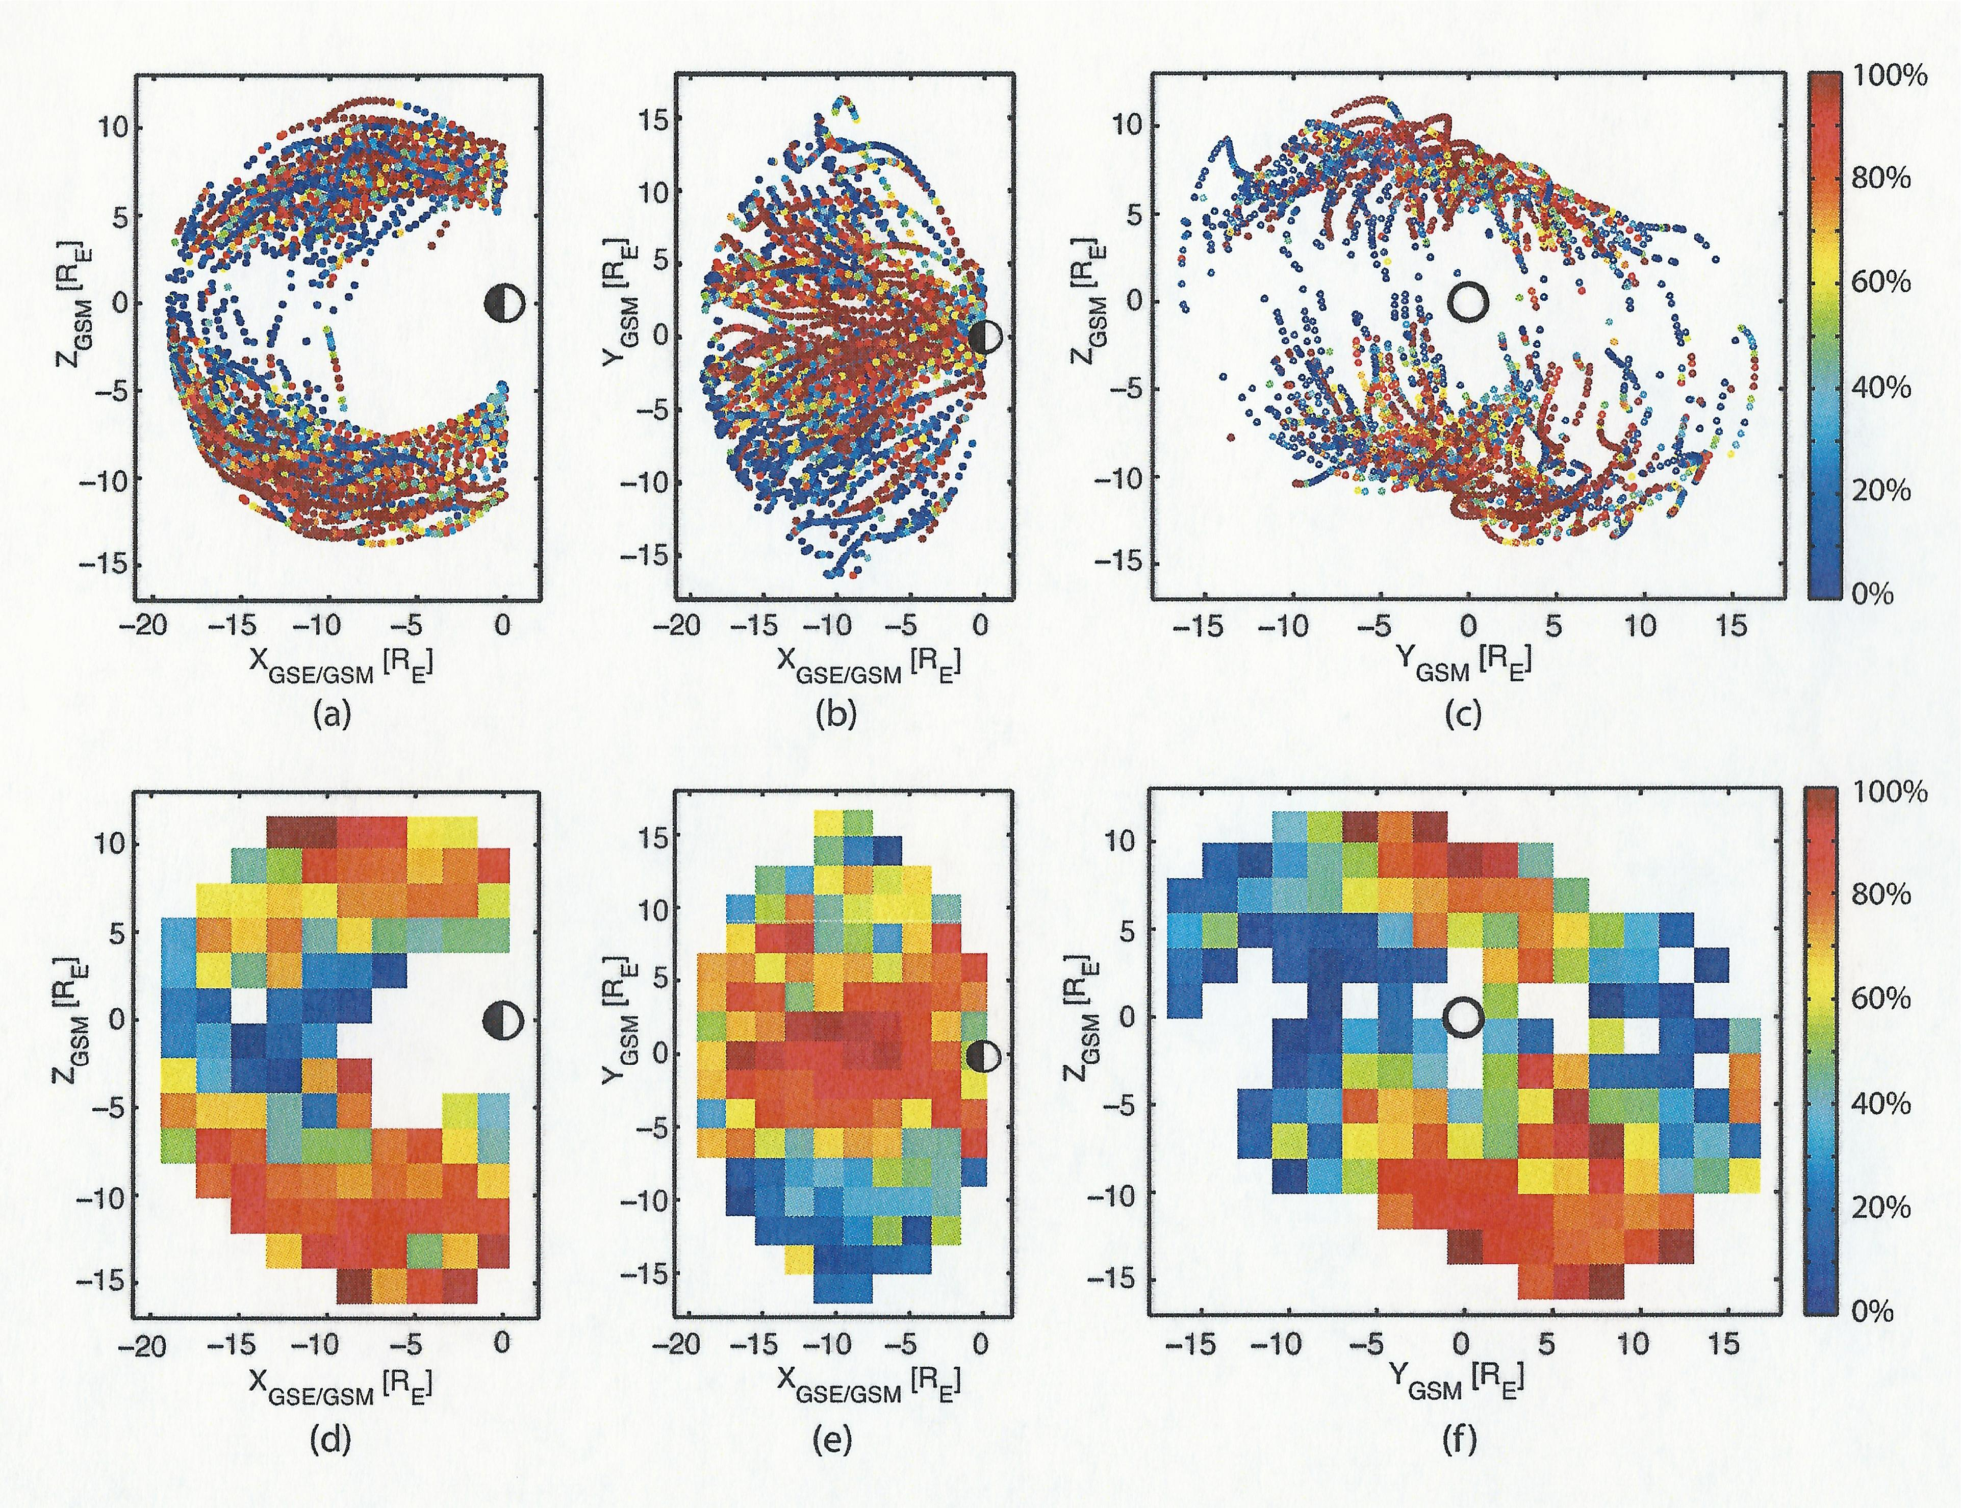

Slide 16
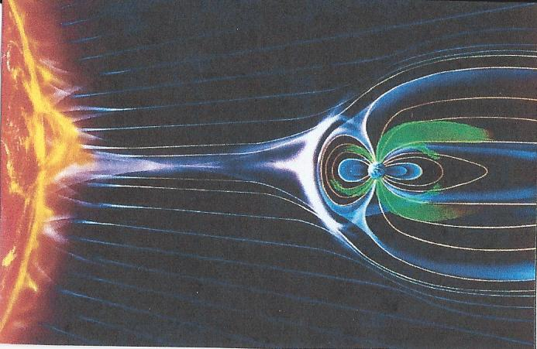

Slide 17
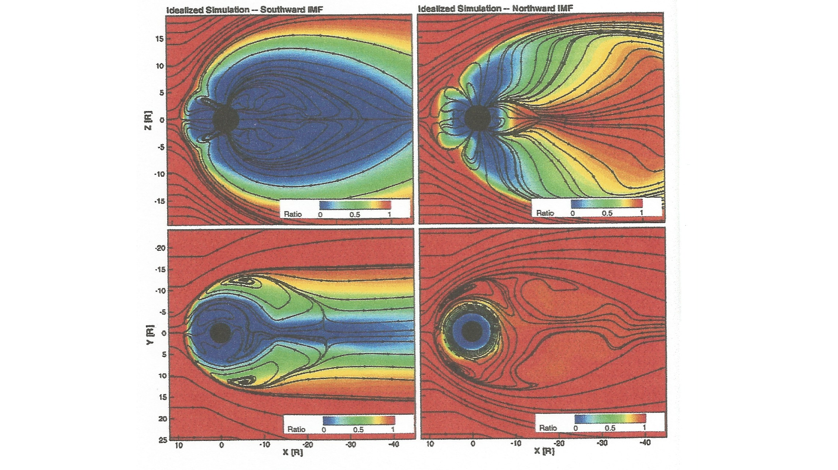
Welling 2010, Moore 2005

Slide 18
Glocer, 2020-Merged Ionosphere/Magnetosphere Multifluid Model-Separate Ionospheric H+ and Solar Wind H+

Slide 19
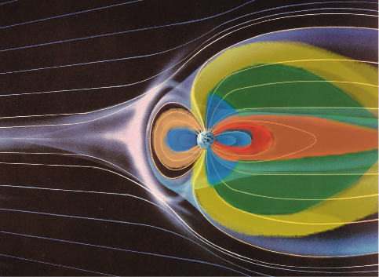

Slide 21
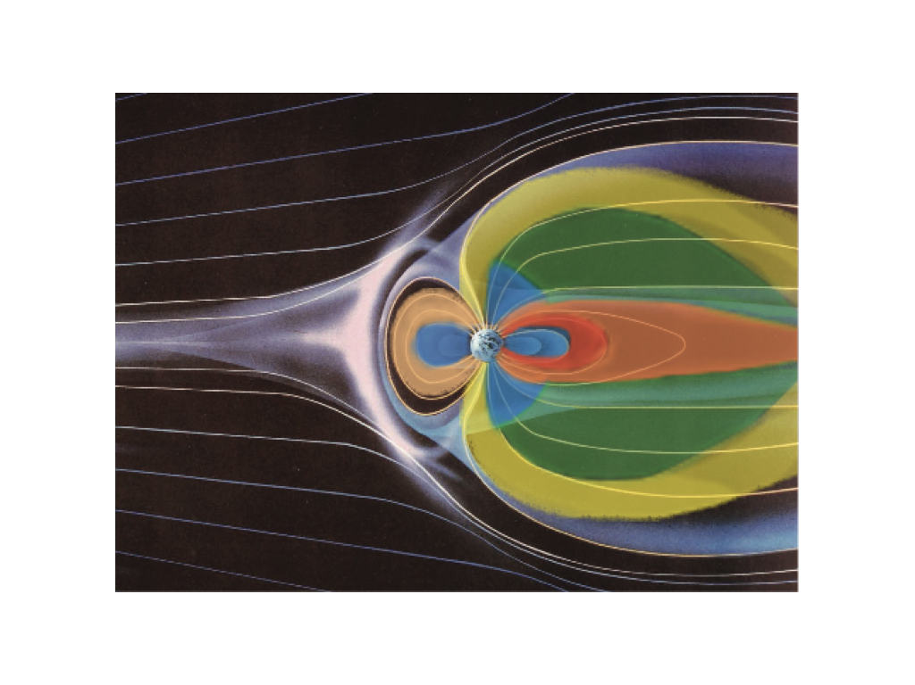
Ionospheric Effects on Reconnection at the Magnetopause and the Magnetotail

Slide 22
Summary
Ionospheric plasma plays a major role in populating the magnetosphere and affecting its dynamics
(Cold)—polar wind, plasmasphere, plasma trough, plume plasma, lobal wind
(Energized)—plasma sheet, warm plasma cloak, ring current
The lobes of the magnetotail are filled with outflowing polar wind and polar cusp ions all of the time!
Together with the solar wind IMF Bz, the ionospheric plasma is a major driver of substorms and major geomagnetic storms.
Drives the creation and loss of the radiation belts through wave-particle interactions
Affects reconnection at the magnetopause and in the mid-plane of the geotail
New measurements of ionospheric outflow, ion trajectory/energization and composition together with multi-fluid merged models of the ionosphere and magnetosphere that separate Blue and Red H+ should be carried out.
Dedicated to Don Carpenter, Stanford University

Slide 23
Substorm Process (?)
Northward IMF Bz—Lobal wind fills lobes, but flows out of the back of tail
IMF Bz turns southward—Lobal wind flows into the mid-plane and loads/distends the tail magnetic field, beginning down tail and moving Earthward
Distended tail increases curvature drift in cross-tail potential and energizes the plasma sheet ions (formally ionospheric ions) to keV energies
Loaded, energized and distended tail begins reconnection starting aurora
Newly energized plasma sheet particles flow earthward and are further energized to form ring current and warm plasma cloak energies
Ring current strengthens from both polar wind origin H+ and polar cusp origin O+ and some solar wind H+
Large geomagnetic storm develops as southward IMF Bz continues to deliver more ionospheric plasma from the tail lobes to the mid-plane
Major storm stops when IMF Bz turns back northward and lobal wind begins to exhaust again out of the back of the tail.

Slide 24
Selected References
Carpenter, Whistler Evidence of a “Knee” in the Magnetospheric Ionization Density Profile, JGR.,1963
Chappell, The Role of the Ionosphere in Providing Plasma to the Terrestrial Magnetosphere, Space Science Reviews, 2015
Yau and Andre, Sources of Ion Outflow in the High Latitude ionosphere, Space Science Reviews 1997
Chappell et al., The Ionosphere as a Fully Adequate Source of Plasma for the Earth’s Magnetosphere, JGR, 1987
Delcourt et al., Polar Wind Ion Dynamics in the Magnetotail, JGR, 1993
Huddleston et al., An Examination of the Process and Magnitude of Ionospheric Plasma Supply To the Magnetosphere, JGR, 2005
Chappell et al., Observations of the Warm Plasma Cloak and an Explanation of Its Formation in the Magnetosphere, J.G.R., 2008
Engwall, et al., Survey of Cold Ionospheric Outflows in the Magnetotail, Ann. Geopyhs, 2009
Haaland et al., Estimating the Capture and Loss of Cold Plasma fro the Ionospheric Outflow, JGR. 2012
Kistler, Cusp As a Source for Oxygen in the Plasma Sheet during Geomagnetic Storms, JGR., 2010
Liemohn, Occurrence Statistics of Cold, Streaming Ions in the Near-Earth Magnetotail, JGR, 2005
Moore, Plasma Sheet and Nonstorm Ring Current Formation from Solar and Polar Wind Sources, JGR, 2005
Welling and Ridley, Exploring Sources of Magnetospheric Plasma Using Multispecies MHD, JGR. 2010
Glocer et al., A Case Study of The Origin of Near-Earth Plasma, JGR. , 2020
Fuselier et al., High-Density O+ in Earth’s Outer Magnetosphere and Its Effect On Dayside Magnetopause Magnetic Reconnection, JGR, 2019

