Slide 1


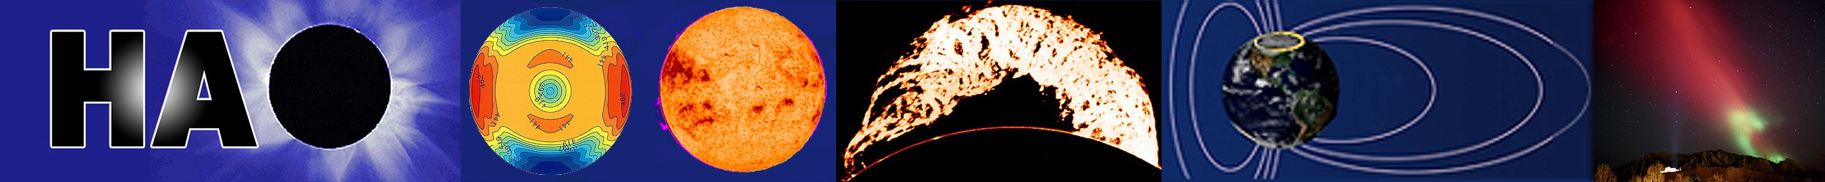
GEM Inner Magnetosphere/Storms Campaign
Planning June 96 & 97; NSF funded by June 99 GEM Workshop
Campaign Coordinators: Mary Hudson followed by Anthony Chan
Working Group 1: Plasmasphere and ring current coupling, Jim Horwitz and Janet Kozyra, co-chairs
Working Group 2: Storm injection and recovery mechanisms --- ring current and radiation belts, Dan Baker and Mary Hudson, co-chairs
Working Group 3: Energetic electron variability, Richard Thorne and Geoff Reeves, co-chairs
<
Condensed to
2 Working Groups,
3 ULF waves added

Slide 2
History: UCLA GEM WIKI
A diagram of GEM history (1987-1990)
Report from the First GEM Campaigns 1991-1997
Thank Ray Greenwald for help summarizing initial IM/S
Campaign; Mike Liemohn 2006 ‘IM/S Assessment
Challenge’ JGR Special Section
Initial events chosen for study influenced by NASA
ISTP International Solar Terrestrial Physics Program ‘90s:
Wind (L1), Polar, Geotail satellite data concurrent;
Funded development of MHD global simulation
models;
Groundbased SuperDarn radars;
Additional data sources for IM/S campaign:
LANL, NOAA GOES geosynchronous data;
NASA SAMPEX, NOAA POES and DMSP LEO polar s/c
NASA IMAGE launched 2000 – p’sphere & ring current
NSF funded groundbased magnetometers, radars, riometers,
all-sky cameras, model development
the duration of the campaign.

Slide 3
Introduction to special section on “Results of the National Science Foundation
Geospace Environment Modeling Inner Magnetosphere/Storms Assessment Challenge”
Michael W. Liemohn
First published: 09 November 2006
https://doi.org/10.1029/2006JA011970
Table 1. Characteristics of Inner Magnetospheric Plasma Populations
Population | Density | Temperature | Source | Composition | Driver | Importance
Plasmasphere | 100s cm⁻³ to 1000s | <1 eV, maybe up to 10s of eV | Subauroral ionosphere | H⁺, some He⁺ and O⁺ | E field | Dominates mass density
Ring current | ∼few cm⁻³, up to 10s | 1–400 keV | Plasma sheet (SW and iono) | H⁺, O⁺ in storms | E and B fields | Dominates energy density
Radiation belts | ≪1 cm⁻³ | 100s of keV to MeV | Plasma sheet, SEPs, local acc. | Mostly e-, some H⁺ | B field | Dominates S/C

Slide 4
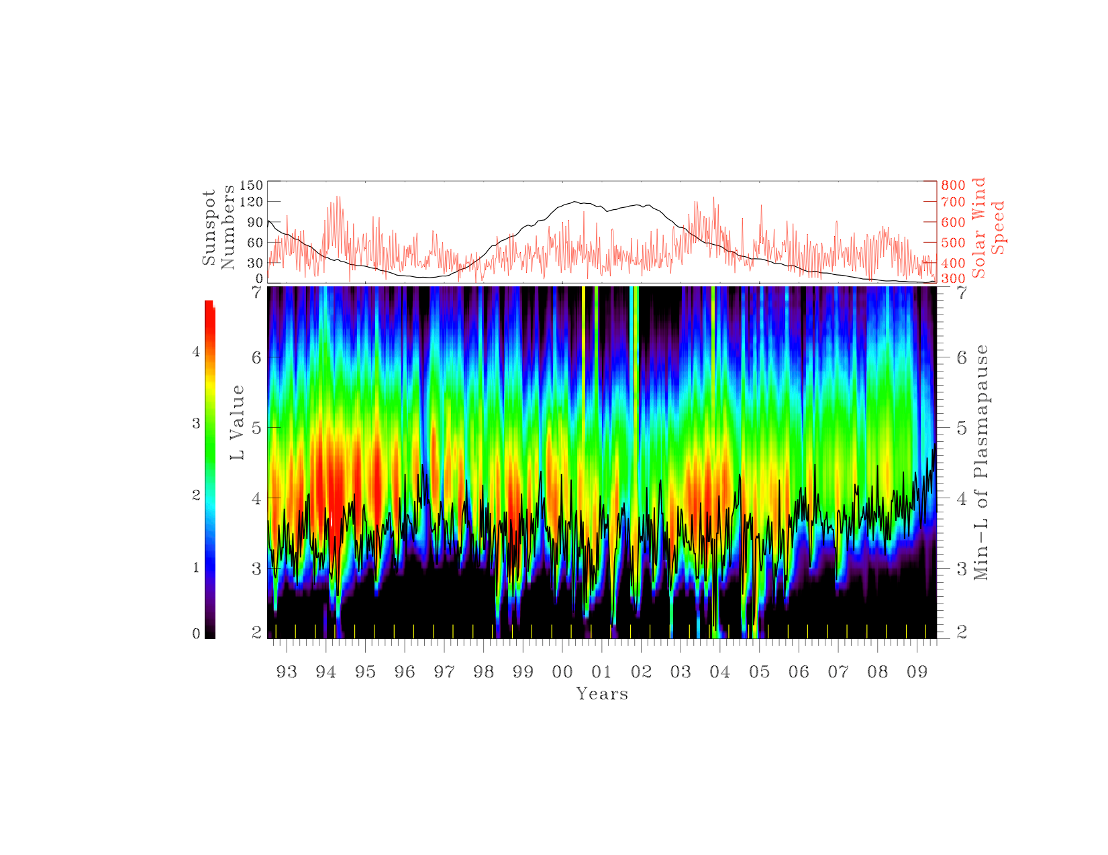
SAMPEX 2-6 MeV for 92-09
CIR storms
CME-storms
(Extended from Li et al., GRL, 2006)
Coming up on Solar Max at beginning of IM/S Campaign 1999
Li et al., JGR, 2011

Slide 5
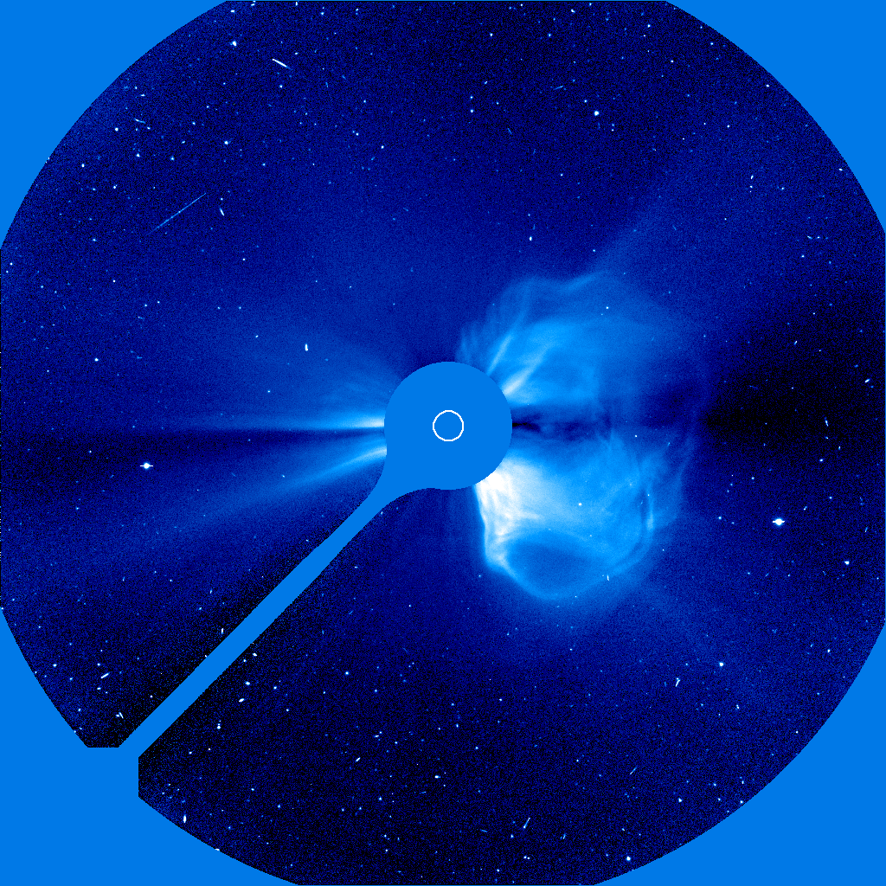
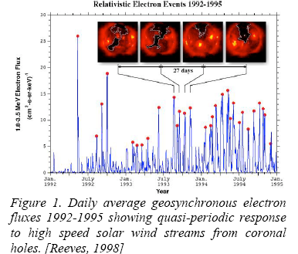
CME vs. High Speed Stream Source of MeV Electron Enhancements
LASCO coronograph on SOHO
Solar Maximum
Declining Phase

Slide 6
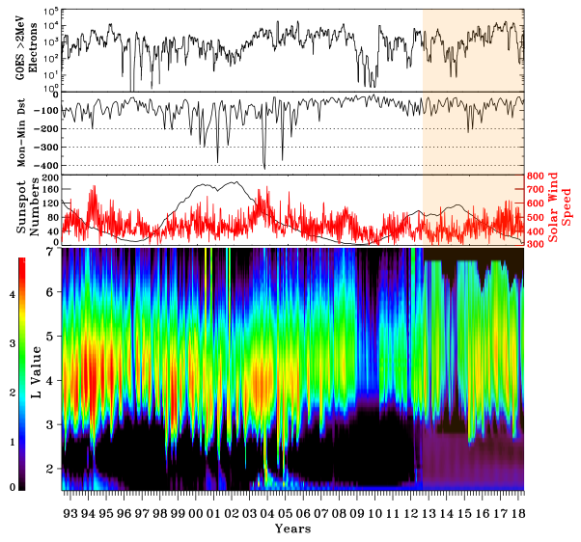
Weaker min at GOES
Weaker max less evident
Li et al., JGR 2017; AGU Monograph , 2021
SAMPEX data 1992 – 2012; 520 x 670 km polar orbit
Van Allen Probes 2012-19
Weaker 2009 min, Weaker 12-14 max

Slide 7
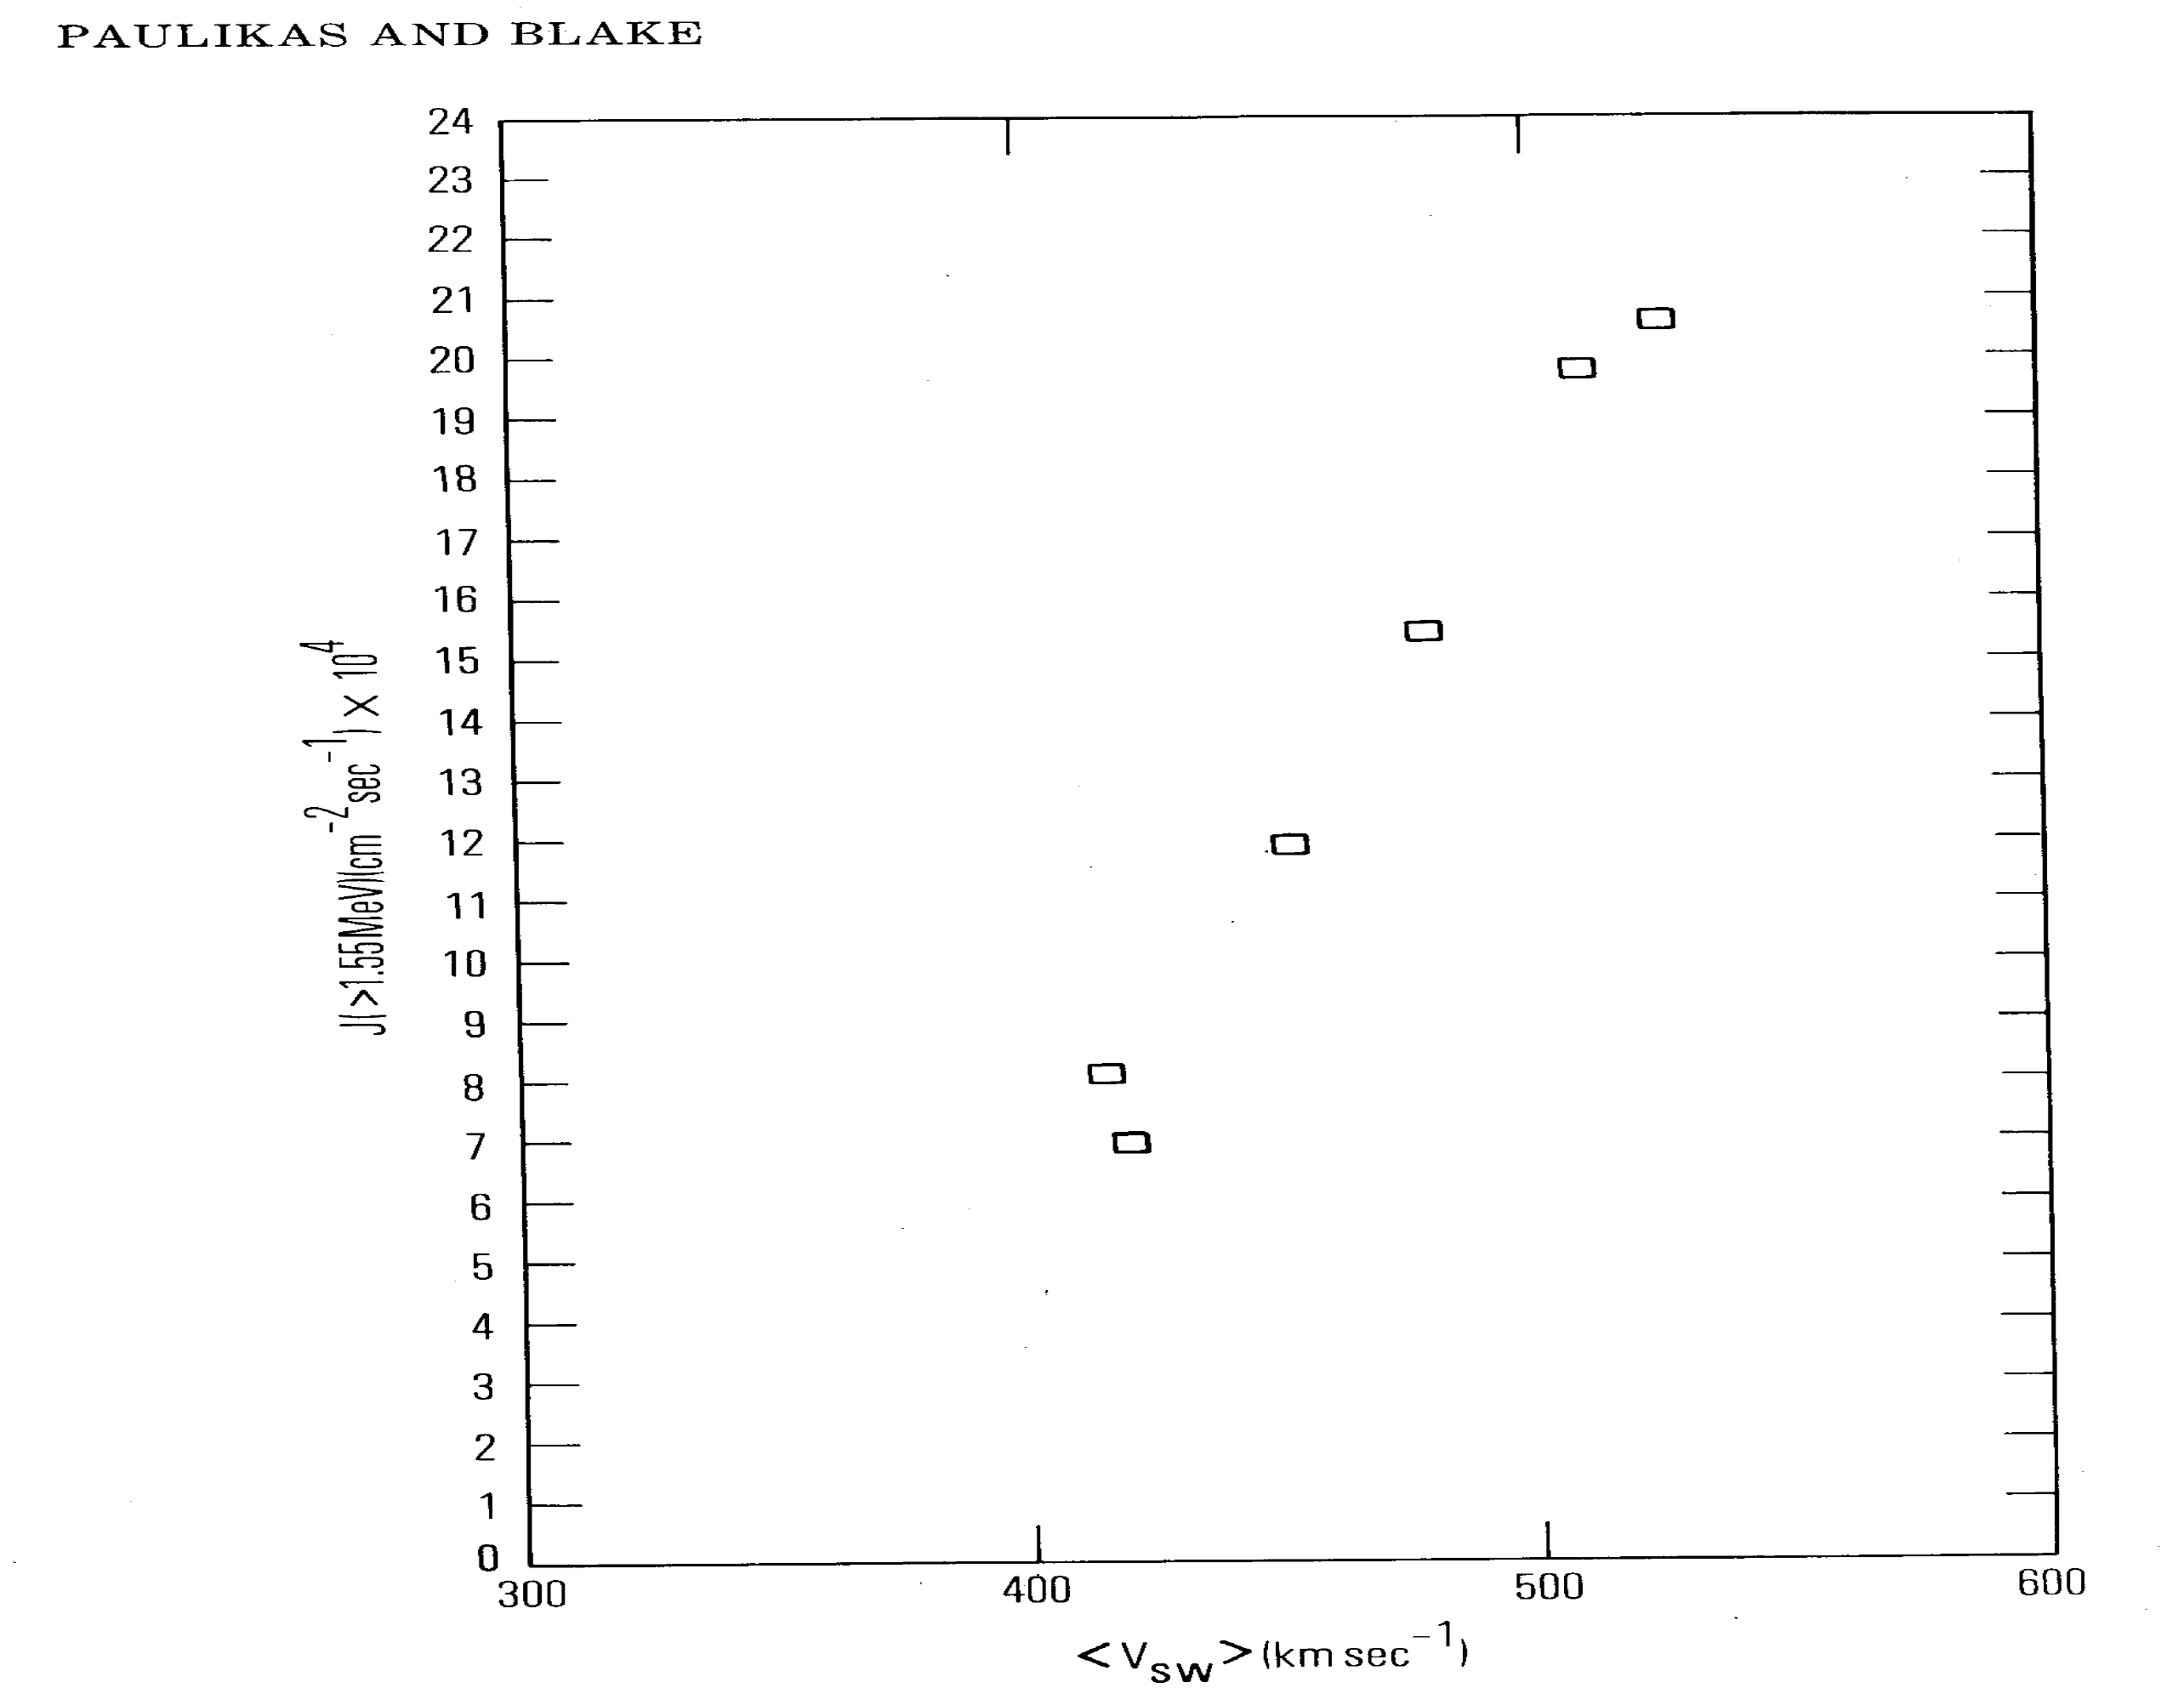
Geosynchronous Electrons vs. v_{sw}measurements from ATS-6; then LANL over longer time interval
(1979)
(1979) ←
Reeves et al. 2011 showed from 1989-2010 LANL geo
data that MeV electron fluxes tend to increase under
increasing Vsw and then persist at a given flux level
as Vsw decreases, producing triangle Vsw dependence.

Slide 8
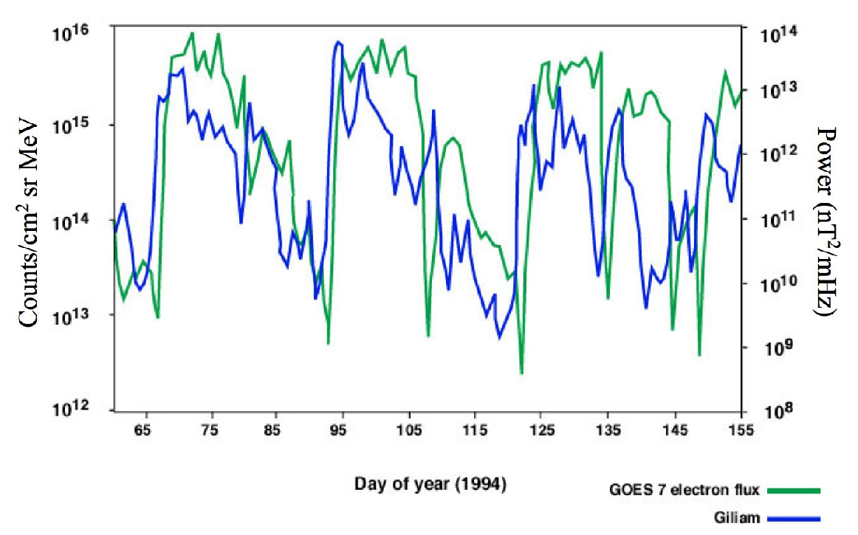
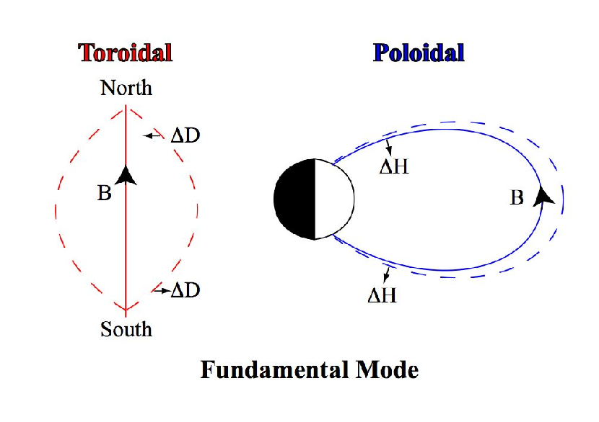
1. ULF Wave-Relativistic Electron Correlation:
Energization by Inward Radial Transport
Rostoker et al., GRL, 1998
mHz ULF wave power increase precedes electron flux ~ 2 days

Slide 9
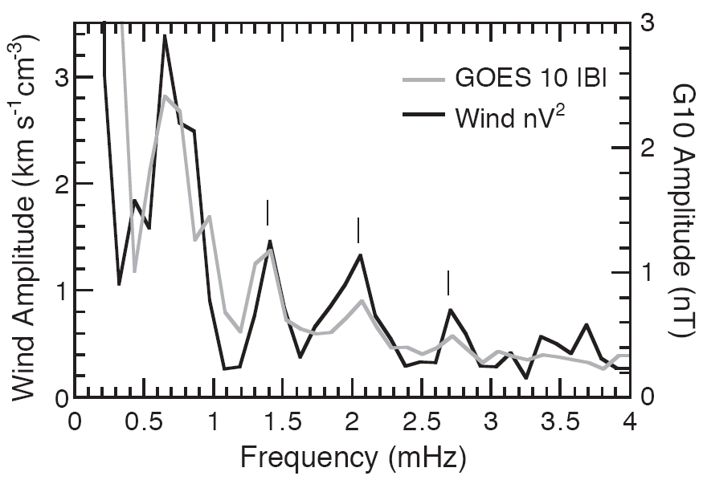
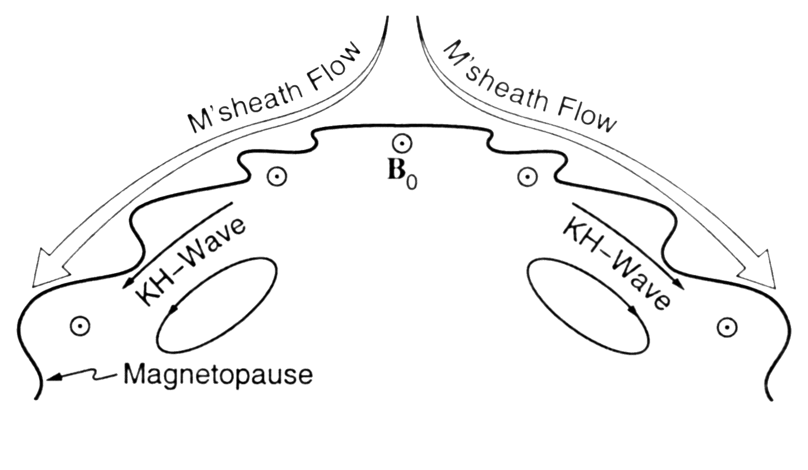
a)Direct Coupling of Solar Wind ULF Waves & b)Shear Flow Instability at Magnetopause
Kepko, Spence & Singer, GRL, 2002
Both correlated with Vsw
Or Convective Growth of
Magnetopause K-H
Waves Miura, JGR, 1992
Claudepierre et al., 2008

Slide 10
Summers, Thorne and Xiao, JGR 1998
Enhanced transport of plasmasheet
electrons due to Ey = - VxBz increase,
& substorm injections for stronger
solar wind driving -> local heating

Slide 11
During increased solar wind driving: Vx and Bz <0;
Ey = -Vx Bz increased, mag convection increased
Whistler Mode
Drive local
acceleration;
µ not conserved
Drive diffusive radial
transport, energize via
betatron acceleration
µ = p⊥²/2mB – first
invariant is conserved;
Φ ~ 1/L – third invariant
violated on drift timescale
Whistler Mode
kHz
mHz
Reeves et al., 2013

Slide 12
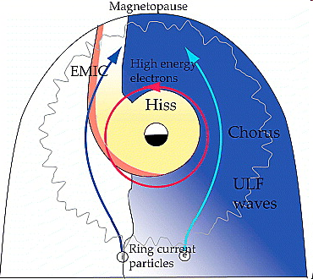
2. Loss & local acceleration due to
Whistler Chorus excited by plasmasheet electrons – dawn side of the magnetosphere – loss of first invariant conservation for freq ~ gyro freq; Whistler Hiss inside plasmasphere causes slot region between inner/outer zone electrons (Lyons and Thorne, 1974)
Equatorial plane
Chorus outside, Hiss inside plasmasphere;
Bortnik et al., 2008
Thorne, GRL, 2010
Thorne et al., Nature, 2013

Slide 13
2012-2019
During Van Allen Probes Era:
perform quantitative tests
Acceleration by chorus waves seen by Van Allen Probes and modeled
using POES electron precipitation chorus proxy – gives longitudinal
distribution of chorus;
Simulated increase df/dt ~ Dαα, Dpp, Dαp diffusion.
Observation above compares well with simulation below.
Local acceleration by chorus most effective > 500 keV
Thorne et al., Nature, 2013

Slide 14

Comparison of quiet and active
flux profile vs. E & L;
Whistler mode hiss produces
slot region during quiet period;
Radial diffusion with time dep –f/τ
based on wave observations
Reeves, et al. 2016;
Ripoll et al., 2017

Slide 15
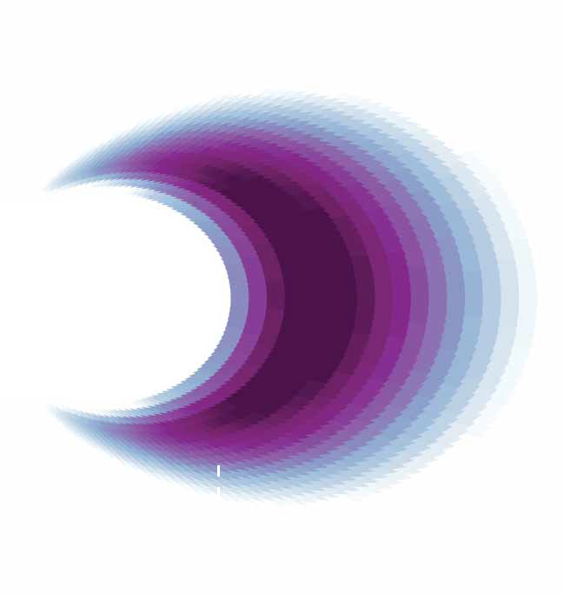


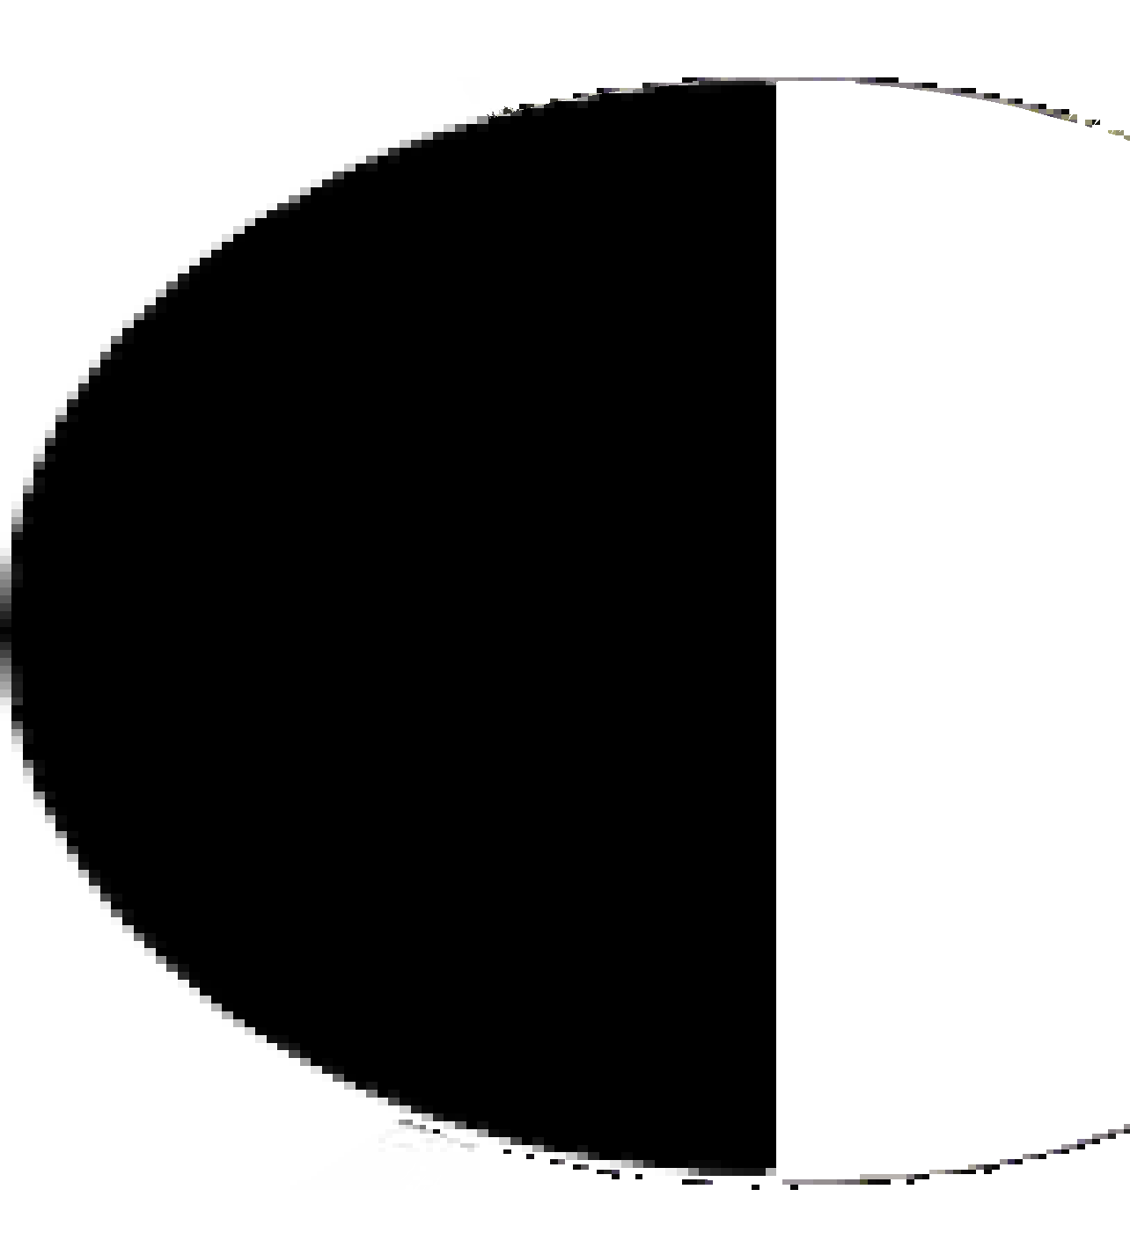




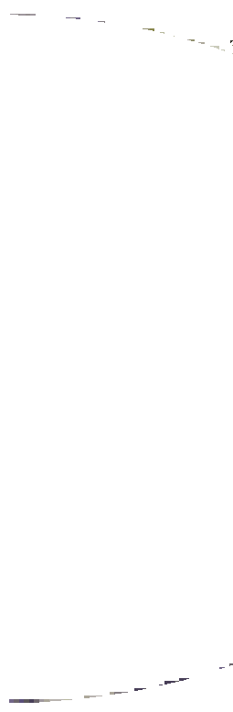





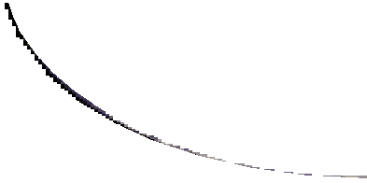







bb
Before
Plasmasphere
After storm enhancement
Of outer zone electrons
3. Local heating due to chorus
4. Radial transport, convection & diffusion
2. Chorus wave excitation
1. Low energy electron injection
Equatorial plane view
Cartoon Summary Break:
Thorne et al., Nature, 2013

Slide 16
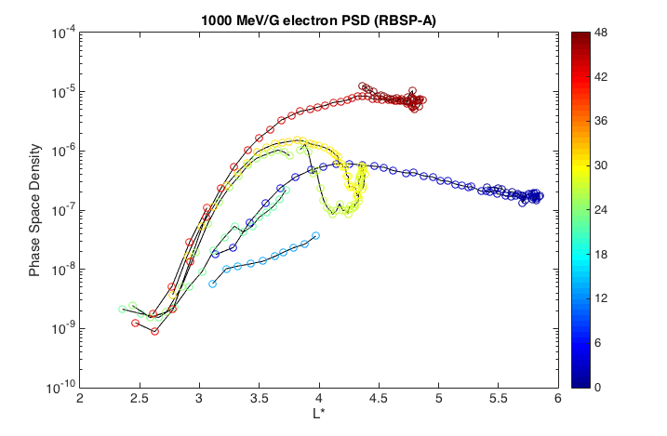
6 orbits of RBSP-A during strongest storm of Van Allen Probes era:
RBSP-A measurements at 1000 MeV/G show a peak in PSD suggesting local heating ~ L*= 4 at 0000UT on 03/17 followed by inward radial convective and diffusive transport by the end of 03/18/2015.
00 UT 3/19
March 17-18, 2015
00 UT 3/18
Recall: VAP apogee at 5.8 Re
00 UT 3/17
Radial diffusion modeled by Zhao Li et al., JGR, 2017, PSD updated at apogee

Slide 17
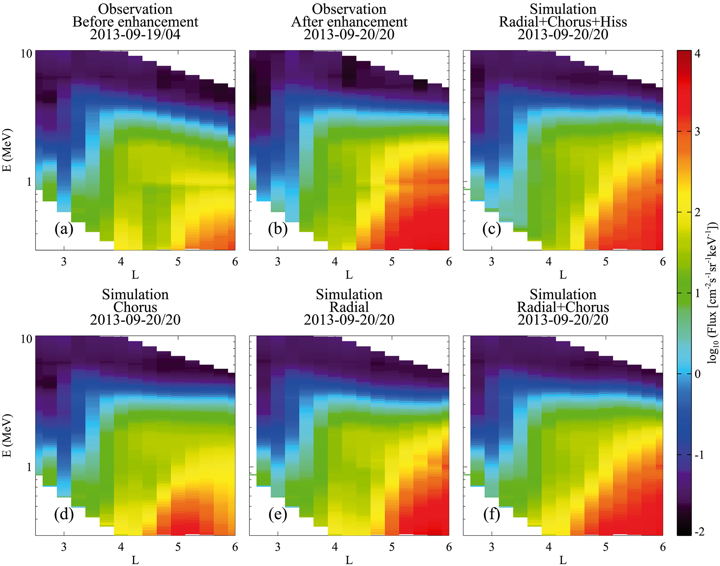
September 2013 – DLL played larger role than chorus – best fit both
3D diffusion simulations in M, K, L
Ma et al., 2016

Slide 18
Weaker min at GOES
Weaker max less evident
Li et al., JGR 2017; AGU Monograph , 2021
23-24 July 2012
SAMPEX data 1992 – 2012; 520 x 670 km polar orbit
Van Allen Probes 2012-19
Weaker 09-10 min, Weaker 12-14 max

Slide 19
Van Allen Probes REPT Data 2018-19
2018-19 Solar Minimum had higher level radbelt flux than 2008-09, driven by CIRs; Whole Heliosphere Planetary Interactions
Sept 13-17 wkshop
whpi.hao.ucar.edu/
May 13-14 CME-shock
Only 7.7 MeV event
Corotating Interaction Region
Courtesy Allison Jaynes

Slide 20
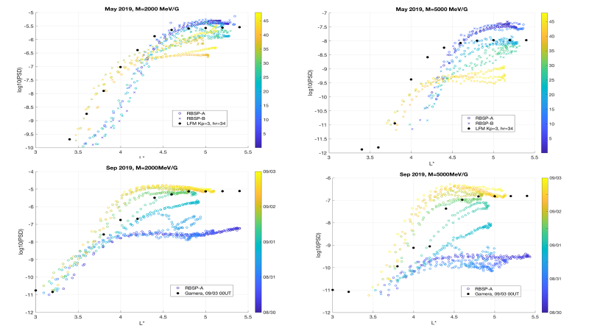
MHD-test particle simulations; following gc electrons in LFM-RCM (top) and GAMERA-RCM fields
CME-shock driven storm
1) M’pause loss greater at higher Mu
CIR-driven storm
2) Local heating greater at higher Mu
Hudson et al., 2021
WHPI workshop

Slide 21
Conclusions
Summarized some of progress since the IM/S campaign understanding outer zone electrons;
Neglected advances in understanding inner zone protons AND
Many advances in modeling and understanding ring current and plasmaphere;
End by noting importance of plasmasphere in determining inner boundary of outer zone electrons–
Seen in minimum L of plasmapause: 1) marks transition from hiss loss to chorus acceleration;
2) obstacle to inward propagation of ULF waves;
Inner magnetosphere is a region of interacting 1 eV to multi-MeV plasma populations – challenge!
(Extended from Li et al., GRL, 2006)

Slide 22
Extra Slides

Slide 23
References:
GEM Wiki https://gem.epss.ucla.edu/mediawiki/index.php/Other_Documents_and_Reports#Older_Archives_from_Campaigns.2C_Steering_Committee.2C_and_Students
Liemohn, JGR, 2006:
https://agupubs.onlinelibrary.wiley.com/doi/full/10.1029/2006JA011970
Li and Hudson, JGR, 2019:
https://agupubs.onlinelibrary.wiley.com/doi/10.1029/2018JA025940
Ripoll et al., JGR, 2019:
https://agupubs.onlinelibrary.wiley.com/doi/full/10.1002/2016GL068869

Slide 24
Synthesis of processes afffecting
outer zone electron variability
to atmosphere
loss strong near plasmapause
Wen Li and Hudson, JGR, 2019

Slide 25
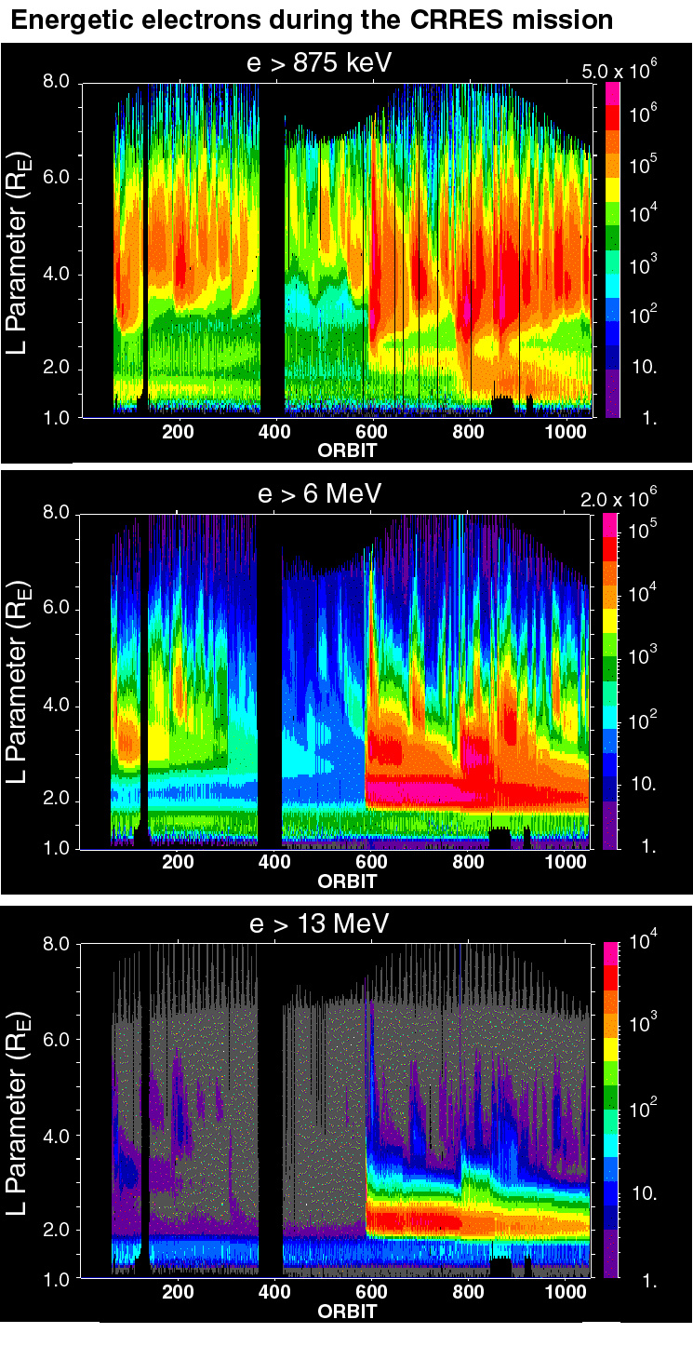
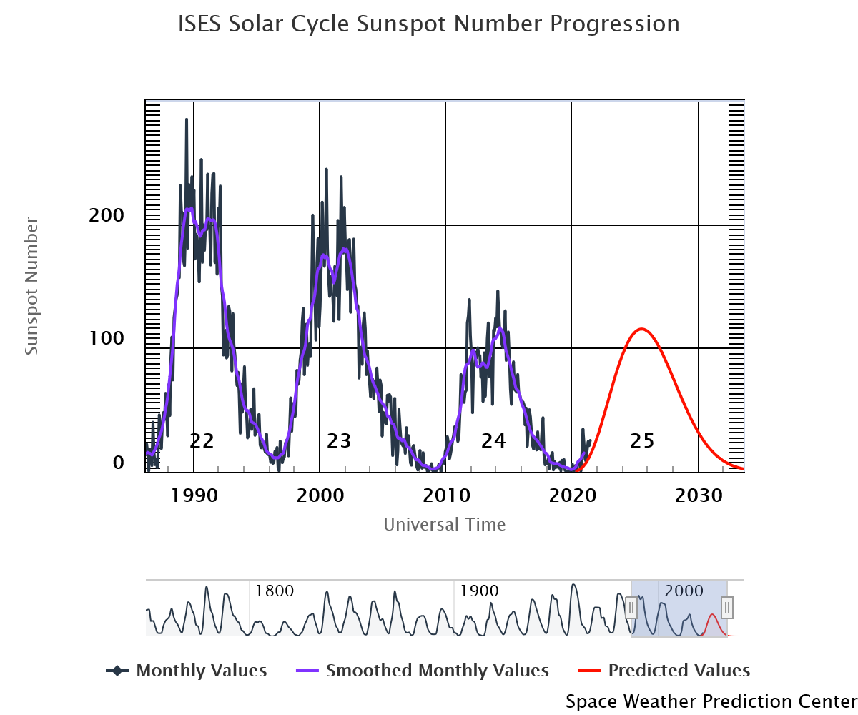
Before start of IMS campaign, previous solar max CRRES* March 91 Electron Injection Event:
Not diffusive! Transport ~1 Re over drift period
*NASA –AF Combined
Release Radiation Effects
Satellite in near eq plane
geo transfer orbit
July 1990
March 24, 1991
Oct. 1991
(Courtesy of J. B. Blake )

Slide 26
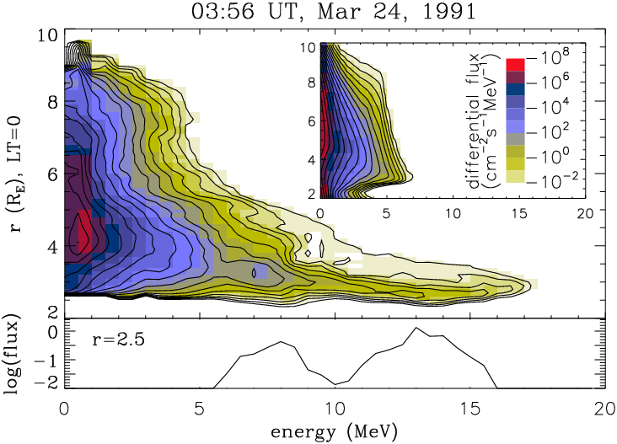
MHD-Guiding Center Simulation
AE8
No solar wind data available!
Elkington et al., JASTP, 2002; 2004

