Slide 1
The Magnetotail
GEM 30th Anniversary Edition
J. Raeder
Space Science Center, University of New Hampshire, Durham, NH
2021 GEM Summer Workshop, Virtual Ohau, HI, 7/27/2021

Slide 2
A big topic with 1000s of papers and probably more opinions than attendees at this workshop. Discovered in 1965 (Norman Ness); up to 3,500 RE long. No time to go deep, but I’ll try to be comprehensive and convey the basic properties and the underlying physics.
* The magnetic field. Not so simple and smooth.
* How does the plasma get in? Very sneaky.
* Why is it so hot? Chokehold.
* How does it move? Yes, it really is 3-dimensional.
* Where does it end up? Not an easy path.
* Substorms, and a historical perspective. 2 minutes is all it takes to confuse science.
Outline

Slide 3
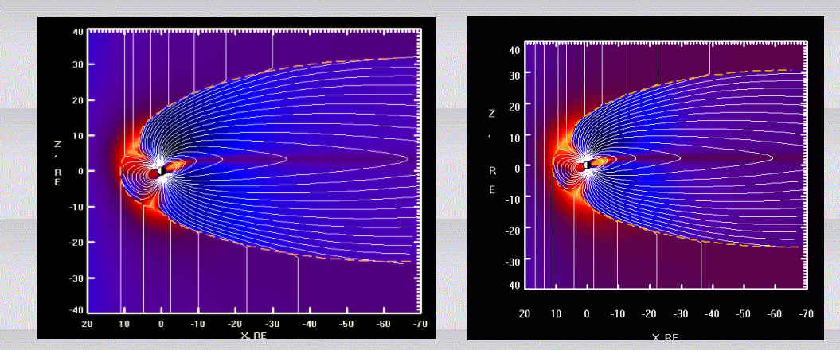
The magnetic field
Classic picture: lobes, plasma sheet, current sheet.
Classic model: come up with some current sheets, calculate B
Or: fit data to a mathematical description: Tsyganenko and others for 5 decades. Improve for events.
Or a pressure equilibrium: make sure p is constant on field lines: Birn et al., Rice group (numerical), …
From N. Tsyganenko’s website

Slide 4
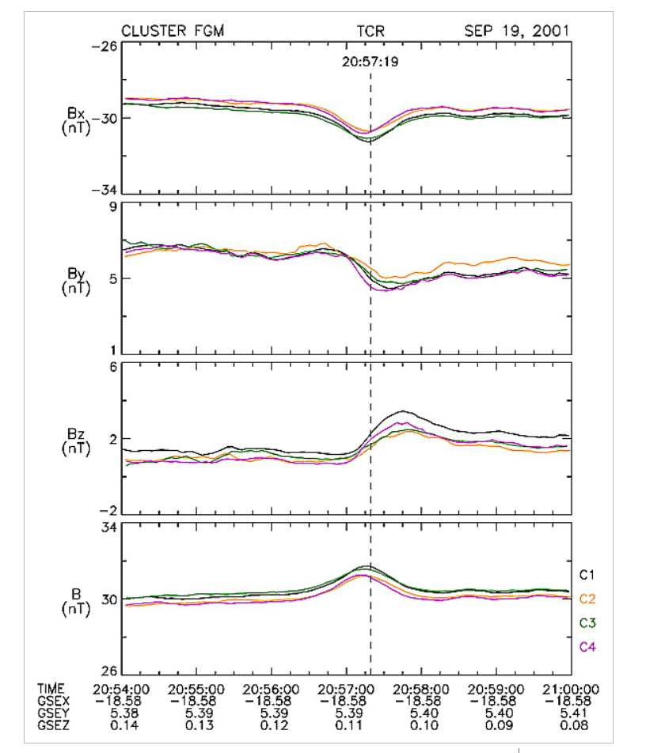
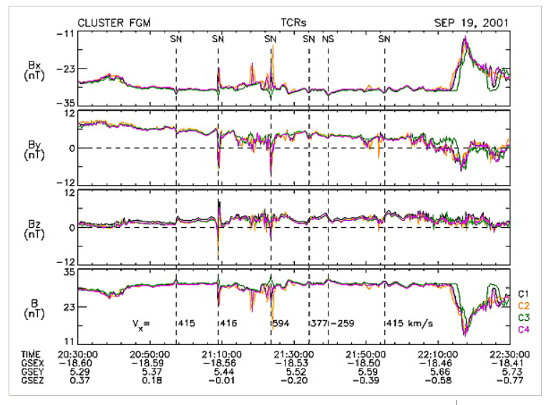
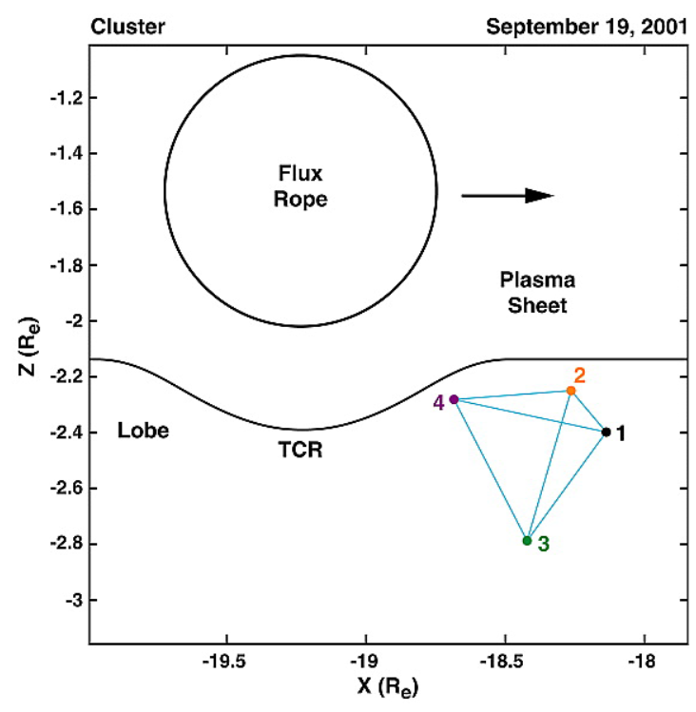
But it is not so smooth
The lobes tend to be smooth with very low plasma beta
Transient perturbations come either from the outside of from the plasma sheath
Typical example: Transient Compression Regions (TCRs)
Slavin et al., 2003

Slide 5
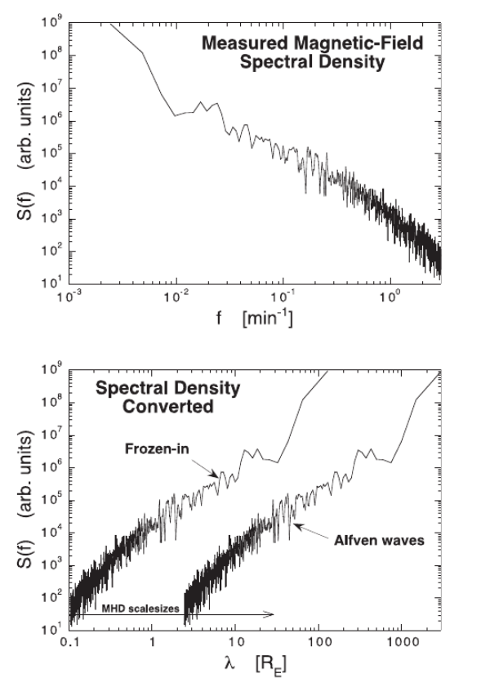
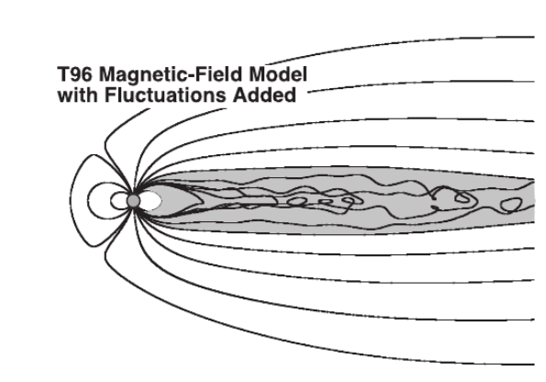
And the plasma sheet is often a mess
Almost always the plasma sheet is ‘turbulent.’ dB/B ~ 1
But the turbulence may be quite atypical.
Because of the magnetic field, turbulent eddies are suppressed.
The turbulence is confined to a box.
The field lines are connected to the ionosphere → special b.c. with wave reflection.
Borovsky & Funsten, 2003

Slide 6
What kind of a mess?
Nature of the turbulence: Eddies or waves?
What kind of waves? Alfven? Slow mode? Magnetosonic?
What drives it? Flow shear (BBFs, KH)? MHD instabilities? Firehose instability? Mirror instability? Kinetic instabilities? Direct driving by solar wind?
Consequences: anomalous diffusion, (Taylor) viscosity, and resistivity. Plasma mixing. Tangled field + chaotic particle orbits (percolation). Particle acceleration.
Dissipation and energy loss: kinetic dissipation at small scales (SW like), energy dumped into the ionosphere (Alfvenic), energy going out the back of the tail (vortex shedding), energy injected into the inner magnetosphere.
It’s definitely not classical homogeneous turbulence!
Much work to do and a 100+ constellation mission would surely help!

Slide 7
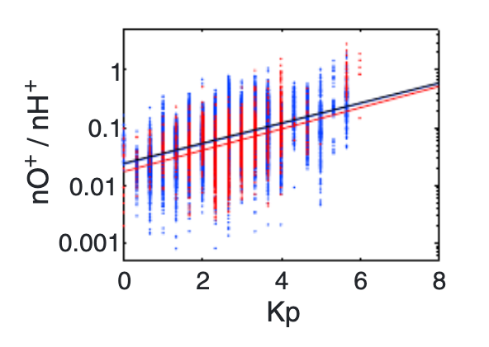
How does the plasma get in?
The ionosphere is one source. Polar wind. Cusp ion fountain.
Oxygen, or He3/He4 can be used as a tracer.
O+ concentration is small during quiet times (a few percent) and rises during active times and with solar activity (F10.7).
Maggiolo & Kistler 2014

Slide 8
How does the plasma get in?
Solar wind plasma can enter through reconnection at the dayside.
Field lines loaded with solar wind plasma convect over the cusp and sink into the lobes.
In MHD terms this is a slow-mode expansion fan.
The plasma eventually reaches the plasma sheet and convects earthward.
This makes the hot, tenuous plasma sheet (a few keV, <1/cc).
But it’s certainly not as 2d like in the figure. IMF is rarely purely south, and there is probably no such thing as a stationary distant x-line.

Slide 9
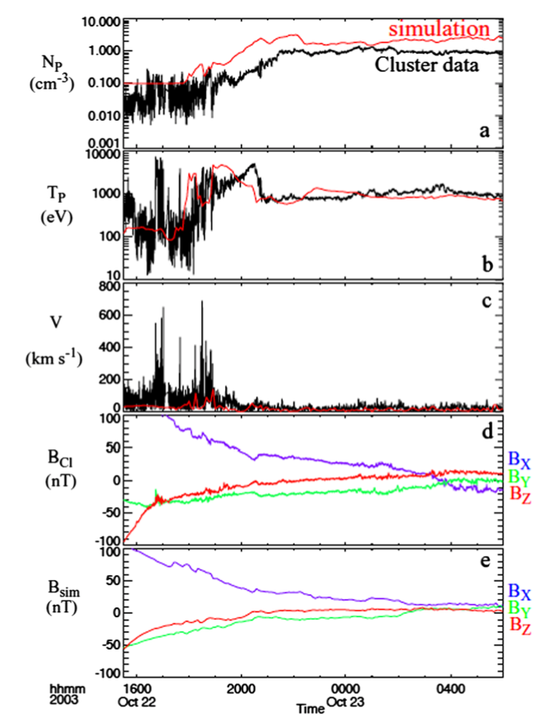
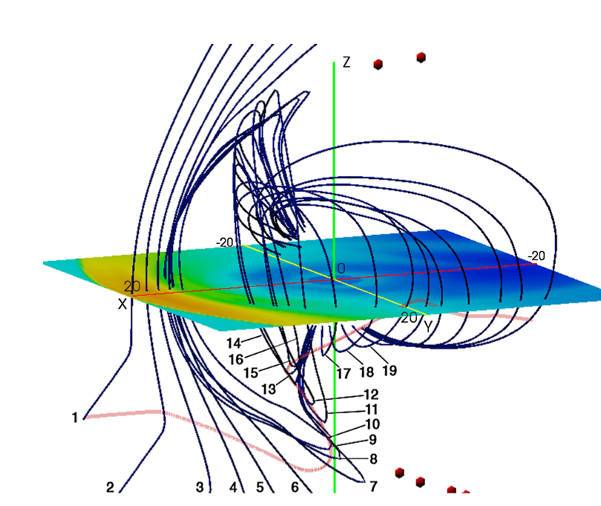
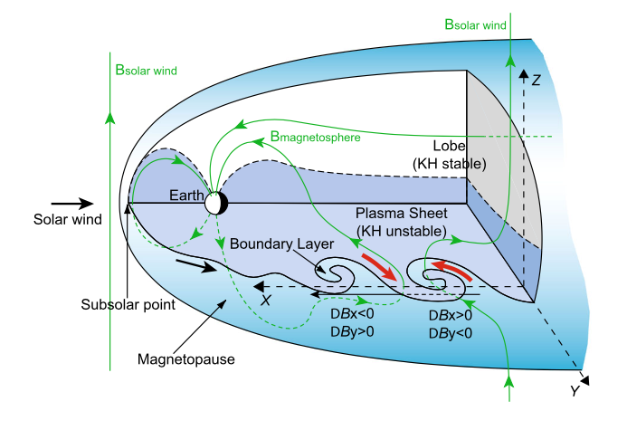
The Cold Dense Plasma Sheet (CDPS)
During northward IMF the plasma sheet gets colder and denser.
There is mixing of cold and hot populations, and the cooling takes hours.
Dual lobe reconnection, KH waves, or diffusion.
From Wing et al., 2014

Slide 10
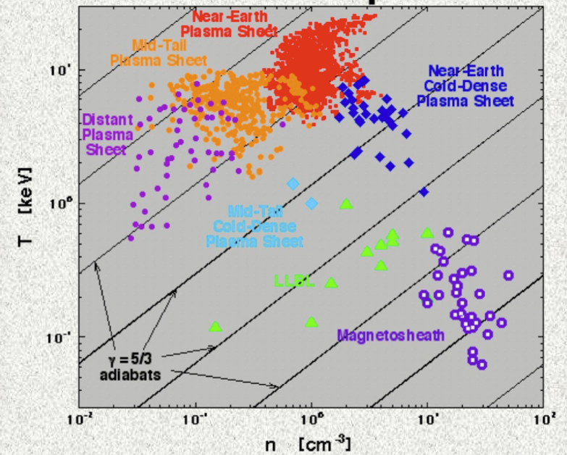
Specific entropy
(p/N^gamma) is an important tracer for plasma in the magnetosphere.
Ideally, specific entropy should be conserved.
However, the populations in the magnetosphere differ by orders of magnitude from the magnetosheath.
Heat: Specific Entropy
Entropy density of plasma populations
Solar wind: less dense, cooler
From Borovsky, GEM’06

Slide 11
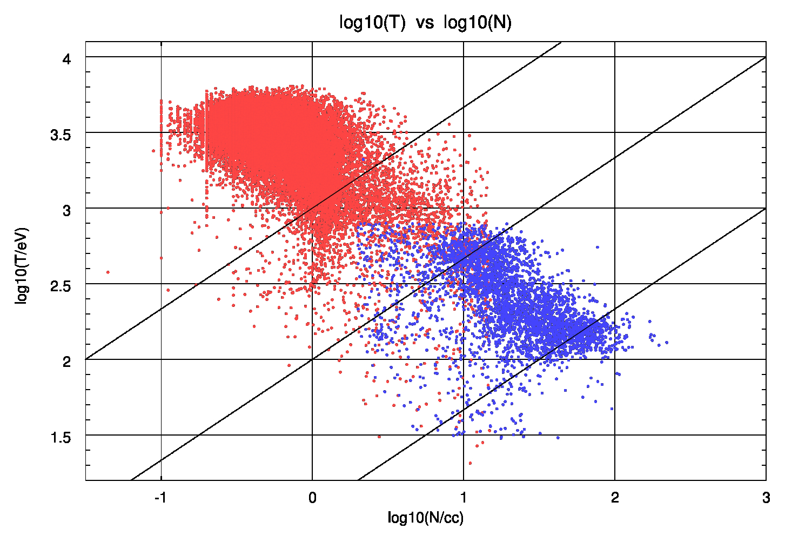
Scatterplot redux w/THEMIS & MMS
Similar scatterplot with THEMIS and some MMS data, all 15m averages.
Blue: MSH, red: PS.
Some region misidentification possible.
Not a good idea to use N, T to identify regions.
Confirms Borovsky results.
Why?

Slide 12
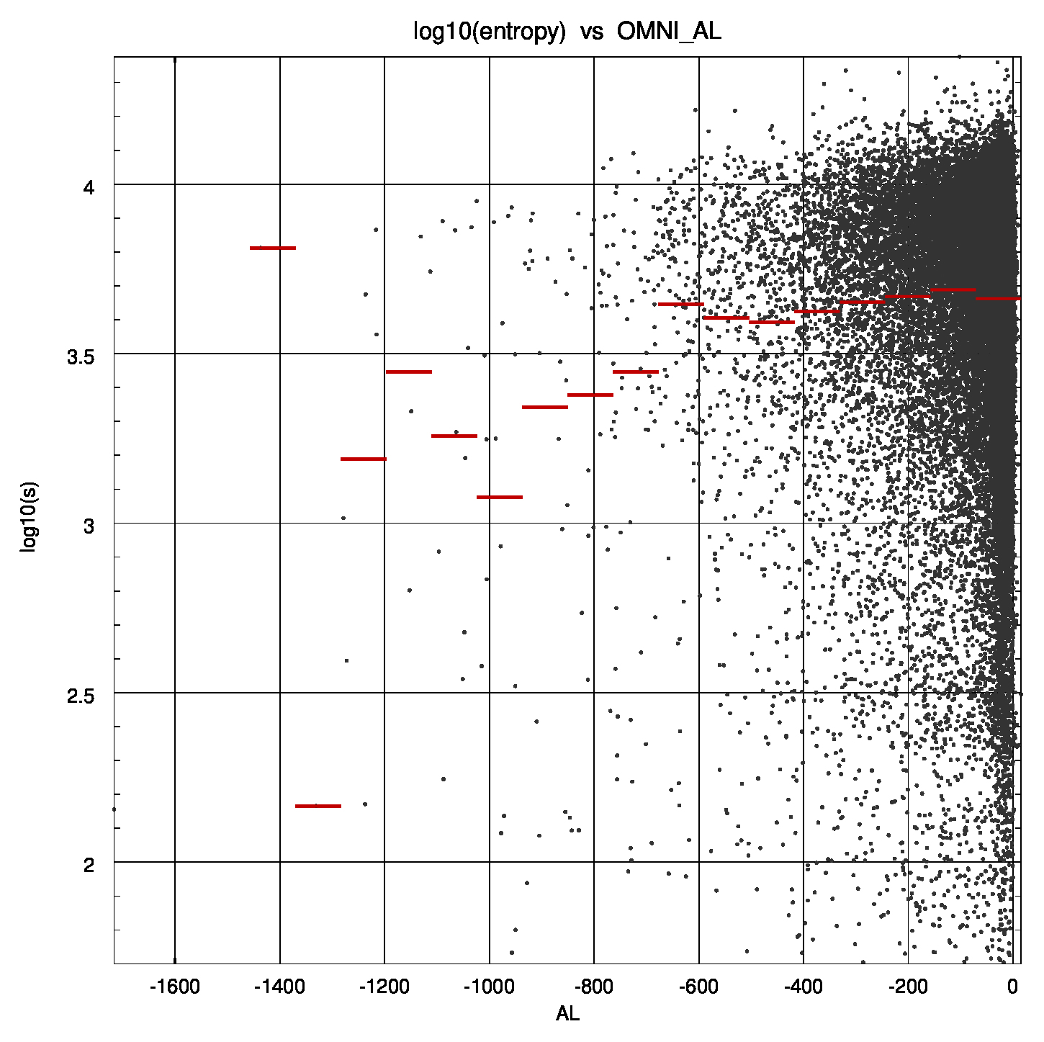
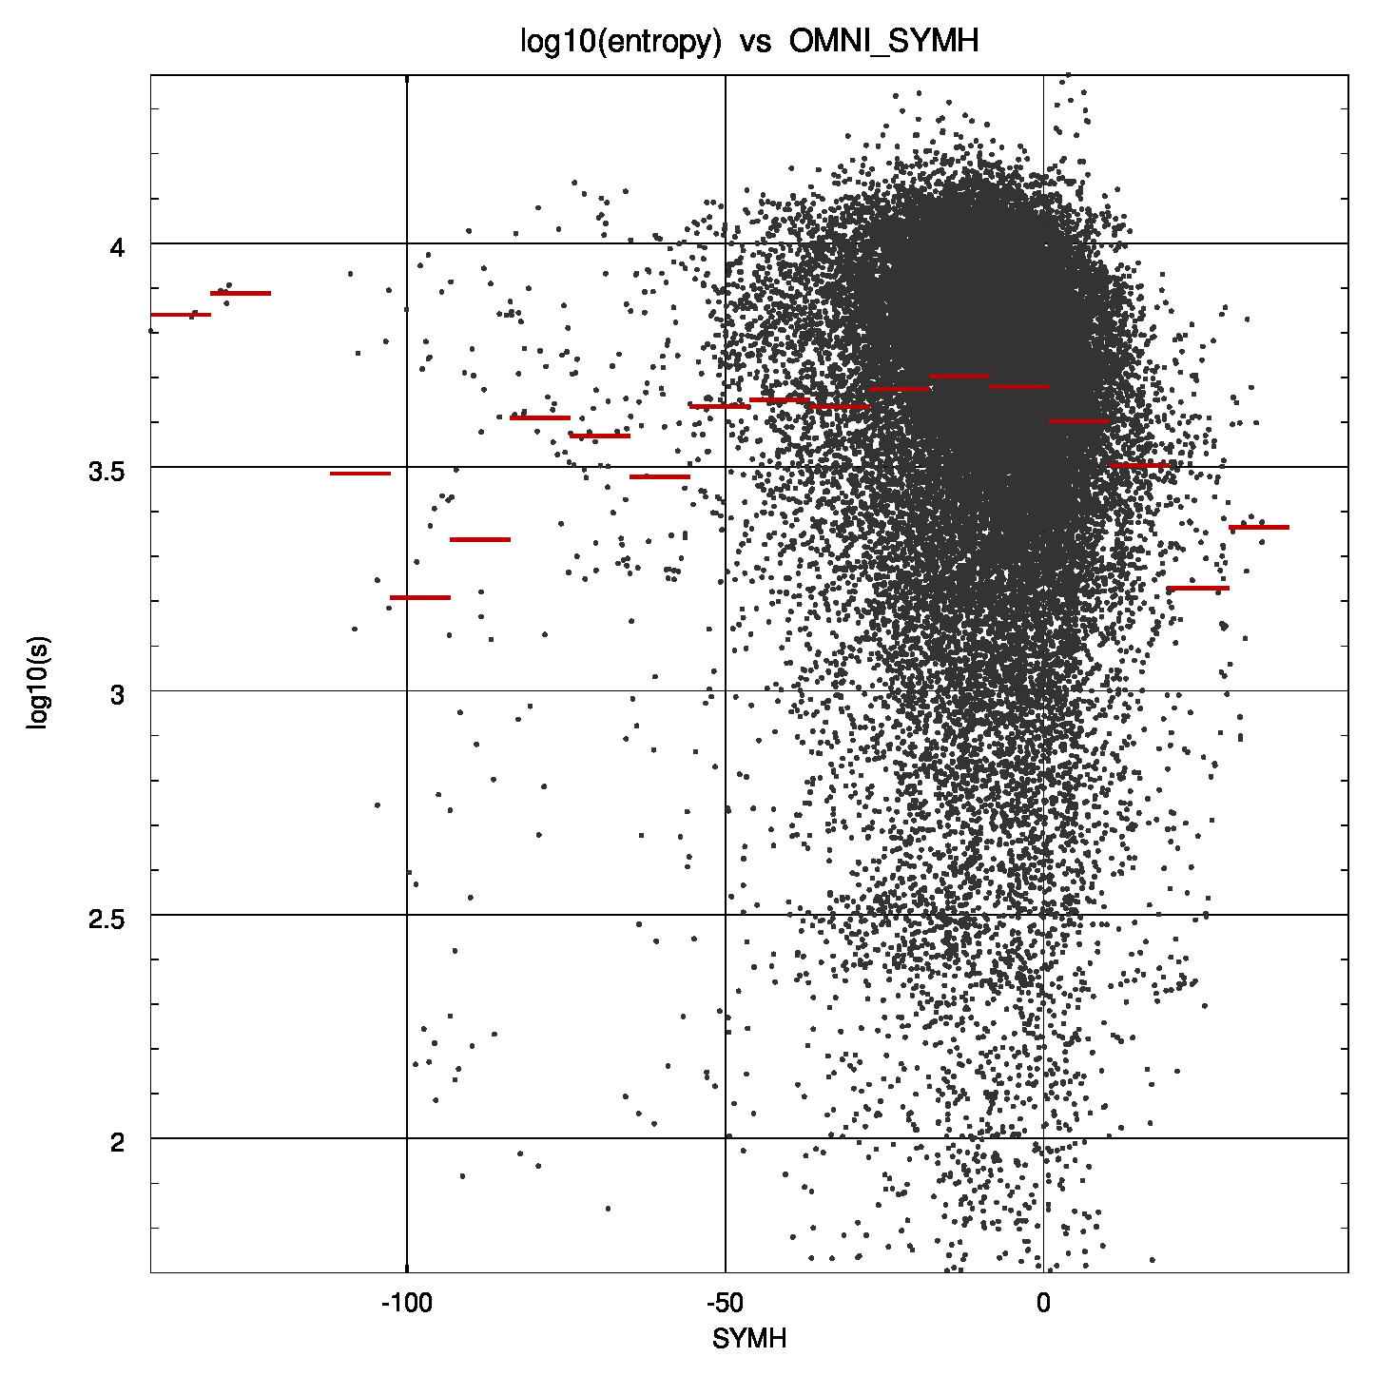
Activity dependencies
Max entropy decreases for higher abs(AL) → BBFs/plasmoids remove high entropy plasma from tail?
SYMH similar to AL → lower SYMH does not imply hottest plasma.

Slide 13
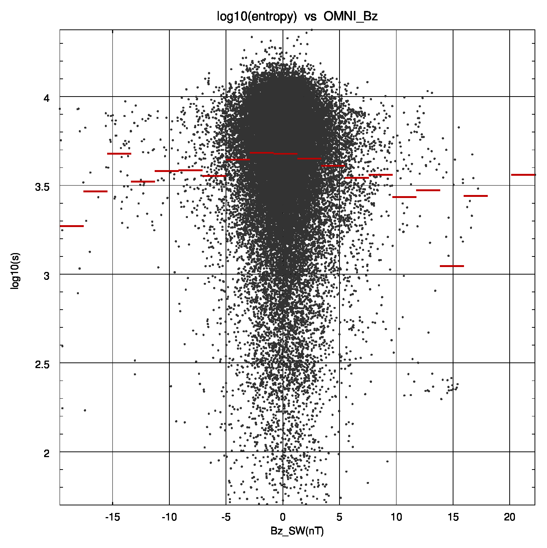
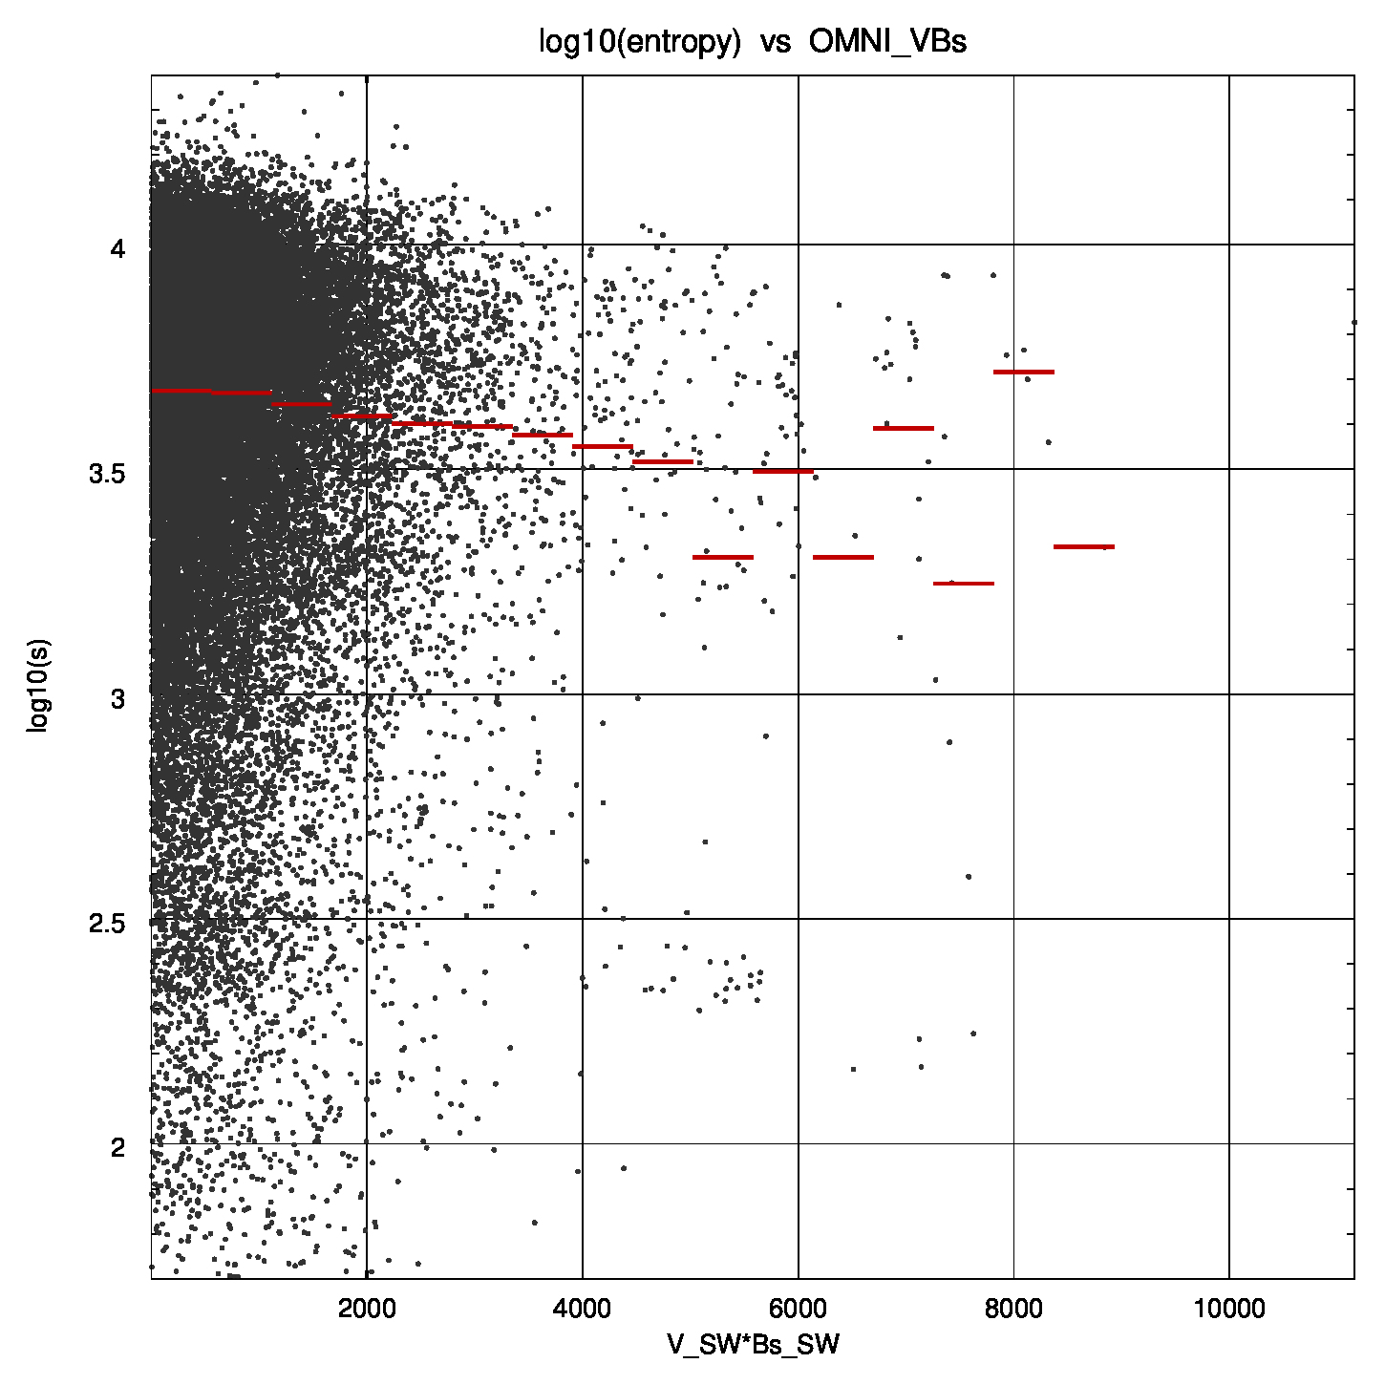
Solar wind dependencies
No obvious Bz dependence.
Including time lag may change the picture a bit.
Hottest PS for lowest driving?

Slide 14
What does the heating?
The energy conversion density rate E.J in ideal MHD plasma is given by
If resistivity is present, this becomes
Which can be written as
The first term on the RHS is the density of the rate work done by the field on the plasma, which is reversible/adiabatic (motor/generator). The second term is irreversible Ohmic dissipation rate. We are interested in computing the latter from gridded numerical variables.

Slide 15
Energy conversion in MHD Codes
In numerical codes two electric fields can be distinguished. The first is the motional electric field:
The second is the numerically calculated field that includes any applied resistivity terms along with numerical resistivity. The latter comes from finite difference errors, upwinding, flux limiters, and other methods that are used to keep the numerical scheme stable. The true dissipation in the code can then be extracted using the difference of these fields:
There are some subtleties involved because the fields are on different grids, but different interpolation schemes give basically the same results.

Slide 16
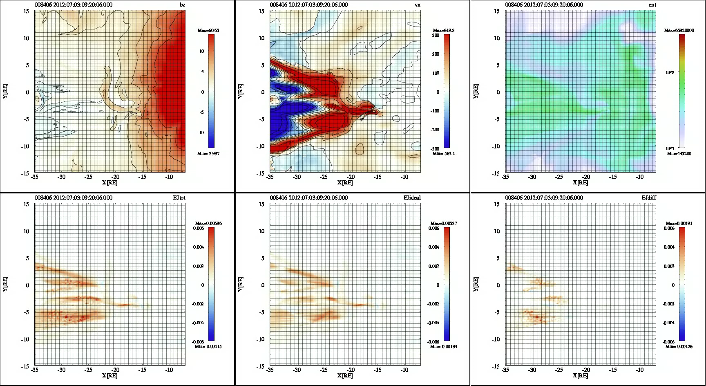
Dissipation in OpenGGCM

Slide 17
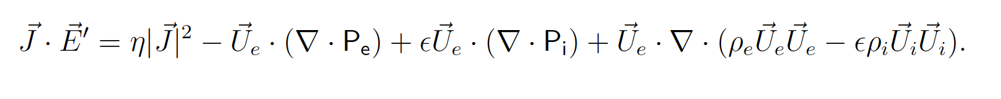
The full Ohm’s law does not change the MHD picture
All terms on the RHS are reversible, except for the collisions (expressed as a resistivity).
Thus, reconnection is not likely to produce entropy.
Slow mode shocks could do the trick, but they are rarely observed, and A. Otto showed that for prevailing tail parameters they can hardly produce much entropy.

Slide 18
Summarized as this Hypothesis:
During quite and moderately disturbed times the plasma sheet acts like a slow cooker, constantly churning and slowly dissipating energy.
This may be EM power or flow energy dissipation (KH waves) in some some sort of viscous interaction, probably at the end of the turbulent cascade.
During active times the tail rids itself of the extra internal energy by expelling plasmoids & tailward BBFs, and by injecting low entropy plasma into the inner magnetosphere or convecting it out to the dayside. Note that low entropy is required for DFs to penetrate close to Earth.
A constellation w/100+ probes would help to nail it down!

Slide 19
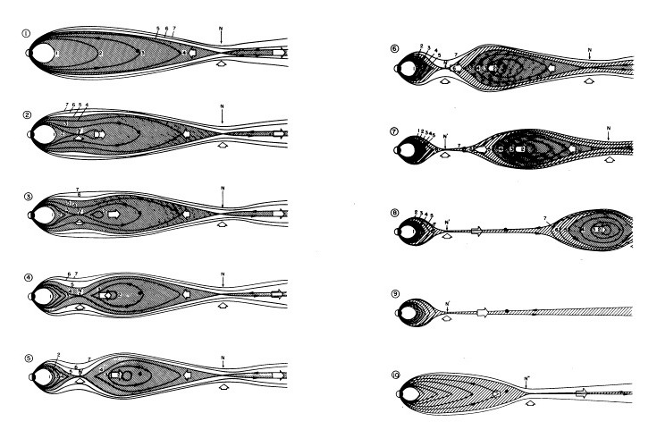
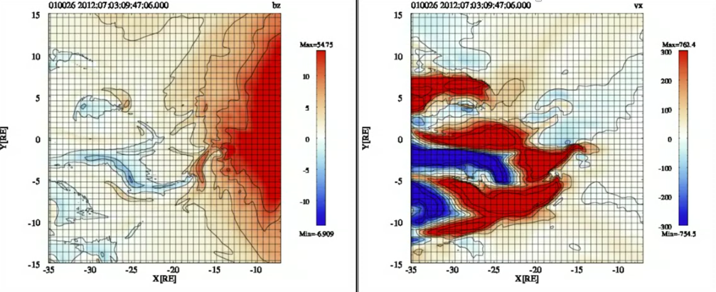
The plasma sheet is inherently 3d
Old 2d cartoons are still used ☹
Global simulations might not be entirely correct, but the 3d nature is consistent with observations.
Hones, 1985 →

Slide 20
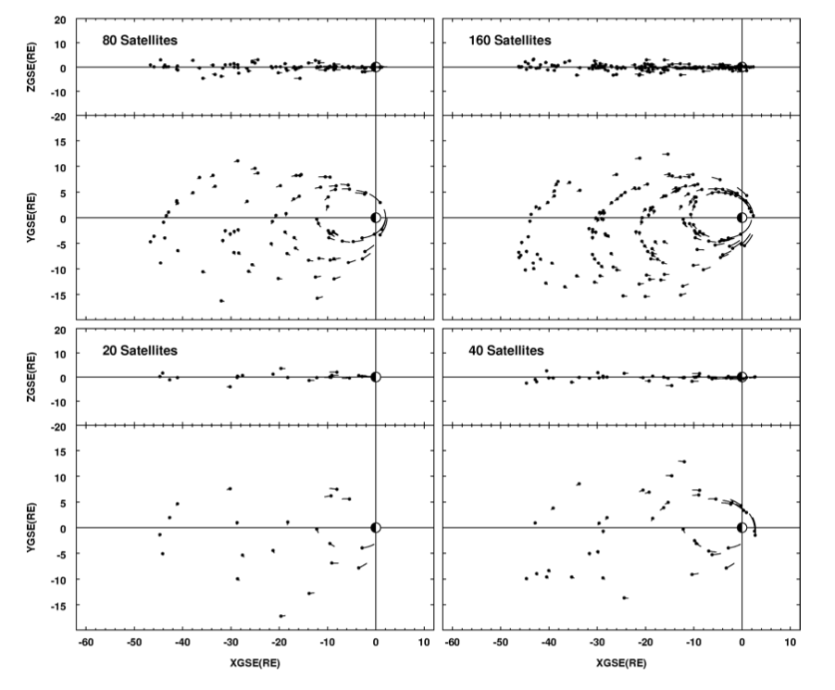
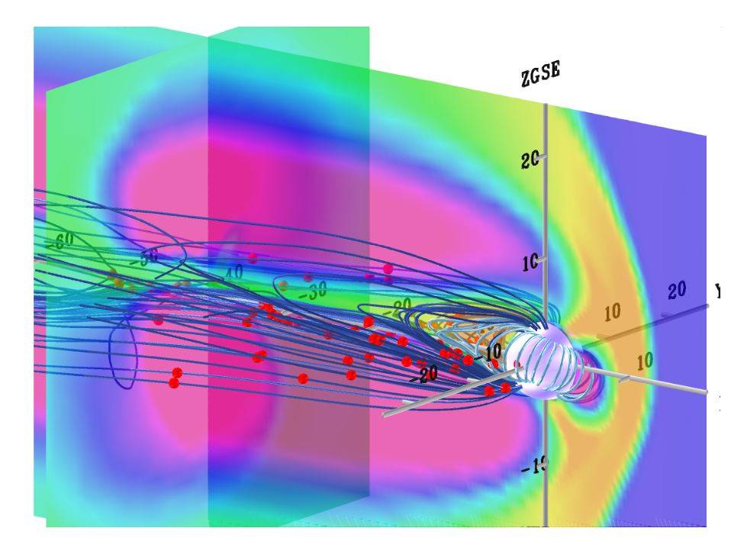
The plasma sheet is inherently 3d
100+ satellites would help ☺
How many BBFs/DFs?
Their size?
Their structure?
Their dependence on geophysical conditions?
Wedgelets to wedges?
Is a substorms just on big BBF?
Such mission were conceived 20+ years ago.
Raeder, Angelopoulos, 1998 →

Slide 21
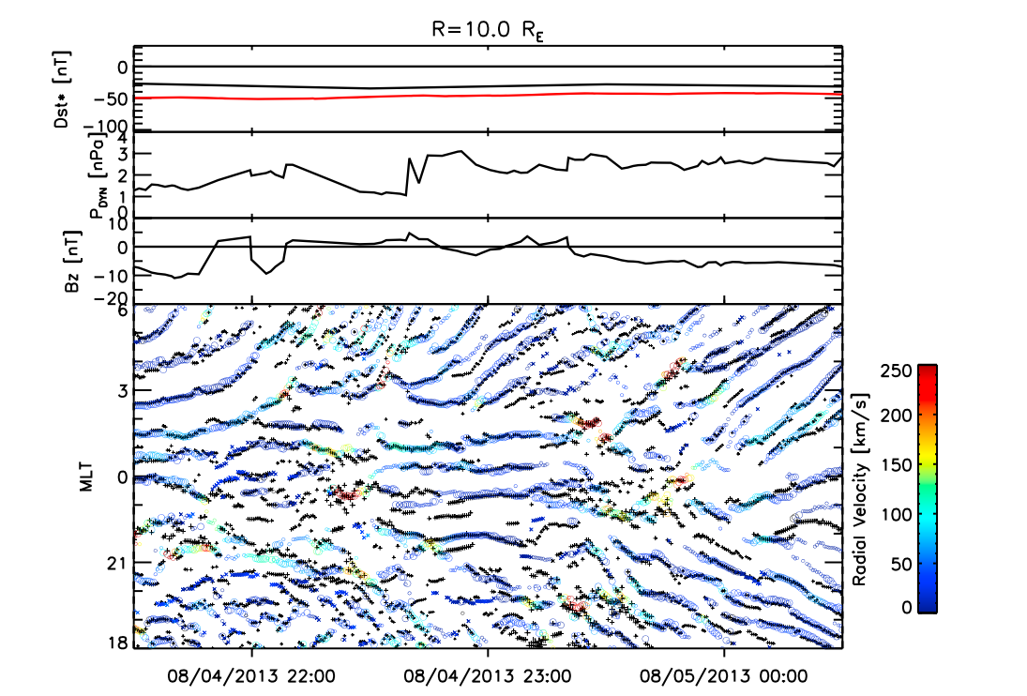
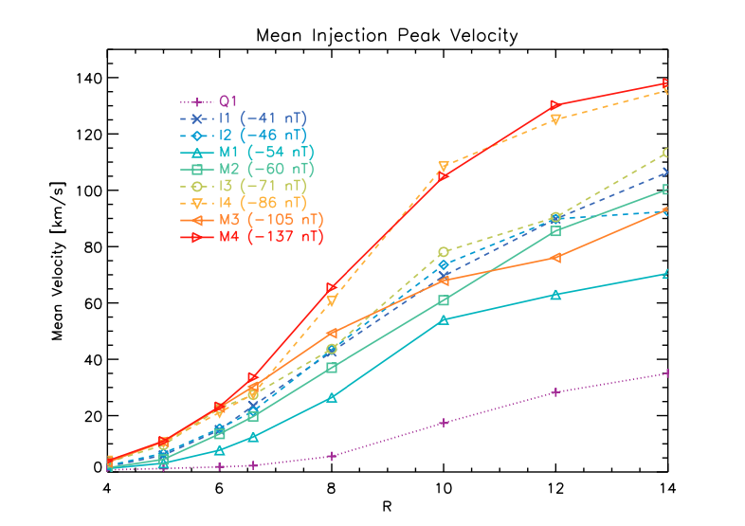
Where does the plasma go?
Most of it just blows out the back of the tail.
Some of it gets injected into the inner magnetosphere.
But it’s not easy. The plasma must be low entropy (bubbles ) to break the barriers of the inner magnetosphere.
The bubbles eventually slow down and get embedded into the inner magnetosphere.
100+ satellites would help ☺
Cramer et al., 2017

Slide 22
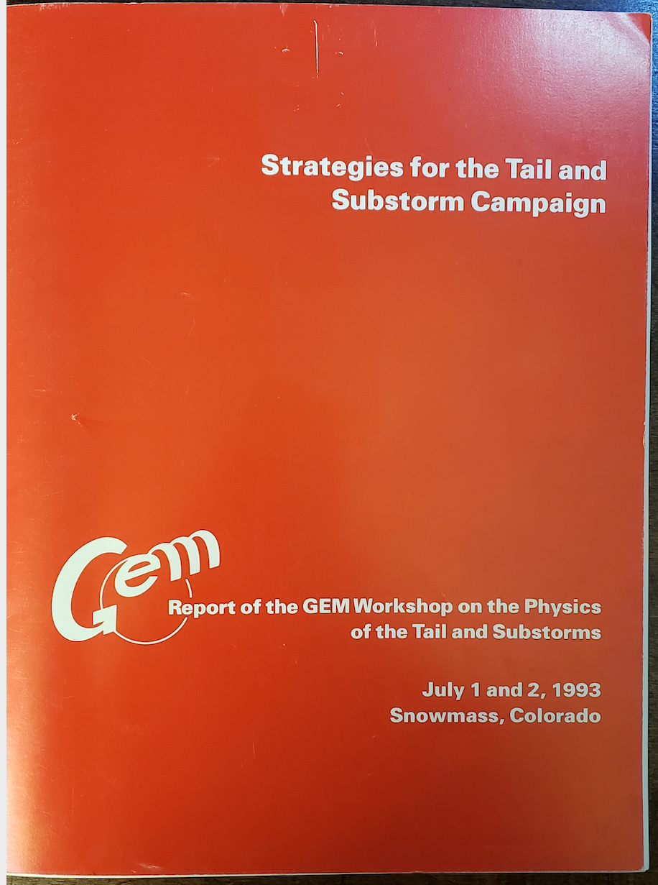
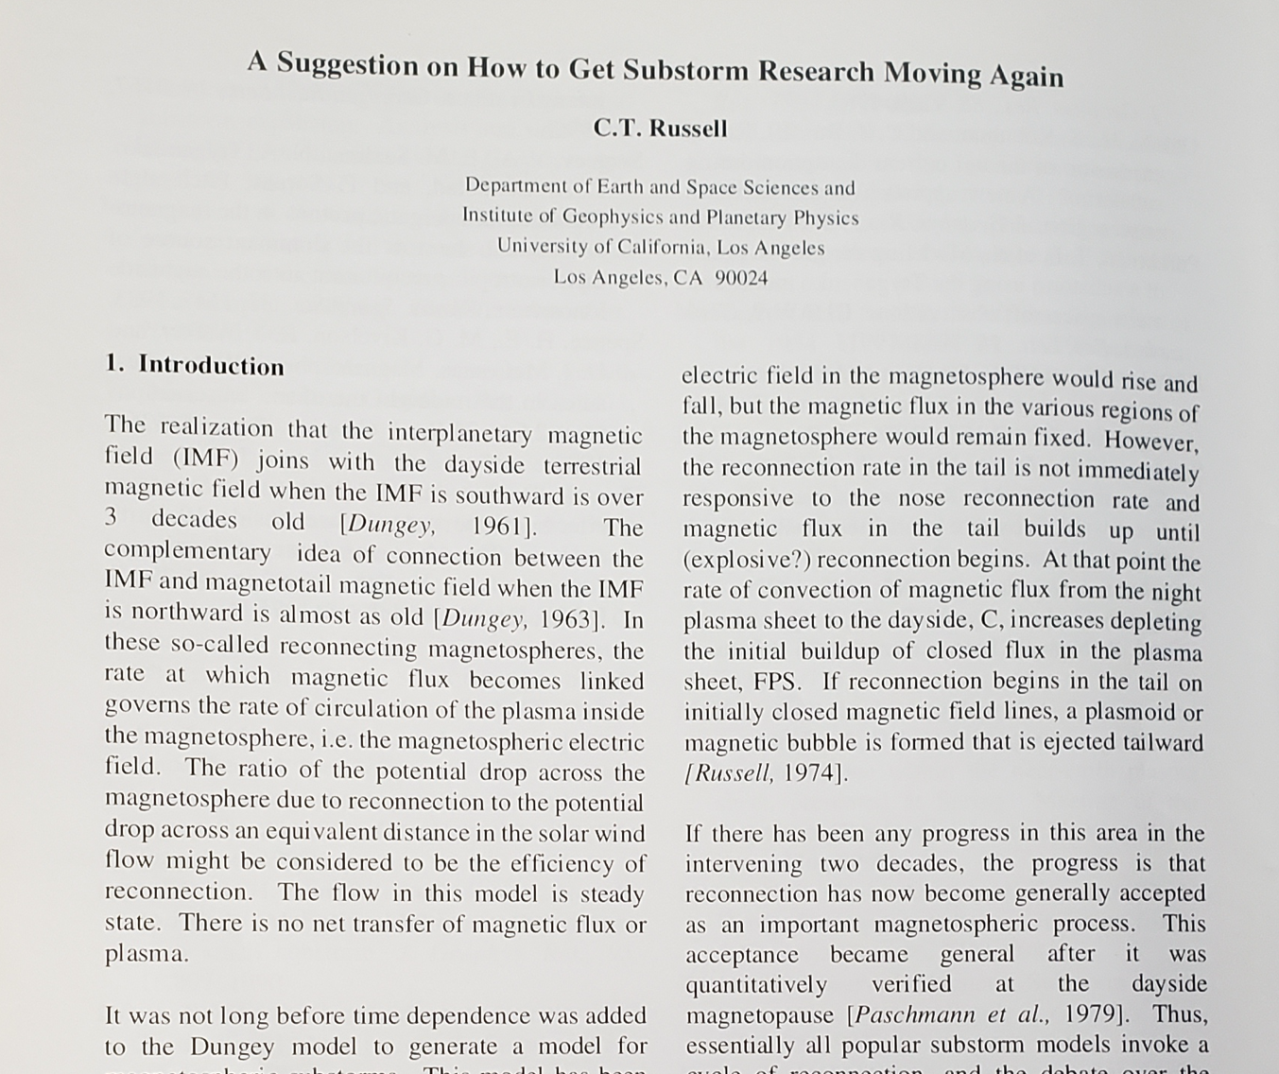
Historical perspective on substorms
At the beginning, GEM was organized into “campaigns” and working groups within the campaigns.
The “Tail and Substorm Campaign” was one of those.
Back in those days text was actually printed on paper.
A memorable contribution came from Chris Russell.

Slide 23
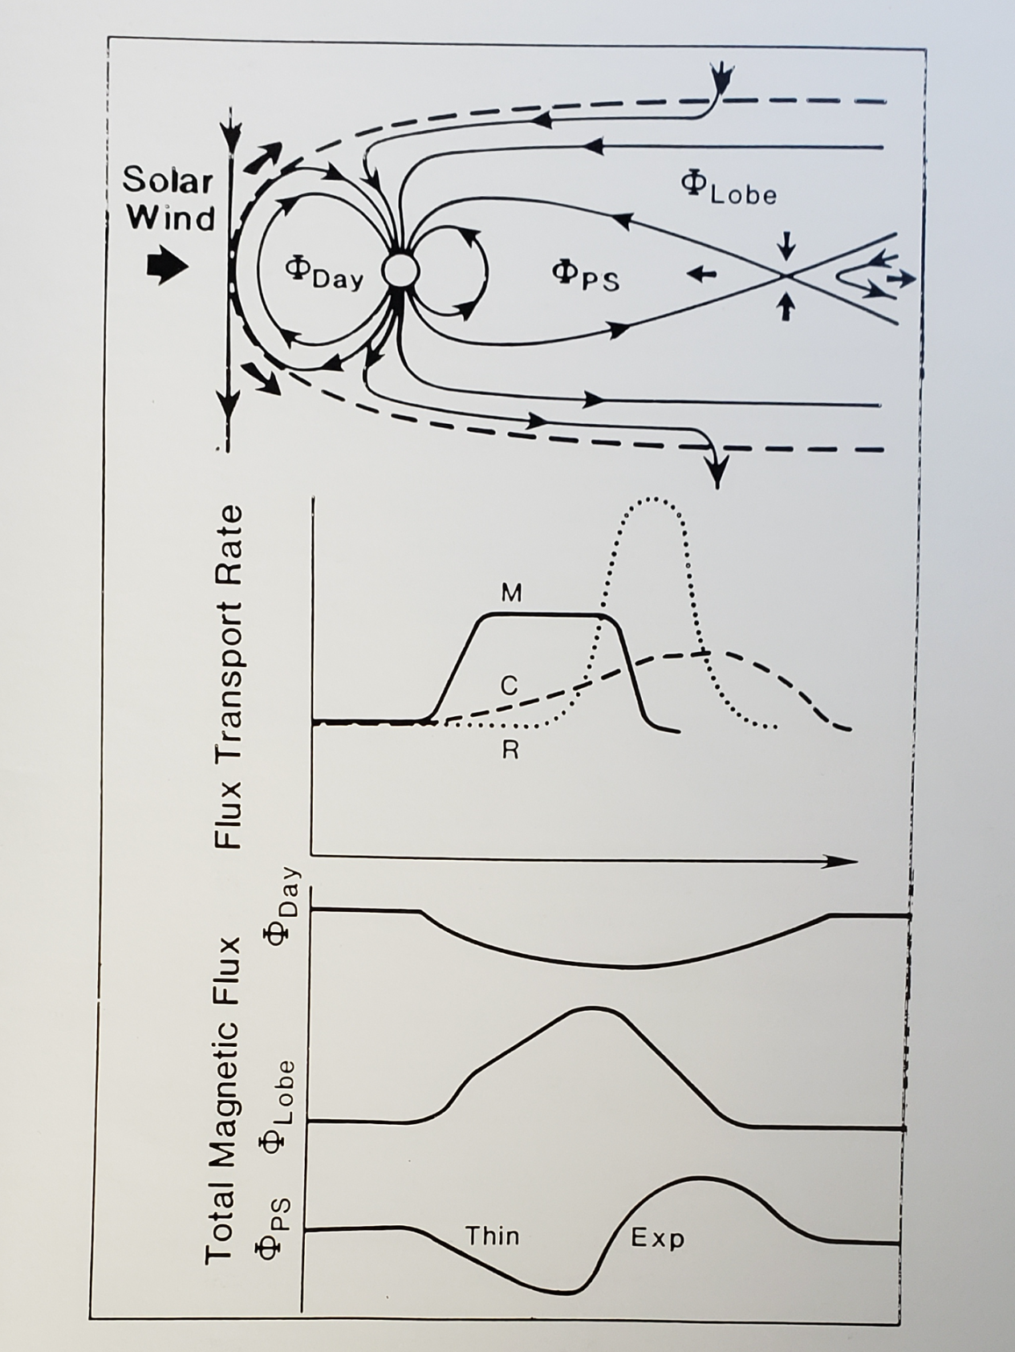
The NENL model, according to CTR
The Near-Earth Neutral Line model (NENL) in terms of magnetic flux.
Dayside reconnection dominates during growth phase.
Then magnetic reconnection in the middle tail turns on explosively, initiating the expansion phase.
Eventually slower convection returns the flux back to the dayside.
Even back then, not everyone agreed. The number of opinions seemed to exceed the number of workshop participants.
The disagreement is at the heart of the 2-minute problem.

Slide 24
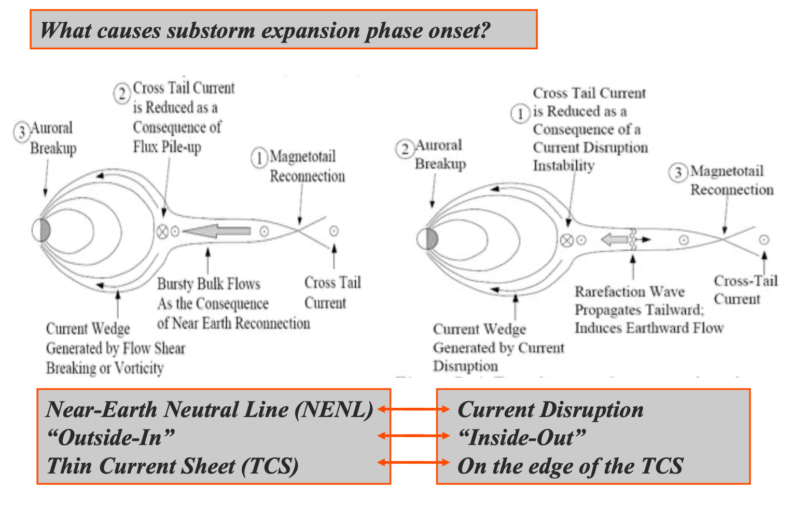
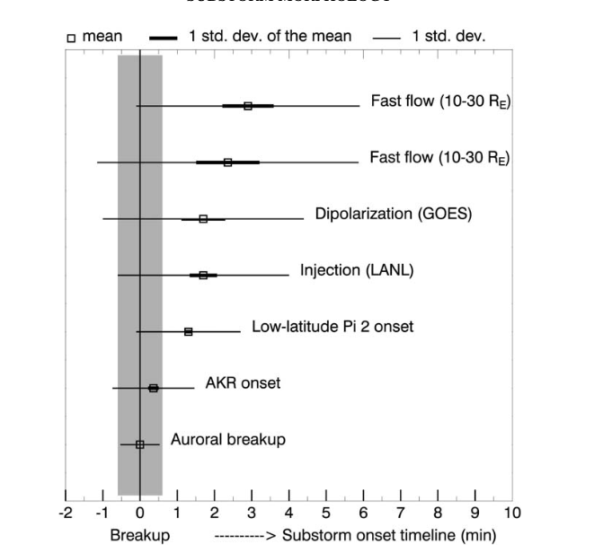
The 2-minute substorm problem
Slide stolen from Eric Donovan
Various substorm expansion phase onset signatures
Within a 2-minute window they all overlap
Meng & Liou 2004 →

Slide 25
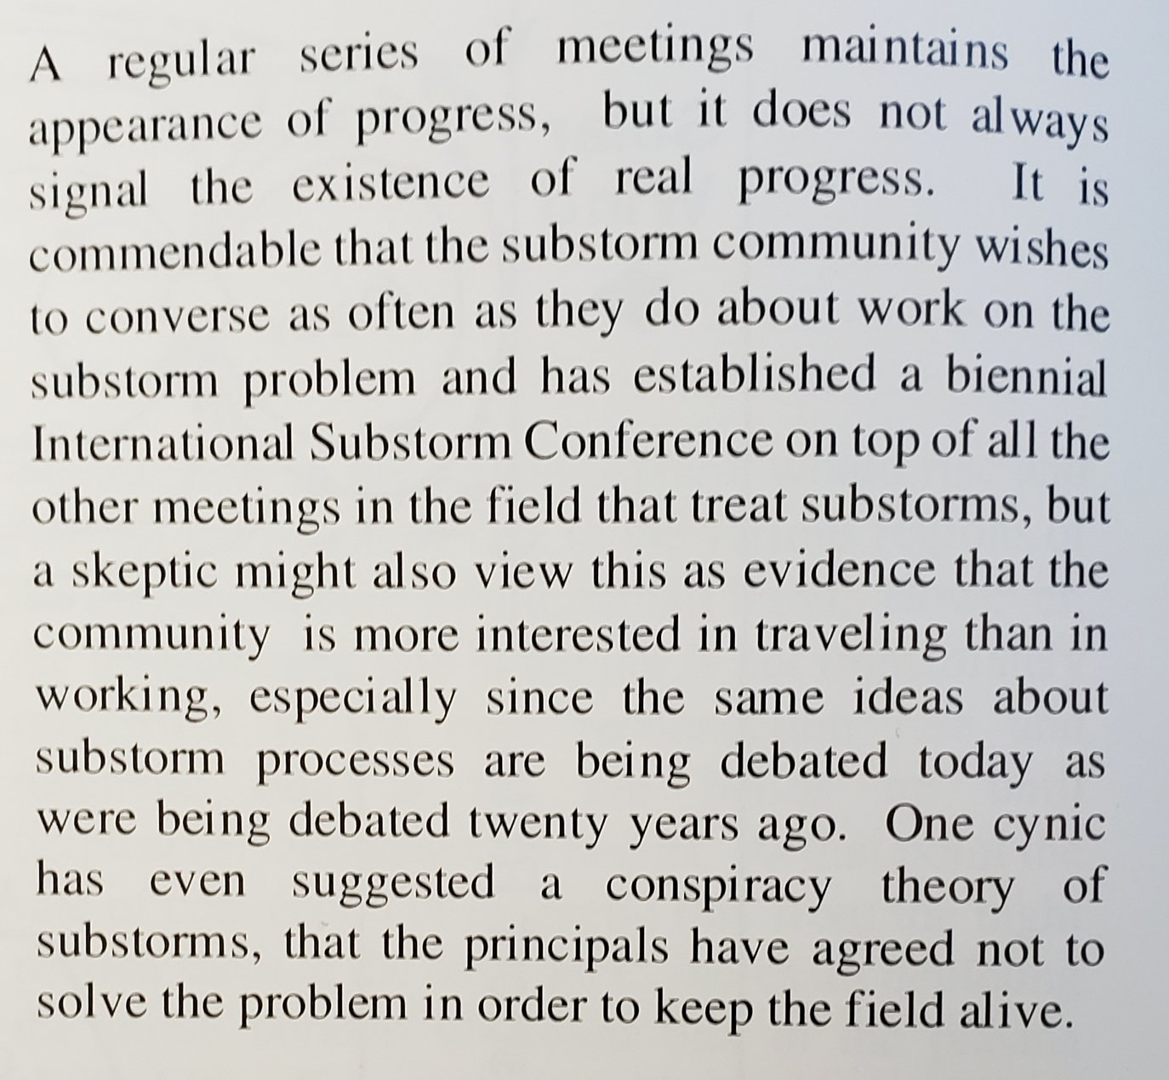
Chris had an opinion on that too:

Slide 26
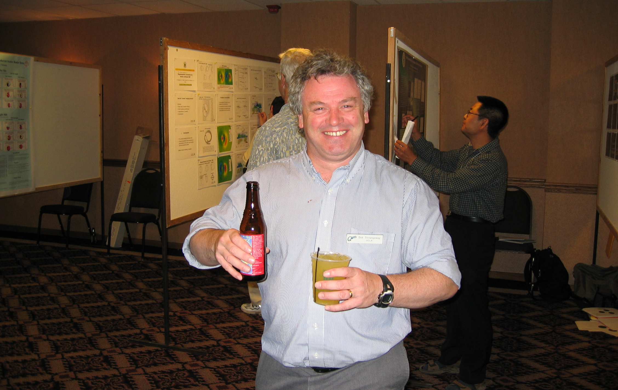
A few years later Bob Strangeway and I actually solved the 2-minute problem during a GEM poster session. Obviously, we were extremely happy.
But there was a problem:

Slide 27
We were planning to make the announcement the next day in the plenary session.
Unfortunately, we drank too much and had forgotten the solution by then.
Very sad!
But there is hope:

Slide 28
Psychologist says:
If the exact circumstances of the memory loss can be recreated, there is a 50/50 chance that the lost memory can be recovered.
So, for the sake of science, GEM, please let’s go back to Snowmass!
Thank You!

